Slide 1
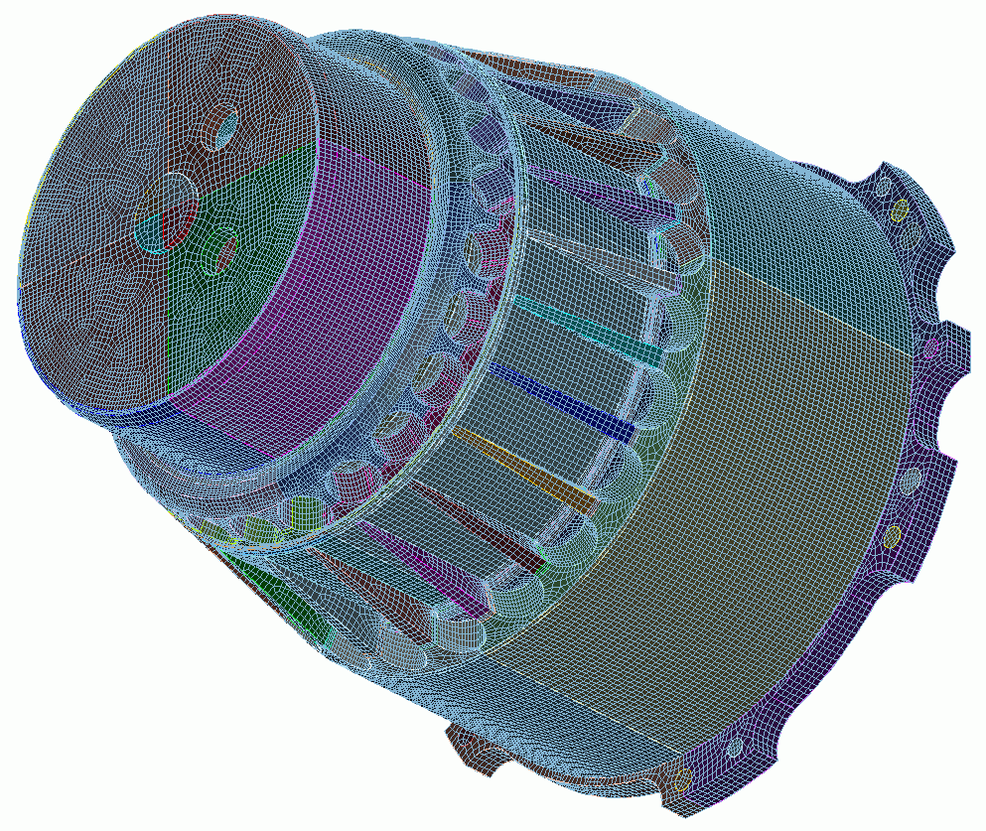
Part Classification and Reduction
17
CUBIT
Geometry and
Mesh Generation Toolkit
CUBIT™ 200 Tutorials
Steven Owen
SAND2022-15142 PE

Slide 2
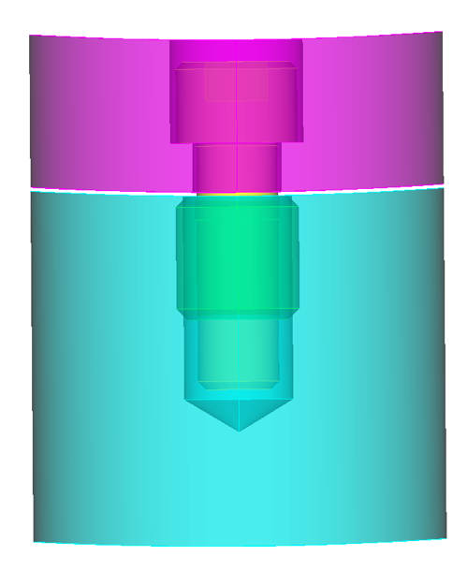
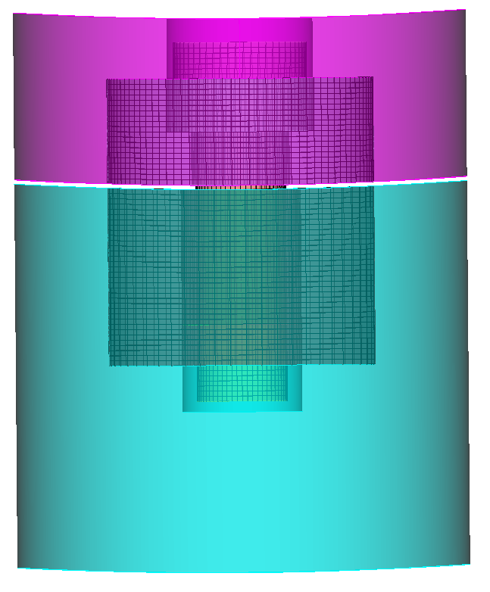
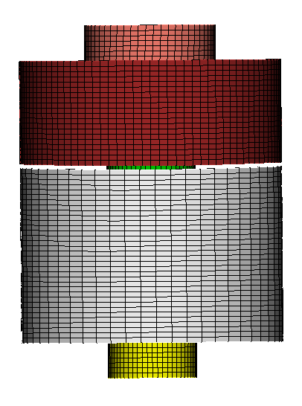
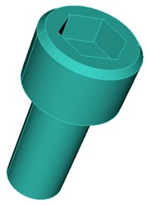
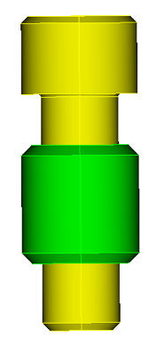
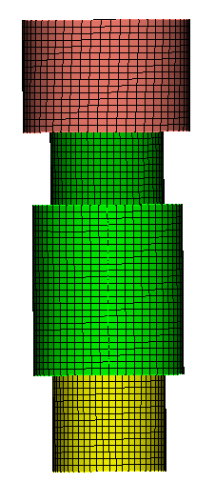
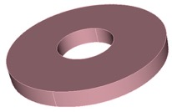
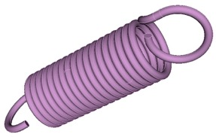
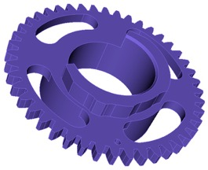
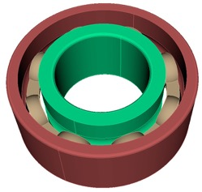
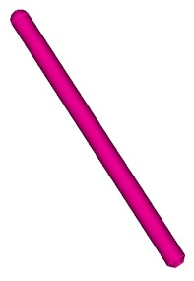
Part Classification with Machine Learning
With complex assemblies, it may be useful to quickly categorize all parts in the CAD model. Some categories of mechanisms may require special treatment to prepare for analysis
Classify Common Mechanisms
Rapidly Prepare for Analysis
Washer
Bolt
Ball
Spring
Pin
Bolt in CAD assembly before preparation
Bolt ready for analysis
Gear
Bearing Race
2

Slide 3
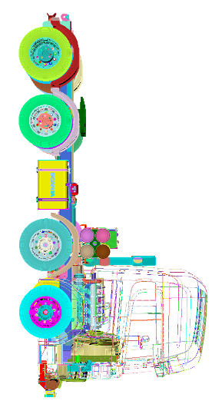
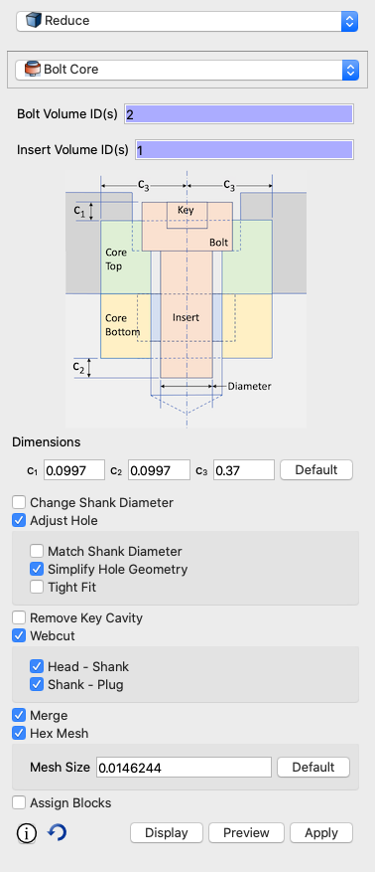
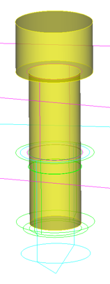
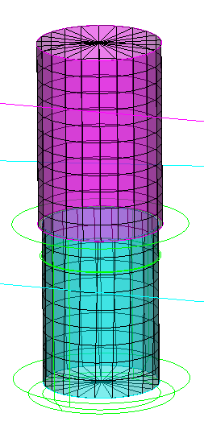
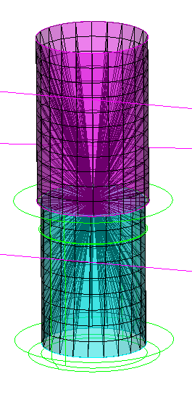
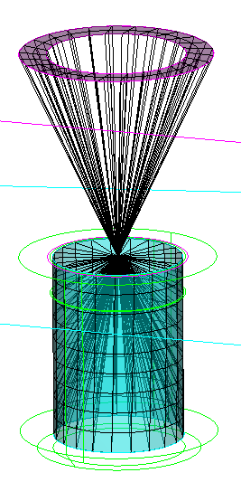
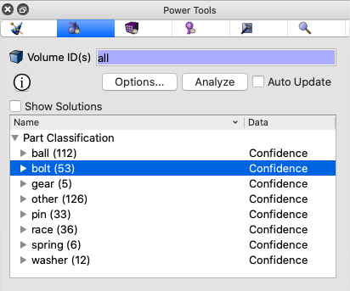
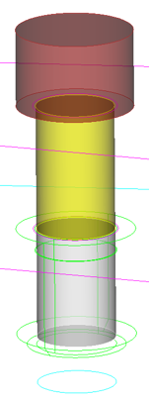
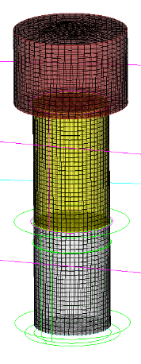
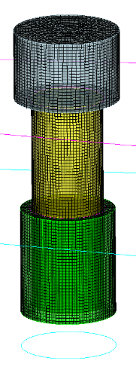
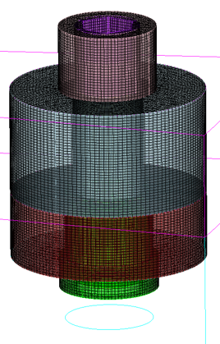
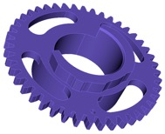
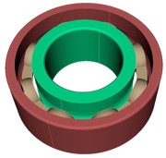
Classify and Reduce Operations
The Geometry Power Tool has built in ML tools that can sort parts by category Once categorized, specialized tools for preparing fasteners and springs can be applied
simulation-ready
CAD
simple reduce
spider
wagon wheel
spider
j2g
spider
countersink
classify
reduce
tweak hole diameter
to shaft; webcut head,
shank, plug
Hex
meshed
Include insert
and tweak
to hole, shaft
core from
surrounding
volumes

Slide 4
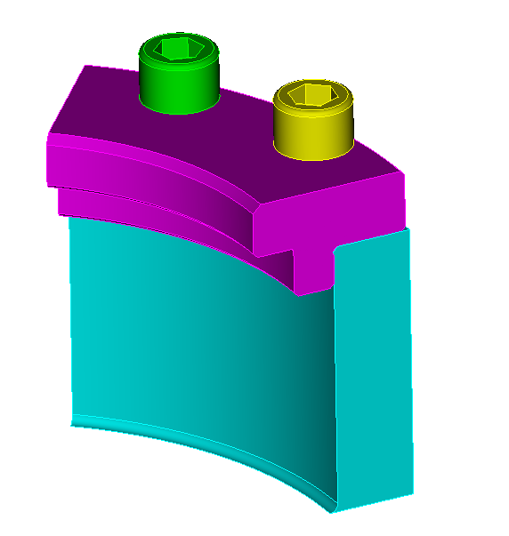
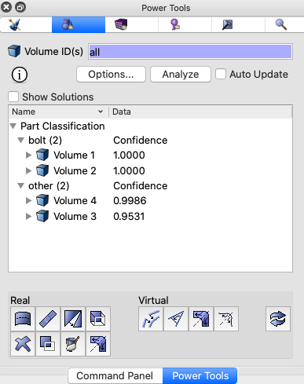
Machine Learning Classification Example
3
1
Reset
Import acis file “bolts.sat”
Go to Geometry Power Tool Options
Check “Part Classification”
Uncheck all other diagnostics
Click Done
Click Analyze
2
3
2
4
5
6
7
7
5
Cubit classified 2 volumes as “bolt” and 2 “other”
Confidence: from ML indicating how sure it is of its categorization (0.0 -> 1.0)
4
Available Categories
6

Slide 5
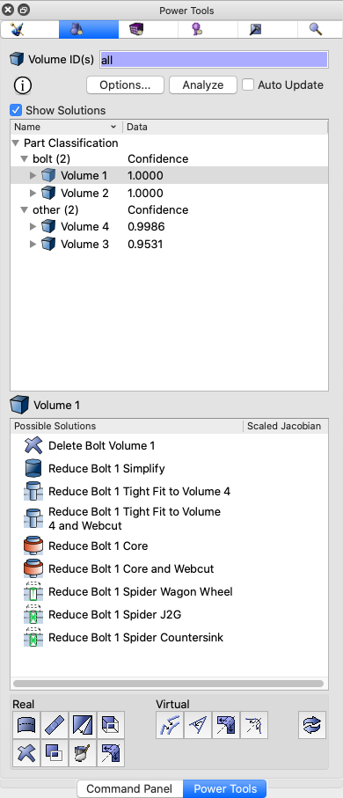
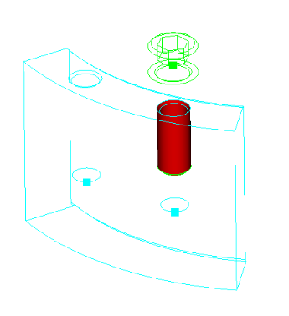
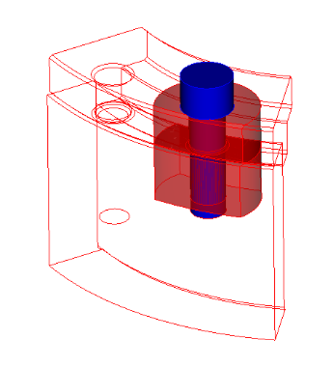
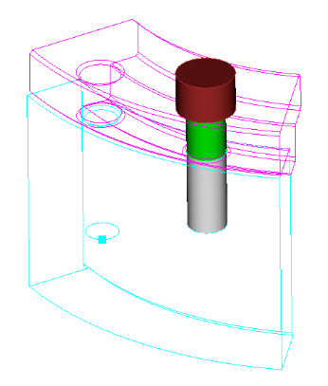
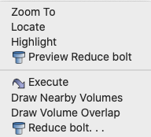
Bolt Reduction Example
3
1
Select Volume 1 under “bolt”
Right Click and “Fly in”
Right Click and “Draw Volume Overlap”
Check “Show Solutions”
Right Click on any Solution and Choose “Preview Reduce bolt”
Double Click on a preferred solution to execute or choose “Execute” from the Right Click menu
Type ”undo” at the Cubit command line to undo the last operation
Try experimenting with other solutions and undo
Choose “Reduce bolt…” to jump to the Command Panel for additional options
2
4
3
4
Volume overlap displayed in Red
5
6
5
7
8
Preview of “Reduce Bolt 1 Core”
Solutions for Bolt 1
9
6
6
6
7
Reduced bolt, webcut into 3 vols.
9

Slide 6
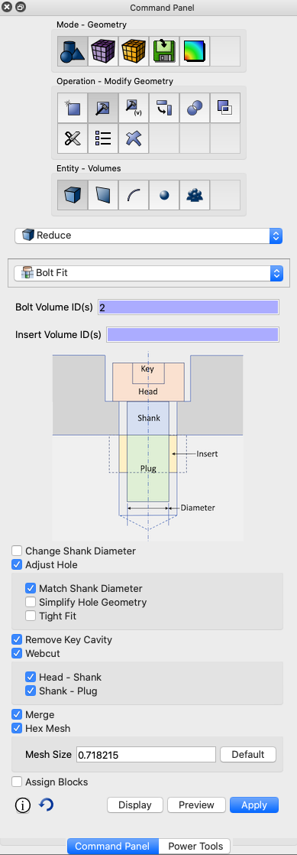
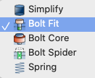
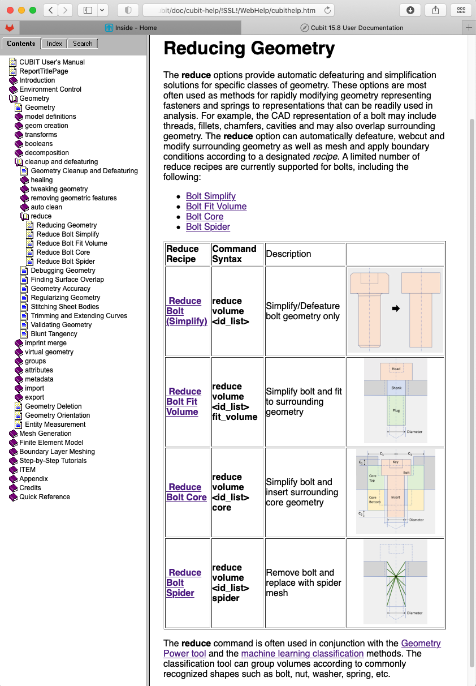
Bolt Reduction Example
Reduce panel has many different options for simplifying, cutting, meshing and assigning blocks. Try experimenting with the bolts.sat example
Main methods for “Reduce”
Simplify: defeature bolt geometry only
Bolt Fit: Defeature and fit bolt to surrounding geometry
Bolt Core: Create a cylindrical core surrounding bolt shaft
Bolt Spider: Create spider elements (beams)
Spring: generate beam elements in place of 3D spring geometry
More details: Cubit documentation. Search for “Reduce”

Slide 7
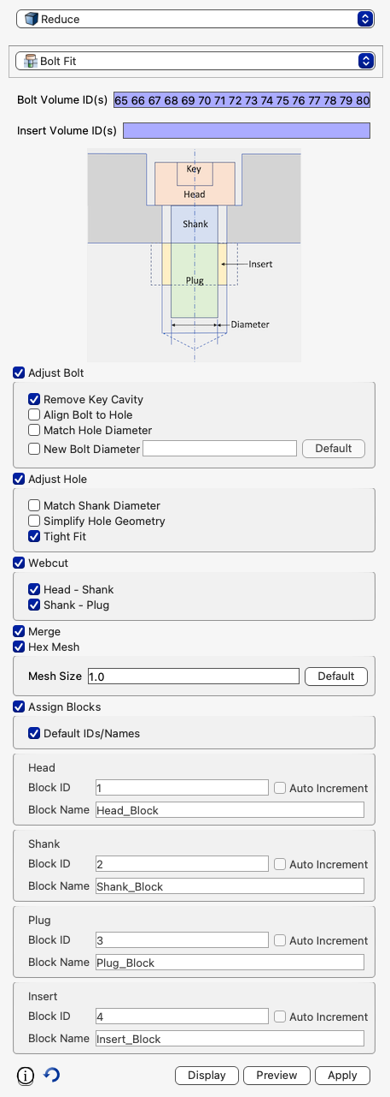
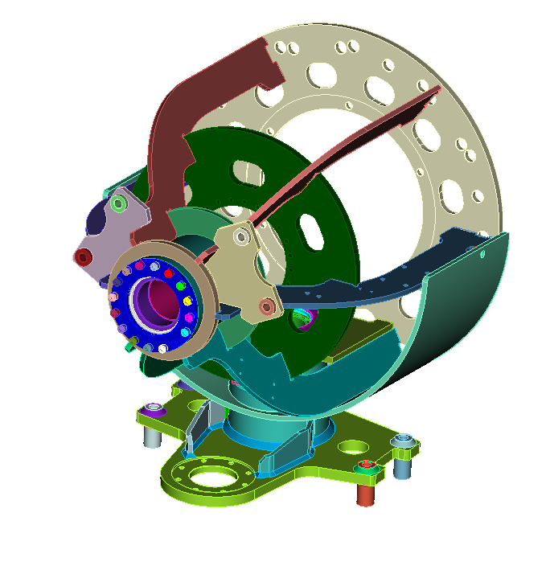
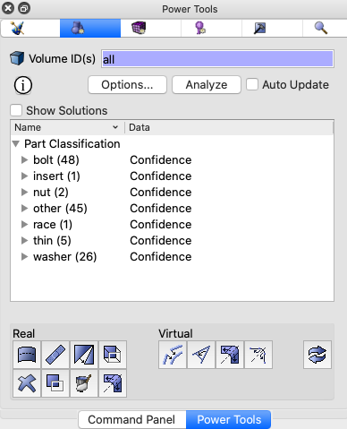
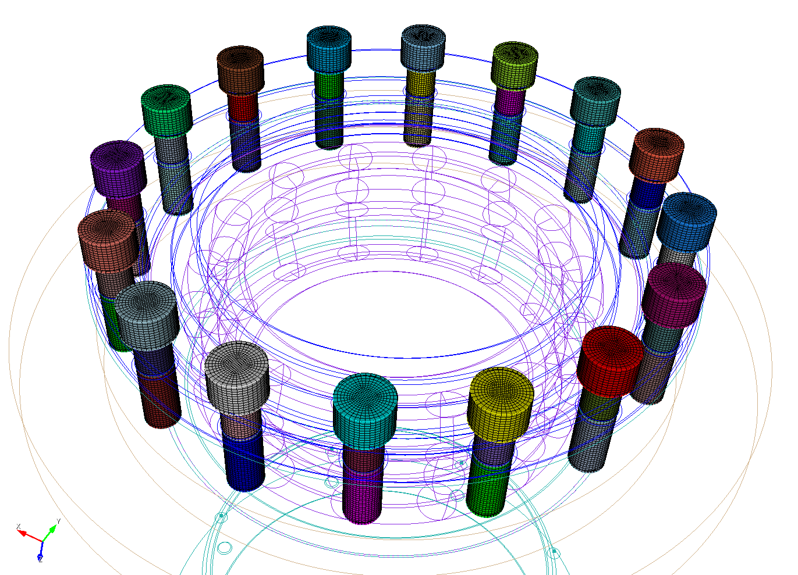
Exercise 17.1 Classification and Reduction
1
Import acis file “Gondola_vaz.sat”
Use the ML Classification tool to identify bolts
Reduce 16 bolts volume 65 to 80 using the bolt fit option (tight fit). Cut each bolt into head, shaft and plug, defeature and remove any allen key cavity, mesh each bolt at a size of 1.0. Assign all bolt heads to block 10, bolt shafts to block 20 and all bolt plugs to block 30
2
3

Slide 8
Classify Command
CUBIT™ Classification Categories
Bolt
Race
Nut
Pin
Washer
Gear
Spring
Other
8
What if I need another category?
What if I want to change or add to a category?

Slide 9
Classify Command
Check the current classification catgory
classify {volume <ids>} [confidence]
Assign volume to a category (add training data)
classify {volume <ids>} "<string>"
List current categories (and user training directory)
classify list
Categories can also be used for selections using extended parsing. For example:
Reset user training data
classify reset ["<string>"]
draw volume with category "bolt"
Reclassify a volume as another category
reclassify {volume <ids>} "<string>"

Slide 10
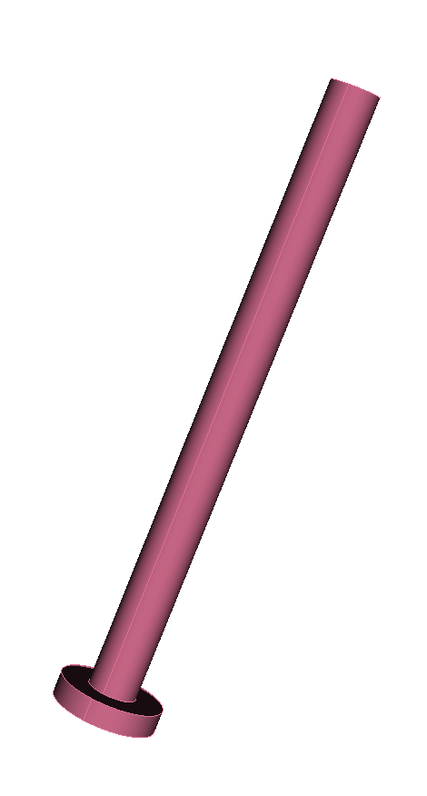
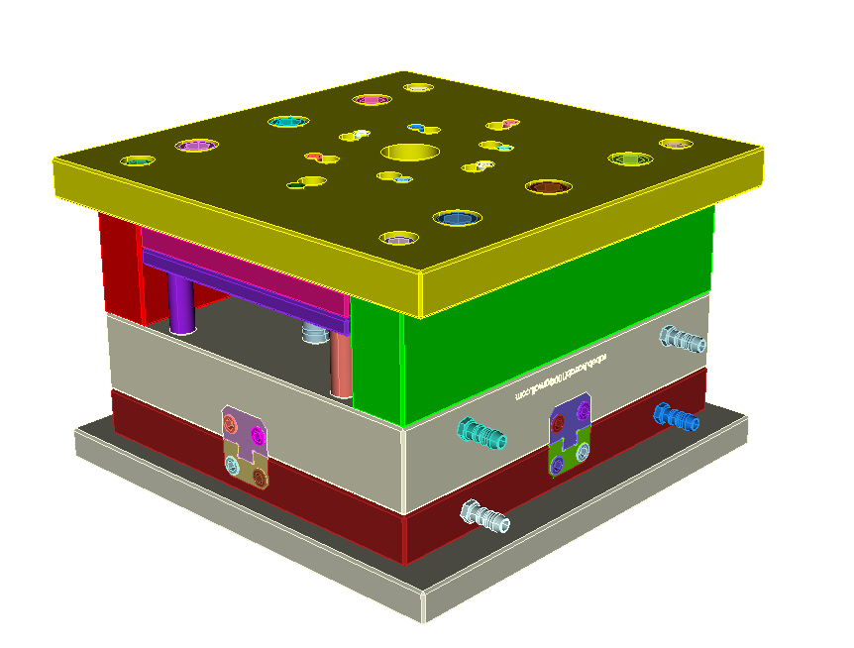
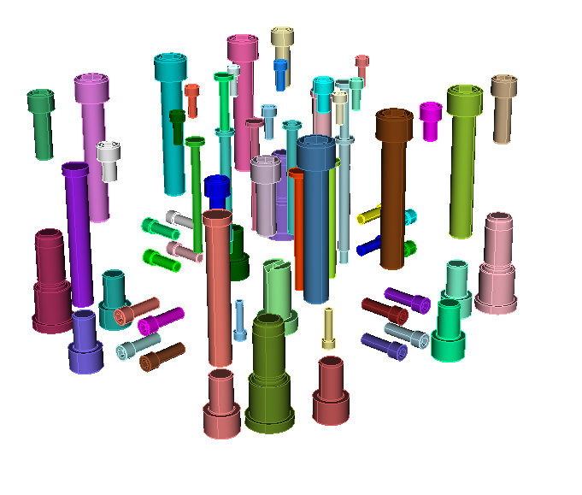
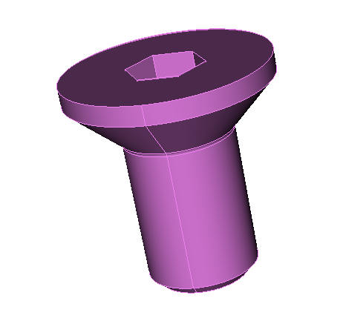
Exercise 17.2 Classify Command
1
Import acis file “Assemblage2.sat”
Draw all volume classified as “bolt”
Examine the confidence of the bolt classification and find volumes with low confidence. (Use the power tool and/or the classify command)
Add some of the long skinny volumes classified as “bolts” and classify them as “pins”.
Find bolts that look like screws and create a new category “screw”
Use the “with category” syntax to display all “screws”
Click Analyze and check that screws, pins and bolts are classified correctly
2
4
3
Volume 52
4
5
6
5
7
Volume 116

