Slide 1
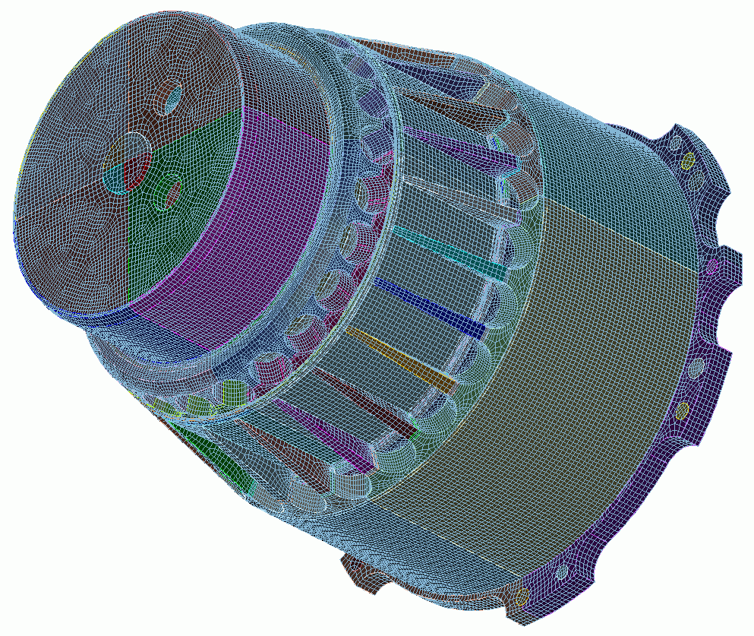

Sculpt
15
CUBIT
Geometry and
Mesh Generation Toolkit
CUBIT™ 200 Tutorials
Steven Owen
SAND2022-15142 PE

Slide 2
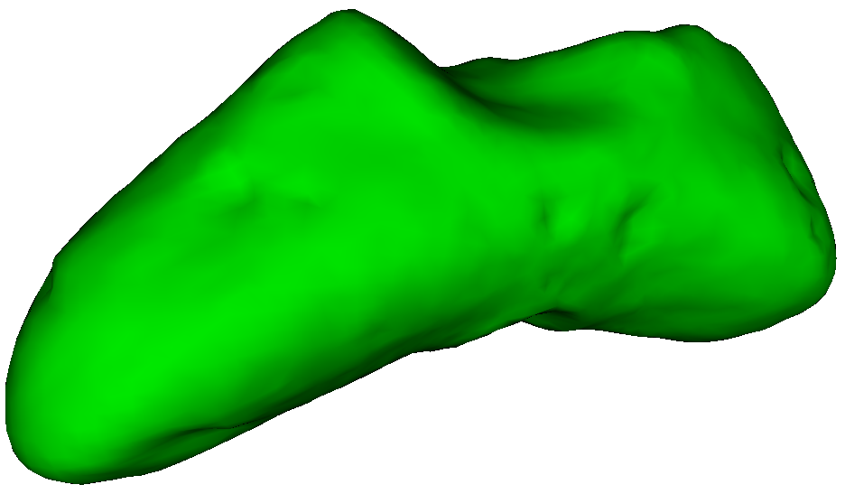
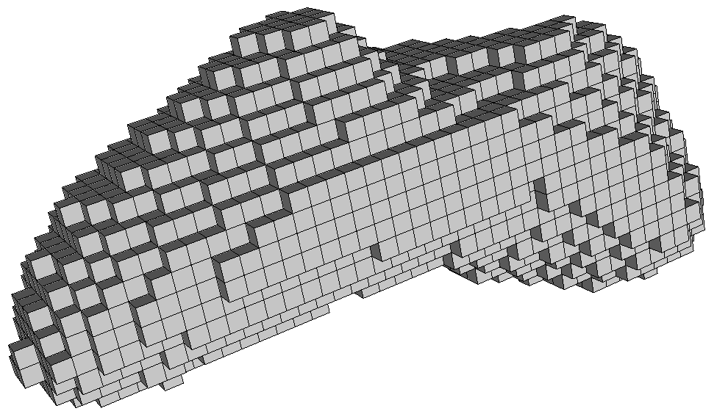
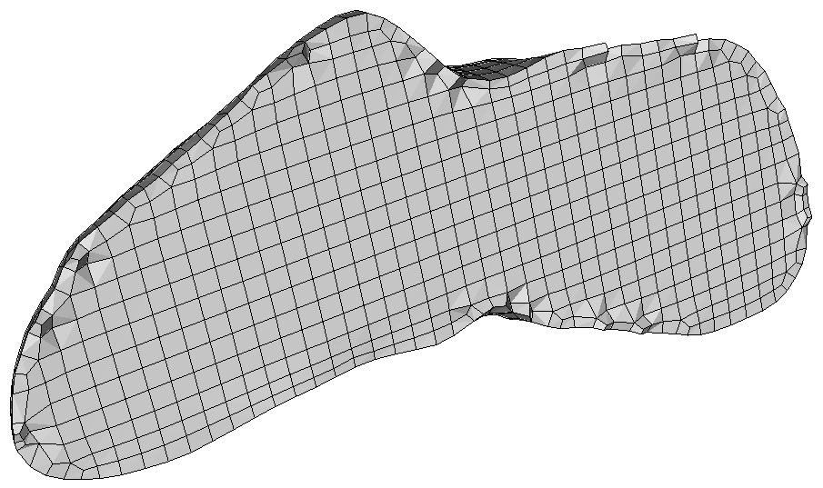
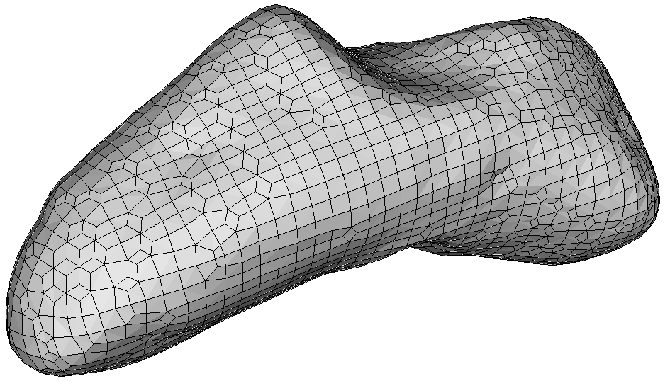
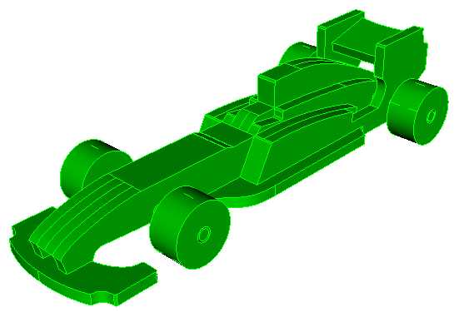
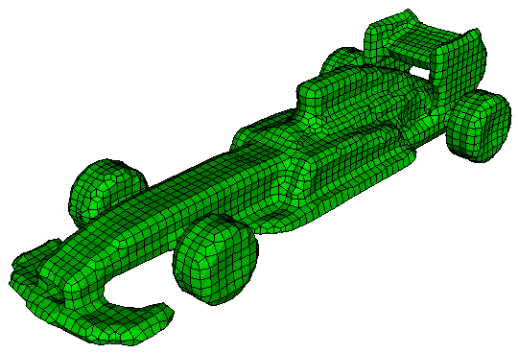
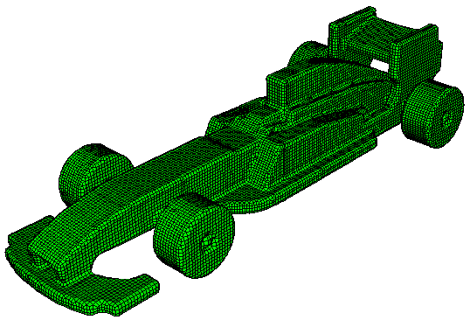
Sculpt
Ideal for non-mechanical/
organic shapes
But can be used for any geometry
Overlay Grid Method
Uses Cartesian Grid as Base Mesh
Adjusts nodes to geometry
Inserts Layer of Hexes

Slide 3
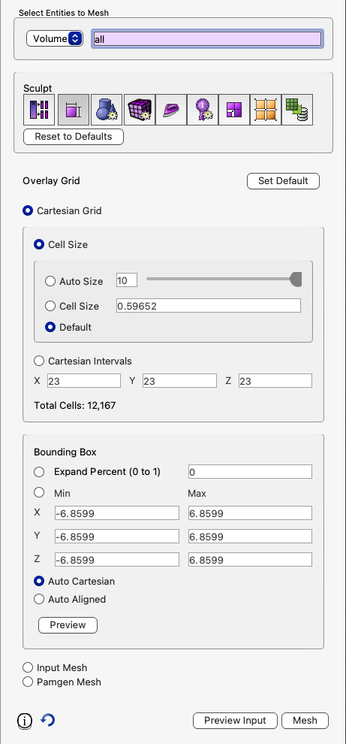
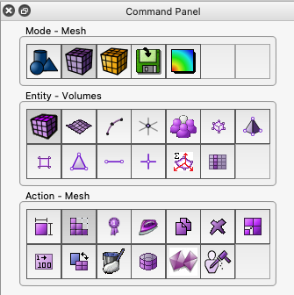
Sculpt
Sculpt is a separate companion application to CUBIT™ .
Does not use Scheme, instead uses Sculpt Parallel command.
1
Can be run from CUBIT™ GUI or in batch from OS command line
2
Parallel application uses MPI to run on multiple cores/processors
3
See Cubit 200 for more details/exercises

Slide 4
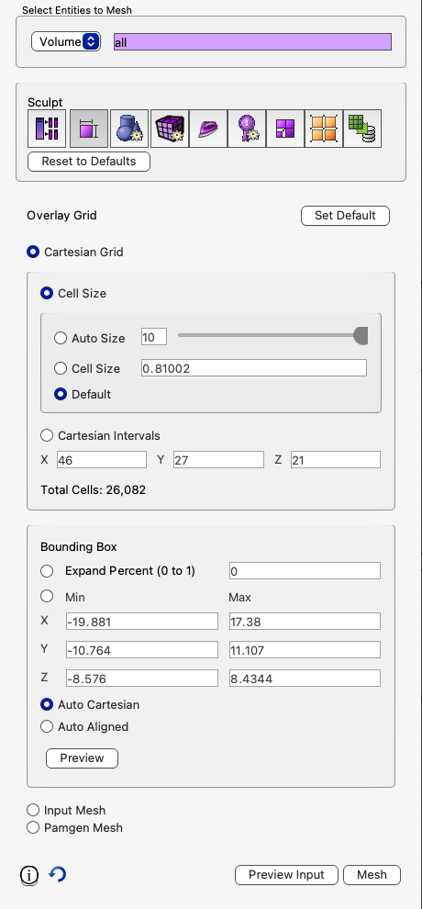
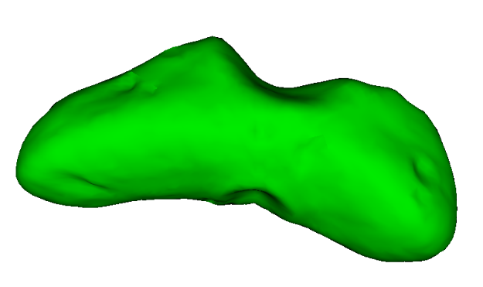
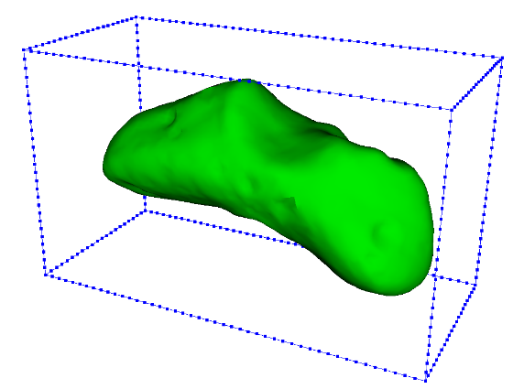
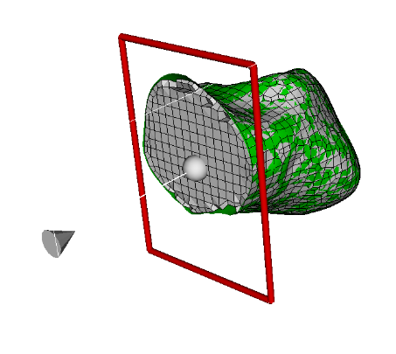
Sculpt Example
1
1
Import the stl file “eros_asteroid.stl” (change the file filter to “stl”)
Preview the overlay grid resolution
Mesh
Use the slice tool to view the interior hexes
2
Navigate to sculpt panel
3
4
5
3
3
5
4

Slide 5
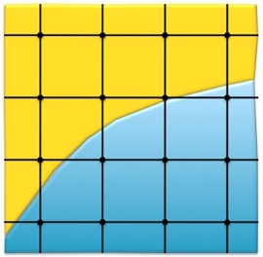
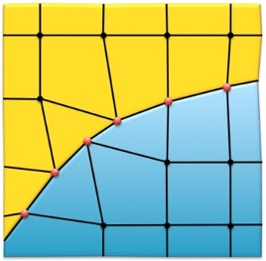
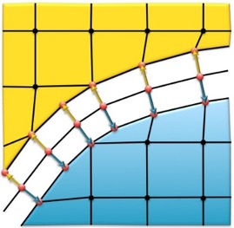
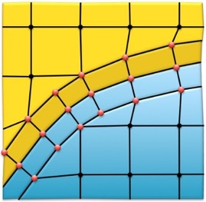
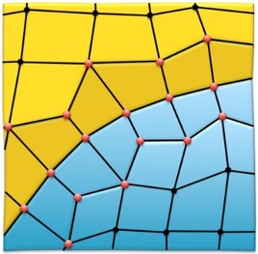
Sculpt Procedure
Overlay Grid Procedure used by Sculpt
Cartesian Grid overlaid on geometry
Nearby nodes projected to boundaries
Mesh pulled away from the boundaries
And Layer of hexes inserted
Smoothing performed to improve element quality

Slide 6
Sculpt Application
CUBIT
stl
exo
psculpt
sculpt
exo
psculpt
exo
mpiexec
epu
exo
psculpt
exo
psculpt

Slide 7
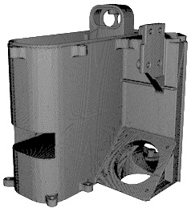
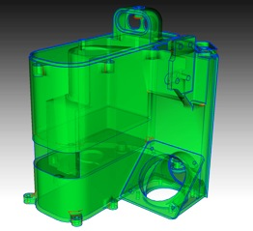
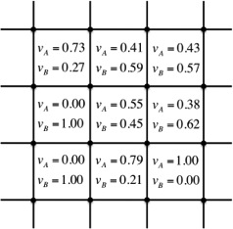
Sculpt Application
CAD Volume
Volume Fraction Data
Hex Mesh
Geometry is first converted to “Volume Fraction” Data before meshing.
Advantages
Geometry Tolerant
No decomposition needed
No imprint/merge needed
Scalable to massive parallel
Disadvantages
No Geometry Associativity
Does not capture corners
“Small” features not resolved
May require large mesh

Slide 8
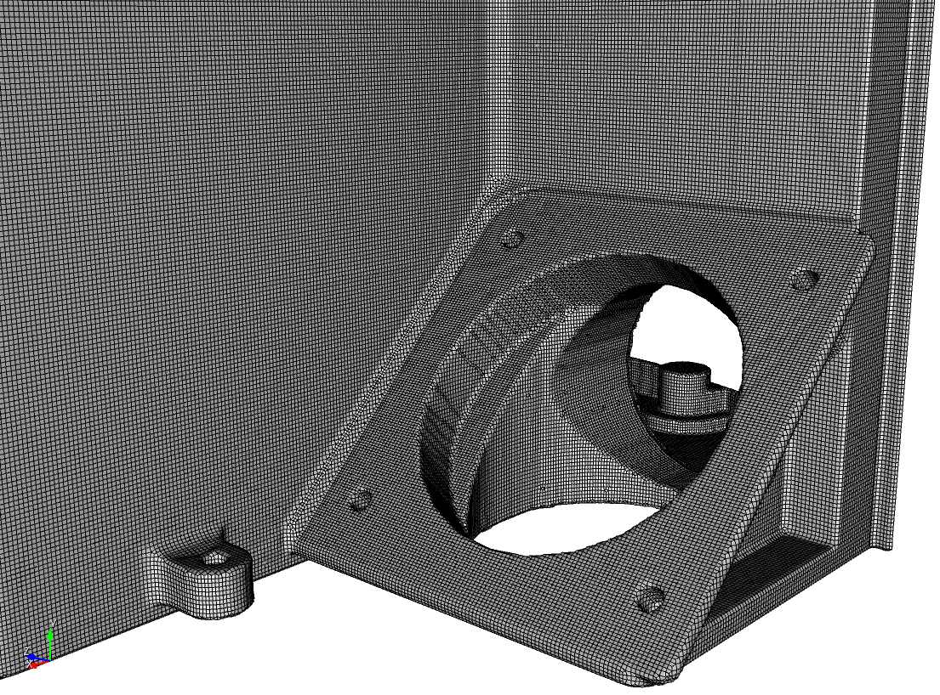
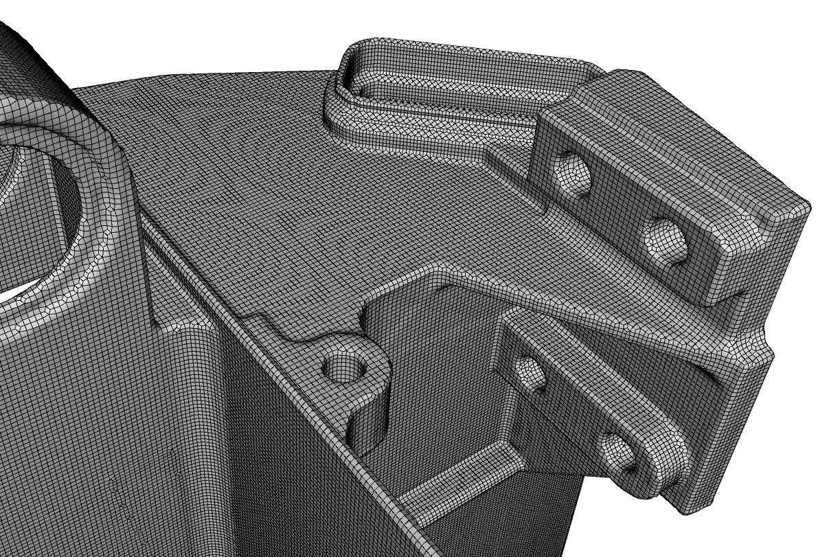
Example Sculpt Mesh

Slide 9

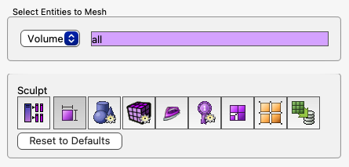






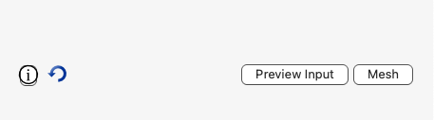



Sculpt Command Panel
Process Control:
parallel processors, execution, filenames
Overlay Grid:
Cartesian grid description, input mesh
Geometry Definition:
Cubit geometry, STL, Diatom, microstructures etc.
Mesh Parameters:
Stair Step, Mesh Void, Hex Dominant
1
Smoothing:
Parameters for smoothing
Help Options
Mesh Improvement:
Pillowing, Defeaturing, Capture, Thicken
Adaptivity:
Mesh refinement and coarsening criteria
2
Boundary Conditions:
Block and sideset definitions
Mesh Output:
Exodus Mesh
3
sculpt print_help [”<string>”]

Slide 10
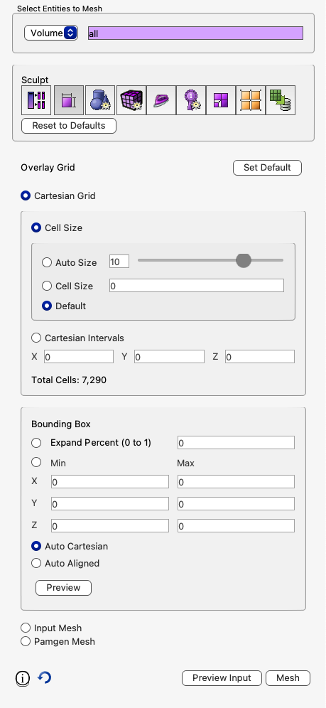
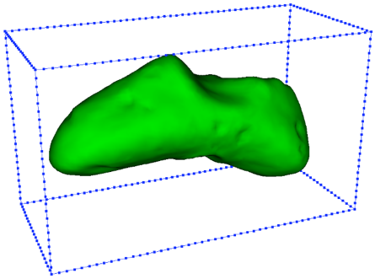
Sculpt Sizing – Cartesian Grid
Select Blocks or Volumes
Volumes: Each volume treated as a separate mesh. One Block created per volume
Blocks: treat all volumes in block as continuous mesh
Resets values in overlay grid panel back to default. Use this if volumes/blocks change
Resets values in all Sculpt panels
4 ways to define size
Autosize – value 0-10. 0=fine, 10=coarse
Cell size – exact size
Default – use the size defined on the volume. If none then autosize=10
Cartesian Intervals – set the number of intervals in x-y-z directions. Tries to maintain constant aspect ratio
Base Grid Requires
  Cell Size
  Bounding Box
Number of cells in Cartesian Grid
4 ways to define box
Expand Percent: larger than bounding box
Set exact x-y-z bounds
Auto Cartesian – Complete model enclosed in axis-aligned box
Auto Aligned – Sculpt attempts to find a natural orientation of the model with the a fitted box
Select to display preview of bounding box and size
Note: Fields automatically synchronize to reflect updated user selections

Slide 11
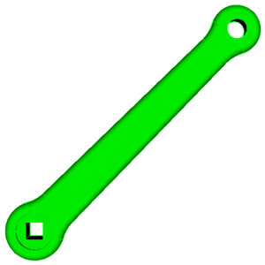
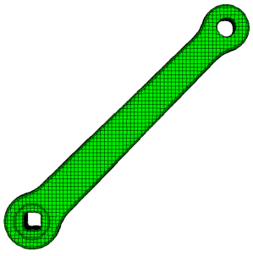

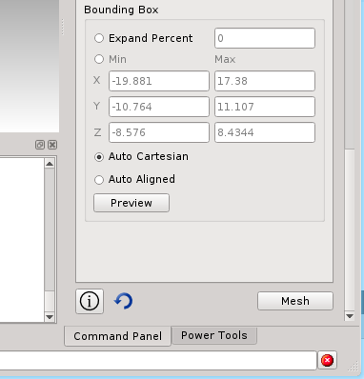
Example 15.1
Sculpt Cartesian Grid Sizing
1
Import the ACIS file “crank.sat”
Experiment with different mesh sizes to see its effect. Observe how well it captures the features
.
Use the Auto Align feature. Observe the difference in the resulting mesh
Check the mesh quality
2
3
Note the Total Cells estimate. This is total number of cells in the base grid (not mesh size) based on current input. Larger numbers indicate longer meshing times.
4
quality hex all draw mesh
Use the Stop button to kill sculpt if meshing time gets too long.

Slide 12
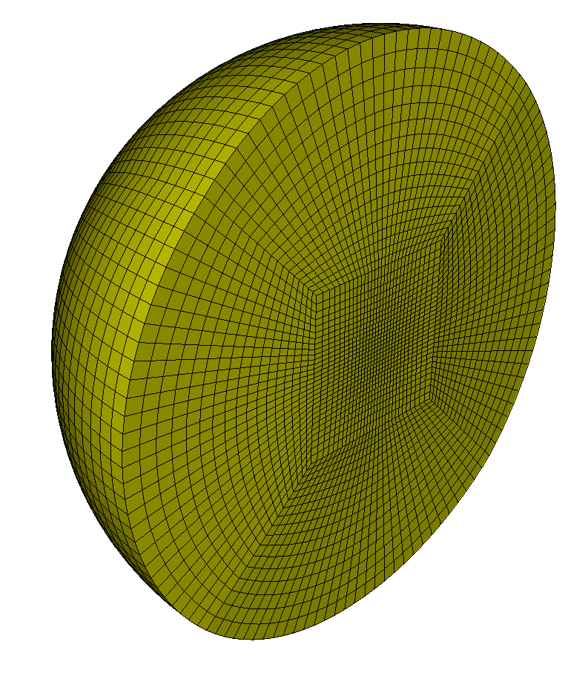
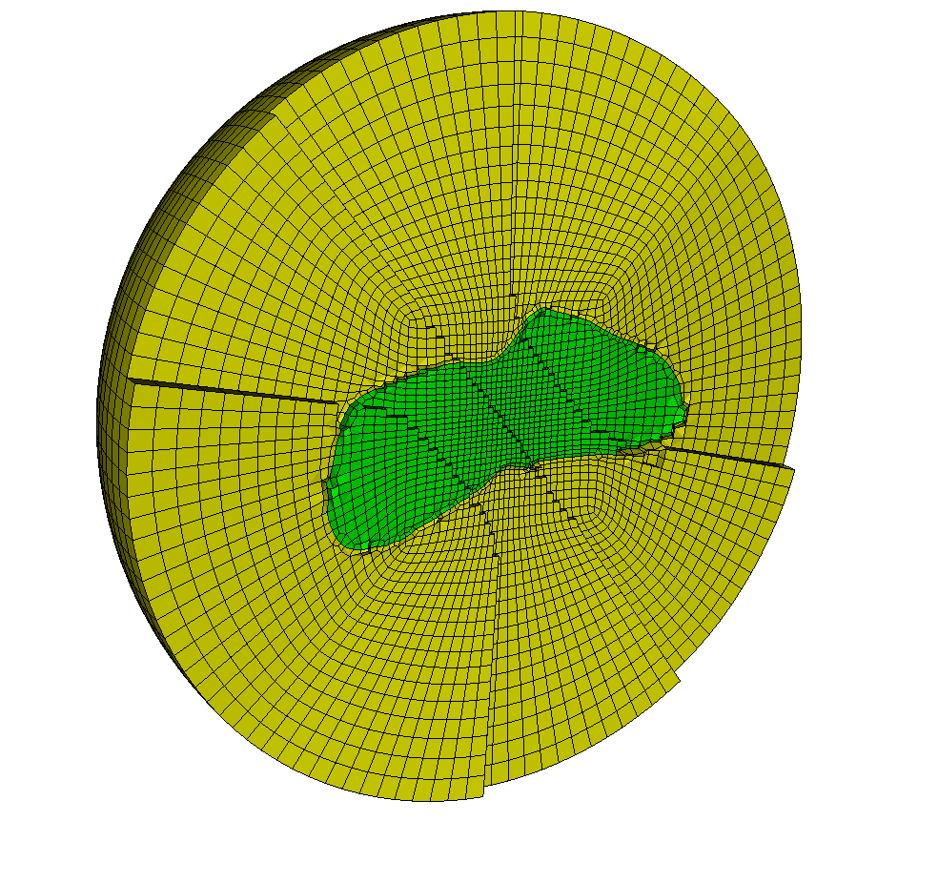
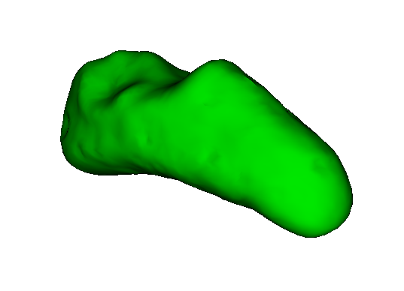
Sculpt Input Mesh
In place of a Cartesian grid, Sculpt can also use
an arbitrary exodus mesh as the overlay grid
Sculpt
Exodus mesh
(Overlay Grid)
Conformal hex mesh of asteroid
embedded in sphere mesh
STL geometry

Slide 13
Example 15.2
Sculpt Input Mesh
Create an overlay grid mesh from a sphere
1
reset
import stl "eros_asteroid.stl"
sphere rad 30
vol 2 size 0.5
mesh vol 2
block 2 vol 2
export mesh "sphere.g" over
1
Create an overlay grid mesh from a sphere
and save the mesh to “sphere.g”
2
Set the Number of Processors to 1
(Current limitation running from Sculpt)
3
Set the Overlay grid to “Input Mesh” and select
the file“sphere.g”
4
Set the Geometry type to STL and select the
File “eros_asteroid.g”
5
Check the Mesh option “mesh void”
6
Click mesh
Create an overlay grid mesh from a sphere
sculpt command line
sculpt processors 1 input_mesh "sphere.g" stl_file "eros_asteroid.stl" void 1

Slide 14
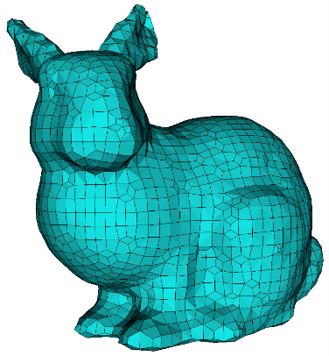
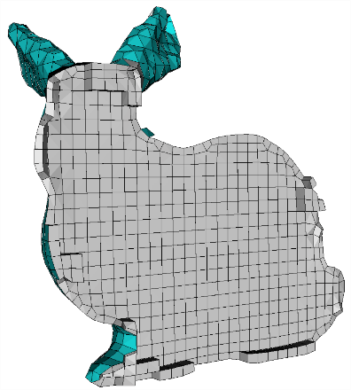
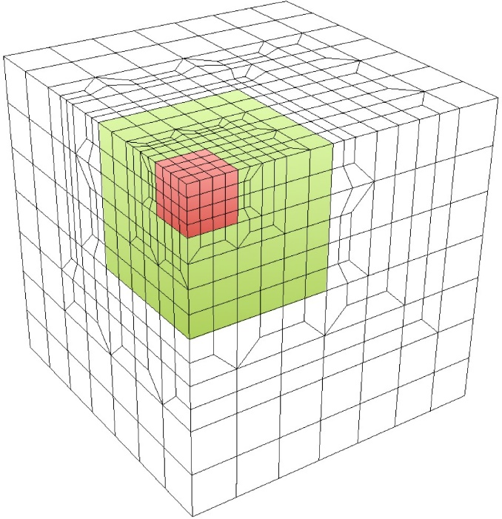
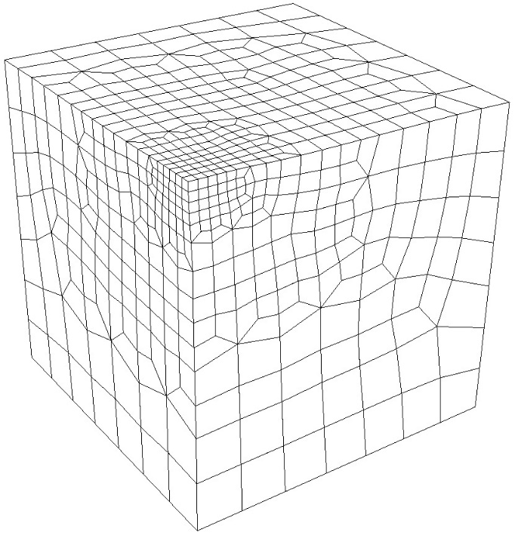
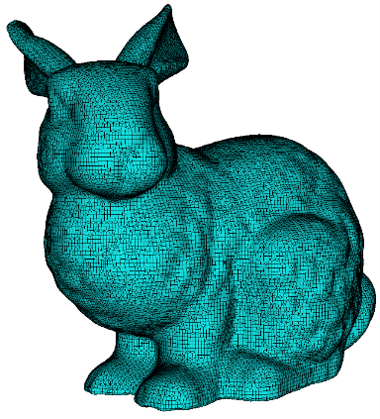
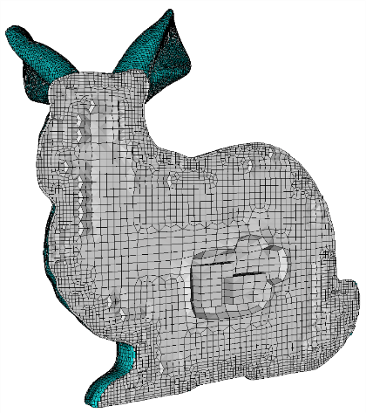
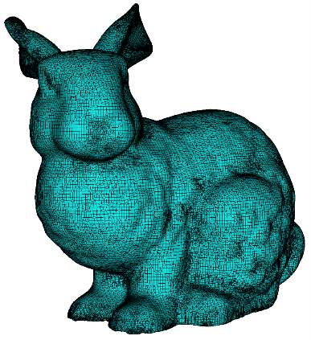
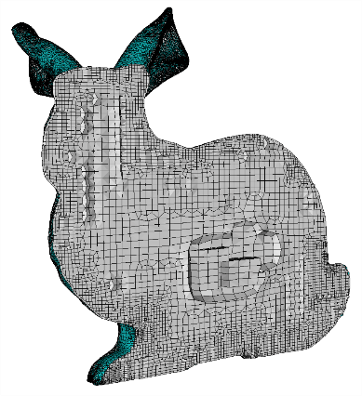
Sculpt Refinement
Sculpt uses an 1:8 refinement procedure.
Specify coarsest size for the overlay grid and number
of levels of refinement
No refinement
2 levels of
refinement
2 Levels
2 levels of
transition
Coarse cell size
for overlay grid
Final smoothed mesh
4 Levels
Adapts only where there is
curvature in the geometry

Slide 15
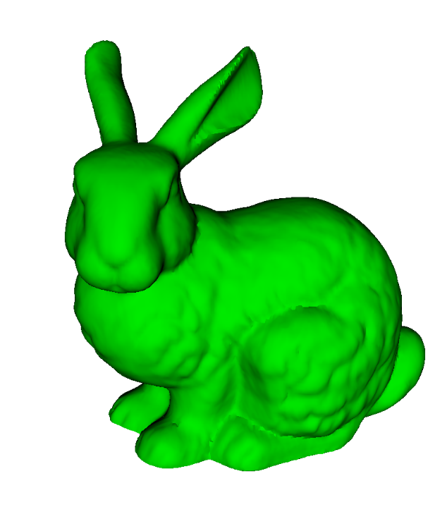
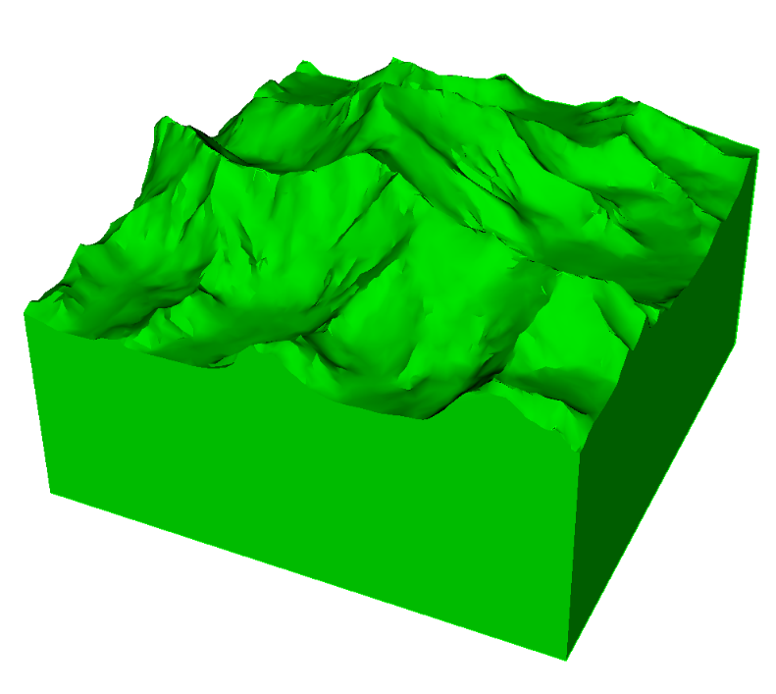
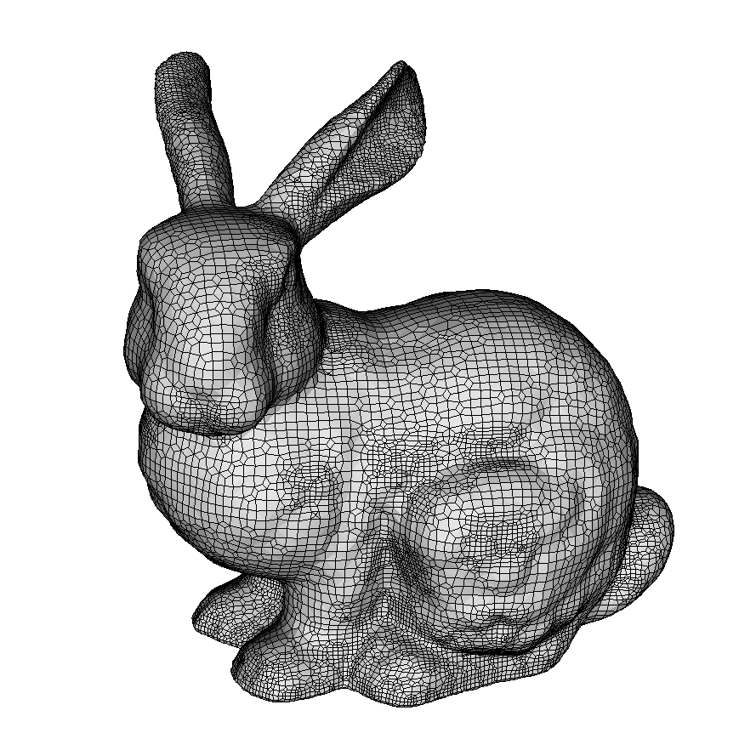
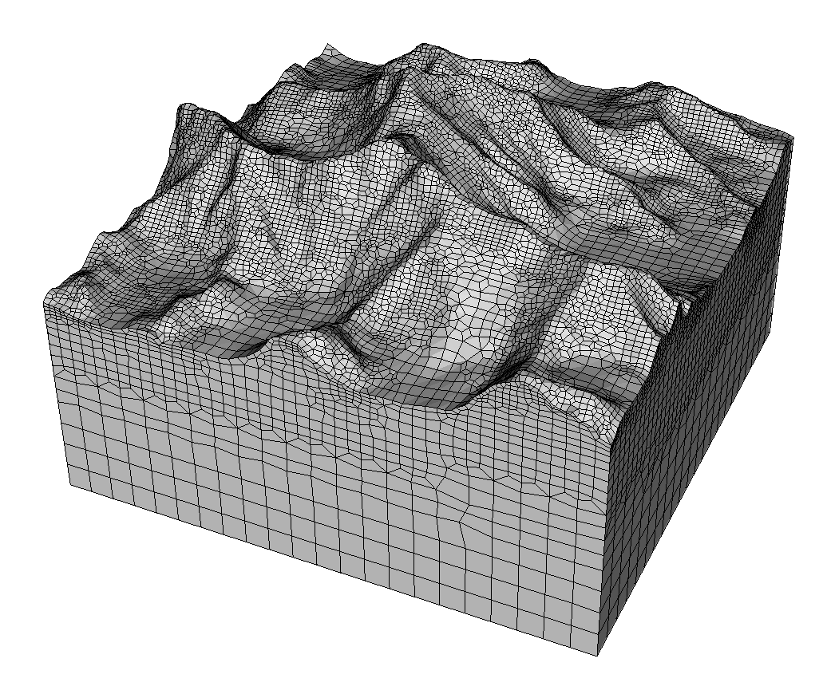
Example 15.3
Sculpt Refinement
1
Import either “bunny.stl” or “everest.stl”
2
Reset the Sculpt panels to Default
3
Try meshing with default sizes to begin
4
Refine by using the default cell size and
applying 1 or 2 levels of refinement to
capture details of the surfaces
bunny.stl
everest.stl
5
For everest.stl, set the overlay grid
bounding box to exactly match the
vertical sides of the model using
the “expand percent=0”
6
For everest.stl also try setting smoothing
surface interpolation method to fixed
bounding box.

Slide 16
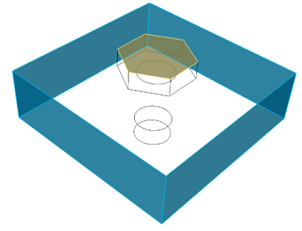
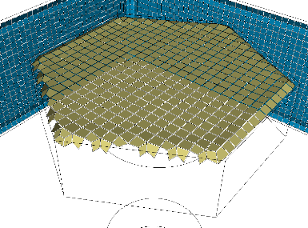
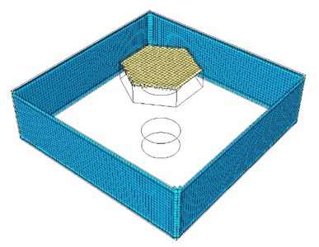
Boundary Conditions
Example:
gen_sidesets = 4
Sideset 2
Sculpt can automatically define nodesets, sidesets and blocks on the
resulting exodus mesh
Sideset 1
(composed of 4 surfaces)
Blocks
Material blocks are most often defined from the input geometry
Cubit Geometry: One block per CUBIT™ Volume
Diatom File: Material identifier in package description
Input Mesh: Can maintain blocks from Exodus input mesh
Microstructures: From volume fraction data
Void space: void_mat option or automatic
User defines 2 sidesets on the solid model
Most often defined using one of the gen_sidesets options
Sidesets
fixed: 3 sidesets. Bbox boundary, material free surfaces and material interfaces
variable: Unique surfaces defined bbox boundary, free surfaces and interfaces
geometric_surfaces: From CUBIT™ surface IDs
geometric_sidesets: From CUBIT™ sideset definitions
RVE: for microstructures. At each bbox surface and material interfaces
input_mesh_and_stl: combines sidesets from exodus mesh and diatom file
input_mesh_and_free_surfaces: input_mesh but adds an addition free_surface
rve_variable: Similar to 5, but defines sidesets at unique material interfaces
input_mesh: Builds sidesets from the exodus input_mesh
Note that sides are only an approximation of the surface. They may not exactly align with bounding curves
Sideset 2
Sideset 1
Some options for Nodesets are also offered. Also controlled with gen_sidesets option. See CUBIT™ Sculpt docs

Slide 17
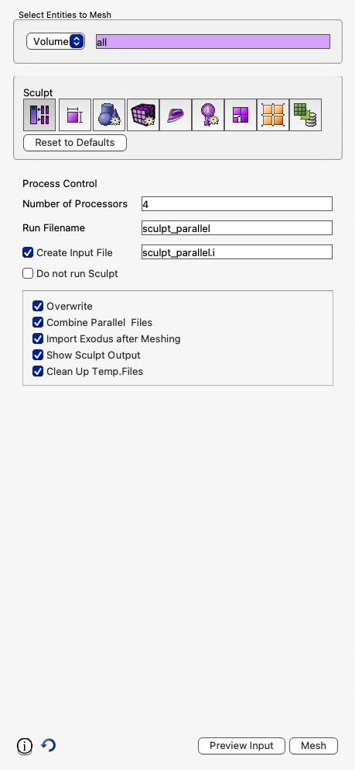
Running Sculpt in Batch
Sculpt can be run in batch on your local desktop or on an HPC machine
2
To generate batch input files
3
1
Set your working directory
4
2
Click the Sculpt Process Tab
3
Fill in names for files or use default (sculpt_parallel)
With the Do Not Run Sculpt option, no mesh will be generated. Instead the batch input files will be written to your working directory
4
Select Do Not Run Sculpt
5
Click Preview Input to see the input file contents in the CUBIT™ output window
6
Click Mesh button to dump the necessary files to run
in batch mode
5
6

Slide 18

Running Sculpt in Batch
In your working directory you should see the following files
Diatom File: Contains a list of all geometry used as input to Sculpt
Input File: Contains a human readable form of all input parameters to sculpt
Run File: Contains a unix command line script to run sculpt with all parameters
STL File: Triangle-based geometry description. One per volume

Slide 19

Running Sculpt in Batch
Edit the .i file to view the sculpt input parameters
For a description of parameters, use the –h option on the unix command line
Type:
sculpt
To see a summary of all sculpt options
Type:
sculpt –h <option>
To see help on the any sculpt option

Slide 20

Running Sculpt in Batch
To run sculpt in batch:
sculpt –i <input file> -j <num_procs>
For example:
sculpt –i asteroid.i -j 4
Observe the mesh summary when the mesh is completed
Number Hexes < 0.0 Scaled Jacobian
Number Hexes < 0.2 Scaled Jacobian
Minimum mesh quality

Slide 21

Running Sculpt in Batch
Exodus mesh files created (1 per processor)
To combine mesh files:
epu –p <num_procs> <base_file_name>
For example:
epu –p 4 asteroid_mesh
To import mesh into CUBIT™ to view mesh from command line
import mesh "asteroid_mesh.e" no_geom

Slide 22

Example 15.4
Sculpt Batch
1
Import the acis file "B3.sat"
2
Build the files needed to run Sculpt from a terminal
window for the B3 model using the procedure described.
Use the default size. Rename the input file and
exodus files to “car”
3
Add a sideset at the boundary of car. Try adding
gen_sidesets = fixed
to your input file car.i
4
Run sculpt from a terminal window with at least 4 processors
sculpt –i car.i –j 4
5
Combine the resulting exodus files using epu
epu –p 4 car
6
Import the resulting mesh into CUBIT™ and check the quality
import mesh geom "car.e" no_geom
quality hex all draw mesh
draw sideset all
7
Draw the sideset that was defined in step 3.
draw sideset all

Slide 23




Microstructures
Material Science applications often use microstructure models defined on a representative volume element (RVE)
to simulate the physics of materials. An RVE is normally a cube shaped domain defined as a Cartesian grid, where
each cell of the grid is represented as a material volume fraction. Sculpt can read microstructure information
directly and build a geometric model for hex meshing.
Initial voxel representation of
polycrystal materials.
Sculpt hex mesh of
microstructure
3D polycrystal microstructure
2 phase polymer microstructure
In addition to standard STL and diatoms,
several formats for microstructures are
supported that contain data on a
Cartesian grid. Each cell holds material
info for its portion of the grid.
Supported Microstructure Formats
input_micro
input_cart_exo
input_spn
input_stitch
Text format. Once row per cell, One column per material
Exodus File restricted to Hex8 Cartesian grid.
Text file with one integer per cell representing material ID
Sandia supported. SPPARKS and LAMMPS applications

Slide 24



Microstructures
Courtesy James W. Foulk
Courtesy Nathan W. Moore
Spray Foam Material
Crystal Plasticity
Sandia Report: Mesh Generation for Microstructures
https://www.sandia.gov/files/cubit/documents/SculptMicrostructuresSANDReport.pdf
Technical documentation and many examples/use cases
Courtesy Judith A. Brown
Elastomeric Syntactic Foam

Slide 25





Example 15.5
Microstructures
1
Run the input file “sculpt_micro9.i” from a terminal.
sculpt –i sculpt_micro9.i
2
Import the resulting exodus mesh into cubit as mesh based geometry
Tetmesh
size 2.0
import mesh geom “micro_clipped.e.1.0”
3
Delete the triangle mesh and generate a tet mesh
delete mesh
vol all size 0.5
vol all scheme tetmesh
mesh vol all
Mesh-Based
Geometry
Tetmesh
size 1.0
Tetmesh
size 0.5

