Slide 1
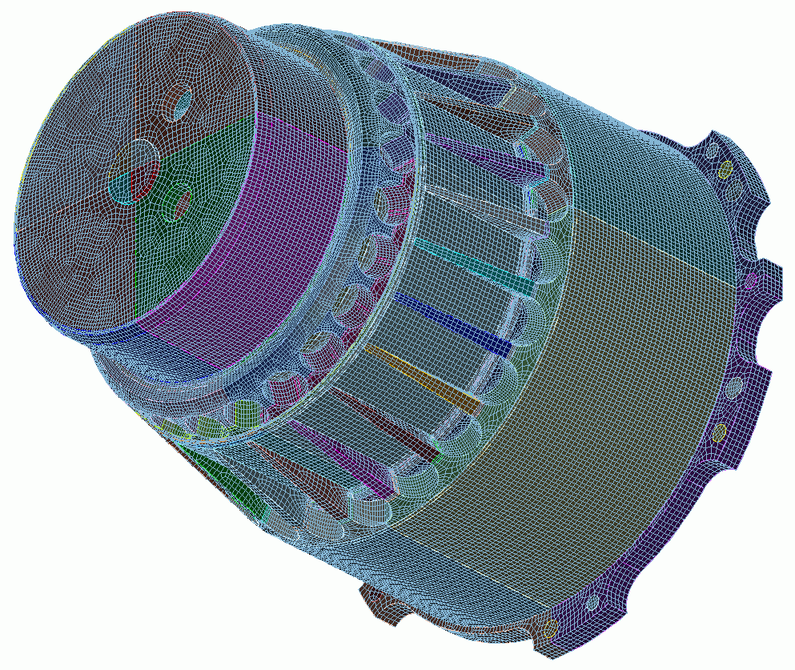
Geometry Cleanup for Assemblies
12
CUBIT
Geometry and
Mesh Generation Toolkit
CUBIT™ 200 Tutorials
Steven Owen
SAND2022-15142 PE

Slide 2
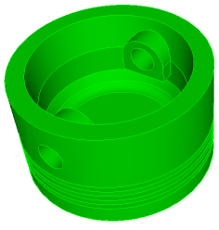
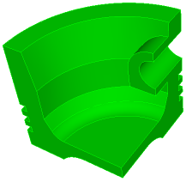
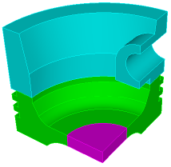
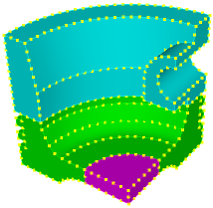
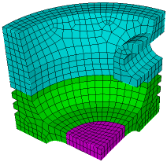
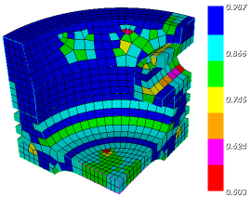
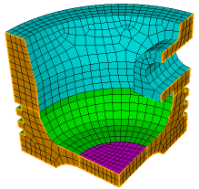
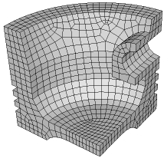
The Basic CUBIT™ Process
1
2
3
Import Solid Model
Simplify Geometry
Decompose Geometry
4
5
6
Imprint & Merge
Set Schemes
& Intervals
Mesh
7
8
9
Check
Quality
Apply B.C.s
Export
Mesh

Slide 3
Geometry Cleanup for Assemblies
Why contiguous meshes? How does CUBIT™ enforce contiguous meshes between parts?
What are the difficulties with generating contiguous assembly meshes?
What are the tools in CUBIT™ that will help me identify problems early?
What are the tools in CUBIT™ that will help me fix the problems?

Slide 4
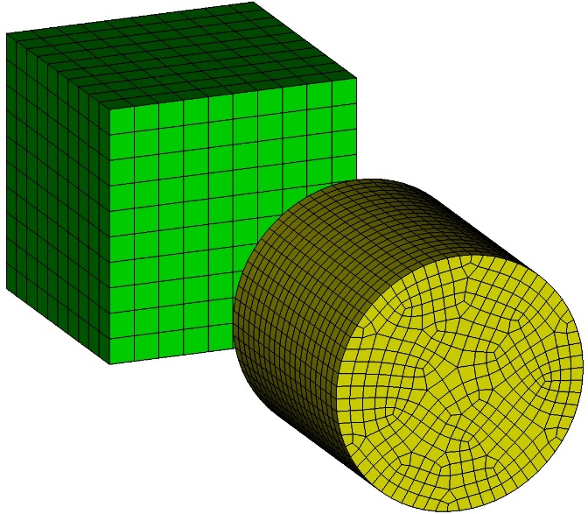
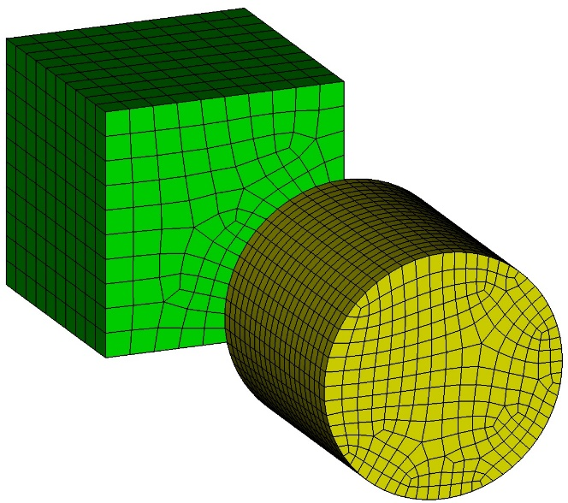
Exercise 12.1 Contiguous Meshing
1
Import “contig_exercise1.sat”.
Mesh the brick with size 1 and the cylinder with size 0.5.
Issue the command “draw surf 1 8” at the command line and notice mesh is not contiguous.
Delete the mesh.
Imprint and Merge the two volumes.
Set the sizes on the volumes again as imprinting may have destroyed mesh settings.
Mesh the volumes.
Issue the commands “draw vol 1” and “draw vol 2” to examine the mesh where the volumes touch.
Turn mesh visibility off, turn surface labels on, and reissue the commands “draw vol 1” and “draw vol 2”. Notice the shared surface at the interface between the 2 volumes.
2
3
4
5
6
7
8
9

Slide 5
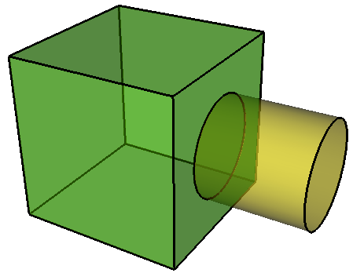
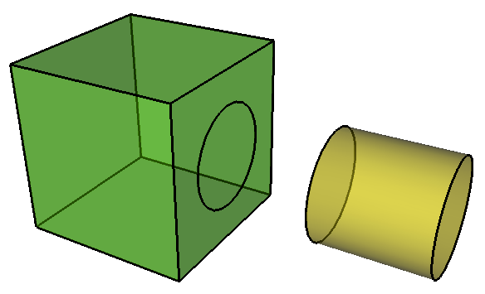
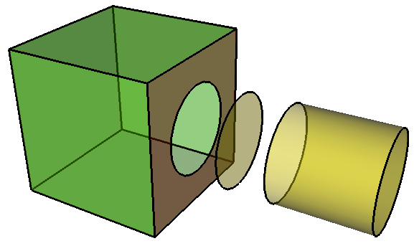
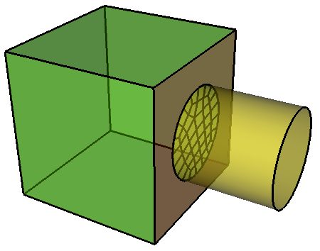
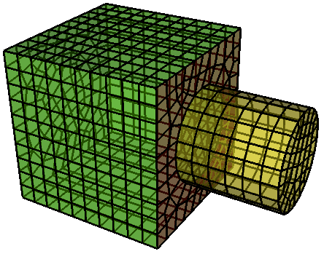
Imprint and Merge
Imprint
Vol 1
Vol 1
Vol 2
Vol 2
Initial volumes
Volume 1 imprinted with volume 2
Surface 9
Surface 9
Vol 1
Vol 1
Vol 2
Vol 2
Volumes merged: now share surface 9
Surface 9 meshed
Volumes meshed with shared surface mesh on surface 9

Slide 6
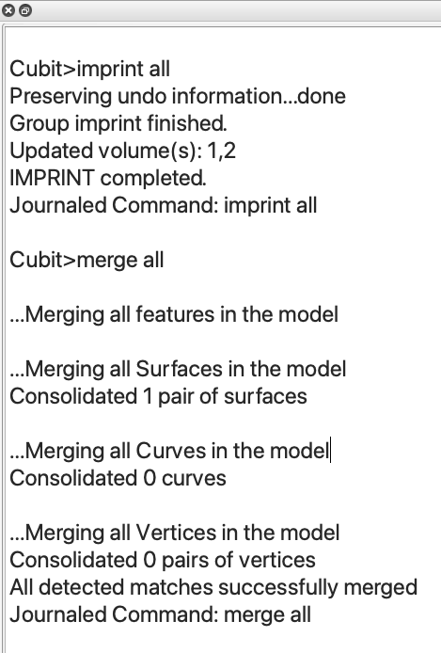
Check for Merged Surfaces
Use is_merged keyword to draw surfaces that are associated with more than 1 volume
draw surf with is_merged
Note: Merge operation in most cases should report consolidation of only the highest dimension entities merged
(Usually surfaces if you have solid volumes)
Check output to Command Line window.
Number of Surfaces, Curves and Vertices Merged

Slide 7
Exercise 12.2 Gaps
1
Import “contig_exercise2.sat”.
Imprint and Merge the two volumes.
Mesh the volumes with the same sizes as before.
Did you get what you expected? Why or why not?
Was there any output from CUBIT™ that would have led you to expect the result you got?
Hint: Measure the distance between vertex 1 and surface 8.
2
3
4

Slide 8
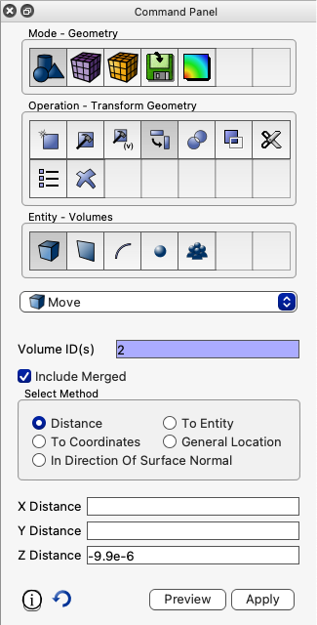
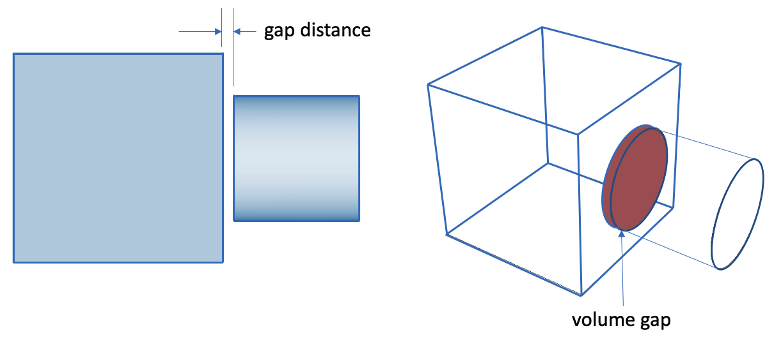
Exercise 12.2 (continued) Gaps
ACIS has a default geometric tolerance of 1e-6.
Entities are not “touching” unless they are closer than 1e-6
Positions in space are not considered the same unless they are closer than 1e-6
Imprinting in CUBIT™ is done using the ACIS kernel and therefore will not occur unless entities are within 1e-6 of one another
5
Continue with Exercise 13.2 by doing the following: move the cylinder 9.9e-6 in the negative z direction (the measured distance between vertex 1 and surface 8 should then be 1e-7), delete the mesh, redo the imprint/merge, and remesh.
move Volume 2 z -9.9e-6

Slide 9
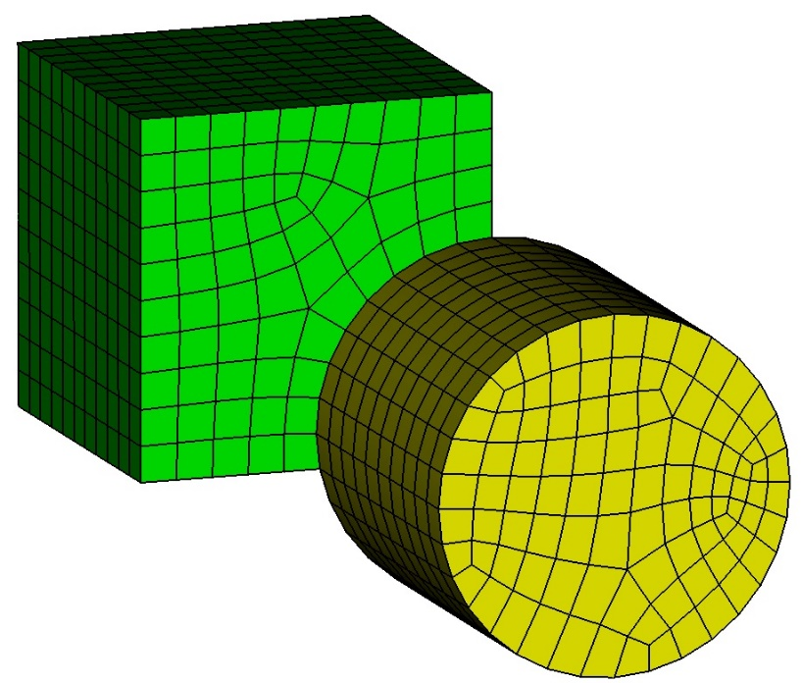
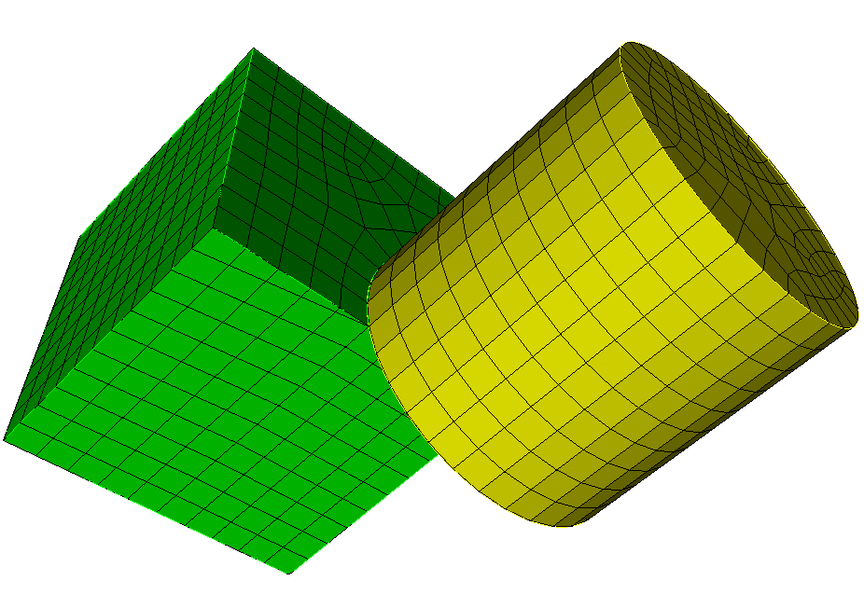
Exercise 12.3 Volume Overlaps
1
Import “contig_exercise3.sat”.
Imprint and Merge the two volumes.
Mesh the volumes.
Did you get what you expected? Why or why not?
Was there any output from Cubit that helps shed light on the results?
Hint: zoom in on vertex 14.
2
3
4
5
6

Slide 10
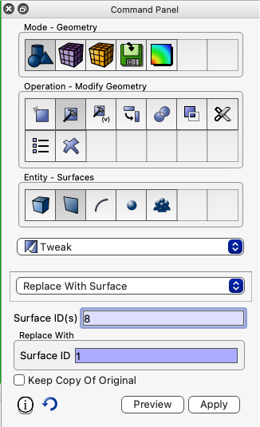
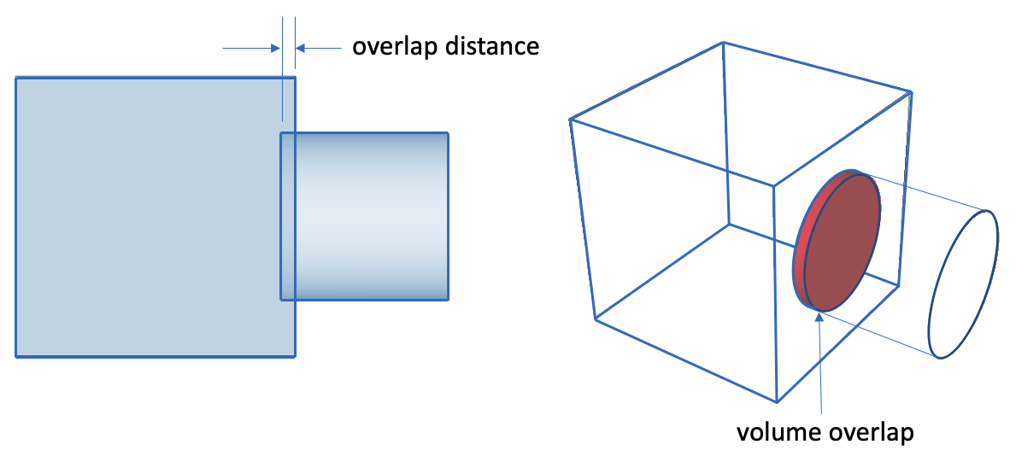
Exercise 12.3 (continued) Volume Overlaps
Volume overlaps usually create sliver geometry during imprinting
Slivers almost always result in poor quality elements
One way to remove overlaps is with the tweak surface operation
7
Reset and import “contig_exercise3.sat” again.
User the tweak surface command to correct the overlap
Imprint and merge and then mesh. Verify that the mesh quality is good
8
tweak surface 8 replace with surface 1
9

Slide 11
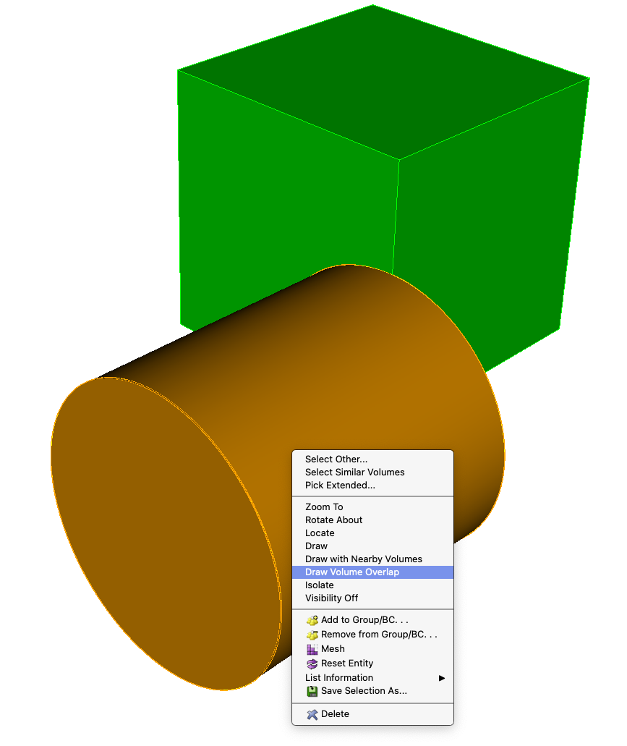
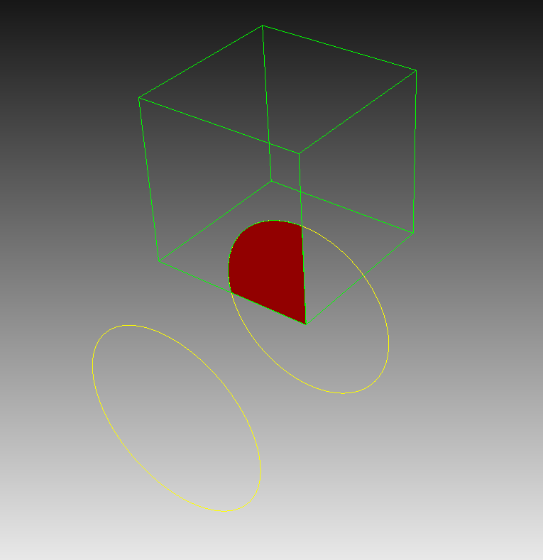
Drawing Volume Overlap
To visually inspect overlap between volumes, use the volume context menu (right click),
Or the draw volume overlap command
Command Line:
Select a volume and
choose the Draw Volume Overlap context menu in the graphics window
Solid red represents overlap region
draw volume 1 2 overlap

Slide 12
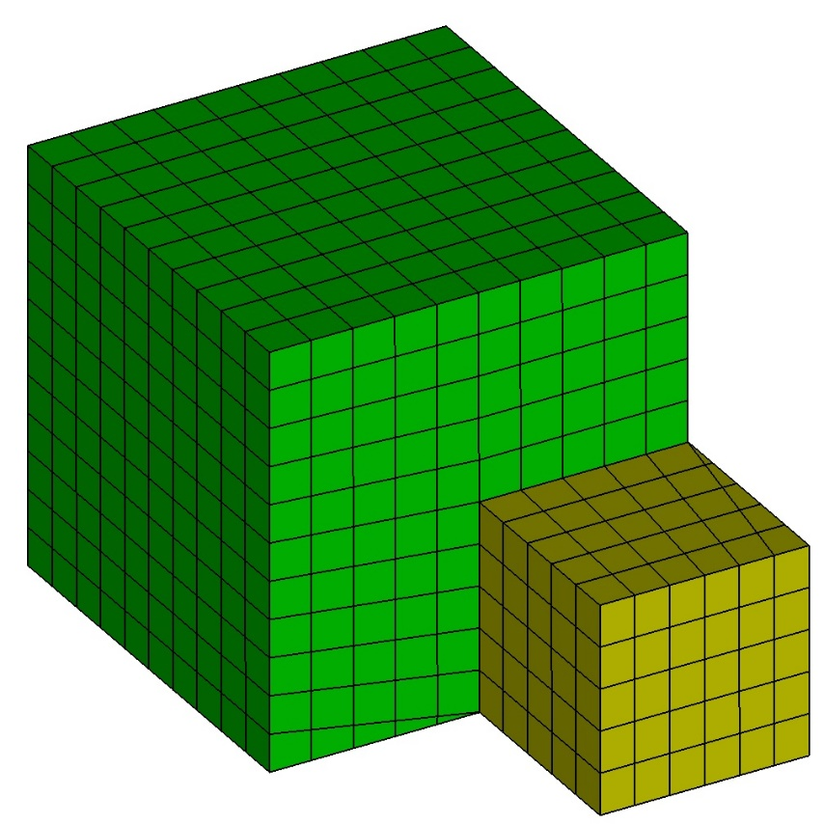
Exercise 12.4 Volume Misalignments
1
Import “contig_exercise4.sat”.
Imprint and Merge the two volumes.
Mesh the volumes.
Did you get what you expected? Why or why not?
Was there any output from CUBIT™ that helps shed light on the results?
Hint: zoom in on vertex 15.
2
3
4
5
6

Slide 13
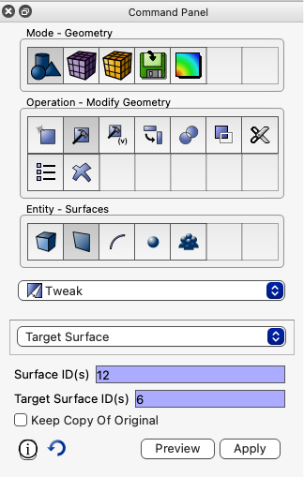
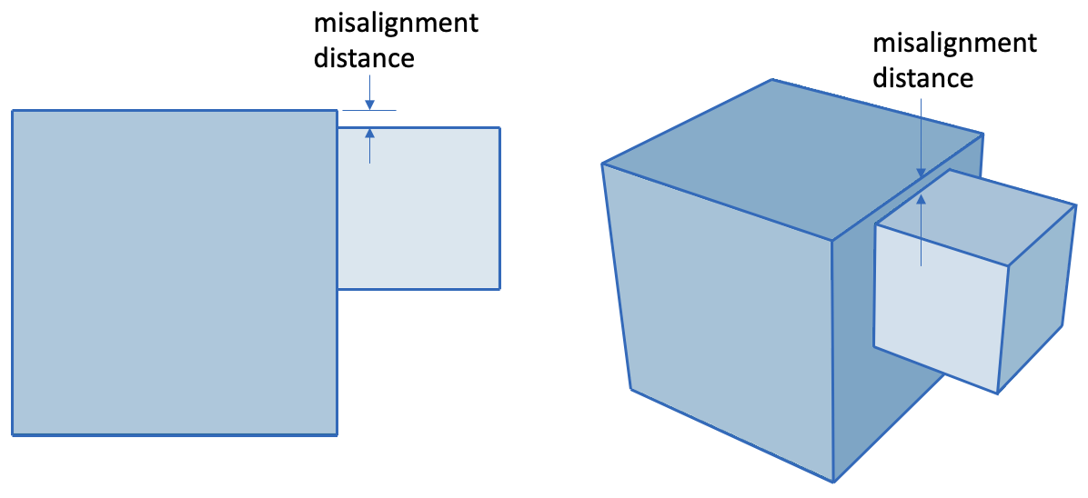
Exercise 12.4 (continued) Volume Misalignments
Volume misalignments can also create sliver geometry during imprinting, causing poor elements
Misalignments can also be resolved with a tweak surface operation
7
Reset and import “contig_exercise4.sat” again.
Zoom to vertex 14
User tweak surface command to correct the overlap
Imprint and merge and then mesh. Verify that the mesh quality is good
8
9
tweak surface 3 target surface 9
tweak surface 12 target surface 6
10

Slide 14
Summary of Adverse Effects of Gaps/Overaps/Misalignments
Gaps
Imprinting fails to occur and volumes are not connected at a merged surface
Volume Overlaps
Imprinting creates sliver geometry resulting in poor mesh quality
Volume Misalignments
Imprinting creates sliver geometry resulting in poor mesh quality
Unfortunately, if you haven’t looked for these problems you may not even know they exist until your analysis run!

Slide 15
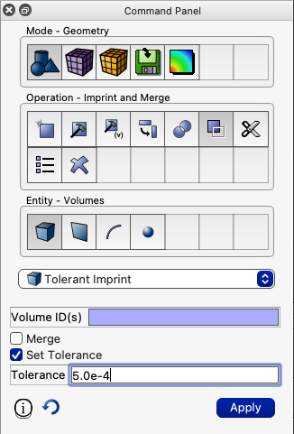
Tolerant Imprint/Merge
Same as regular imprint/merge but effectively allows the user to set the tolerance used during imprinting (and merging).
Instead of using 1e-6 to decide what is coincident it uses whatever the current merge tolerance is.

Slide 16
Tolerant Imprint/Merge
The advantage:
If there is an appropriate merge tolerance that could be used for the whole assembly there is no need for any geometry modifications prior to imprinting/merging.
The challenge:
Finding an appropriate merge tolerance.

Slide 17
Tolerant Imprint/Merge
Tolerance should be greater than gap distance, but less than smallest feature size
gap distance
gap distance
0.01
0.01
0.009
small feature size
small feature size
1.0
Example 1
Any tolerance > 0.01 but less than 1.0 should successfully merge these blocks
Example 2
Since smallest feature size is smaller than the gap distance, this is NOT a candidate for tolerant imprinting.
Try using the tweak operation to remove larger gaps, overlaps, misalignments until smaller than small feature size

Slide 18
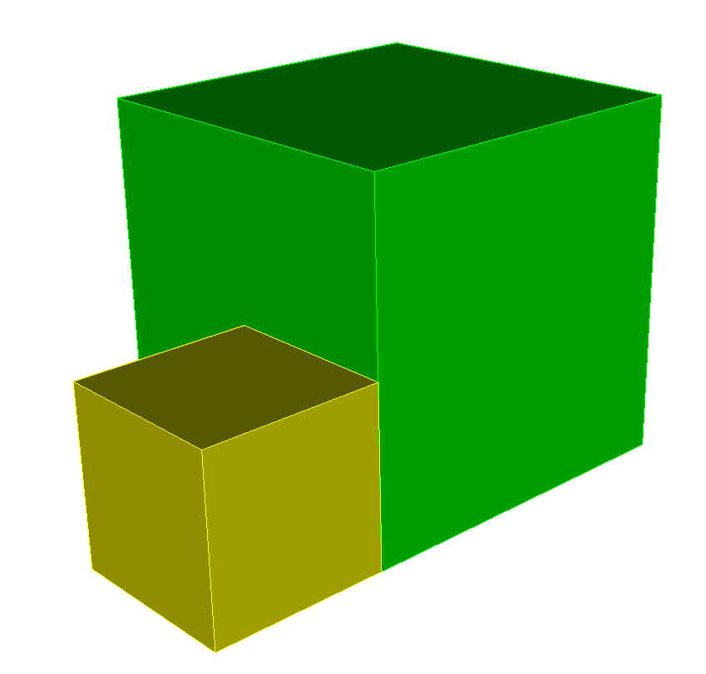
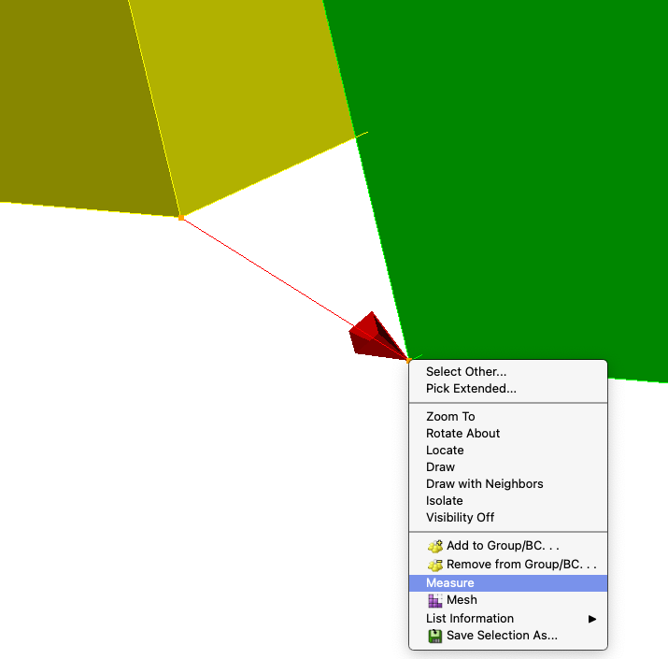
Exercise 12.5 Tolerant Imprinting
1
Import “contig_exercise4.sat”.
Zoom to vertex 14 and 1
Measure the distance between vertices 14 and 1
Measure the length of the smallest curve in the assembly (one of the curves in volume 2)
Set an appropriate imprint tolerance based on your measurements
Perform tolerant imprint and merge.
Check that volumes are merged (try is_merged)
Mesh the geometry and check for a valid mesh
2
3
Distance between Vertex 14 and Vertex 1 is 0.01414213562373
vertex 14, 1
4
5
vertex 14
6
vertex 1
7
8

Slide 19
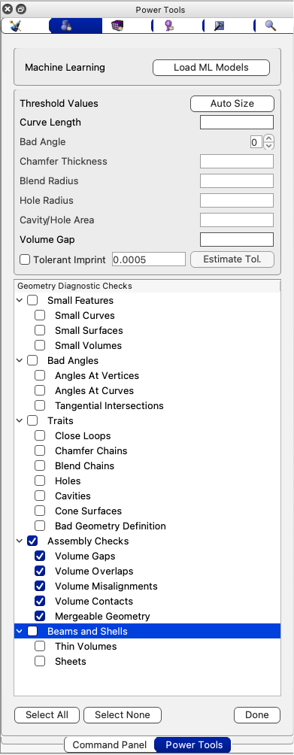
Geometry Power Tool
2
The Geometry Power Tool has diagnostics to check for gaps, overlaps and misalignments.
Suggests tweak and move solutions to resolve potential problems
Can perform tolerant Imprinting (includes option for automatically setting imprint tolerance)
3
1
Select the Power Tools Panel
4
2
Select the Geometry Power Tool
3
Select the Options Button
4
Select the Assembly Checks Diagnostic
1

Slide 20
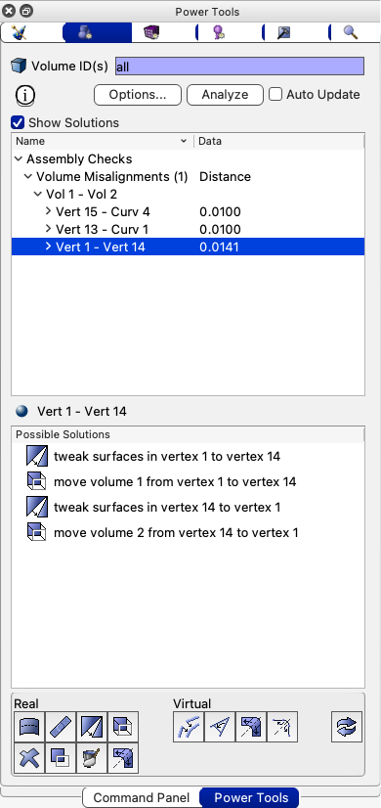
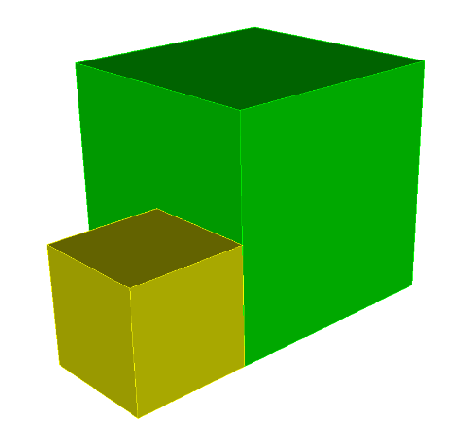
Exercise 12.6 Geometry Power Tool – Assembly Checks
1
Reset and Import “contig_exercise4.sat”
6
5
2
Navigate to the Geometry Power Tool and set the Assembly Checks Diagnostic in the Options panel
3
Click the Auto Size button to populate the thresholds with default values
4
Click Done on the Options panel
5
Click the Analyze button
6
Click the Show Solutions check box
7
Explore solutions:
Expand the Volume Misalignments and Vol1—Vol2 items in the list. Single click on a solution: preview the tweak or move operation Double click: execute the solution
8
Click the Analyze button after executing a solution to check if you have resolved all misalignments
9
Imprint, merge and mesh. Visually check for a valid mesh

Slide 21
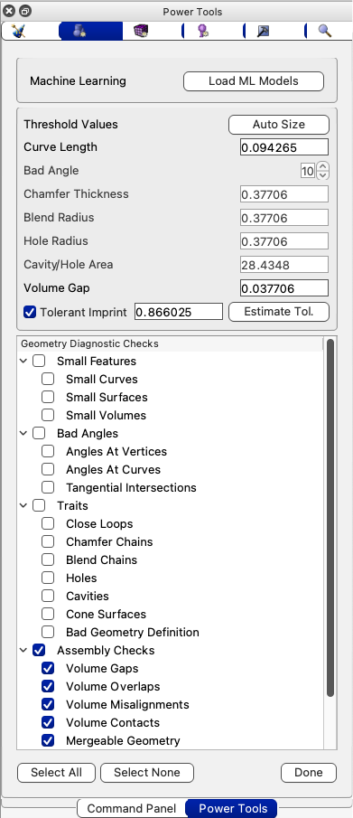
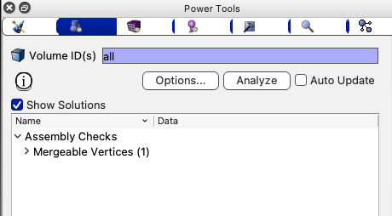
Geometry Power Tool – Tolerant Imprinting
The Geometry Power tool can be used for tolerant imprinting
Check the Tolerant Imprint Option
Use the Estimate Tol. Button. CUBIT™ will estimate a tolerance and display it. You can always override the estimated tolerance
If the tolerance works for your model, the Analyze button should show only mergeable entities. (No gaps, overlaps or misalignments)

Slide 22
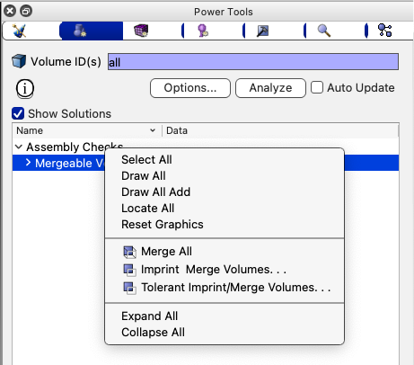
Exercise 12.7 Geometry Power Tool – Tolerant Imprinting
1
Reset and Import “contig_exercise4.sat”
2
Try using an estimated tolerance for imprinting in the Geometry Power tool Options panel
3
Check that no misalignments exist
4
Perform tolerant imprint and merge with the estimated tolerance
Note: To execute tolerant imprinting from the Geometry Power tool, right click on Mergeable entities (vertices) and select Tolerant Imprint/Merge Volumes…
5
Mesh

Slide 23
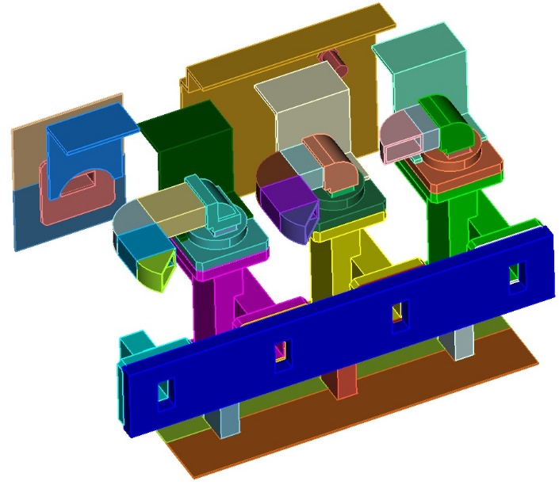
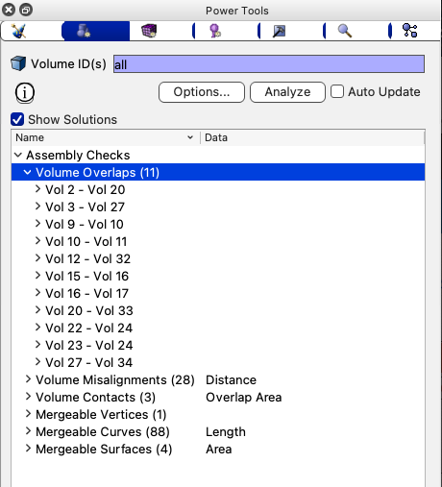
Exercise 12.8 contig_assembly
1
import “contig_assembly.sat”.
Try the default imprint and merge commands and observe the results
Reset and reimport “contig_assembly.sat”
Go to the Geometry Power Tool Options panel and uncheck Tolerant imprint, Click Auto Size, check the Assembly Checks diagnostics. Click Done
In the Geometry Power Tool, Click Analyze
Expand the Volume Overlaps and Volume Misalignments and explore some of the issues. Attempt to resolve overlaps and/or misalignments using the suggested Solutions
2
3
4
5
Note: For this example, there are far too many
overlaps and misalignments to deal with one by one.
This is a good candidate
for tolerant imprinting.
6
7

Slide 24
Exercise 12.9 contig_assembly – tolerant imprint
1
Reset and import “contig_assembly.sat”.
Go to the Geometry Power Tool Options panel and now check Tolerant imprint, Click Auto Size, check the Assembly Checks diagnostics.
Click Est. Tolerance button and observe the CUBIT™ computed tolerance. Click Done
Click Analyze and observe the number of overlaps and misalignments
Perform tolerant imprint and merge with the suggested tolerance
Check the output to the Command Line Window and note the number of merged surfaces, curves and vertices
Set the meshing scheme to tetmesh for all volumes and mesh
2
3
4
5
6
7

Slide 25
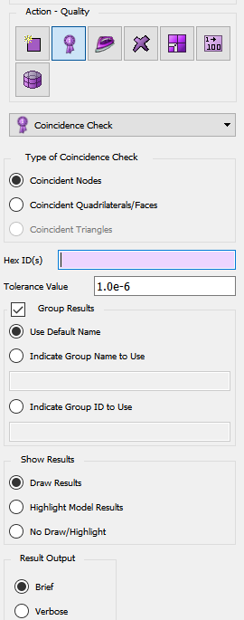
Coincident Mesh Check
Coincident mesh is often an indicator that imprint/merge failed and that the mesh is not contiguous. Coincident nodes and mesh faces are key indicators that there is a problem. The coincident mesh tool, found in the command panels under the Mesh->Entity->Quality sections allows the user to search for coincident nodes or mesh faces in the model. The input can be a list of geometry or mesh entities.
Option to specify which type of coincident mesh entity to search for.
Range of elements to search. Depending on which section of the mesh command panels you are in this can be geometry or mesh entities.
Tolerance for the coincidence check.
Options for grouping the results.
Options for displaying the results.
Option for specifying verbosity of text output to the command line.
This tool can be found by clicking the following links in the command panels: Mesh->(Some entity type)->Quality->Coincident Check (in the drop-down box).

Slide 26
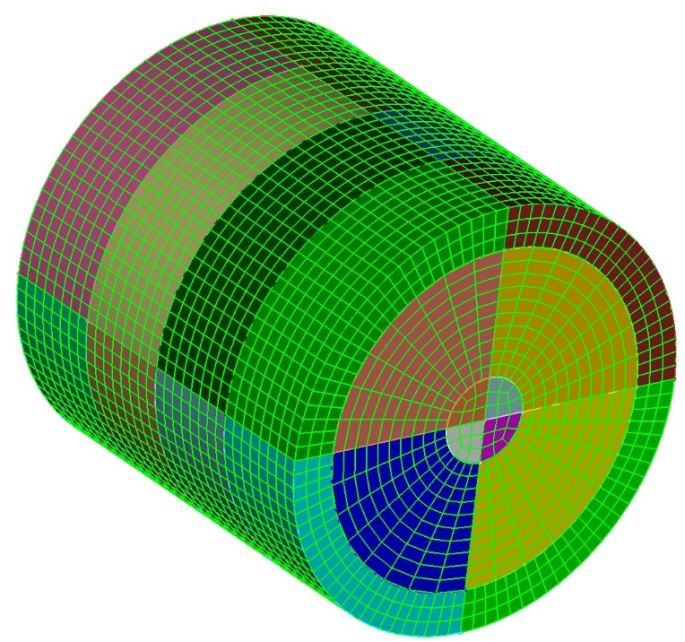
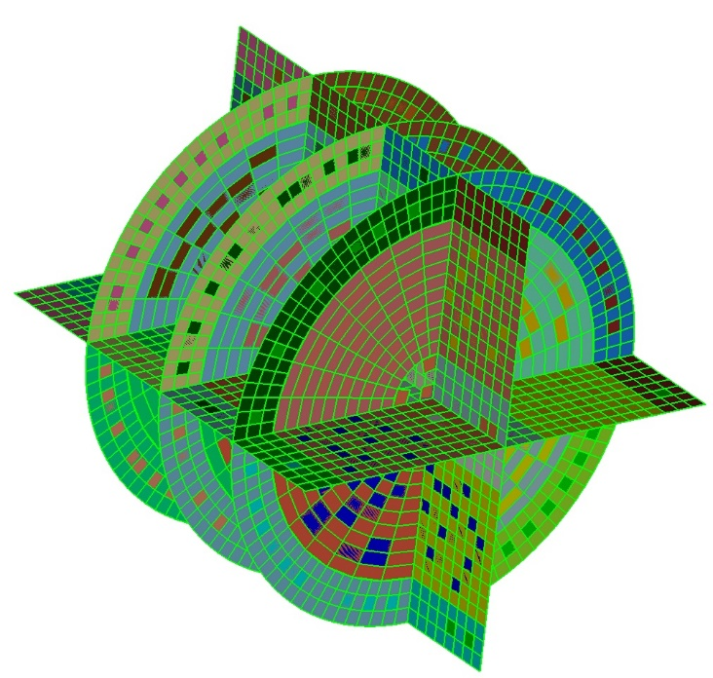
Exercise 12.10 Coincident Mesh Check
1
Import “contig_cyl_assem.sat”.
Mesh all of the volumes with the command “mesh vol all”.
Go to the coincident mesh tool in the command panels: Mesh->Volume->Quality->Coincidence Check.
Right-click and choose “Select All” in the volume list.
Check that you want to search for coincident quads.
Click on the “Apply” button to run the check. Did you get what you expected?
Delete the mesh: “delete mesh”.
Imprint/merge all of the volumes: “imprint all”, “merge all”.
Mesh the volumes again: “mesh vol all”.
Rerun the coincident quad check. Did you get what you expected?
2
3
4
5
6
7
8
9
10

Slide 27
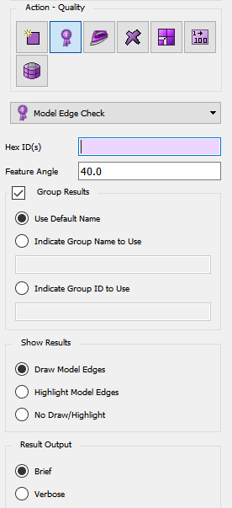
Model Edge Check
Another quick way to see if there is coincident mesh is to do the model edge check. This check will identify and draw all of the “edges” of the mesh found by skinning the set of elements specified as input. If there were merges that didn’t happen correctly during imprint/merge these will usually show up as interior edges in the display of the model edge check. The input can be a list of geometry or mesh entities.
Range of elements to search. Depending on which section of the mesh command panels you are in this can be geometry or mesh entities.
Feature angle to be used in determining the model edges.
Options for grouping the results.
Options for displaying the results.
Option for specifying verbosity of text output to the command line.
This tool can be found by clicking the following links in the command panels: Mesh->(Some entity type)->Quality->Model Edge Check (in the drop-down box).

Slide 28
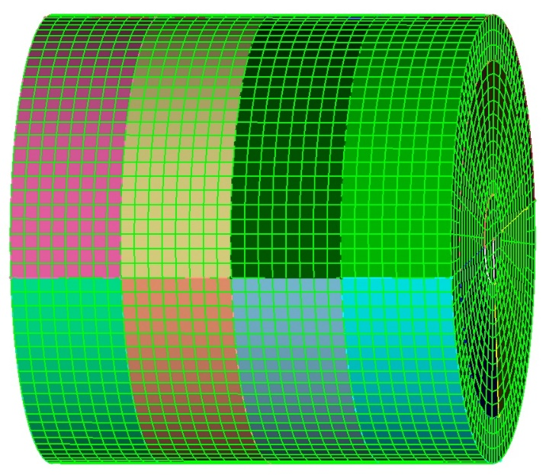
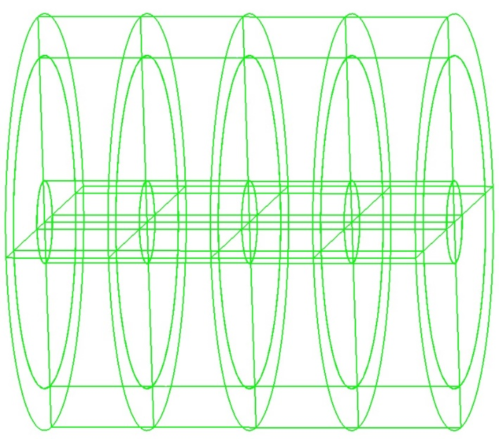
Exercise 12.11 Model Edge Check
1
Import “contig_cyl_assem.sat”.
Mesh all of the volumes with the command “mesh vol all”.
Go to the model edge tool in the command panels: Mesh->Volume->Quality->Model Edge Check.
Right-click and choose “Select All” in the volume list.
Click on the “Apply” button to run the check. Did you get what you expected?
Delete the mesh: “delete mesh”.
Imprint/merge all of the volumes: “imprint all”, “merge all”.
Mesh the volumes again: “mesh vol all”.
Rerun the model edge check. Did you get what you expected?
2
3
4
5
6
7
8
9

