Slide 1
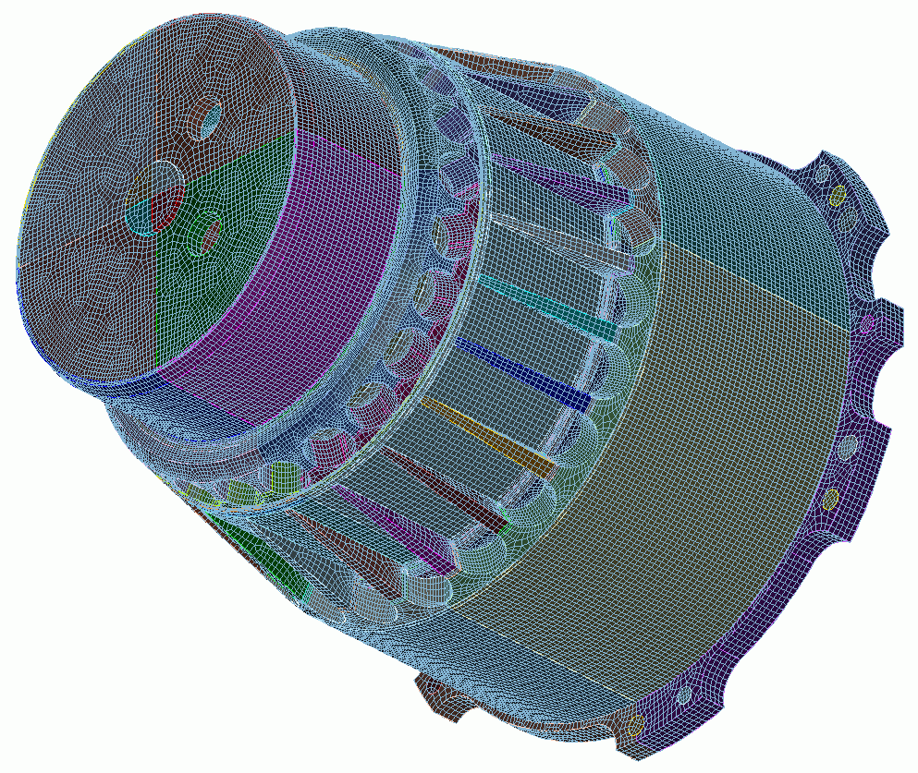

Mesh Quality and
Mesh Improvement
11
CUBIT
Geometry and
Mesh Generation Toolkit
CUBIT™ 200 Tutorials
Steven Owen
SAND2022-15142 PE

Slide 2
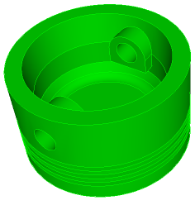
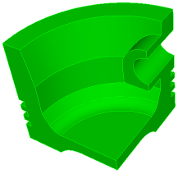
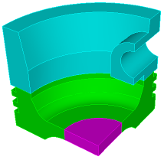

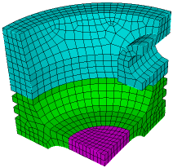
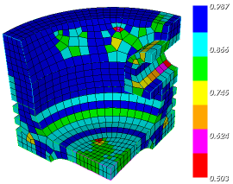
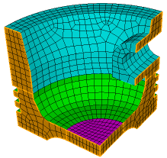
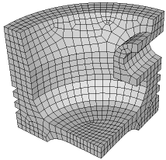
The Basic CUBIT™ Process
1
2
3
Import Solid Model
Simplify Geometry
Decompose Geometry
4
5
6
Imprint & Merge
Set Schemes
& Intervals
Mesh
7
8
9
Check
Quality
Apply B.C.s
Export
Mesh

Slide 3
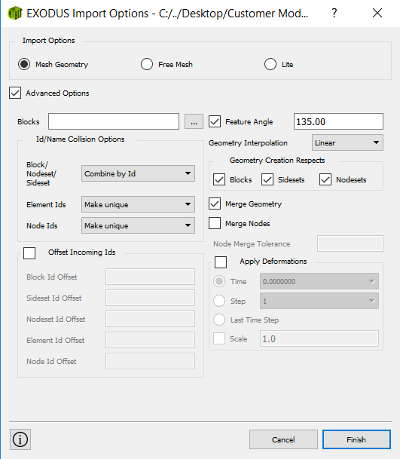
Mesh Import
Importing an existing mesh into CUBIT™
1
Select the File->import menu
Choose the Genesis/Exodus File Filter
Select a mesh file to import
Note that in addition to Exodus, Patran, Ideas, Abaqus, Fluent and Nastran mesh file formats are also supported.
2
3
4
Choose how you want CUBIT™ to use the mesh
Mesh Geometry: A new “mesh-based” geometry definition is automatically created on import. Vertices, Curves, Surfaces and Volumes are generated from the boundary of the mesh.
Free Mesh: Imports the mesh with no geometry association
Lite: Imports a light-weight version of the mesh suitable for responsive display and a small set of operations.
4
import mesh geom “file.g”
import mesh “file.g” no_geom
import mesh “file.g” lite

Slide 4
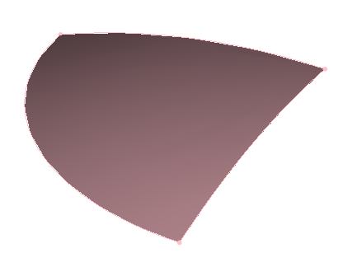
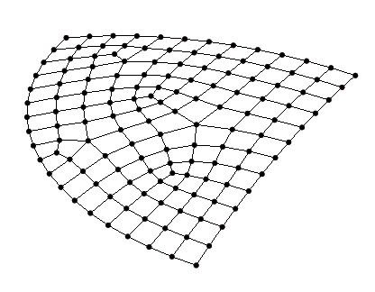

Free Mesh
Geometry
Mesh
Mesh Owned By Geometry
Traditionally this is the only way mesh could exist in CUBIT™.

Slide 5
Free Mesh
Geometry
Mesh
Mesh Not Owned By A Geometric Owner (“Free Mesh”)
Now mesh can exist and be manipulated without a geometric owner.

Slide 6
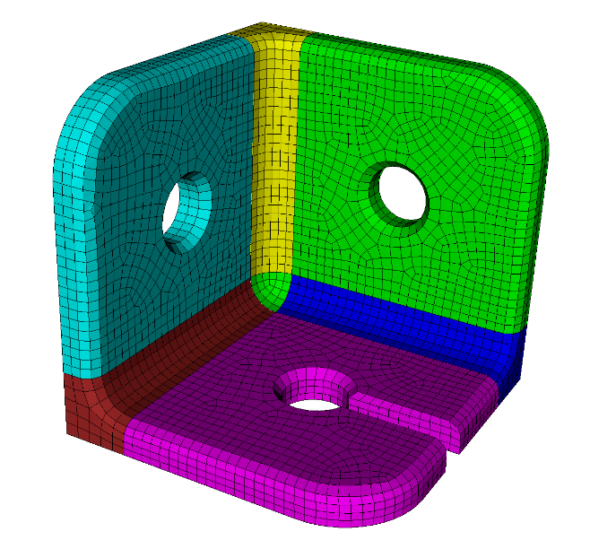
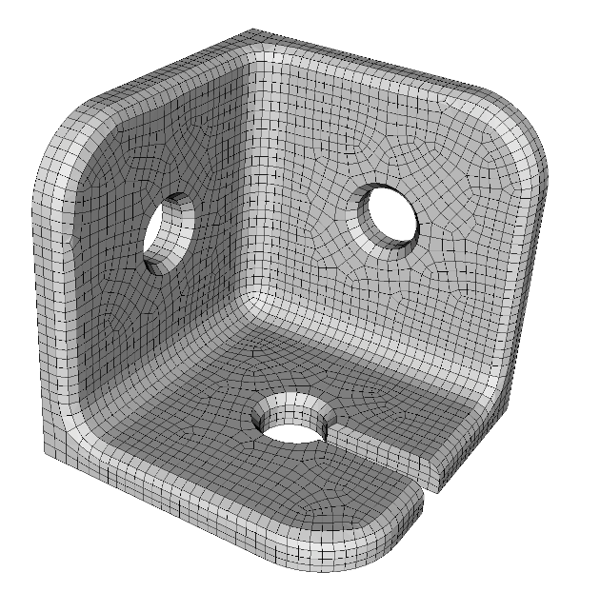
Exercise 11.1
Free Mesh
1
Import the mesh file “Mbracket.g”
(Choose the Genesis/Exodus File Filter)
Try the mesh import modes in turn
Mesh Based Geometry, Free Mesh
For each import mode try the following commands and observe the result:
2
3
draw block all
draw volume all
quality hex all draw mesh
nodeset 100 add node with y_coord > 9.91
refine hex in node in surface 11 26 33
refine hex all
4
Which commands work with MBG and which work with Free mesh. Why?

Slide 7
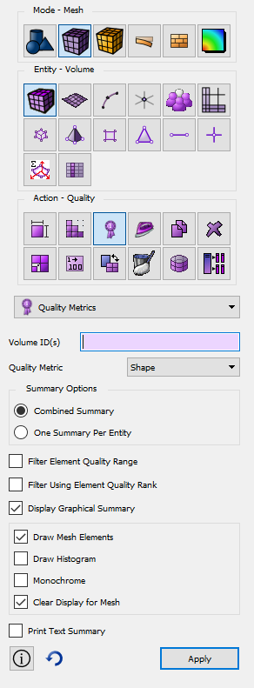

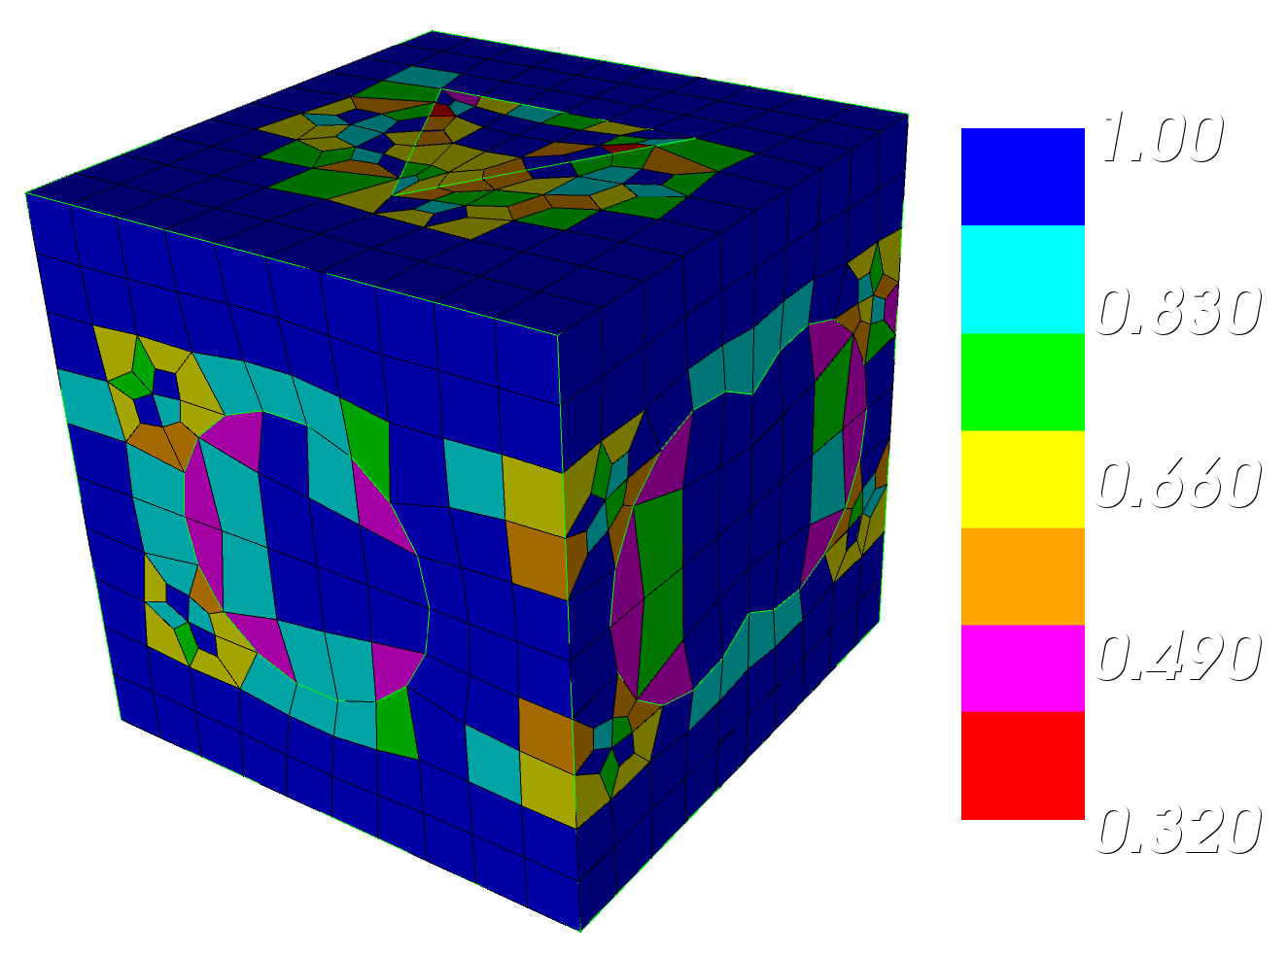
Mesh Quality Command Panel
1
Navigate to Mesh Quality Panel
Note that this panel is available for volumes, surfaces and elements
1
2
Select a meshed volume to examine
3
Select a Quality Metric
4
Select the options for displaying the metrics
2
3
Common command line options
quality hex all
quality vol all
quality hex all draw mesh
4

Slide 8
Quality Metrics
Definitions of the metrics are in the online documentation
  Go to the quality page and hit the F1 key
  Click on icon
CUBIT Documentation
Notes:
8

Slide 9
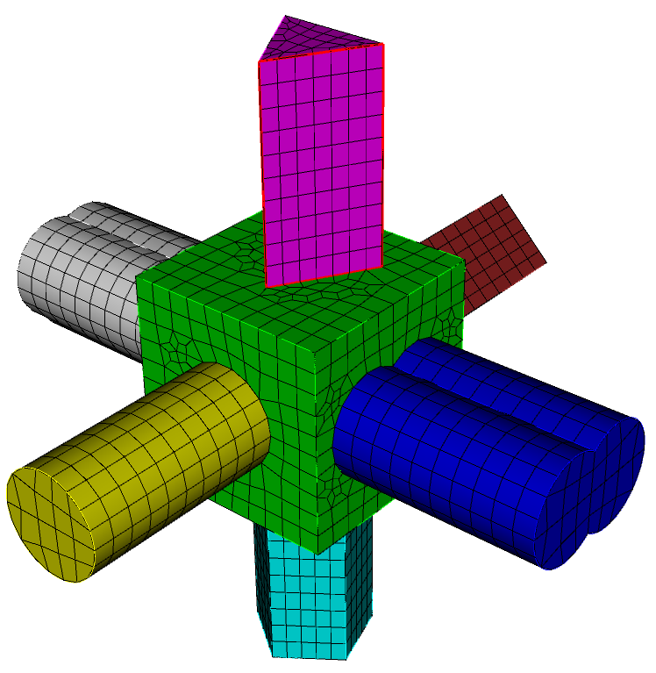
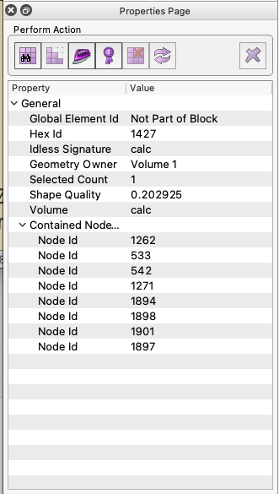
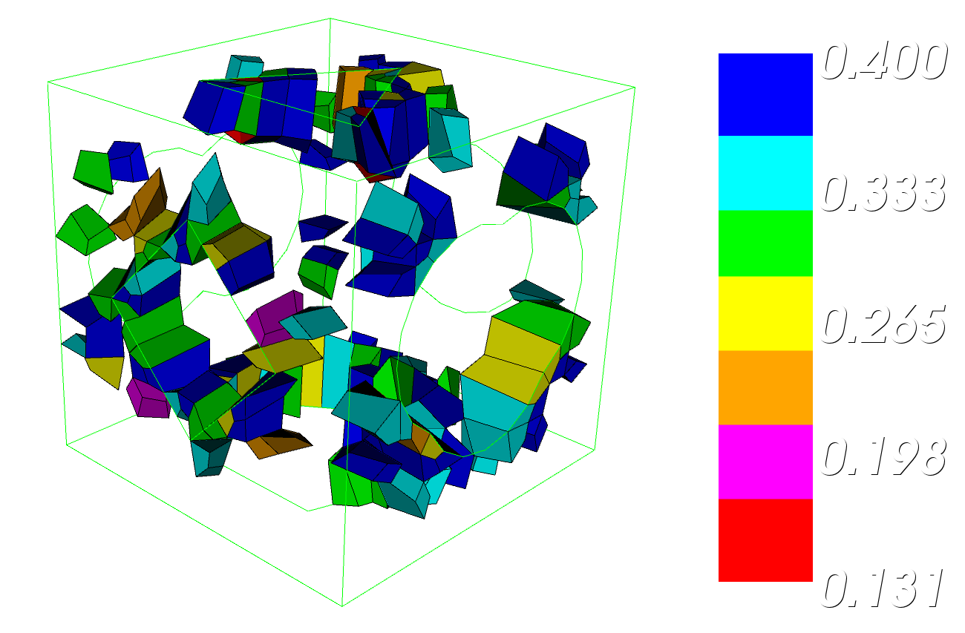

Exercise 11.2
Mesh Quality
1
Open cub file “graft.cub”
Navigate to the volume mesh quality panel
Draw the mesh quality of volume 1 using the shape metric.
Draw mesh quality again using the scaled jacobian metric.
Filter the mesh based on an upper limit of .4 and a lower limit of 0 and redraw the mesh.
Draw the shape and scaled jacobian quality histogram for volume 1.
Set the 3D filter in the tool bar
to select hexes.
Select one of the poorly shaped elements and examine the properties panel .
List quality of single hex from the command line
2
3
4
5
6
7
8
9
zoom hex 1427
highlight hex
quality hex 1427 scaled
quality hex 1427 shape
9

Slide 10
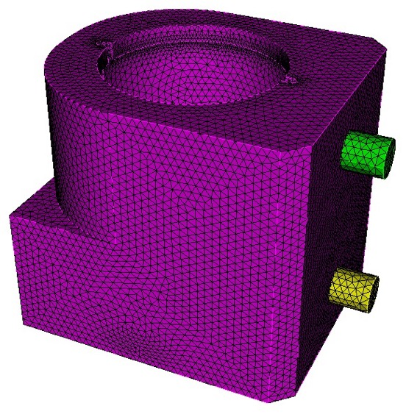
Time Step Metric
Small elements can result in very small time steps in your SD analysis.
Smallest element size can control how long your analysis will take to run when using explicit transient dynamics codes.
CUBIT™ can display metric based on time step
import acis "a901-2.sat"
vol all scheme tetmesh
vol all size 0.2
mesh vol all

Slide 11
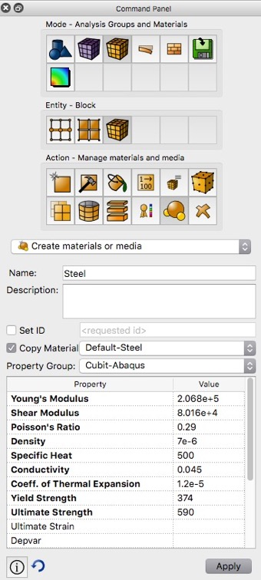
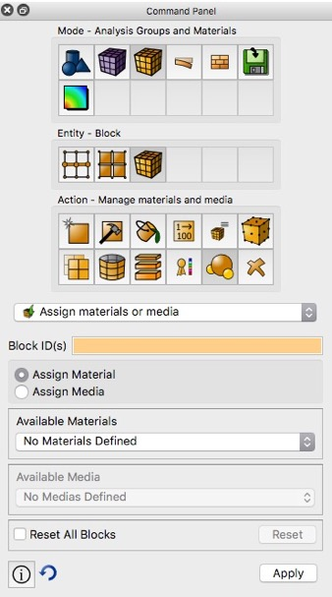
Time Step Metric
The time step metric is the only quality measure that relies on material properties. Material properties must be created and assigned to each block where time step will be measured
1. Create Material
2. Assign Material to Block
From the Command Panels, create a material by copying Default-Steel and then assign the new material to the blocks
Or from the command line:
create material name 'steel' elastic_modulus 2.068e5 poisson_ratio 0.29 density 7e-6
Note that materials can be created from command line. Consider creating a set of commonly used materials in a journal file
block 1 volume all
block 1 material 'steel'

Slide 12
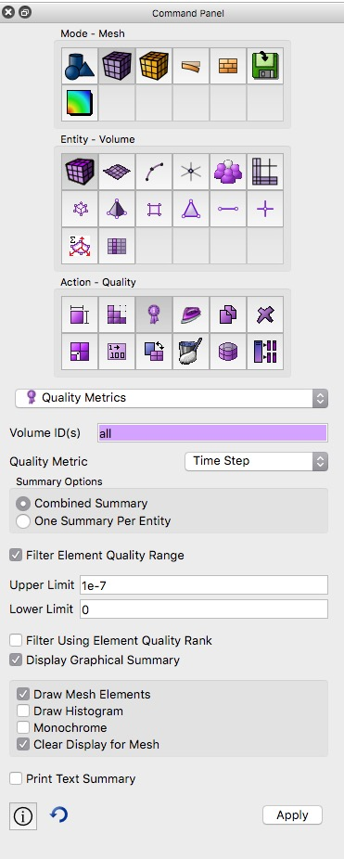
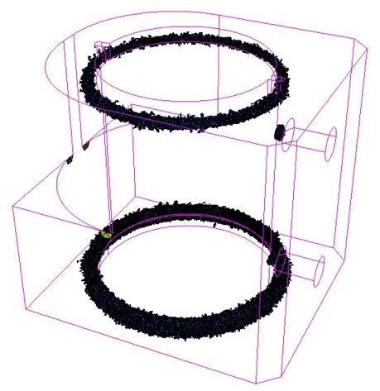
Exercise 11.3
Time Step Metric
1
Import “a901-2.sat” and tet mesh the geometry with a size of 0.2
Create blocks from the geometry
Define a default material with name ‘steel’
Assign ‘steel’ to all blocks
Display the time step metric on the tet mesh
Filter the element quality to display only elements with time step less than 1.0e-7
2
3
4
5
6
7
Note where "poor" elements are located. What is causing elements to be "small"?

Slide 13
Automatic Mesh Quality Checks
Quality is automatically computed after every meshing or smoothing operation
Always check output window following meshing
CUBIT> Mesh Volume 1
ERROR: >>>> Negative Jacobian Hex Element Generated! <<<<<
Check Mesh Quality.
CUBIT> Mesh Volume 1
WARNING: >>>> Poorly-shaped Hex Element Generated! <<<<<
Check Mesh Quality
Use smoothing, cleanup or modify the geometry to improve quality before using mesh with poor quality in an analysis
Poor quality may be acceptable if located where physics is not as important. Engineering judgment needed.

Slide 14
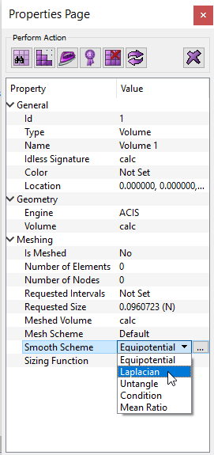
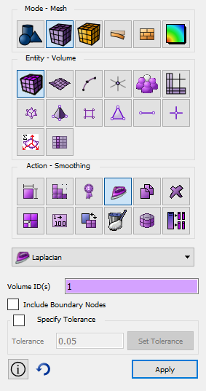
Smoothing
Smoothing adjusts node locations without changing element connectivity.
Many different smoothing schemes with different characteristics
Usually iterative algorithms that attempt to improve the local mesh quality
Short cut to smoothing command panel
Smoothing schemes for surfaces and volumes
Smoothing schemes applied as an attribute, (similar to meshing scheme)
Surface and volume schemes are independent (unless free boundary option selected)
Smooth scheme can be set from the property panel
Smooth scheme can also be set from the command panel

Slide 15
Smoothing
Surface Smoothing Schemes
Volume Smoothing Schemes
Equipotential
Centroid Area Pull
Optimize Jacobian
Winslow
  longtime favorite for structured meshes has been extended to unstructured in CUBIT - theoretical guarantee against mesh folding
  fast and high quality, try first for quads
Laplacian, centroid area pull (smart Laplacian)
  fast, poor near concave features
Untangle
  remove stubborn inverted elements
Condition number
  improve stubborn low-quality elements
  must be non-inverted to start
Mean Ratio
  Optimization-based
  Slower but robust
Laplacian
  fast, poor quality near concave features
Equipotential
  medium fast and medium quality
Untangle
  remove stubborn inverted elements
  Can take a long time
  Control time limit:
  Volume <range> Smooth Scheme Condition Number [beta <double=2.0>] [cpu <double=10>]
Condition number
  Guarantees the same or better quality
  improve stubborn low-quality elements
  must be non-inverted to start (runs untangle if inverted)
  Can take a long time (control time limit)
Mean Ratio
  Optimization-based
  Slower but robust

Slide 16
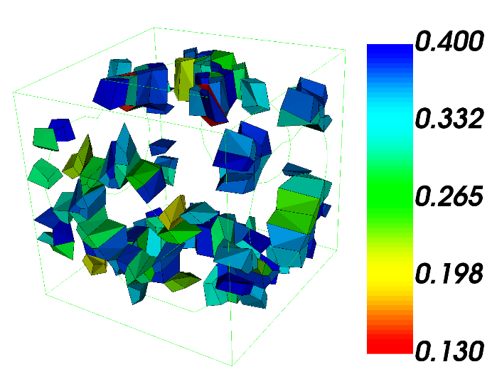
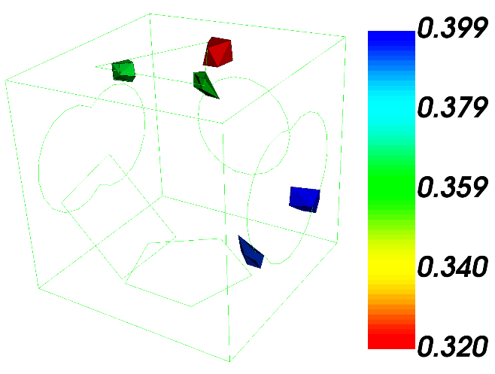
Exercise 11.4
Smoothing
1
Open cub file “graft.cub”
Smooth volume 1 using equipotential.
Draw the mesh quality of volume 1 using the shape metrics and the same filter as before.
Smooth volume 1 using mean ratio.
Draw the mesh quality of volume 1 using the shape metrics and the same filter as before.
2
3
4
5
shape
shape
Result from Equipotential Smoothing
Result from Mean Ratio Smoothing

Slide 17
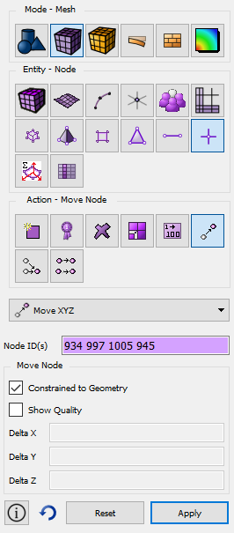
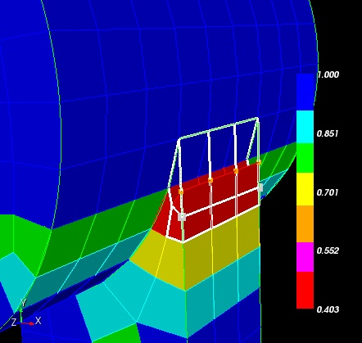
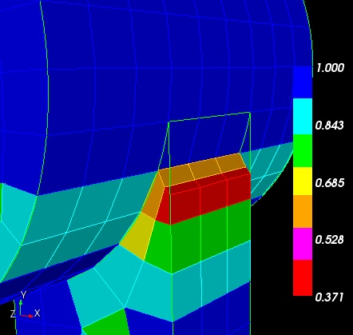
Interactive node editing
Select nodes to reshape elements
  Draws element outlines as nodes are moved.
  Can display element quality as nodes move

Slide 18
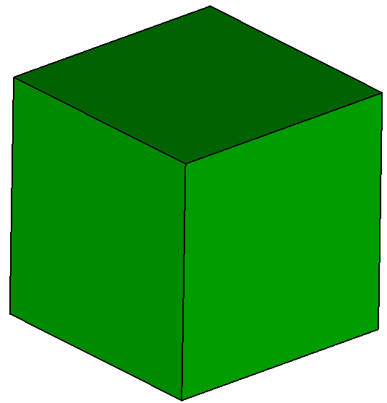
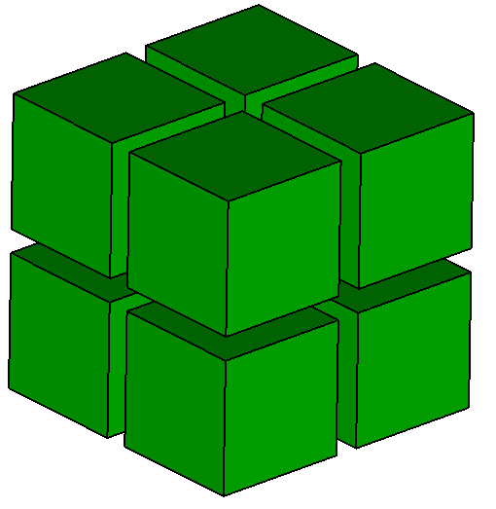
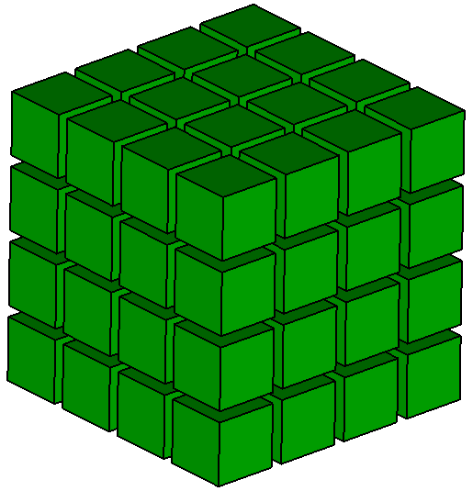
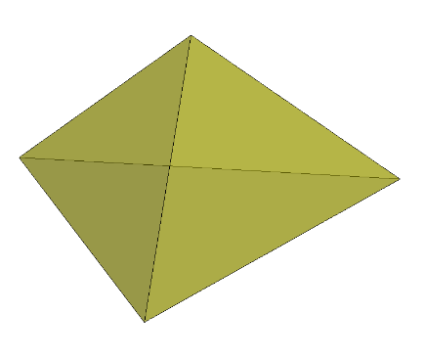
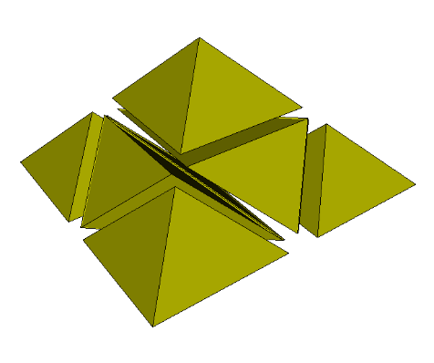
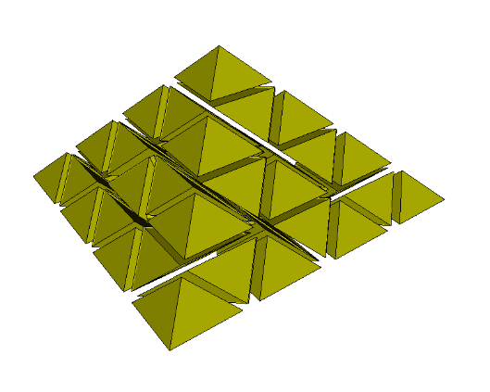




Mesh Refinement
8X
64X
Uniform Mesh Refinement
Useful for FEA convergence studies
  Assumption: more elements
  converges to accurate solution
Splits each hex/tet into eight
  Can quickly overwhelm memory
Command Line:
8X
64X
refine hex all
refine tet all
refine vol all
$$N=N_{i}8^{S}$$
$$N_{i}=$$
initial number of elements
$$N=$$
final number of elements
$$S=$$
number of splits

Slide 19
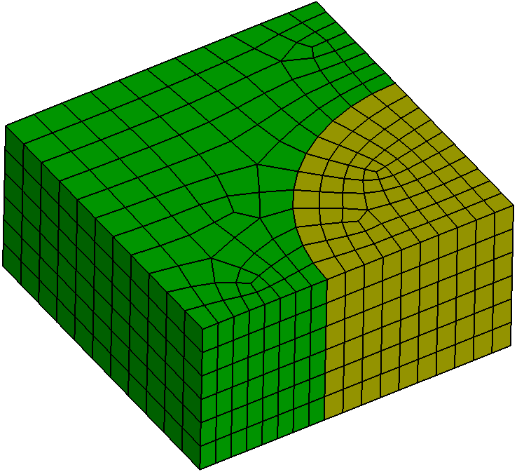
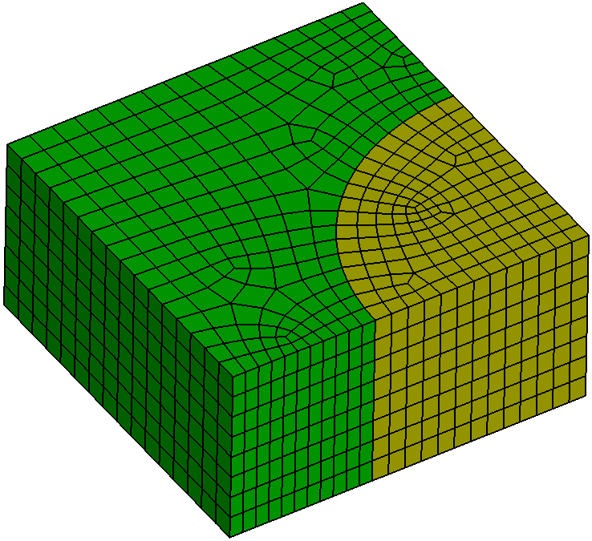
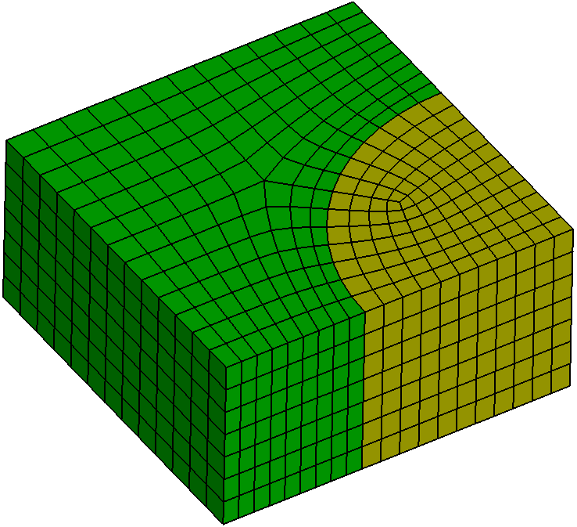
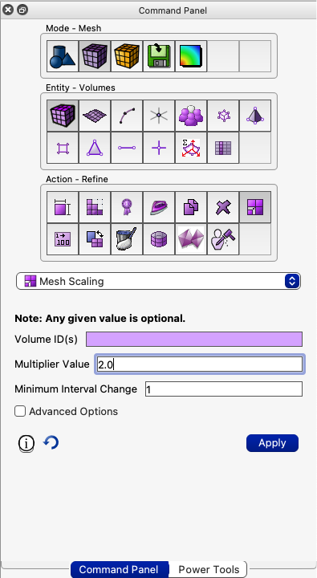
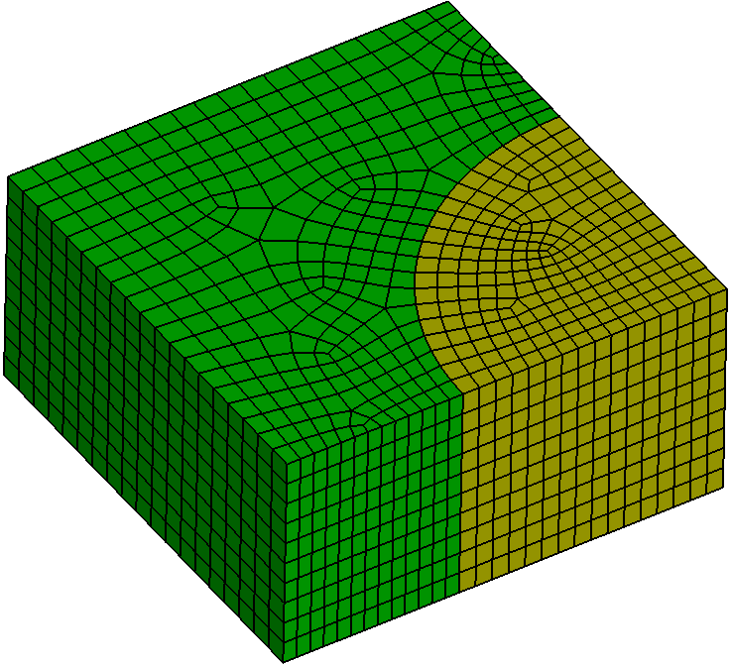
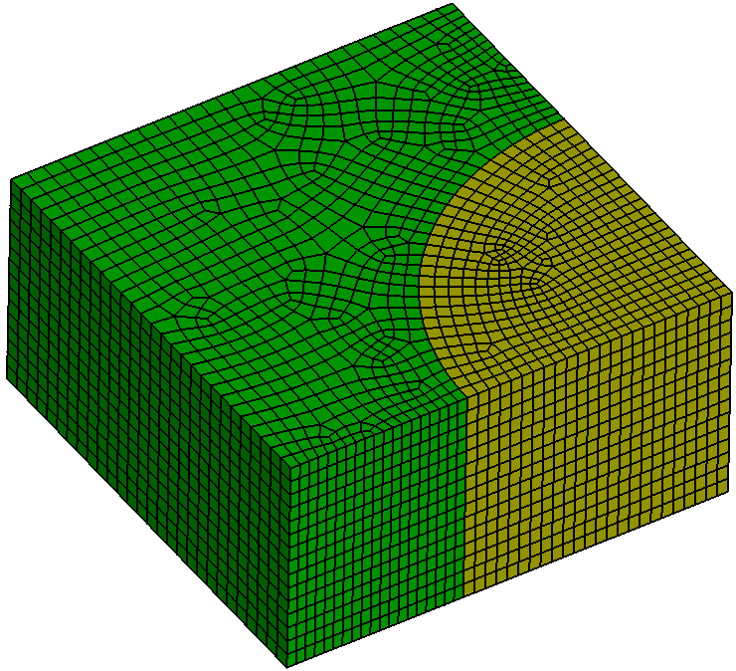
Mesh Refinement
Factor 0.667
1128 hexes
Mesh Scaling
Hexes only
Allows for any factor of refinement
Scale factor can be < 1 (coarsening)
or > 1 (refinement)
Remeshes each volume to maintain
approximate scaling factor
Initial Mesh
1869 hexes
Factor 1.75
2880 hexes
Factor 3.0
5140 hexes
Factor 10.0
19,040 hexes
scale mesh volume all multiplier 2

Slide 20
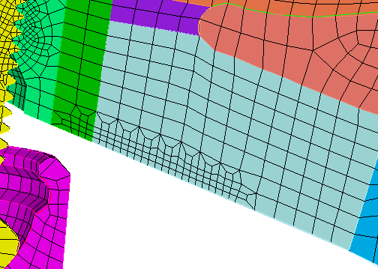
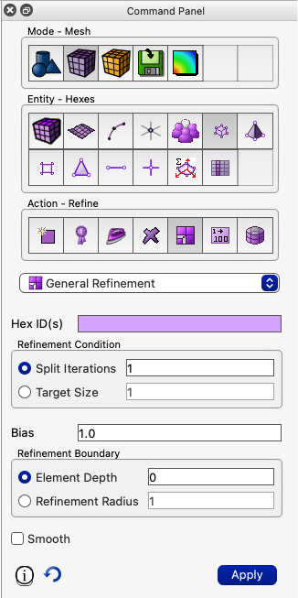
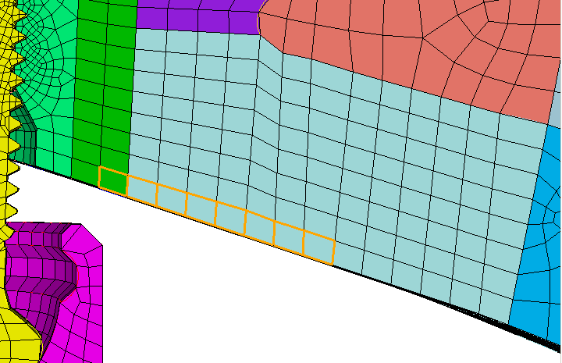
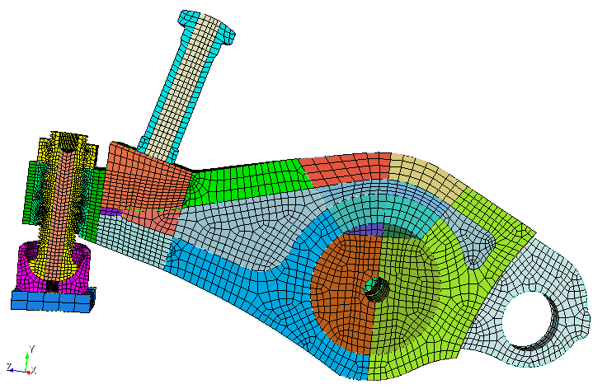
Mesh Refinement
General Refinement
Hex, tet, face, and tri mesh refinement
Specify a mesh or geometry entity and number of
times to split

Slide 21
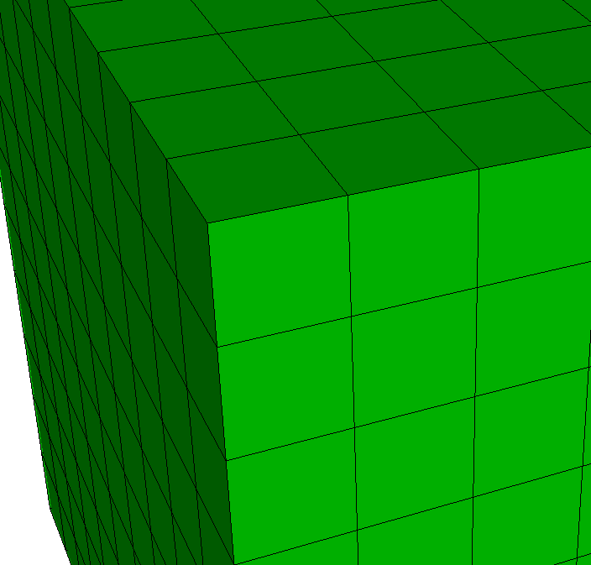
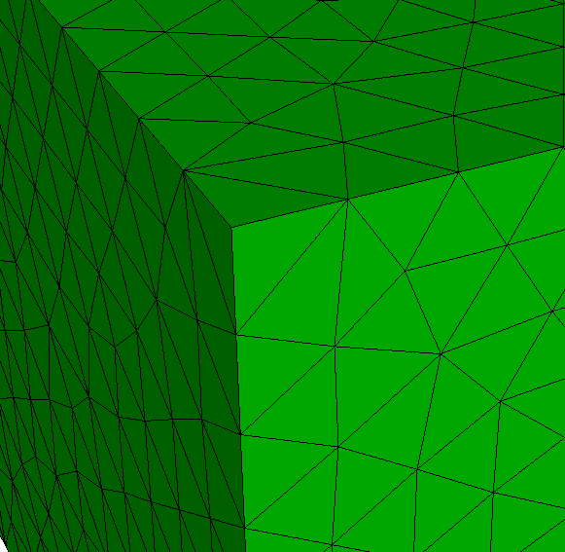
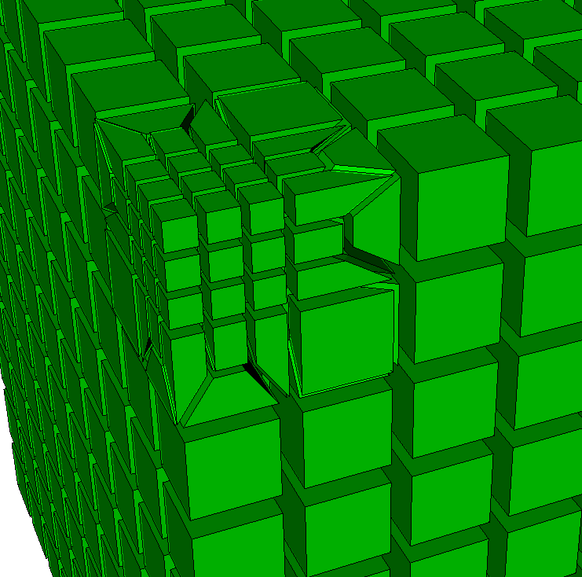

Mesh Refinement
Hex Refinement
Tet Refinement
General Refinement
Hexes result in 27X + transitions
Tets result in 8X + transitions
New nodes projected to geometry
tet to be
refined
hex to be
refined
Command Line Options
Refine {Node|Edge|Tri|Face|Tet|Hex} <range> [NumSplit <int = 1>|Size <double> [Bias <double>]] [Depth <int>|Radius <double>] [Sizing_Function] [no_smooth]
Refine {Vertex|Curve|Surface|Volume} <range> [NumSplit <int = 1>|Size <double> [Bias <double>]] [Depth <int>|Radius <double>] [Sizing_Function] [no_smooth]
transition hexes
transition
hexes
transition
tets
8 tets
27 hexes

Slide 22





Exercise 11.5
Mesh Refinement
Brick x 10 y 10 z 20
Create cylinder height 25 rad 3
Subtract vol 2 from vol 1
Mesh vol 1
1
Build the simple model again from exercise 9.3 and generate a default hex mesh
Mesh with hexes using default size and scheme
Do a uniform refinement
Remesh and try mesh scaling at factor 2X and 0.5X. Check the number of elements before and after
Remesh mesh and refine using general refinement at surface 11 to a depth of 5 elements.
Try applying the same refinement again to surface 11
Remesh with tets and apply general refinement again to surface 11 with depth 5
2
1134 hexes
3
refine hex all
4
scale mesh volume all multiplier 2
5
0.5X multiplier
546 hexes
2X multiplier
1794 hexes
refine surface 11 depth 5
6
7
Graded hex and tet meshes using element depth 5 applied twice

