Slide 1
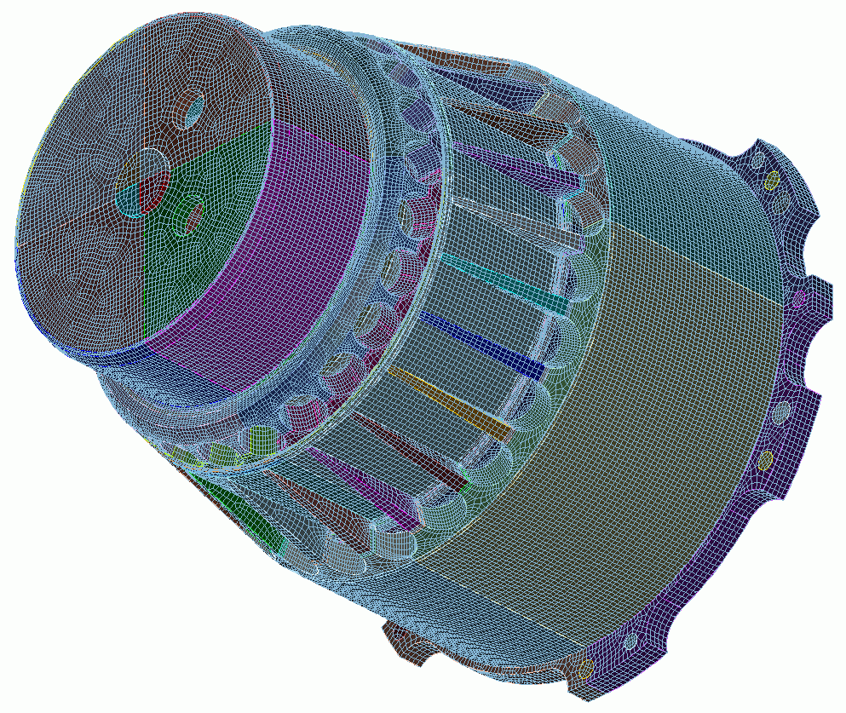

Geometry for Sweeping
10
CUBIT
Geometry and
Mesh Generation Toolkit
CUBIT™ 200 Tutorials
Steven Owen
SAND2022-15142 PE

Slide 2
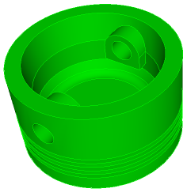
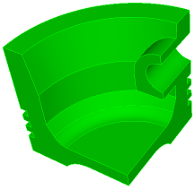
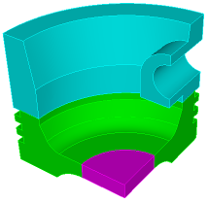

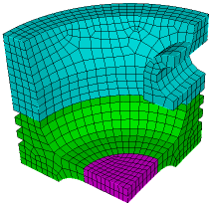
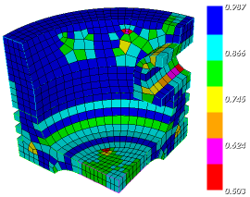
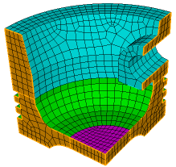
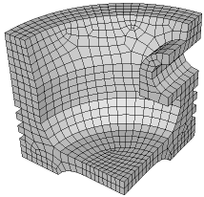
The Basic CUBIT™ Process
1
2
3
Import Solid Model
Simplify Geometry
Decompose Geometry
4
5
6
Imprint & Merge
Set Schemes
& Intervals
Mesh
7
8
9
Check
Quality
Apply B.C.s
Export
Mesh

Slide 3
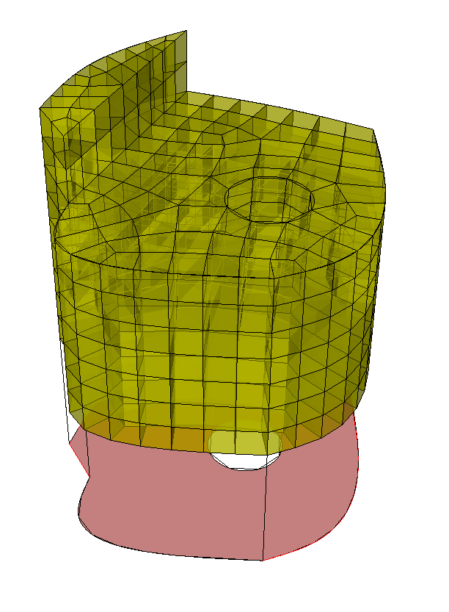
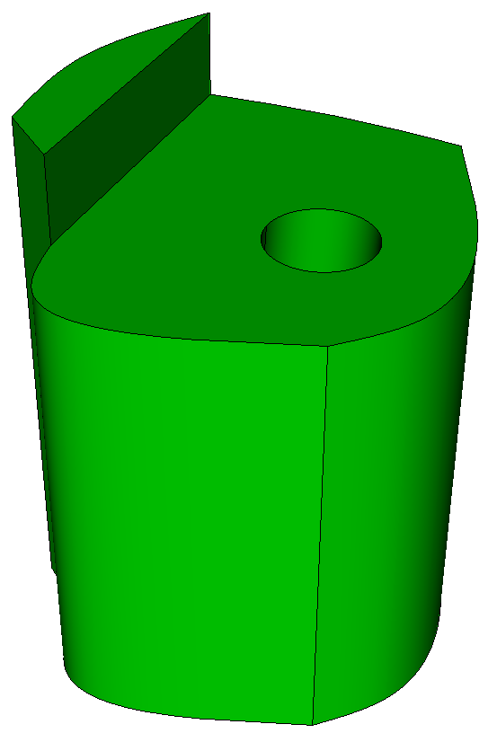
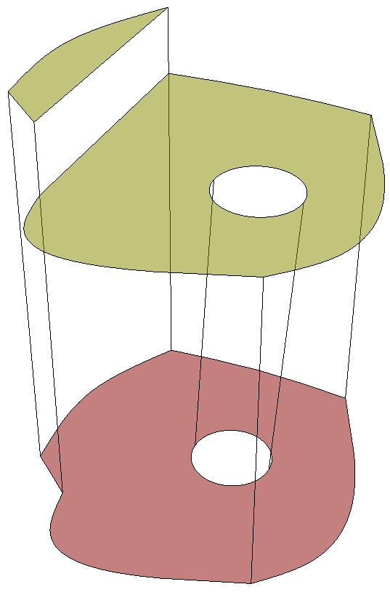
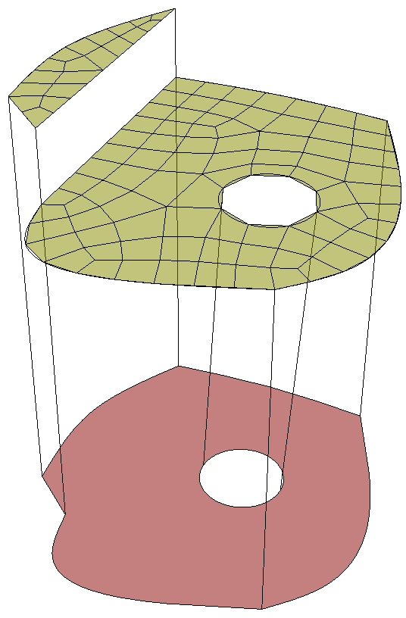
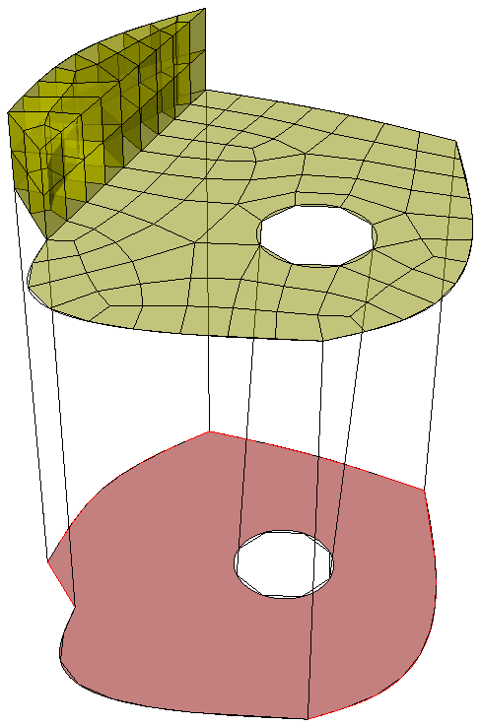
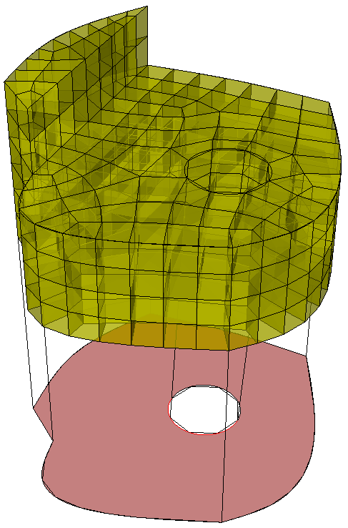
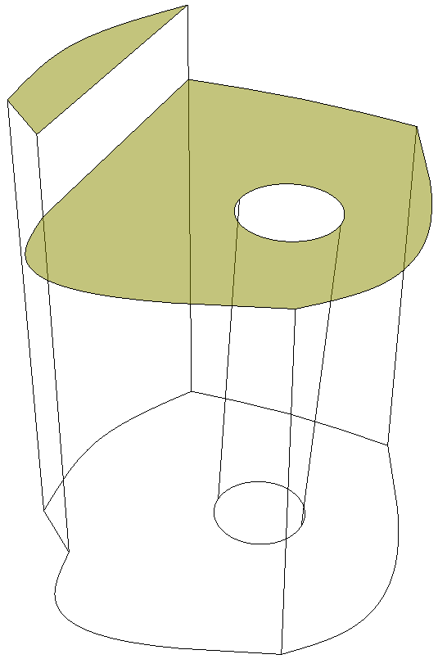
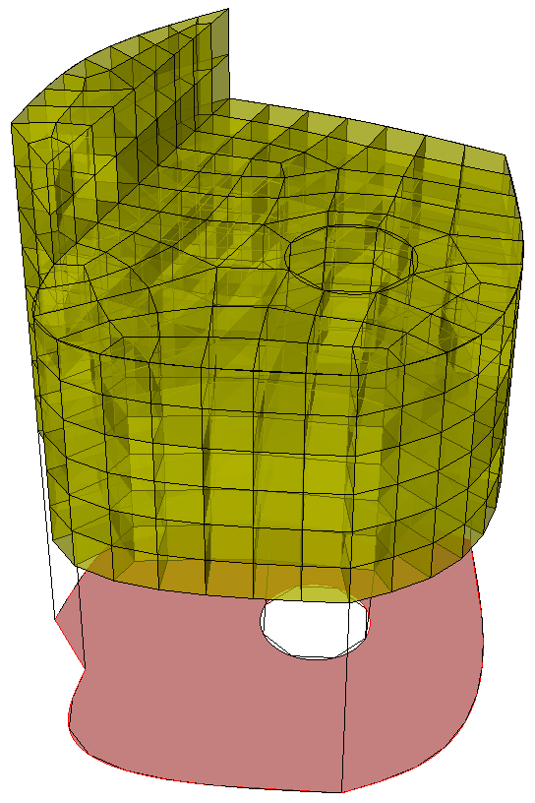
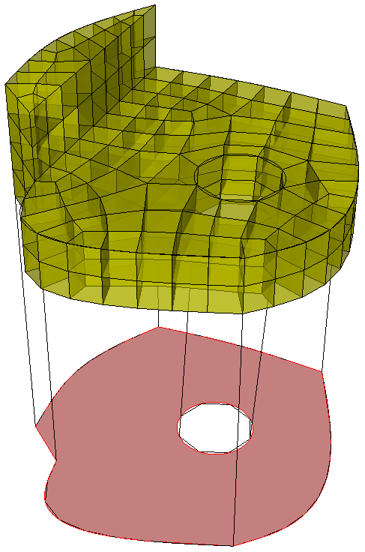
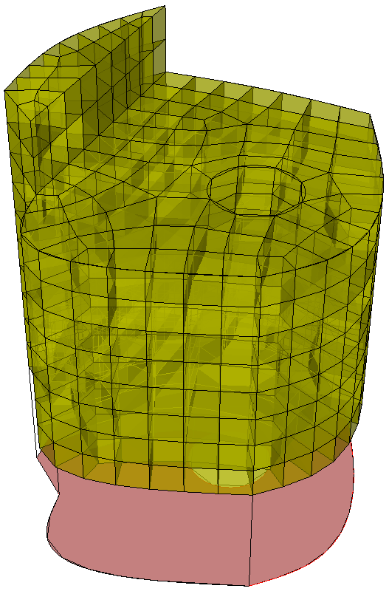
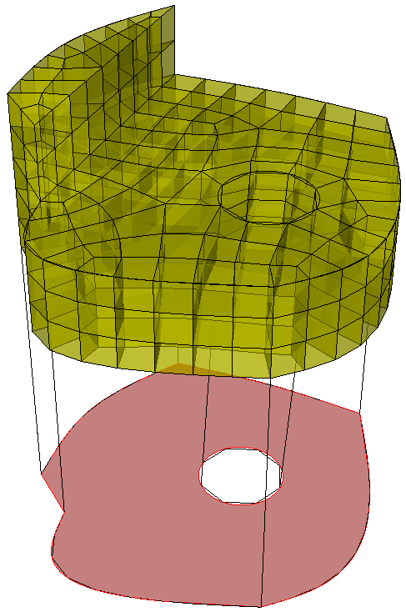
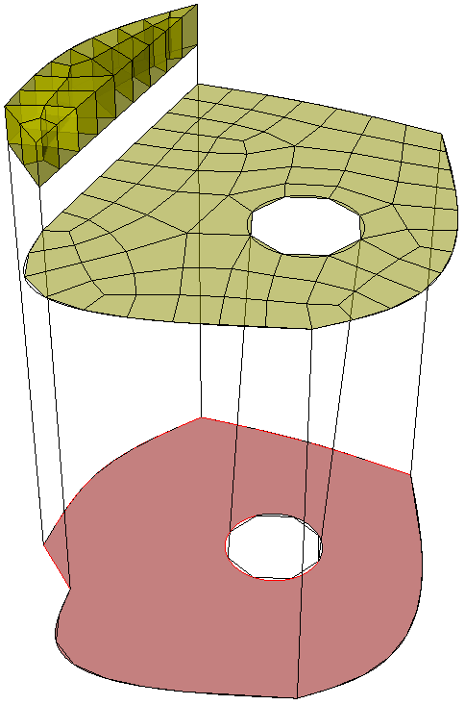
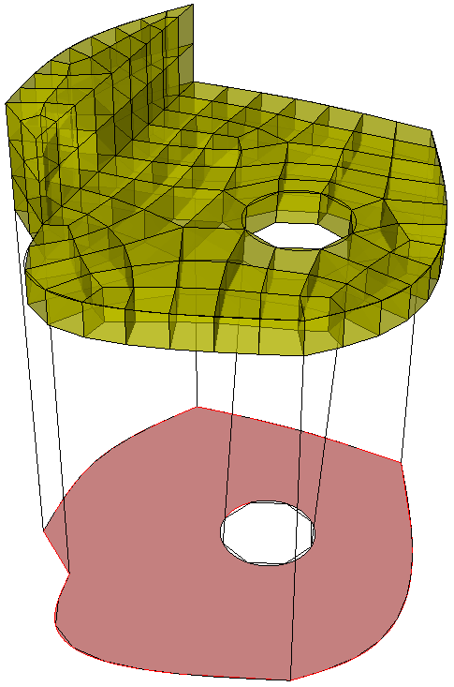
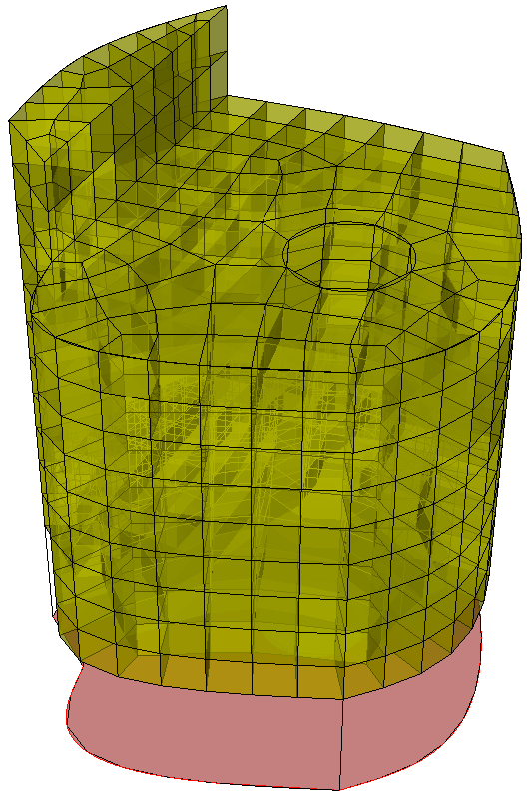
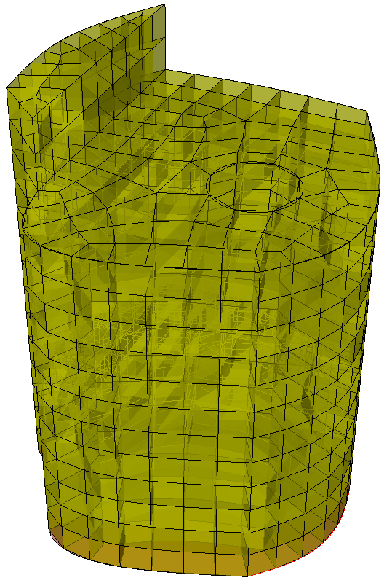
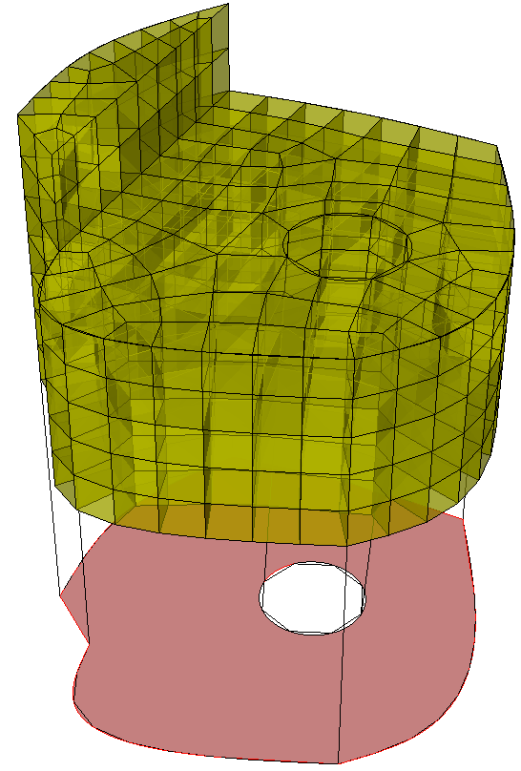
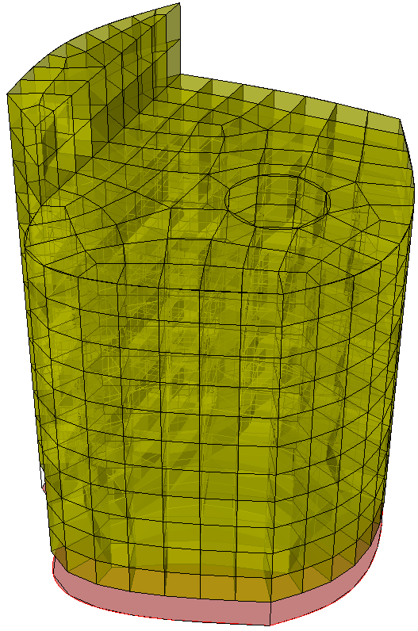
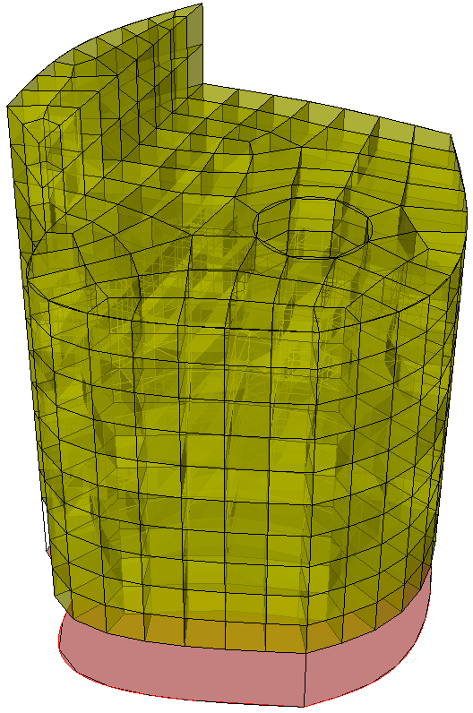
Sweep Scheme
Source Surfaces
One or more surfaces
Can be meshed with any Quad Scheme (Pave, Map)
Source surfaces
Source surfaces
Source surfaces
Source surfaces
Source surfaces
Source surfaces
Source surfaces
Source surfaces
Source surfaces
Source surfaces
Source surfaces
Source surfaces
Source surfaces
Source surfaces
Source surfaces
Source surfaces
Source surfaces
Target surface
Target surface
Target surface
Target surface
Target surface
Target surface
Target surface
Target surface
Target surface
Target surface
Target surface
Target surface
Target surface
Target surface
Target surface
Target Surface
Must be a single surface
Must be unmeshed
Matches topology of source surfaces
Target surface

Slide 4
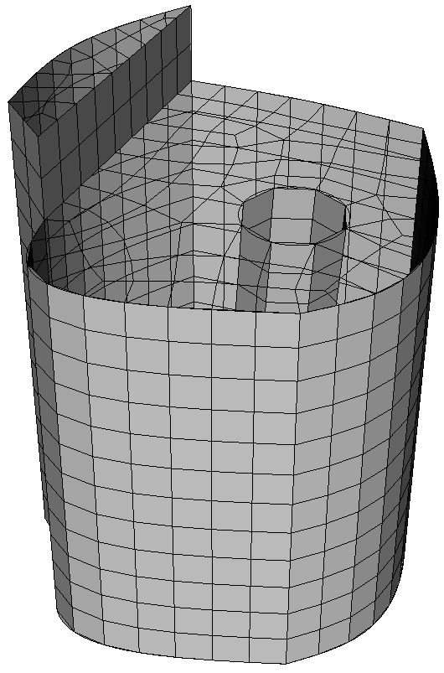
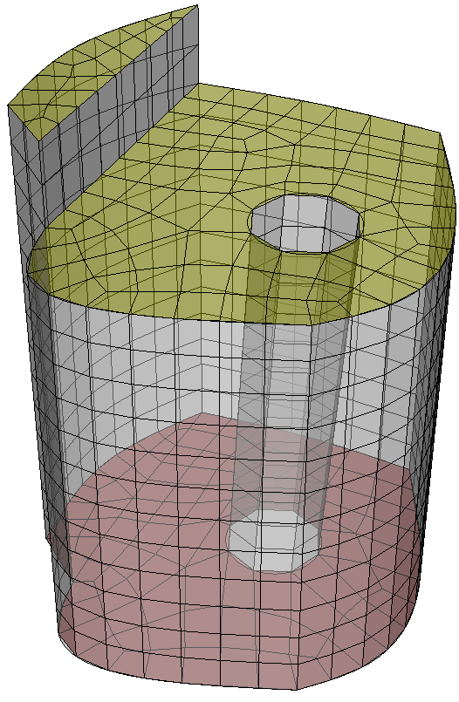
Sweep Scheme
Linking surfaces
Linking surfaces
Linking surfaces
Linking surfaces
Linking Surfaces
Must be “Mappable”
Connect Sources with Target

Slide 5
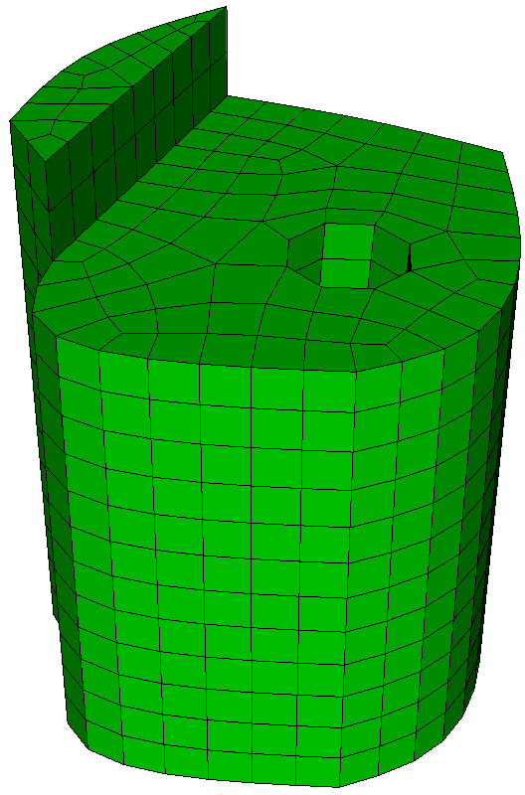
Sweep Scheme
Most frequently used meshing scheme
Normally requires geometry to be decomposed to apply sweeping (webcutting)

Slide 6
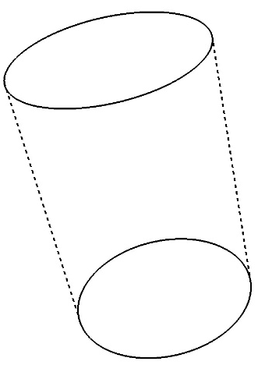
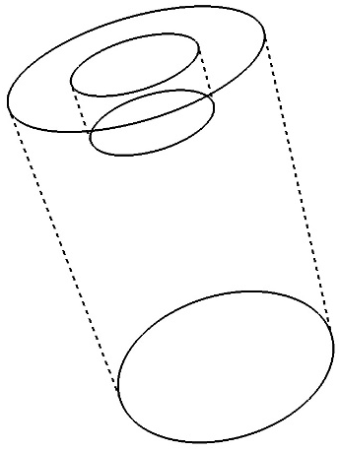
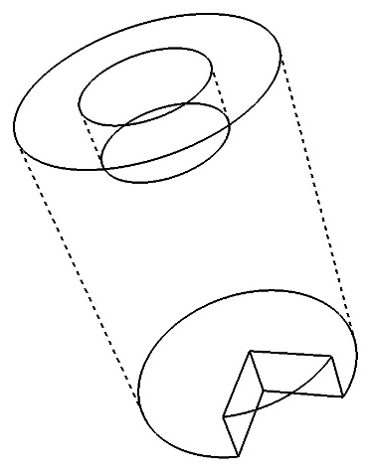
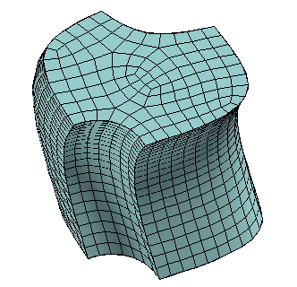
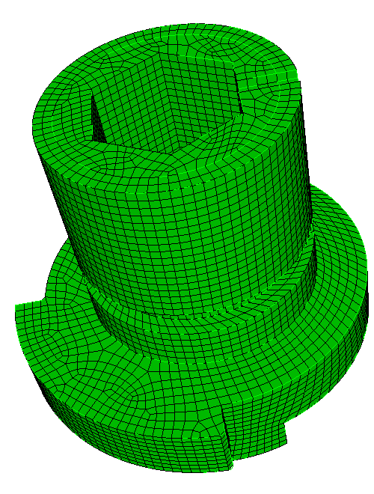
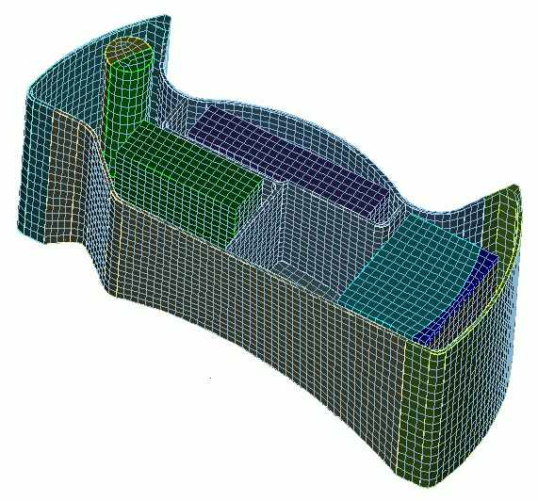
Sweep Scheme
One-to-one
Many-to-one
Many-to-many
Multiple
Sources
Multiple
Sources
Source
Sweep Direction
Sweep Direction
Sweep Direction
Target
Target
Multiple
Targets

Slide 7
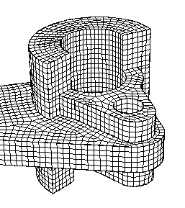
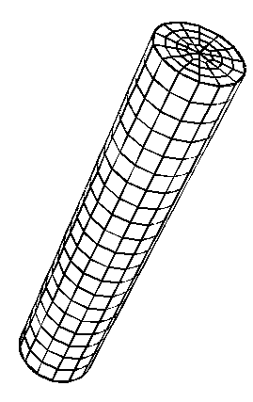
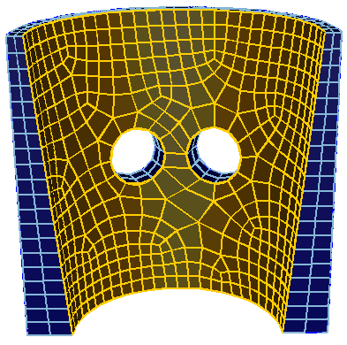
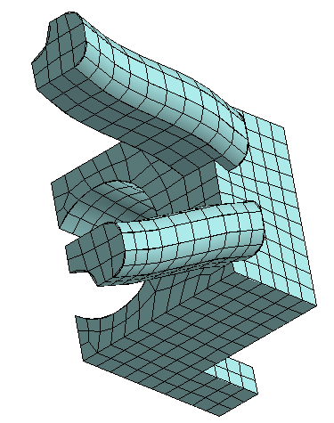
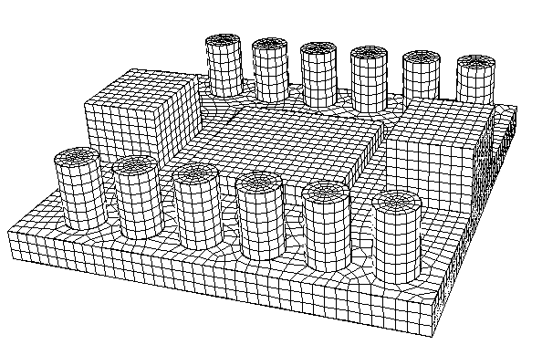
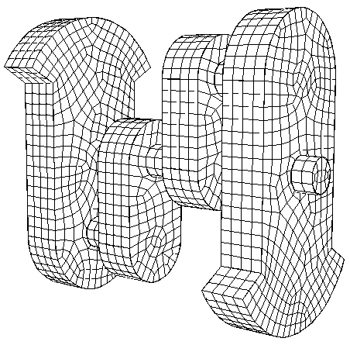
Sweep Scheme
What type of sweep scheme is used on each of these meshes?
One-to-one
One-to-one
Many-to-many
Many-to-many
Many-to-many
Many-to-one

Slide 8
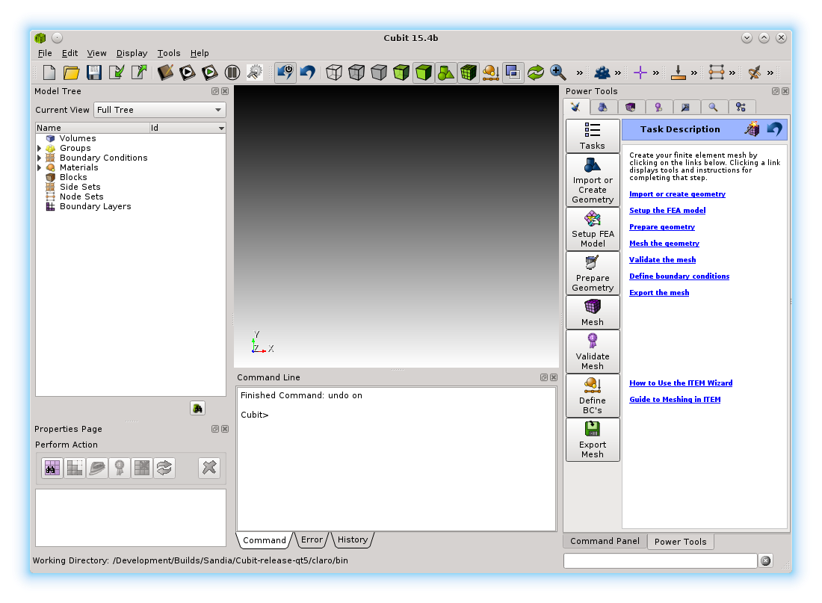
Meshing Power Tool
Mesh Power Tools are located on the Entity Tree window under the purple tab.

Slide 9
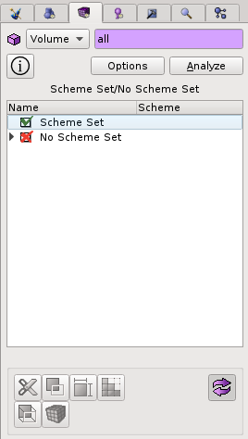
Meshing Power Tool
Helps identify volumes that
are sweepable and those
that are not
Entities to analyze
Run scheme analysis
Scheme analysis output
Tools for working on model

Slide 10
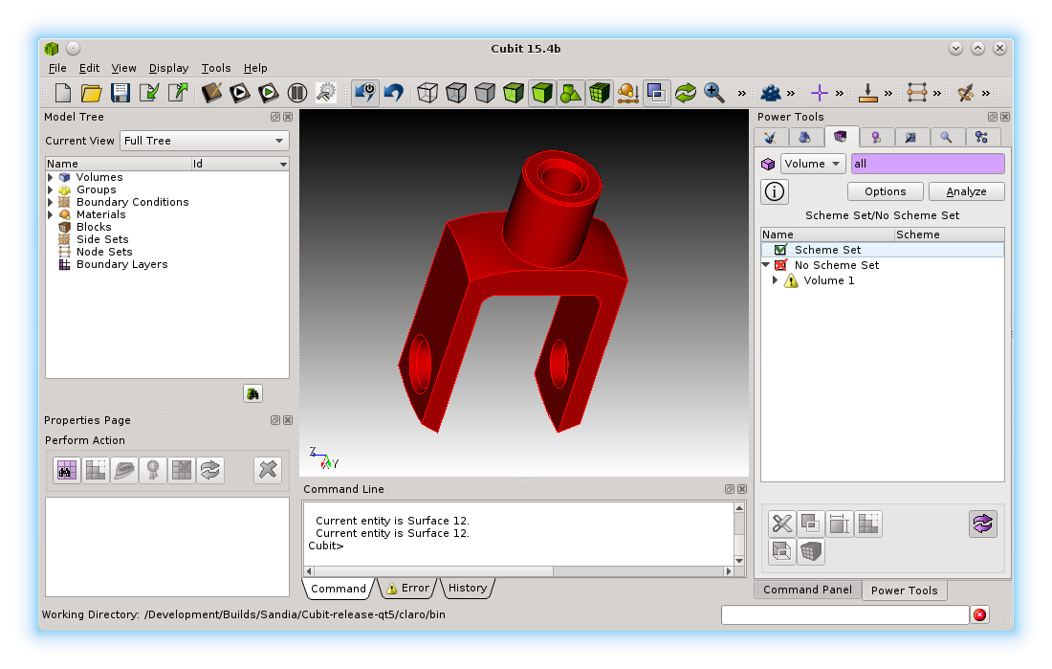
Meshing Power Tool Example
Run the mesh scheme analysis on knuckle.sat after cleaning up geometry but before doing any decomposition.
Volume 1 is painted Red, indicating no scheme set
Results are displayed in two ways
Listed in the power tool window
Displayed Graphically
Volume 1 listed under No Scheme Set

Slide 11
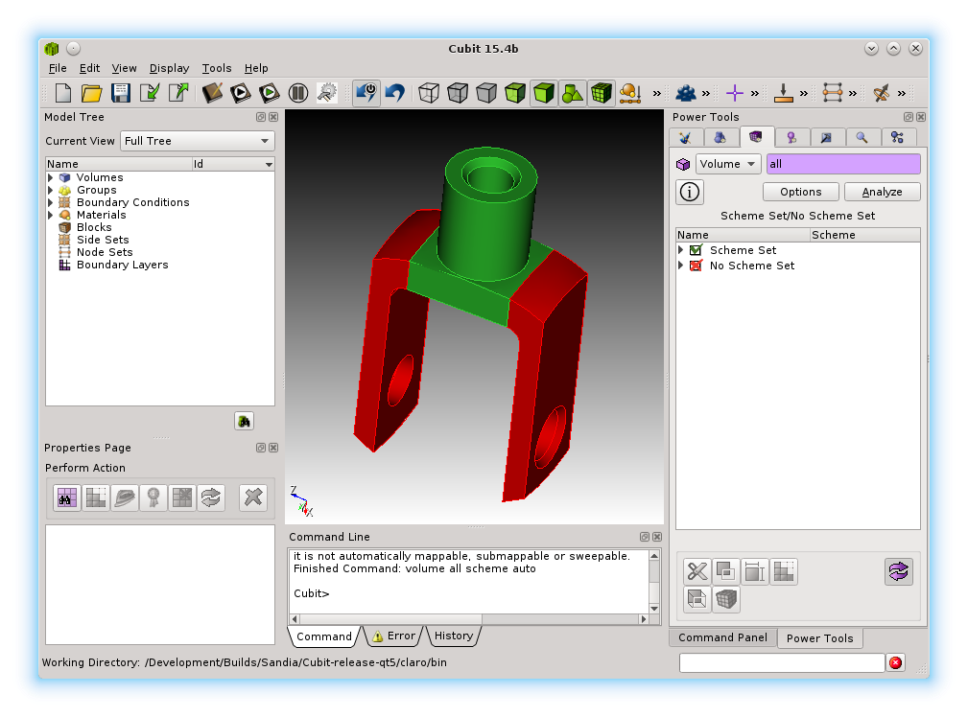
Meshing Power Tool Example
Perform webcuts as needed. After each webcut, run the analysis again to check meshability
Note when a volume moves to the Scheme Set category
Volumes where scheme is set are painted green

Slide 12
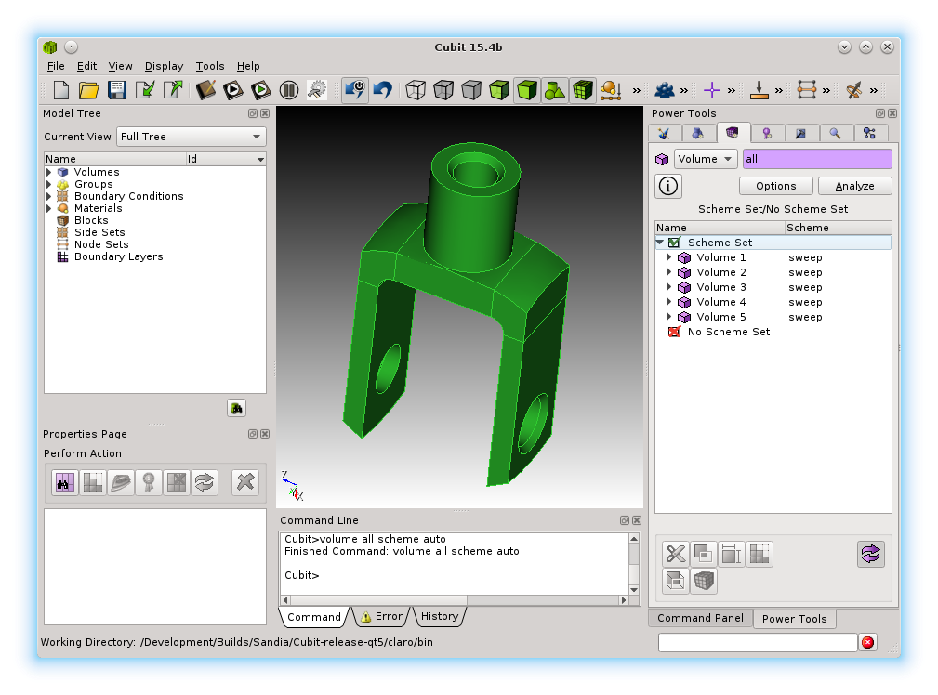
Meshing Power Tool Example
Complete the decomposition
Run imprint and merge
Run the analysis again
Mesh the parts
All volumes should be painted green if schemes successfully set
All volumes should be listed under Scheme Set

Slide 13
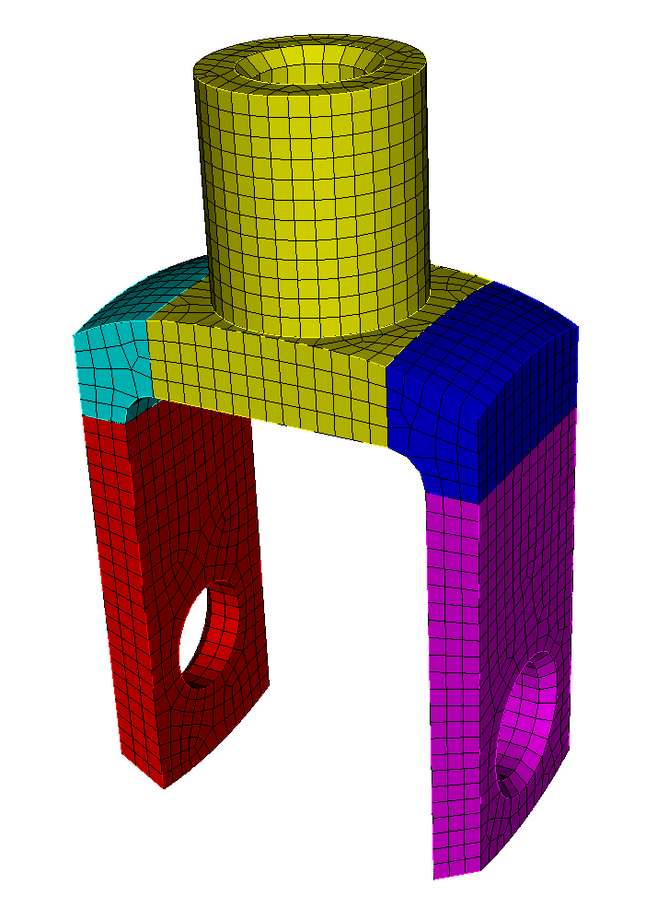
Exercise 10.1
Meshing Power Tool
1
Import acis “knuckle-defeatured.sat”
Use the meshing power tool to check meshability
Do 3 webcuts, check meshability after each
Imprint and merge
Mesh with hexes using size 1.5
2
3
webcut volume 1 with plane normal to curve 34 close_to vertex 30
webcut volume 2 with plane normal to curve 34 close_to vertex 31
webcut volume 1 3 with plane vertex 25 vertex 28 vertex 20
4
5

Slide 14
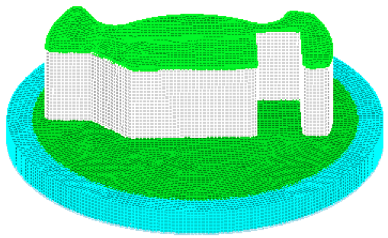
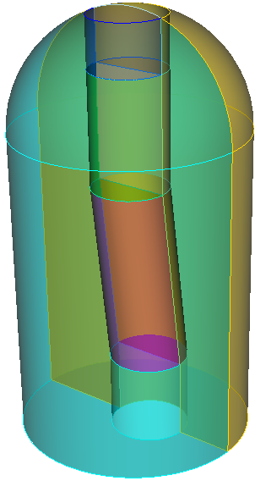
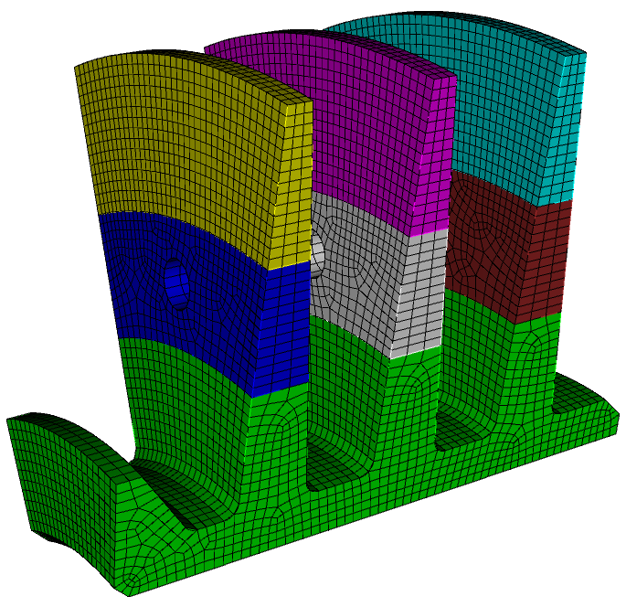




Common Techniques for Sweep Decomposition
Sweep Scheme
2.
1.
1. Find One-to-one: Locate the logical one-to-one and many-to-one sweep paths and webcut to isolate (see exercise 1 from fast-start 10)
3.
2. Coring: Core out the center of a cylindrical type object. Use a radial sweep and a top-to-bottom sweep (see exercise 2 from fast-start 10)
3. Multiple sweep directions: Cut to avoid features not in the sweep direction
4.
4. Graded Meshes with pave-sweep: Cut multiple times in direction of grade. Alternate pave-sweep directions
5. Midpoint Subdivision: Cut volumes so the polyhedron scheme can be used
6.
6. Modify surfaces with tweak and composite tools to make volumes sweepable
5.

Slide 15




Exercise 10.2
Webcut many-to-many sweeps
Mesh the geometry in the file example01.sat with a contiguous all-hex mesh.
Use a mesh size of 0.15
Hints:
Examine sweepability of all volumes. Is there a many-to-many sweep volume?
Don’t forget to imprint and merge
This assembly can be meshed with as little as 1 webcut
CUBIT> webcut volume 5 with sheet extended from surface 70
CUBIT> imprint all
CUBIT> merge all
CUBIT> volume all size 0.15
CUBIT> volume all scheme auto
webcut volume 5 with sheet extended from surface 70

Slide 16



One-to-one sweeping
Typical one-to-one sweeps
translation
rotation
inside-out

Slide 17





Tool Volume Webcut
Decomposition may require creation of a temporary tool volume to aid in cutting the geometry
A Tool volume is first created and used to webcut the volume
A
B
A lofted volume is first created between surface A and B and used as a Tool to cut the volume

Slide 18


Exercise 10.3
Coring
Mesh the geometry in the file example04.sat with a contiguous all-hex mesh.
Use a mesh size of 0.15
Hints:
Consider a coring approach: Sweep radially around the outside and top to bottom on the interior core.
Consider creating a tool volume using the loft option for creating volumes to create the core
Remember to delete the tool volume afterward webcutting
Use a sweep surface webcut to extend the core to the top
Split the volumes along a symmetry plane to permit the radial sweep.
Remember to imprint and merge!

Slide 19


Multiple Sweep Directions
sweep direction
source
target

Slide 20

Multiple Sweep Directions
sweep direction
source
target
One-to-one sweep
“Easy” to mesh

Slide 21


Multiple Sweep Directions
sweep direction
source
target
What do we do now?

Slide 22


Multiple Sweep Directions
sweep direction
webcut
webcut
sweep direction
sweep direction
sweep
direction
Cut around the feature that is stopping us from sweeping
sweep direction
In this case we have used the webcut with cylinder tool

Slide 23


Multiple Sweep Directions
Resulting mesh with 2 sweep directions

Slide 24

Exercise 10.4
Multiple Sweep Directions
Import the model “blades2.sat”
Generate a mesh with a size of about 2.0
Hint: Use the webcut with cylinder operation to cut out the features that don’t line up with the principal sweep direction

Slide 25


Creating a Graded Mesh
8
How to generate a graded mesh using sweeping
Coarse Mesh
Sweep Direction
8
32
Sweeping requires a constant number of elements through the entire sweep direction
Fine Mesh
32
But Paving can provide a way to transition the mesh. (However paving is only a 2D procedure)
16
8

Slide 26

Creating a Graded Mesh
8
How to generate a mesh using sweeping
Coarse Mesh
8
32
Fine Mesh
32
Webcut the model multiple times along the direction from fine to coarse

Slide 27

Creating a Graded Mesh
8
How to generate a mesh using sweeping
16
16
Coarse Mesh
32
8
8
32
16
16
Fine Mesh
32
Set up alternating matched intervals on curves

Slide 28
Creating a Graded Mesh
8
How to generate a mesh using sweeping
16
Pave
Sweep
16
Coarse Mesh
Pave
Sweep
8
32
Pave
Sweep
8
32
Sweep
16
16
Pave
Fine Mesh
32
Alternate pave and sweep directions in each volume

Slide 29


Exercise 10.5
Graded Mesh
vol 2 size 1
Import the model “blades1.sat” and generate a graded mesh. Try grading the mesh from a mesh size of 1.0 to 5.0 as shown here
curve 149 size 1
surface 71 scheme pave
Size = 1.0
Hints:
Use the graded mesh procedure described in the previous slides.
Use the webcut with cylinder operation to cut the geometry.
Try the curve biasing tools to improve the mesh size grading
Try using the “copy mesh” scheme to avoid having to set up the intervals for each paved mesh.
vol 1 size 5
Note: When defining bias, use first size and last size. (in command panel first = fine (1.0), last = coarse (5.0))
Size = 5.0

Slide 30


Midpoint Subdivision
3D Midpoint subdision
Requires 3-valent vertices and
convex polyhedron

Slide 31


Midpoint Subdivision
All surfaces must be convex

Slide 32




Midpoint Subdivision
CUBIT™ will subdivide the geometry into logical mapped regions

Slide 33






Midpoint Subdivision
A mapped mesh will be applied to each logical region

Slide 34


Exercise 10.6
Midpoint Subdivision
Create a cubit model using the following commands
sphere radius 10
brick x 50
subtract vol 1 from vol 2 keep
delete vol 2
compress all
Mesh the two volumes with a size of 1.0. Make sure the mesh matches between the volumes
Hints: Try cutting the volumes on the 3 coordinate axis. This should result in 16 volumes. You should be able to mesh each of the volumes with scheme Polyhedron. You may want to simplify the model and work on one quadrant, and then use copy/reflect for the other quadrants.

Slide 35








Surface Geometry Tools
CUBIT™ includes several tools to modify the surface geometry.
Tools can be used to enforce source-link-target topology for sweeping
Composite
surfaces
Surface Context Menu
Surface Modify Command Panels
Split surfaces
Remove surfaces

Slide 36



Remove Surface
Use CUBIT™’s remove surface command to remove and extend the neighboring surfaces
Sweep direction
Surface Context Menu
(Select a surface – right click)
Remove Surface Command Panel

Slide 37





Splitting Surfaces
Mesh the existing topology gives a poor quality mesh
By splitting the surface and then using virtual geometry will result in a higher quality mesh

Slide 38
Splitting Surfaces
Sweep direction
Sweep direction
Watch quality!
fillet splits
Sweep direction

Slide 39


Splitting Surfaces
Use CUBIT™’s split surface command to split fillets down the axis of the fillet
Choose split method (along fillet)
Select surfaces to split
Preview/Apply

Slide 40




Composite Surfaces
Virtual Geometry is most often used to cover a set of surfaces which normally prevent the volume from being swept.
Sweep direction
Surface Context Menu
(Select two or more
surfaces – right click)
This surface is now mappable and can be used as a linking surface.
Note this is a virtual geometry operation

Slide 41




Composite Surfaces
Use this button to toggle the dotted line display on virtual composite surfaces
Removing Composites
Surface Context Menu
(Select a composite
surface – right click)
Use Delete toggle to remove virtual
Notice a (v) displayed next to virtual surfaces in the model tree

Slide 42


Exercise 10.7
Splits and Composites
Mesh the geometry in the file Mbracket.sat with an all-hex mesh. Use a mesh size of about 0.3
Hints:
Consider surface modification to improve mesh quality. Try split surface and composite operations
Decompostion for sweeping may require multiple sweep directions
At least one of your decomposed volumes should not be sweepable. Try the polyhedron scheme
Even though your topology following split/composite is sweepable, CUBIT™ may not recognize it as such. You may need to explicitly set source and target surfaces.

