Slide 1
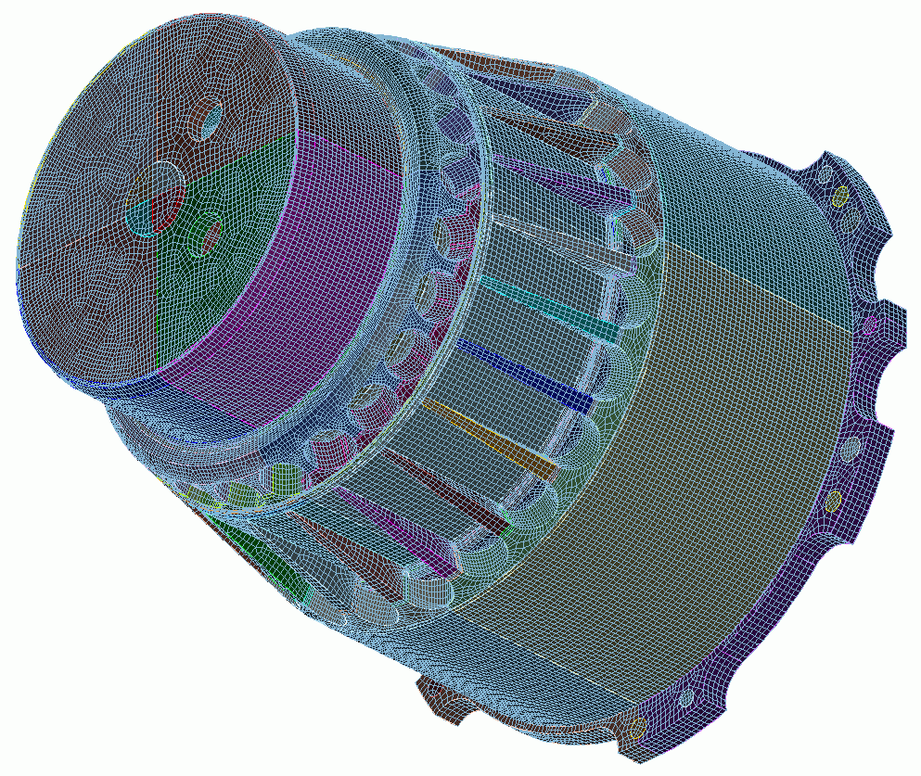
Mesh Sizing
9
CUBIT
Geometry and
Mesh Generation Toolkit
CUBIT™ 200 Tutorials
Steven Owen
SAND2022-15142 PE

Slide 2
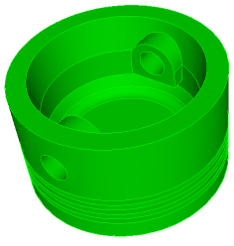
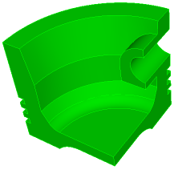
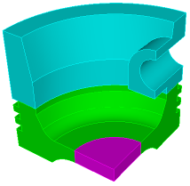
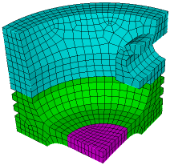
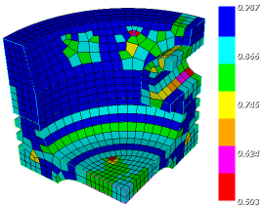
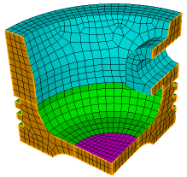
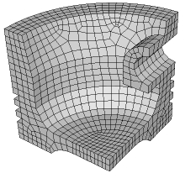
The Basic CUBIT™ Process
1
2
3
Import Solid Model
Simplify Geometry
Decompose Geometry
4
5
6
Imprint & Merge
Set Schemes
& Intervals
Mesh
7
8
9
Check
Quality
Apply B.C.s
Export
Mesh

Slide 3
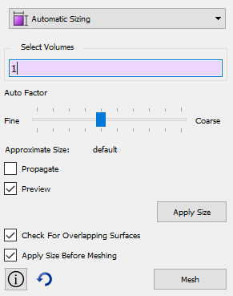
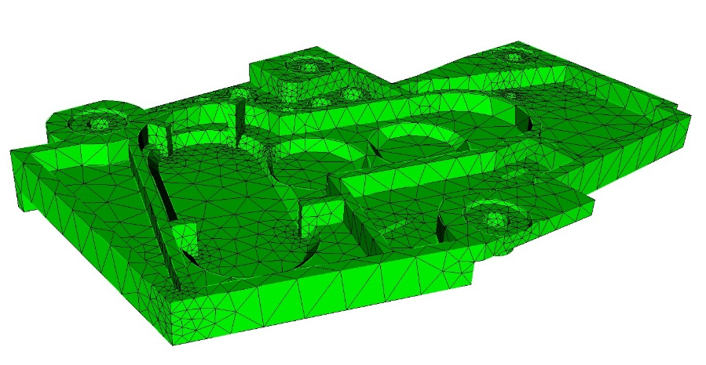
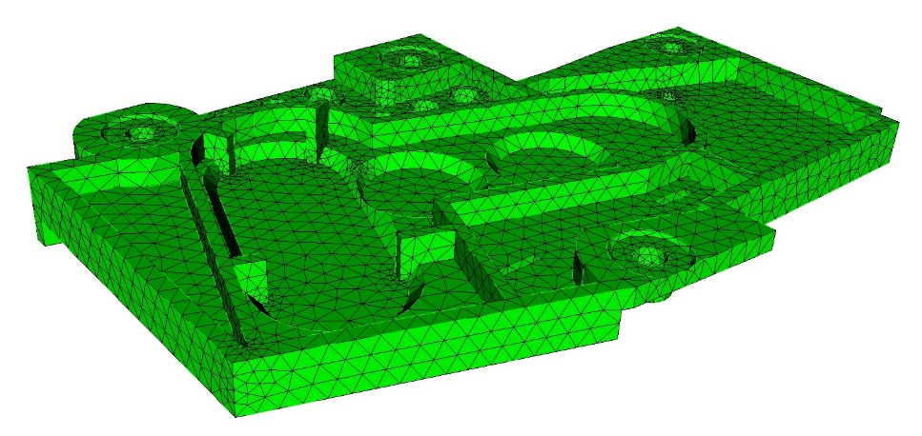
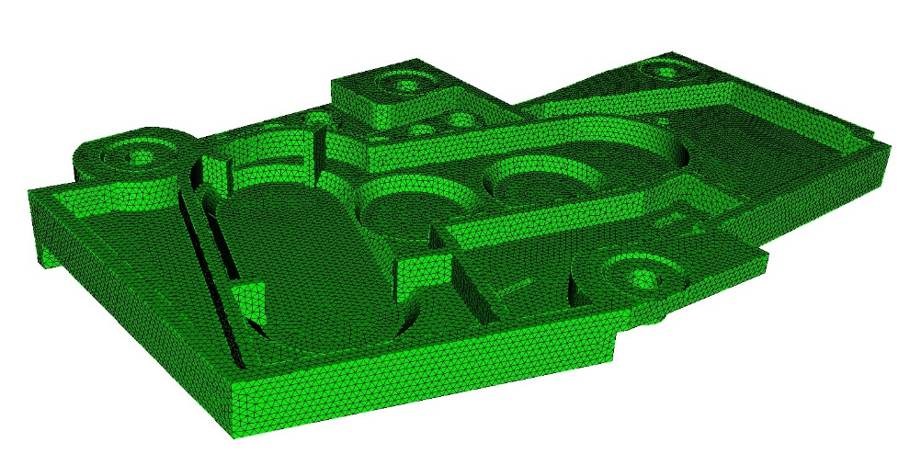
Auto Mesh Sizing
Move slider to see preview of mesh on curves
Auto size = 7
No need to know exact size of elements
Auto size = 5
Uses heuristic to compute size of element
If no size has been set, CUBIT™ will compute an auto mesh size=5
Auto size = 1

Slide 4
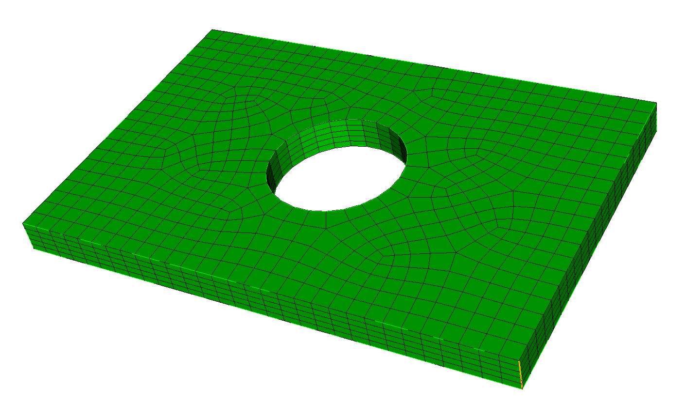
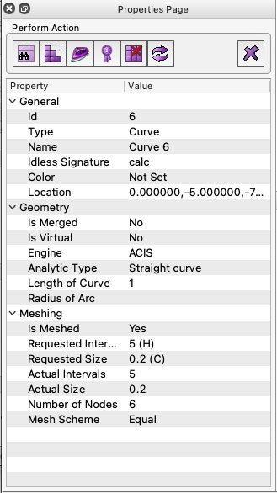
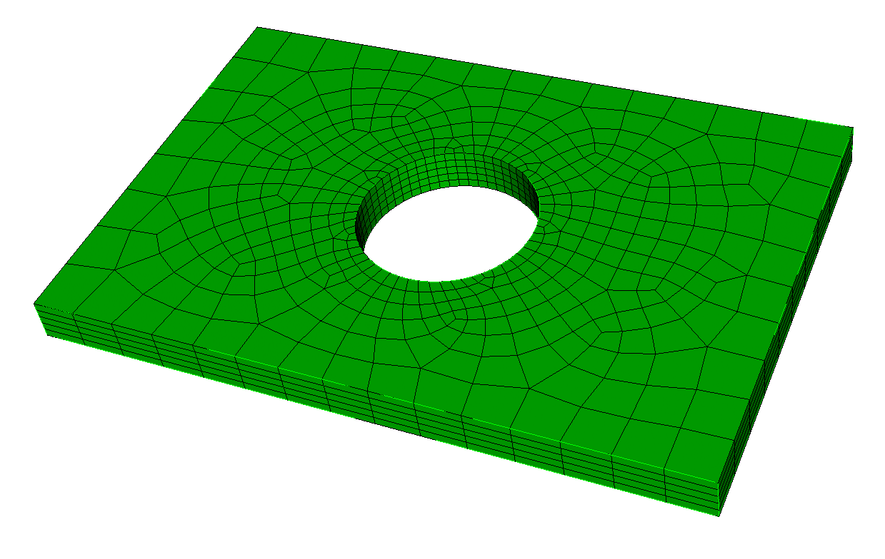
Curve Mesh Sizing
reset curve
curve 6
curve 14
curve 3
curve 1
curve 7
curve 12
curve 6
import acis "plate-with-hole.sat"
curve 6 interval 5
mesh vol 1
delete mesh
curve 1 size 0.1
curve 3 7 12 14 size 2
curve 6 int 5
mesh vol 1
Mesh size and interval is an “attribute” of the curve
Remains persistent unless reset

Slide 5
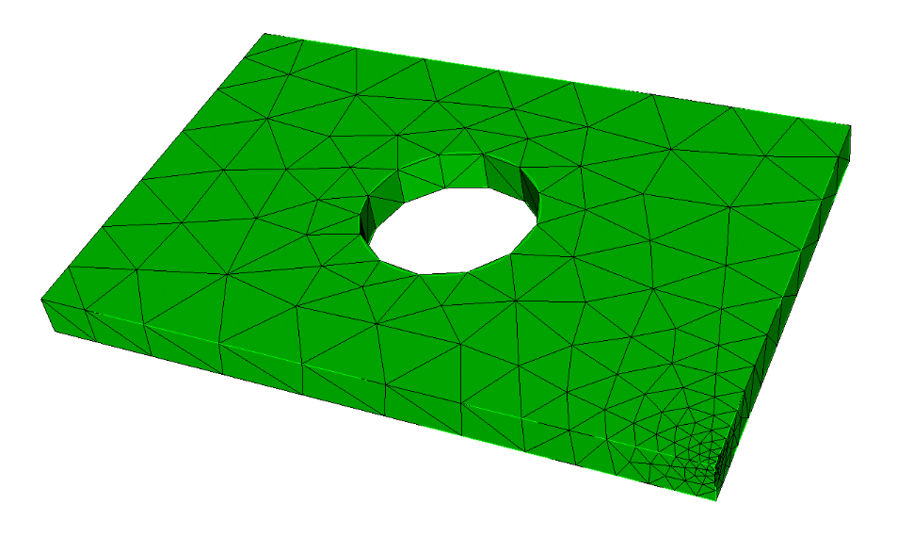
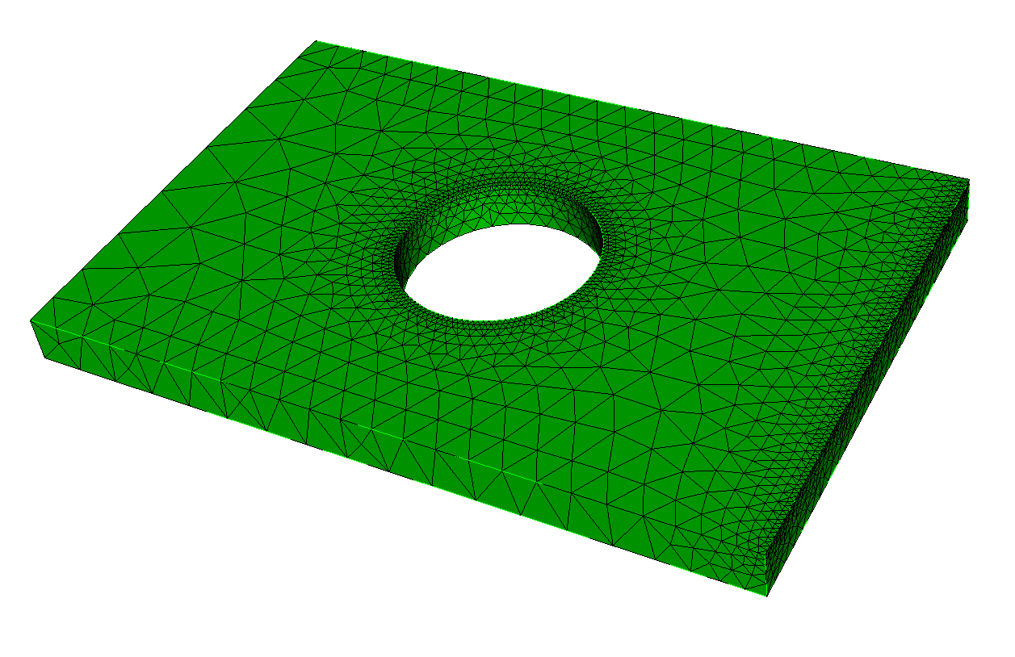
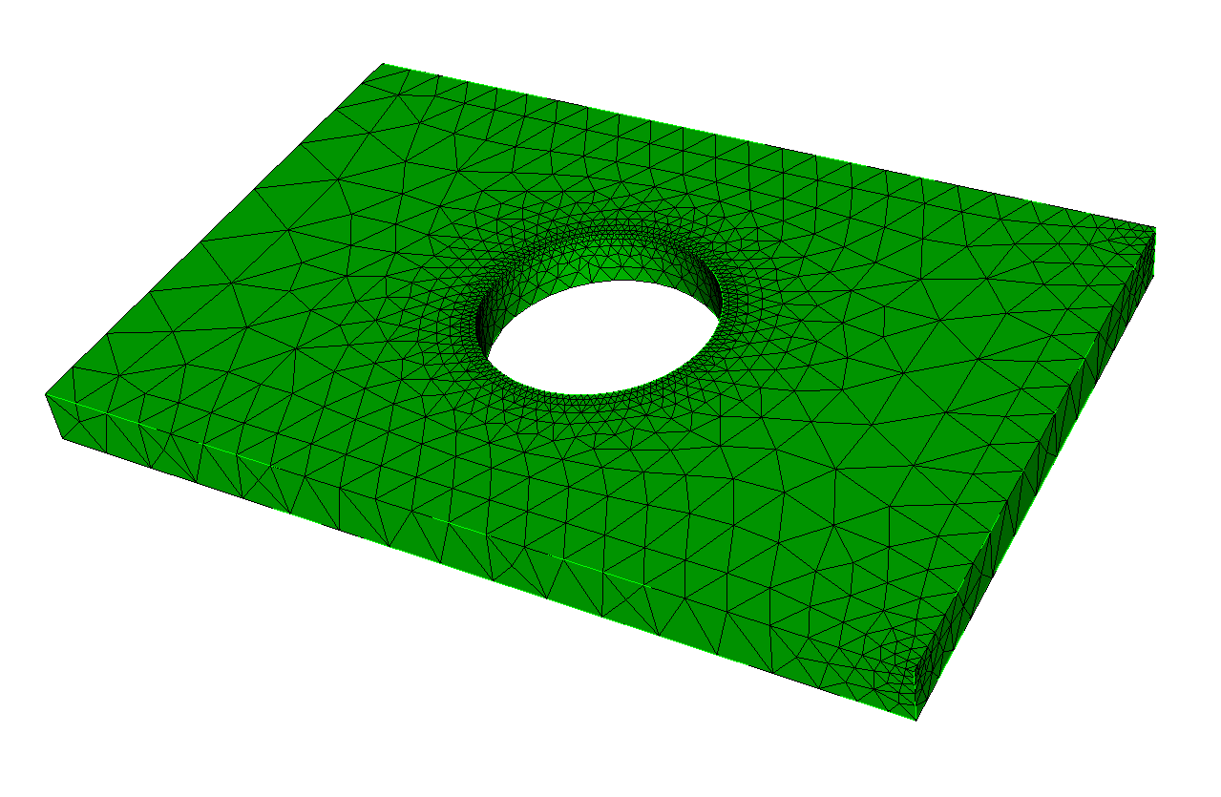
Vertex Mesh Sizing
vertex 7
curve 1
curve 7
vertex 8
vertex 8
reset vol 1
vertex 8 size 0.1
vol 1 size 2
vol 1 scheme tetmesh
mesh vol 1
delete mesh
vertex 7 size 0.1
curve 1 size 0.1
mesh vol 1
delete mesh
curve 7 size 2
mesh vol 1
Vertex sizing can be used with tri and tet meshing (not quad or hex meshing)

Slide 6
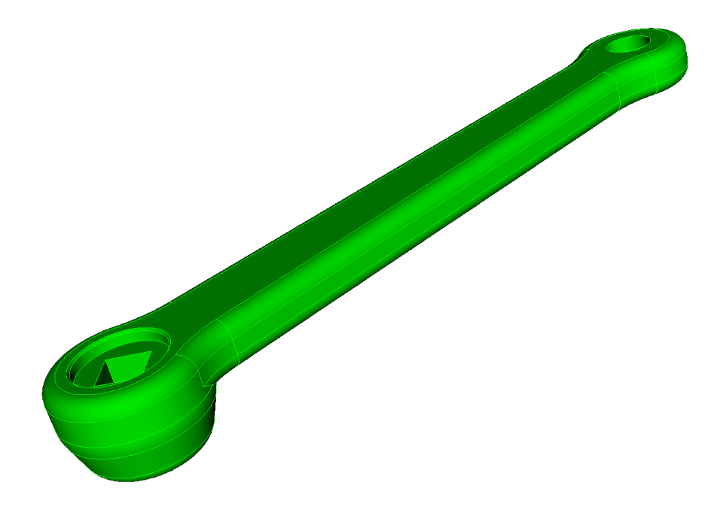
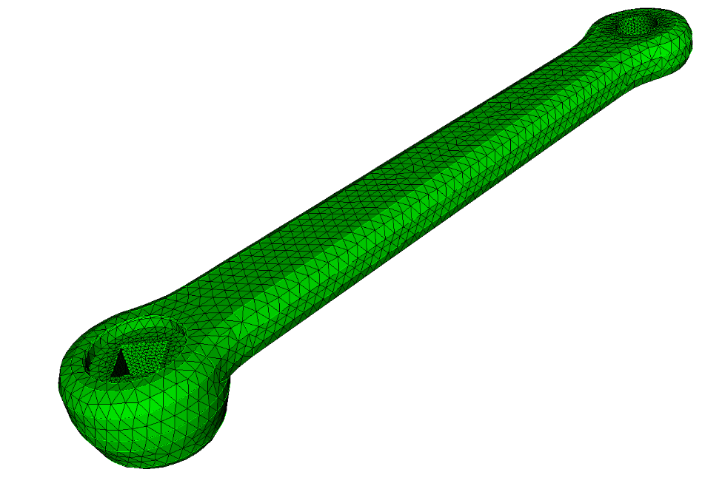
Exercise 9.1 Geometry Entity Mesh Sizing
surface 9
1
Import acis “crank.sat”
2
Set scheme to tetmesh
surface 5,6,7,8
3
Mesh using auto sizing to mesh at finest resolution (factor 1)
4
Mesh using auto sizing to coarsest resolution (factor 10)
5
Set internal hole surfaces (5 6 7 8 9) to 1 and the volume to size 3 and mesh

Slide 7
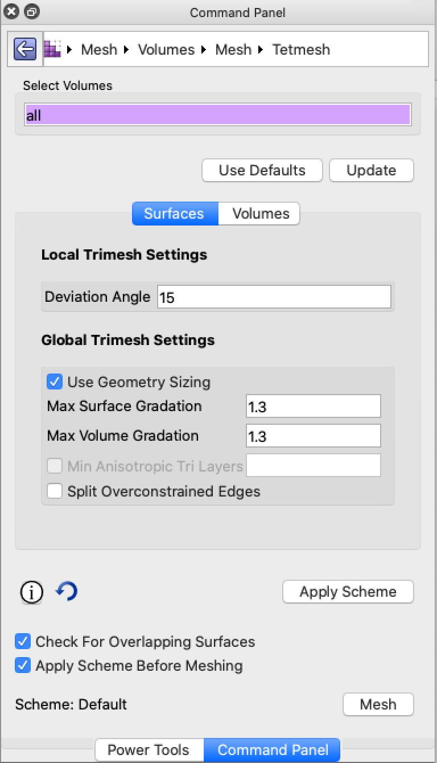
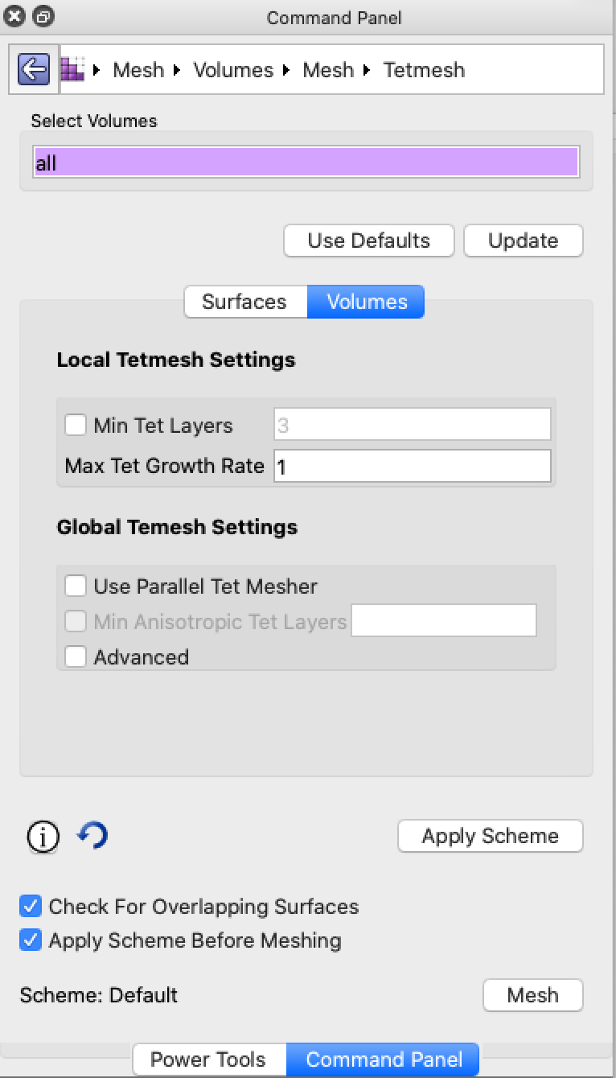
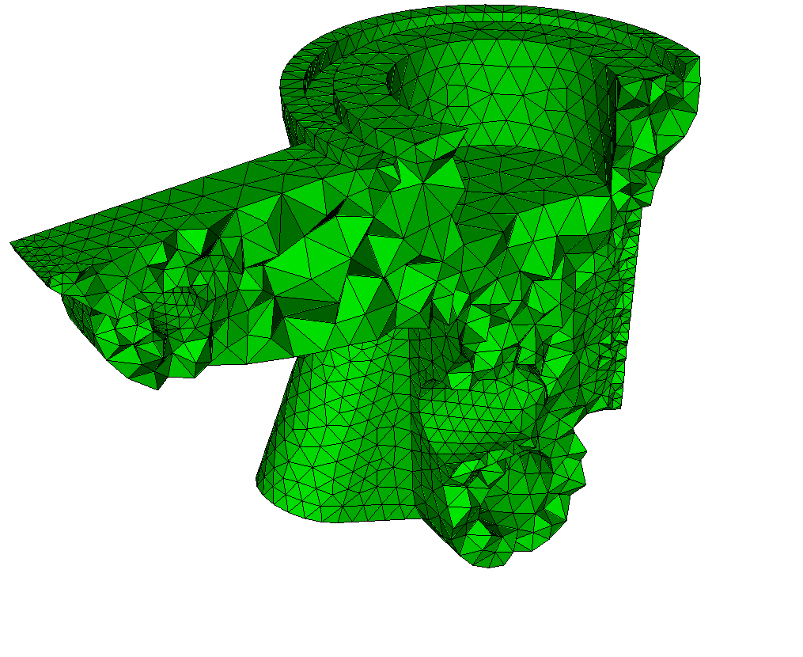
Tetmesh Scheme
Surface Controls: Shape and size of triangles at the boundaries
Use Default: Change all selected volumes to default settings
Update: View all current settings for selected volumes
Local Settings: Attribute can be different for each volumes
Global Settings: Attribute is the same for all volumes
Volume Controls: Shape and size of tets on the interior
Tetmesh Controls on Surfaces
Tetmesh Controls in Volumes

Slide 8
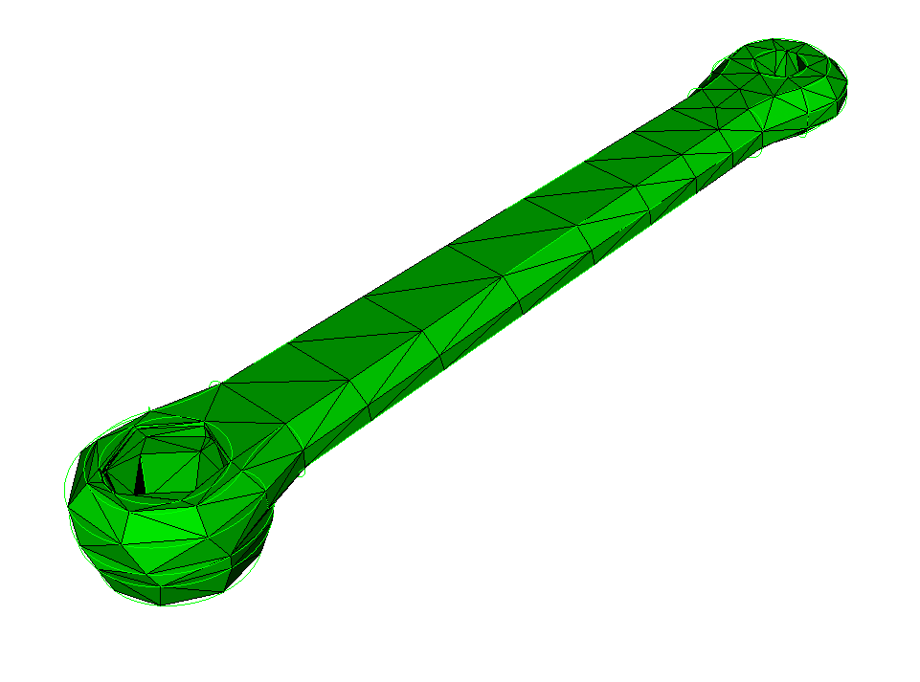
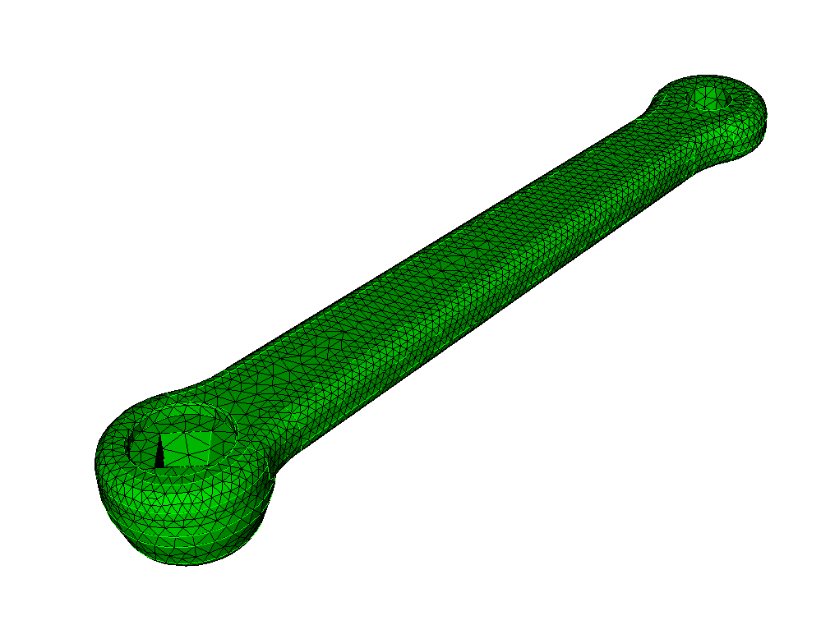
Tetmesh Scheme
Surface Controls
Geometry Sizing:
Uses Geometry characteristics to limit size (over-rides entity sizes)
ON by default
reset
set trimesher geometry sizing off
import acis "crank.sat"
vol 1 scheme tetmesh
vol 1 size auto factor 10
mesh vol 1
Geometry sizing OFF
Geometry sizing ON
delete mesh
set trimesher geometry sizing on
mesh vol 1

Slide 9
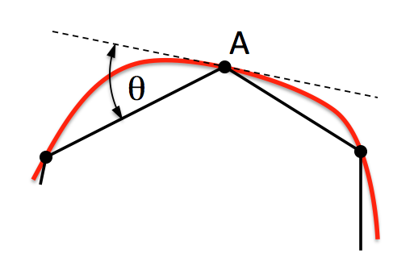
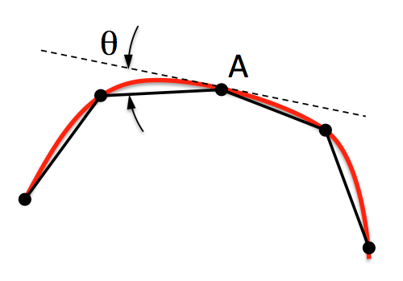
Tetmesh Scheme
Surface Controls
Deviation Angle
Deviation Angle
Deviation Angle (Geometry Approximation Angle)

Slide 10
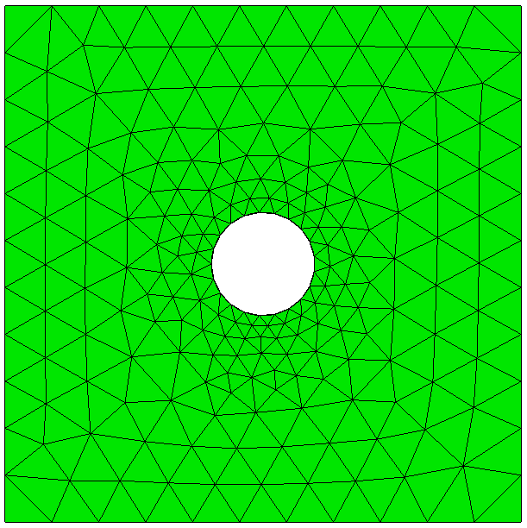
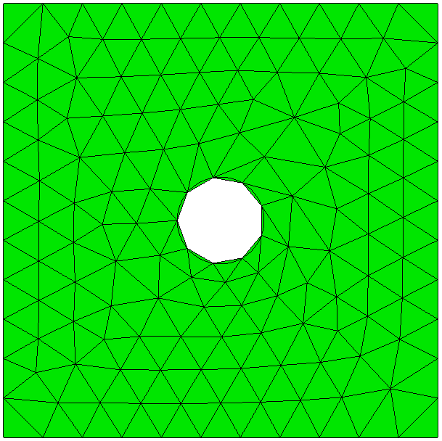
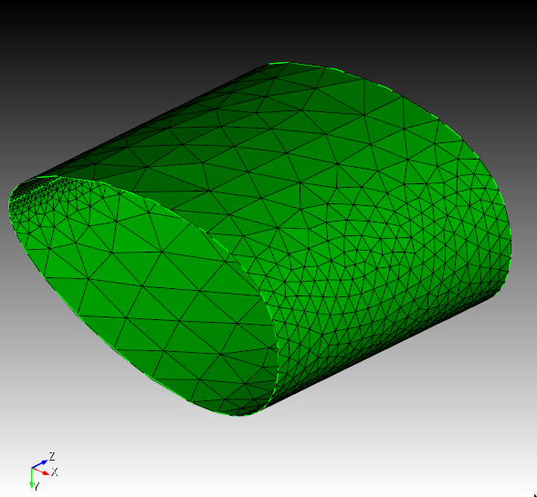
Tetmesh Scheme
Surface Controls
Deviation Angle (Geometry Approximation Angle)

Slide 11
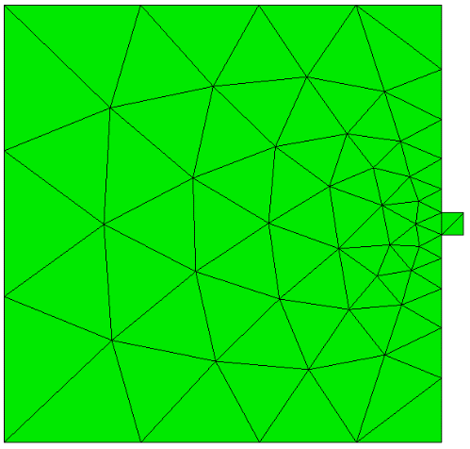
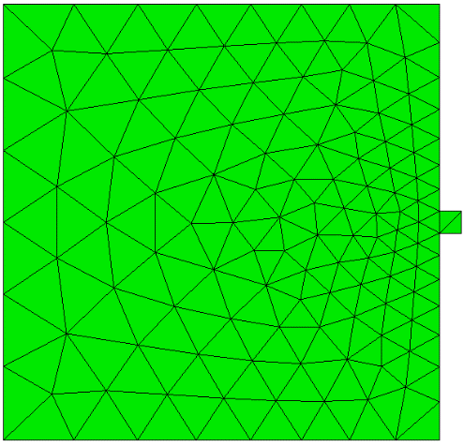
Tetmesh Scheme
Surface Controls
Maximum Surface Gradation:
Controls maximum change in triangle sizes from features on the same surface
1.3
1.1

Slide 12
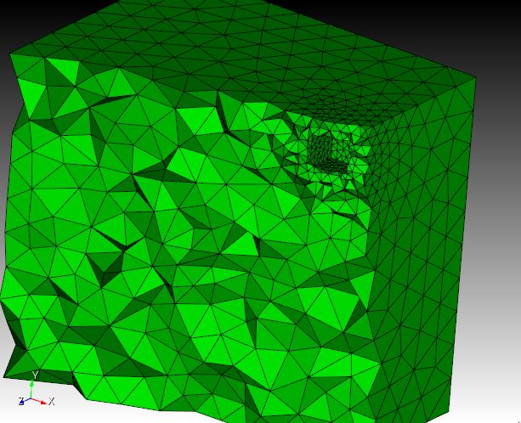
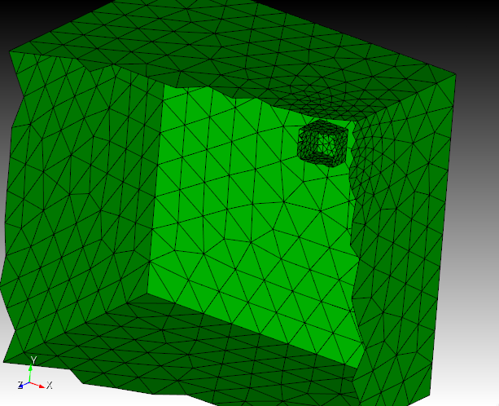
Tetmesh Scheme
Surface Controls
Maximum Volume Gradation:
Controls maximum change in triangle sizes based in features on other nearby surfaces (proximity)

Slide 13
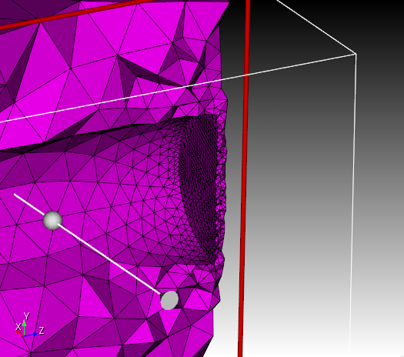
Tetmesh Scheme
Volume Controls
Min Tet Layers: Minimum number of tets in narrow regions

Slide 14
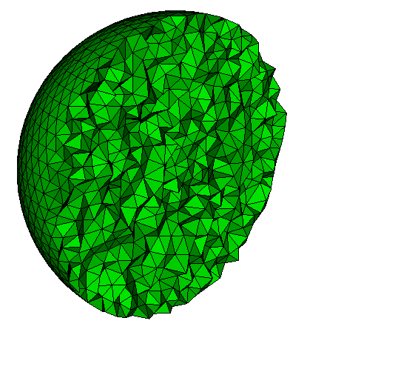
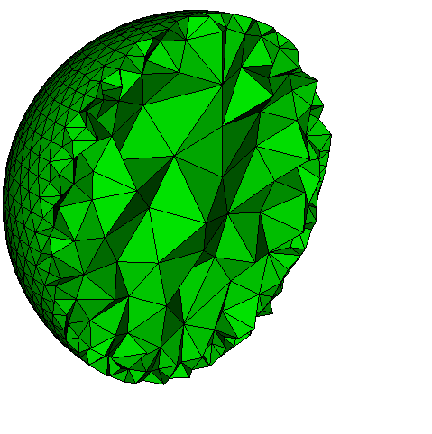
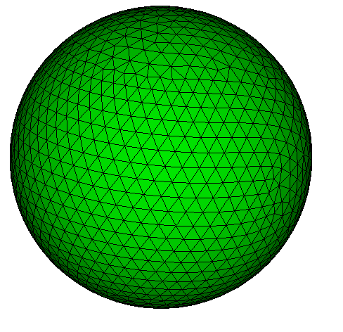
Tetmesh Scheme
Volume Controls
1.0
1.3
Max Tet Growth Ratio: Tets increase in size from boundaries at this rate

Slide 15
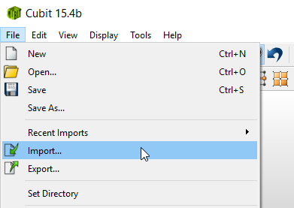
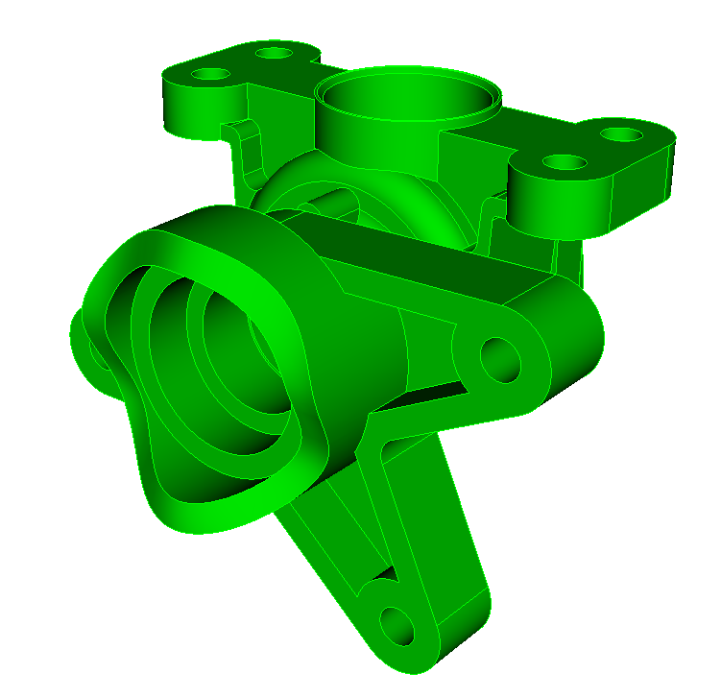
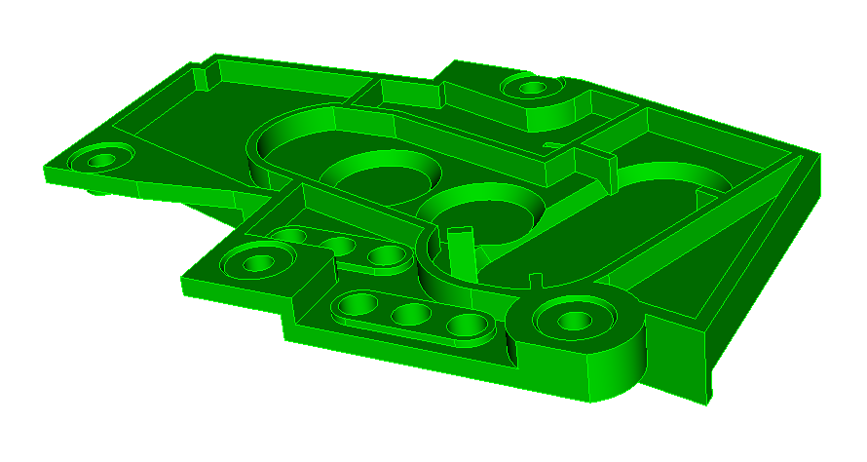
Exercise 9.2 Tetmesh Sizing
1
Import ACIS file driver.sat, cad6.sat OR crank.sat
Import model
1
cad6.sat
driver.sat
crank.sat
2
Set scheme to tetmesh and mesh with default size

Slide 16
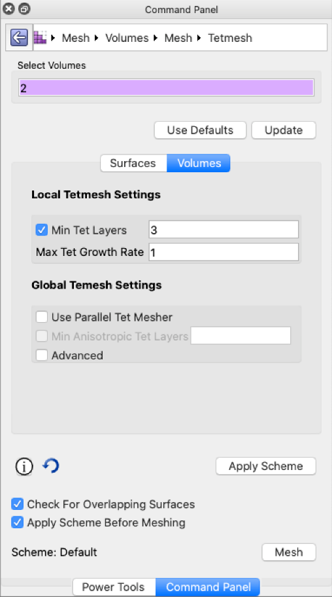
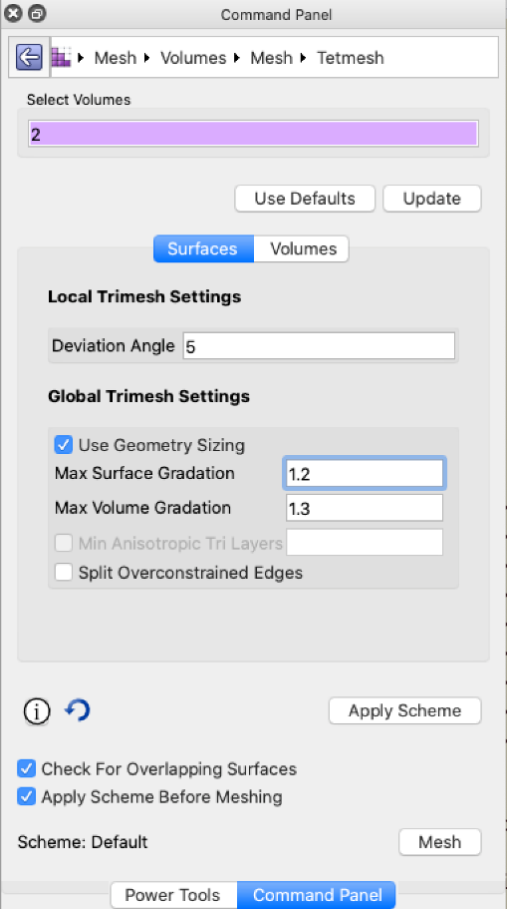
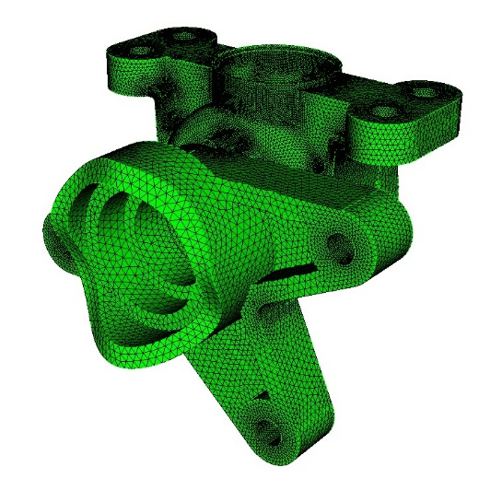
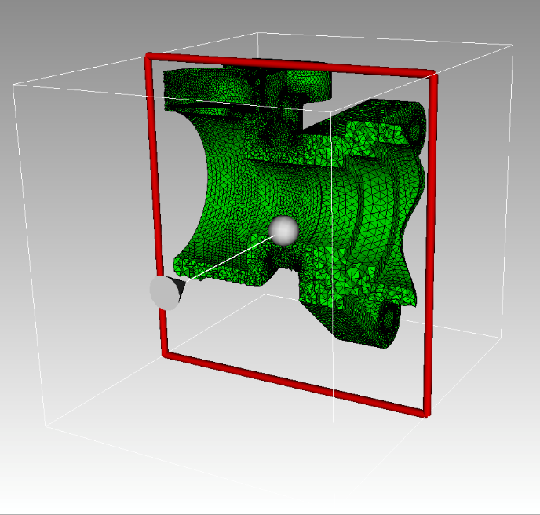
Exercise 9.2 Tetmesh Sizing (continued)
3
Modify the parameters one at a time and observe the changes to the mesh. (Hit “Use Defaults” button after each mesh)
For example:
Turn off geometry sizing
Min Tet Layers = 2
Deviation angle = 5
Surface Gradation = 1.2
4
From the command line:
draw tet all
5
Use the slice tool to see the interior of the mesh

Slide 17
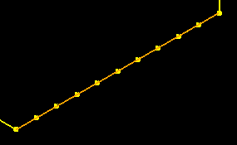
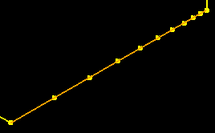
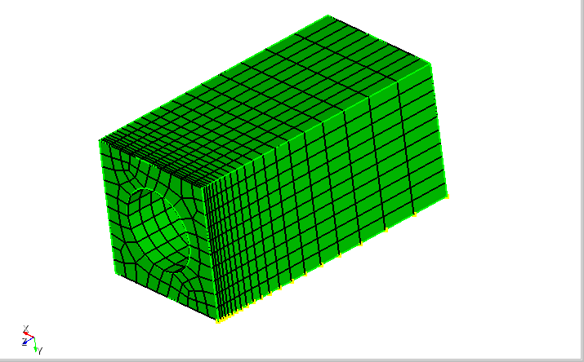
Curve Biasing
1
Navigate to Curve Bias Panel
1
2
Pick a Curve.
3
Select Bias and Intervals & Bias
2
4
Set number of intervals, start vertex, etc..
3
Adjust slide bar to preview biased mesh.
5
4
5
Propagate Curve Bias
Choose from Bias Scheme on GUI panel
3

Slide 18
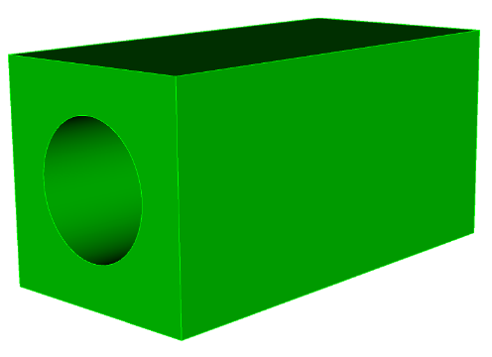
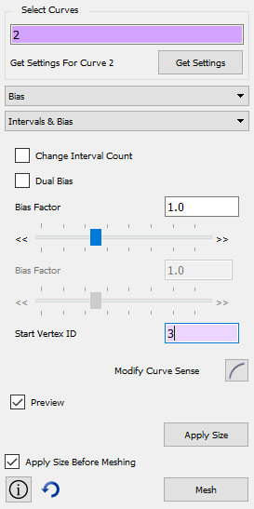
Exercise 9.3 Curve Biasing
Brick x 10 y 10 z 20
Create cylinder height 25 rad 3
Subtract vol 2 from vol 1
1
Create the simple model shown using the GUI or command line
Use the procedure shown in the previous slide to generate a biased mesh
Experiment with different options of curve bias
What happens if propagate curve
bias is not applied?
What’s wrong with the interior mesh? (use the slice tool to visualize)
Fix the biasing on the hole surface. (Hint: Webcut with X plane, merge, propagate curve bias)
2
3
4
webcut volume 1 with plane xplane offset 0

