Slide 1
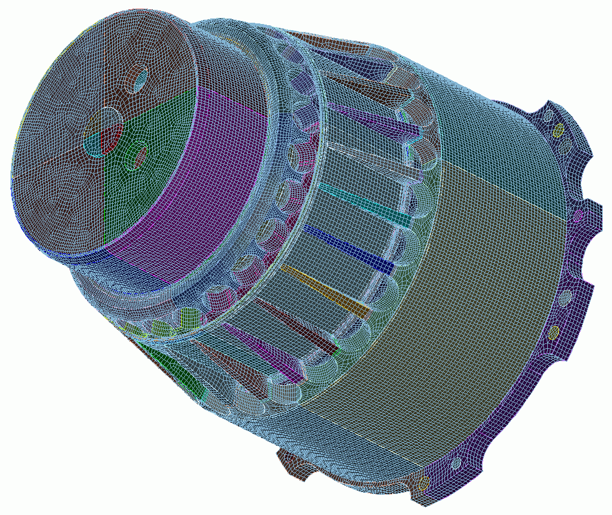

Defeaturing
8
CUBIT
Geometry and
Mesh Generation Toolkit
CUBIT™ 100 Tutorials
Steven Owen
SAND2022-15021 PE

Slide 2
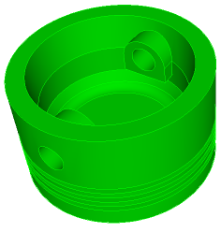
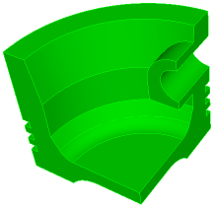
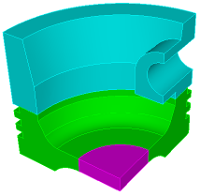

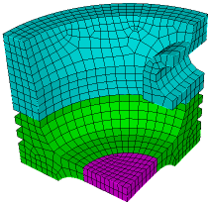
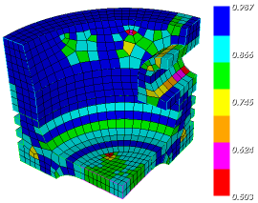
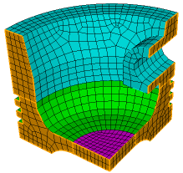
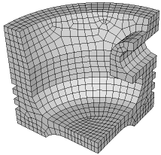
The CUBIT™ Workflow
1
2
3
Import Solid Model
Simplify Geometry
Decompose Geometry
4
5
6
Imprint & Merge
Set Schemes
& Intervals
Mesh
7
8
9
Check
Quality
Apply B.C.s
Export
Mesh

Slide 3
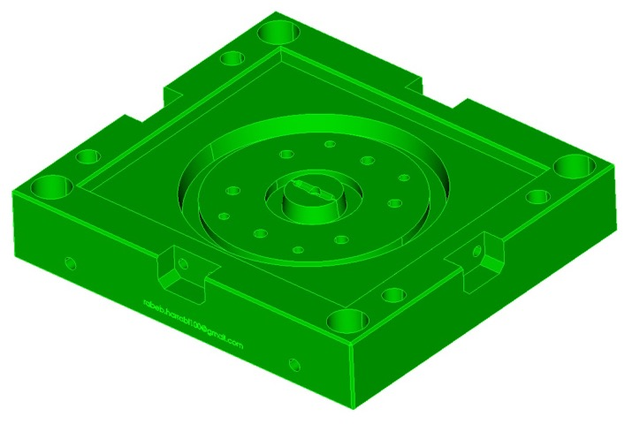
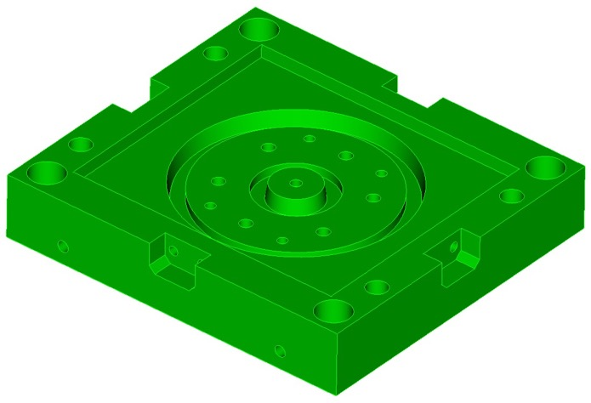
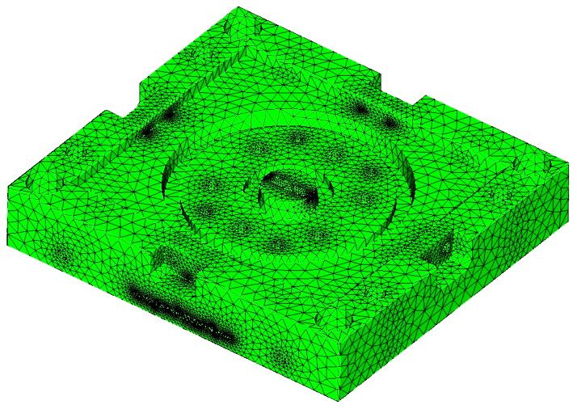
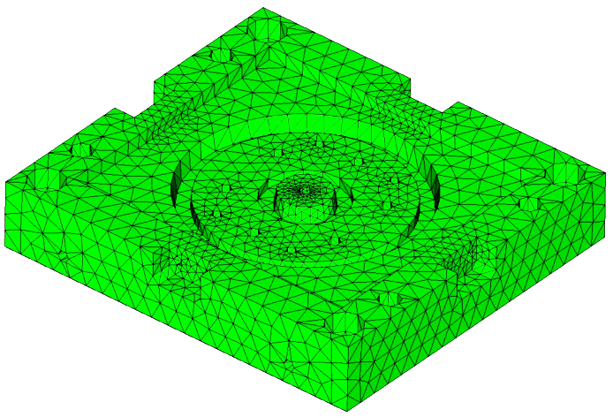
Defeaturing
Geometry from CAD design tools can include many unnecessary features
May be too complex for hex meshing
May require too many elements resulting in long run times
Customer may only want approximate, fast turn-around
CAD part from designer
CAD part for simulation
Defeaturing
595 surfaces
1506 curves
994 vertices
397,258 tets
32,559 tets
3

Slide 4
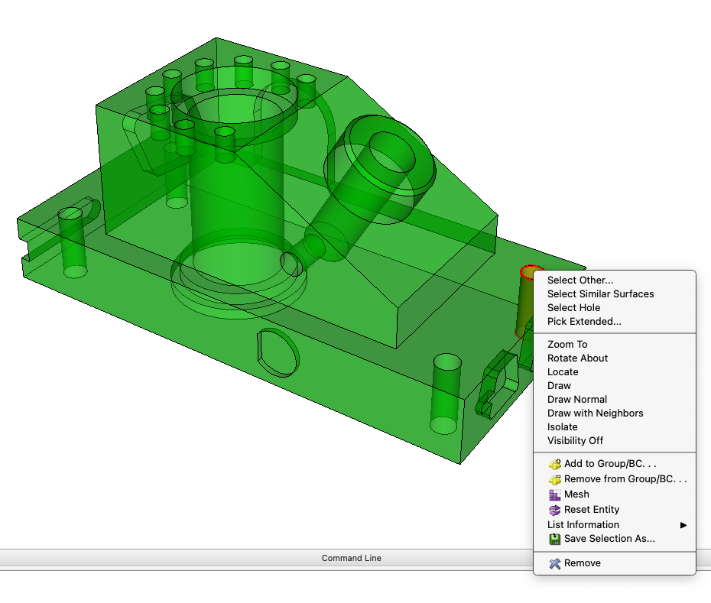
GUI Tools
Select Surface in graphics window
Right Click
A list of available selection tools will be
offered based on the selected surface
Select Similar | Selects other entities with the same geometric description (volume, area, length, topology)
Select Blend Chain | Selects other surfaces in the same blend chain that have the same radius of curvature
Select Cavity | Selects other surfaces in the same cavity collection. Surfaces bounded by curves where the external angle is greater than 180 degrees.
Select Hole | Selects other surfaces that are within the same hole definition
Select by Name | Selects other entities with the same name. Includes entities with the same name prefix prior to the "@" character if it exists.

Slide 5
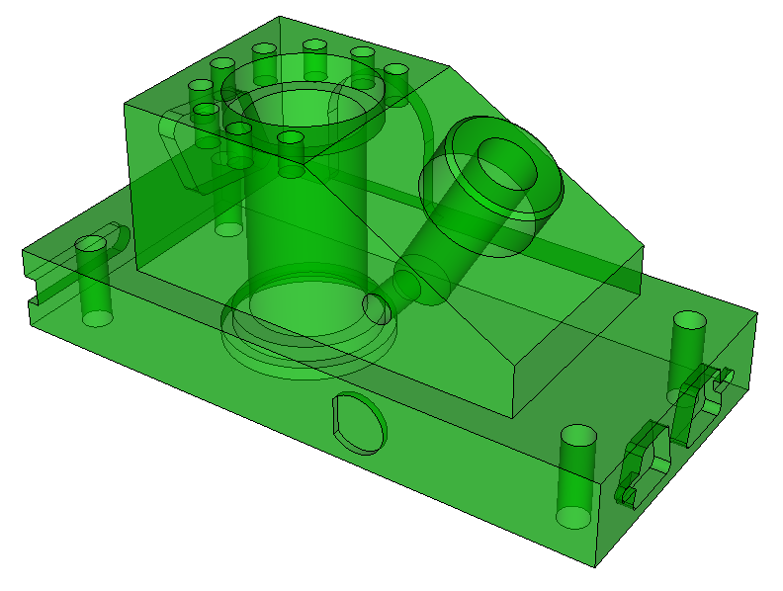
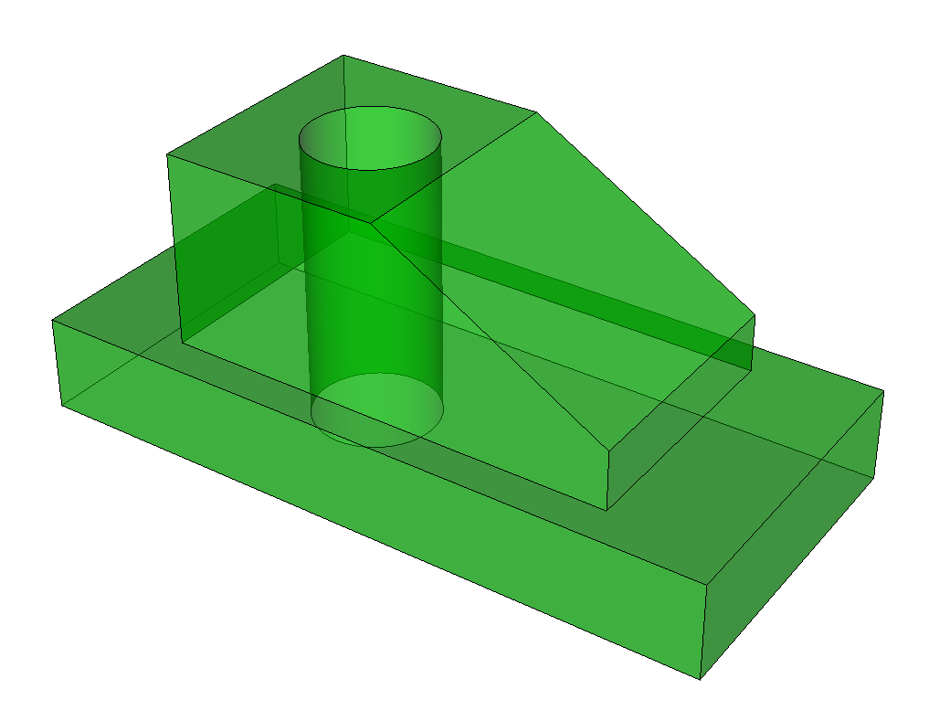
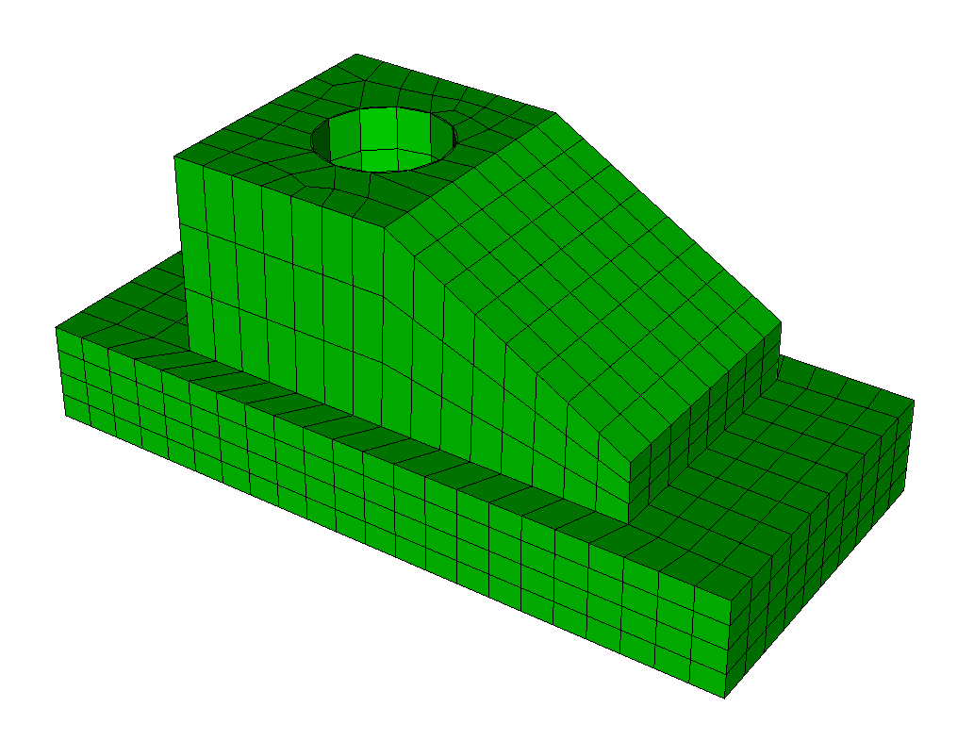
Exercise 8.1
Defeaturing with the GUI
1
Import the acis file “anc101.sat”
3
Use the GUI selections and remove operation
to simplify so it looks like the image below
2
Measure the volume before defeaturing
4
Find the volume of the defeatured geometry.
Compute the percent difference in volume
list volume 1 geometry
Make a note of the volume of volume 1
5
Use the sweep scheme to mesh the
defeatured volume

Slide 6
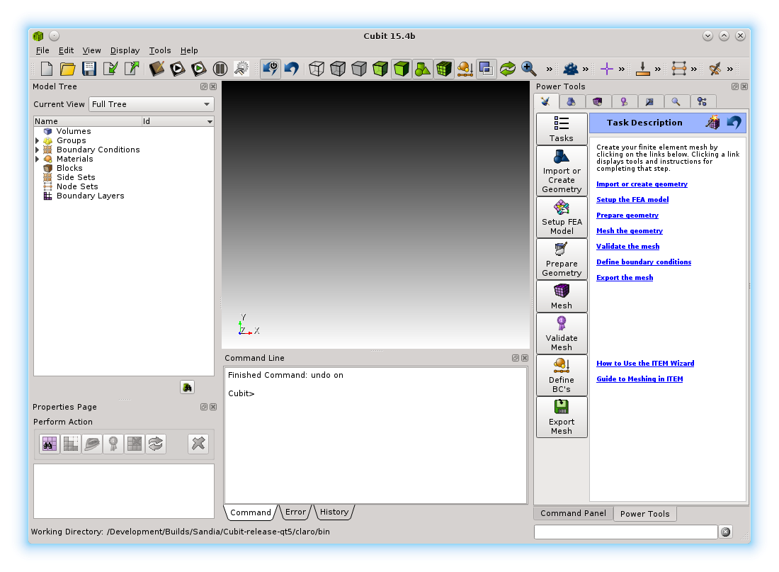

Geometry Power Tool
Geometry Power Tools are located in the second tab of the PowerTools window.

Slide 7
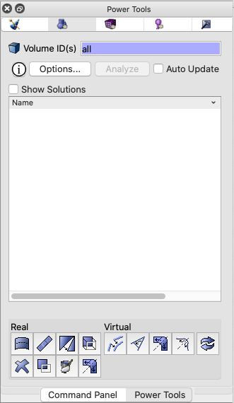
Geometry Power Tool Panel
Select Geometry Diagnostics
(Click Here first)
Pick volumes to analyze
Update analysis after each geometry operation
Show Documentation
Run geometry analysis
(disabled until Options… selected)
Display Solution Window
Geometry analysis output
Additional Geometry Operations

Slide 8
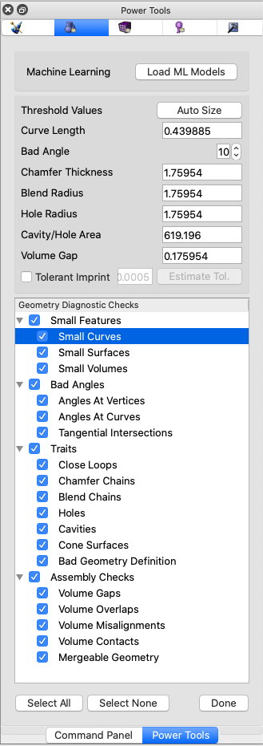
Geometry Power Tool Options Panel
Add Additional Diagnostics that use machine learning
Generate diagnostic threshold values automatically
Threshold values for Diagnostics
Diagnostic Checks
(select only those you want to perform)
Fast way to select or unselect diagnostics
Select Done to return to Power Tool

Slide 9
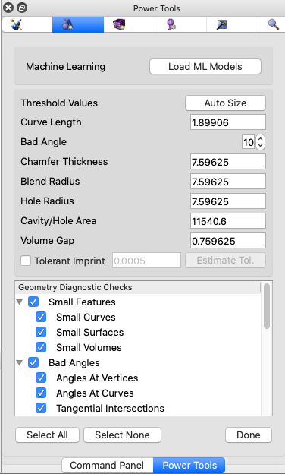
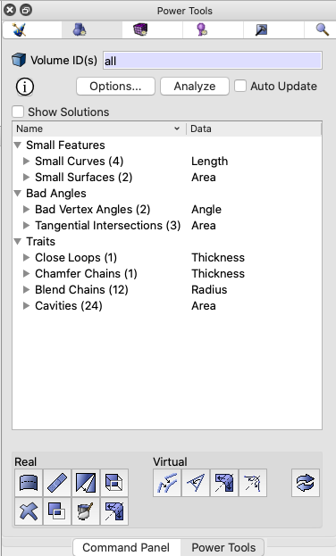
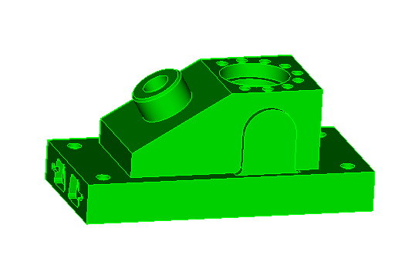
Geometry Power Tool Example
2
1
Import anc101.sat
Enter “all” or “1” for volumes to analyze
Select “Options…”
Select “Auto Size”
Select “Select All”
Select “Done”
Select “Analyze”
3
7
4
2
3
4
5
6
7
5
6
You should see results in the power tool that look similar to those shown.

Slide 10
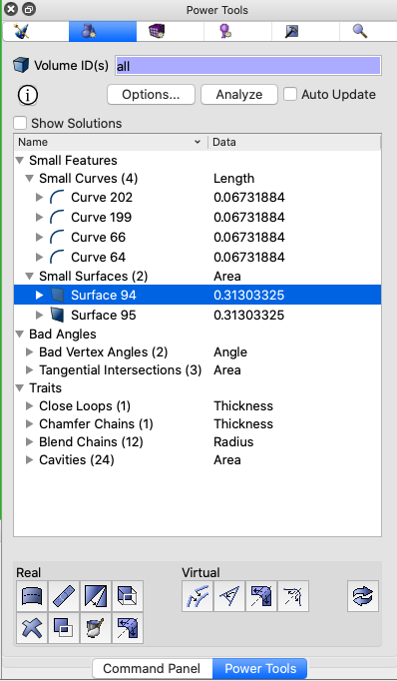
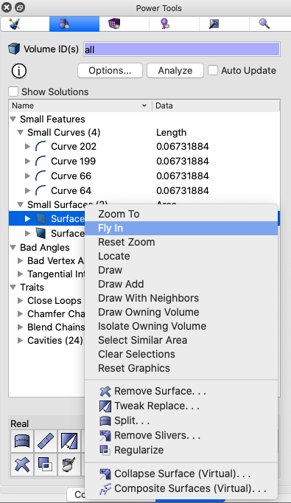
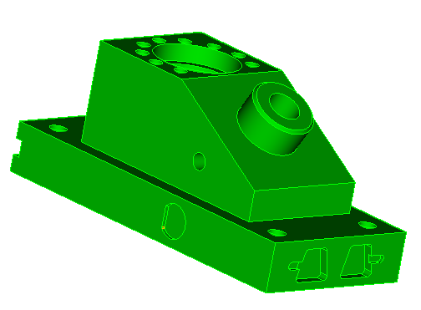
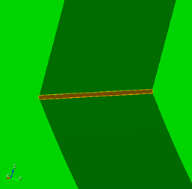
Geometry Power Tool Example
Remove small curves and surfaces
3
Right Click to display context menu
1
Click triangle to expand “Small Surfaces” Diagnostic
4
Select “Fly In” to zoom into surface 94
2
Select Surface 94
Visualize/Selection Options
Relevant Cubit Commands (Jump to Command Panel)
Surface 94

Slide 11
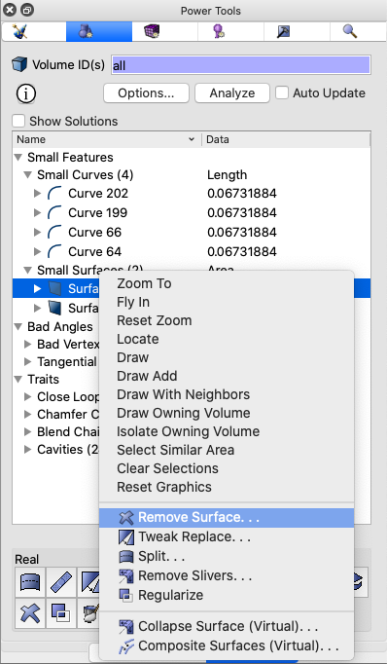
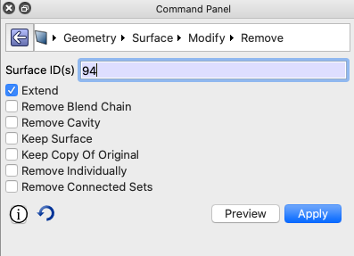
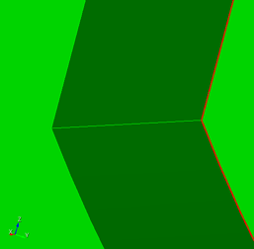
Geometry Power Tool Example
Remove small curves and surfaces
Note: Surface 94 is auto populated in pickwidget
2
Click Apply
Select Remove Surface
1
(Command Panel Appears)
Surface 94
Before
Surface Remove
After
Surface Remove

Slide 12
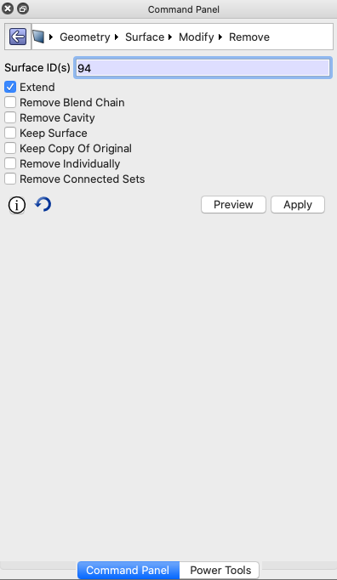
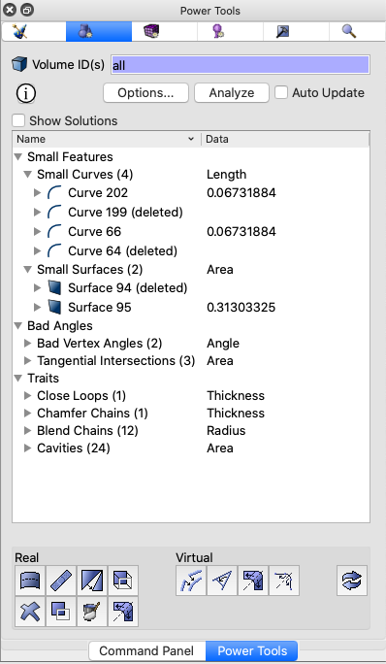
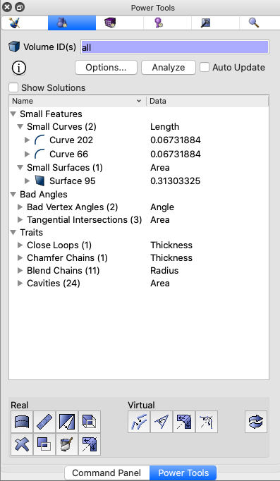
Geometry Power Tool Example
Remove small curves and surfaces
2
Note: Surface 94 and it’s small curves are shown (deleted)
Note: Check Auto Update to auto. regenerate every time model changes (slow for large models)
1
1
Click Power Tools Tab to return to Geometry Power Tool
2
Click Analyze to regenerate diagnostics
3
Try the same procedure to remove surface 95

Slide 13
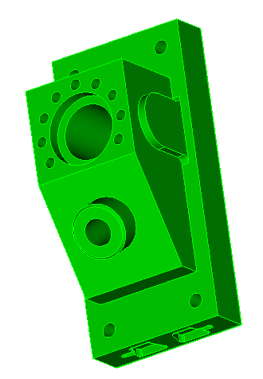
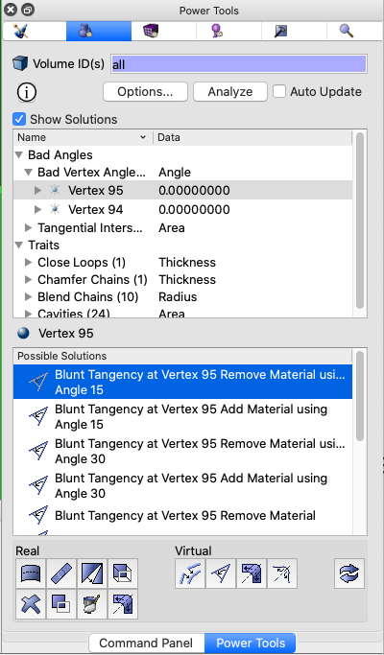
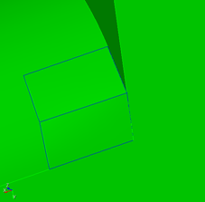
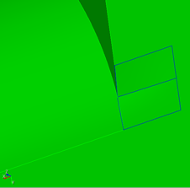
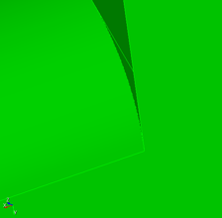
Geometry Power Tool Example
Custom Solutions – Remove bad angles
Select Show
Solutions
1
3
Blunt Tangency Add Material Angle 15
Expand “Bad Vertex Angles” Diagnostic
Select vertex 95 and “Fly-in”
2
4
Single Click: Preview and visualize custom solutions
Blunt Tangency Remove Material Angle 30
Custom Solution Window
Shows specific solutions for selected entity (vertex 95)
5
Double Click: Execute the solution
Collapse Angle 45
Note: Right Click on Solution for additional options (Jump to command panel)
6
Try same procedure on Vertex 94

Slide 14
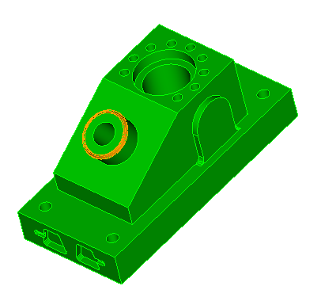
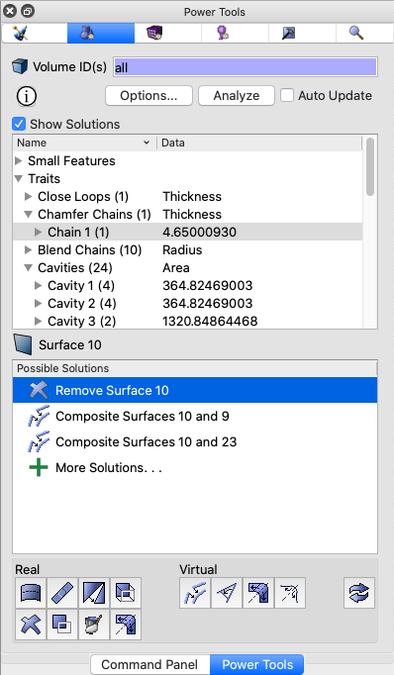
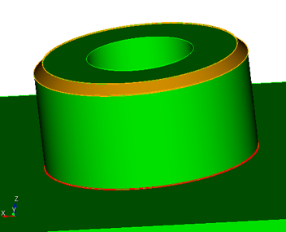
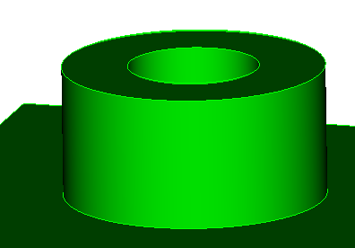
Geometry Power Tool Example
Geometry Traits – Remove chamfer
1
Expand “Chamfer Chains” Diagnostic
2
Select and fly into Chain 1
3
Double Click “Remove Surface” Solution

Slide 15
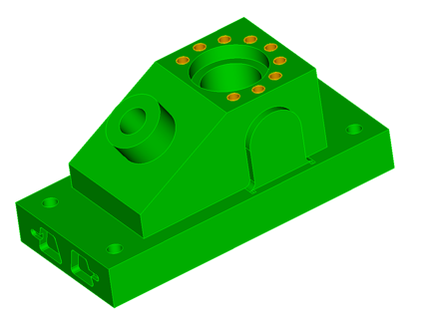
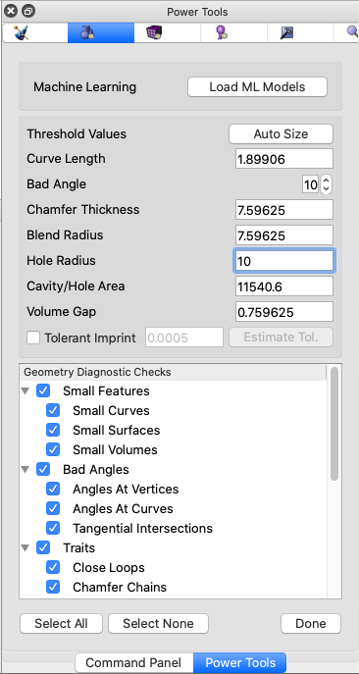
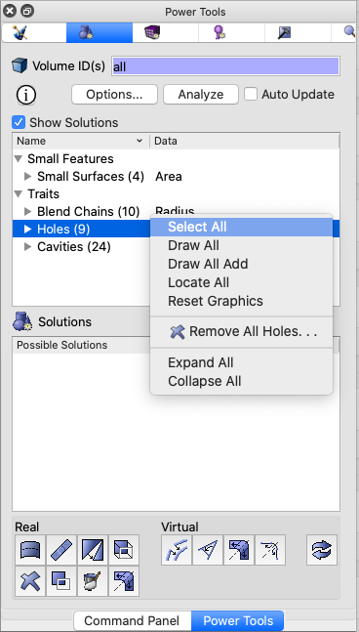
Geometry Power Tool Example
Geometry Traits – Remove holes
Note: Holes are not currently displayed because they all have a radius larger than the “hole radius threshold”. Go back to the Options panel to manually change this value.
1
Click on the Options button
4
Click Analyze
2
Enter “10” for the “Hole Radius” threshold
Right Click on Holes and “Select All”
5
6
Use the “Remove All Holes…” menu option to delete holes with one command
Click Done
3

Slide 16
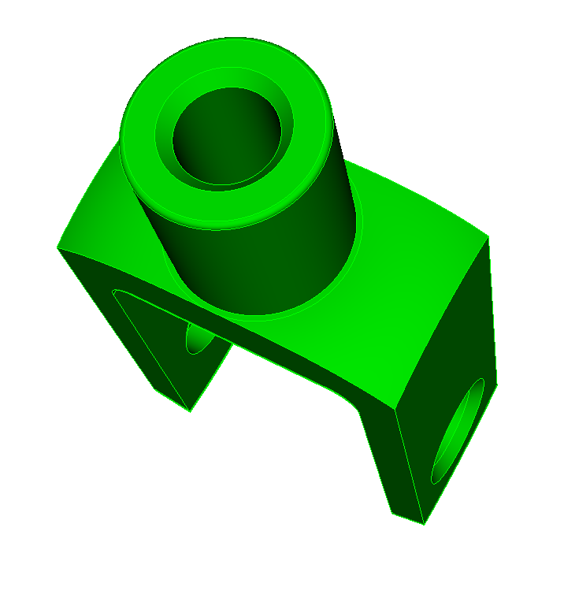
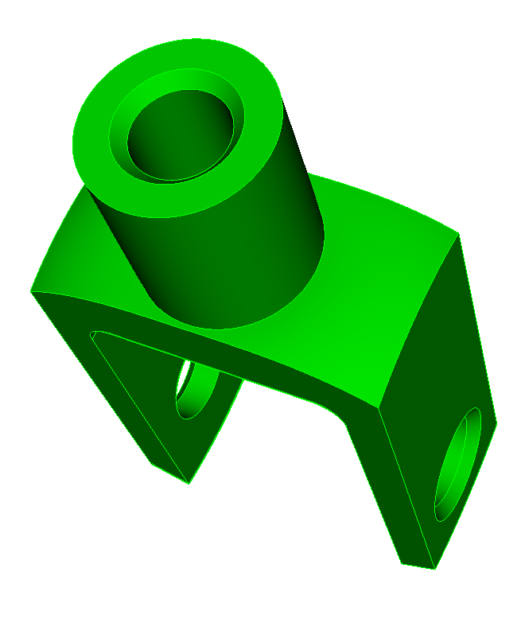
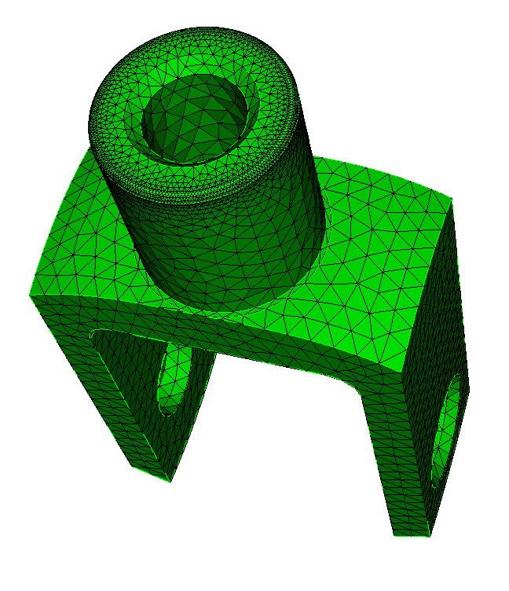
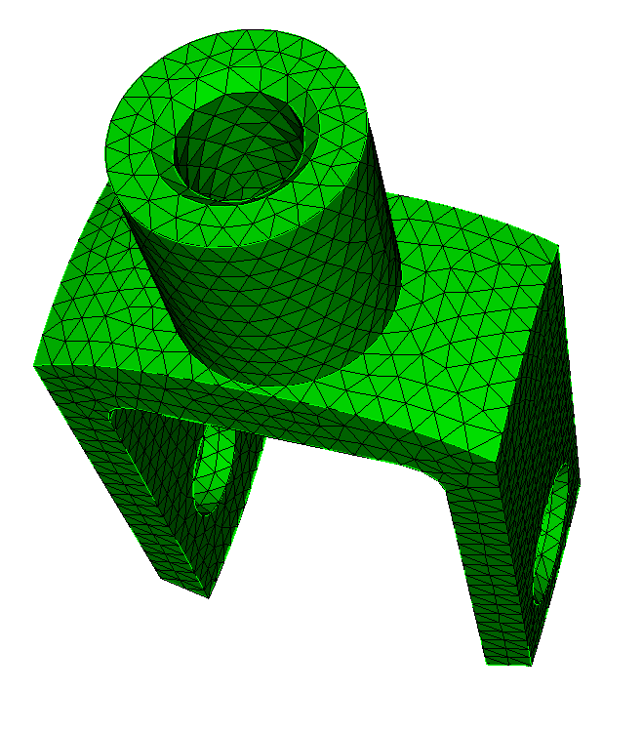
Exercise 8.2
Geometry Power Tool
1
Import acis “knuckle.sat”
Mesh with tets using size 2.0
Delete Mesh
Use the Geometry Power Tool to assist in defeaturing. Suggested operations:
Remove Close Loops
  Surface 17
  Surface 15
Heal Bad Geometry
  Bad Curves
Mesh with tets using size 2.0
Delete Mesh and save acis geometry file “knuckle-defeatured.sat”
2
3
4
Original Geometry
Defeatured Geometry
5
6

Slide 17
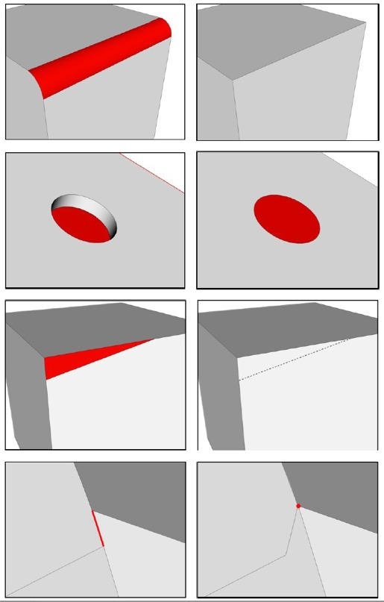
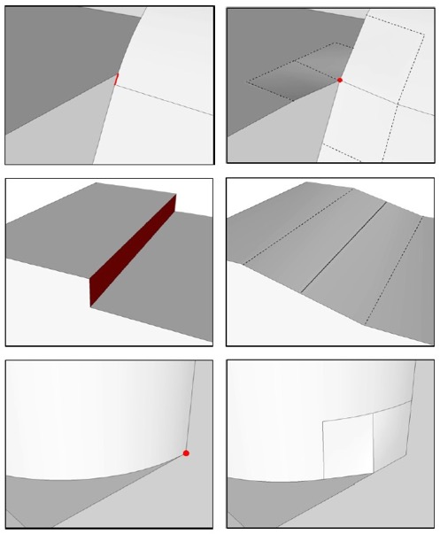
Defeaturing using Machine Learning
begin state
end state
1
Find the most problematic features in the CAD Model
remove surface
For a given local topology
  Small Curve
  Small Surface
  Sharp Angle at Vertex
Predict local mesh quality
  Scaled Jacobian
  In-Radius
  Deviation
tweak replace surface
composite surfaces
2
Find solution that yields best mesh quality
collapse curve
For a given local geometry operation
  Remove Surface
  Tweak Replace Surface
  Composite Surfaces
  Collapse Curve
  Etc..
Predict local mesh quality after operation
  Scaled Jacobian
  In-Radius
  Deviation
tweak remove topology curve
tweak remove topology surface
17
blunt tangency
17

Slide 18

Geometry Power Tool with Machine Learning
Click to add additional diagnostics that use machine learning
Settings used only with Machine Learning Diagnostics
Diagnostics available without ML Models Loaded
Two new diagnostics that use Machine Learning:
1. Predict tet mesh quality on the CAD before meshing
2. Classify volumes based on their predicted function
Without ML
With ML

Slide 19


Geometry Power Tool ML Example
2
1
Import anc101.sat
Enter "all" or "1" for volumes to analyze
Select "Options…"
Select "Auto Size"
Select "Tetmesh Poor Quality Metrics"
Unselect the remainder of the diagnostics
Select "Done"
Select "Analyze"
3
8
2
3
4
4
5
6
6
7
5
8
7

Slide 20





Geometry Power Tool ML Example
List of entities predicted to have poor Scaled Jacobian
Predicted minimum Scaled Jacobian near Curve 64
List of entities predicted to have poor Inradius ratio
Predicted minimum Inradius ratio near Curve 64
Curve 64
r

Slide 21


Geometry Power Tool ML Example
ML generated Solutions for Curve 64
Click Show Solutions
1
2
Single Click: Preview Solution
Double Click: Execute Solution
Right Click:
Visualize solution
Execute the solution
Jump to Command Panel
Best predicted Solution:
Remove Surface 94
Predicted Scaled Jacobian: 0.3977
List of proposed solutions for Curve 64 ordered by Scaled Jacobian prediction
2

Slide 22


Exercise 8.3
ML Defeaturing
1
Import the acis file B3.sat
Mesh with tets using a size of 1.0
Display and record minimum scaled Jacobian and/or Inradius metric. Note the minimums and where the worst quality elements occur
Delete the mesh
Use the Geometry Power Tool with ML to defeature the model
Mesh the volume again and check mesh quality. How has the mesh quality changed
2
3
4
5
6

