Slide 1
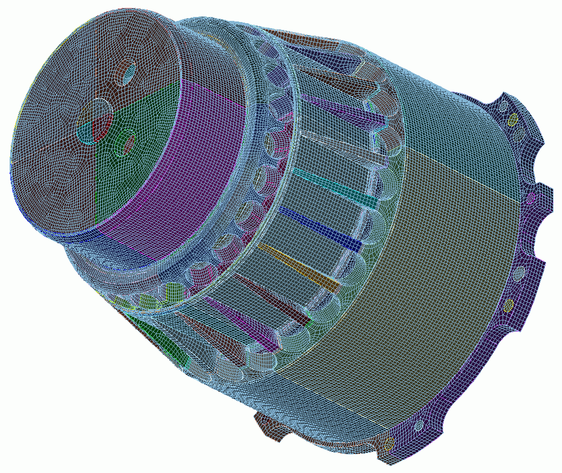
Meshing Schemes
7
CUBIT
Geometry and
Mesh Generation Toolkit
CUBIT™ 100 Tutorials
Steven Owen
SAND2022-15021 PE

Slide 2
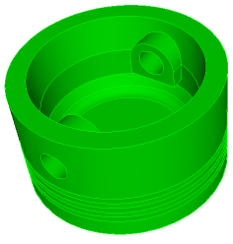
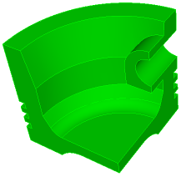
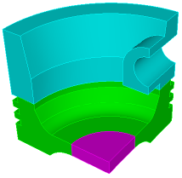
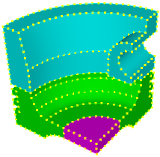
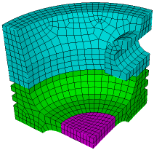
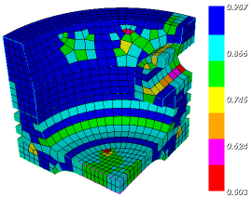
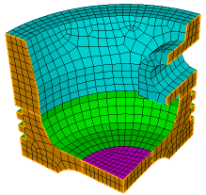
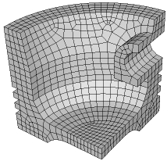
The CUBIT™ Workflow
1
2
3
Import Solid Model
Simplify Geometry
Decompose Geometry
4
5
6
Imprint & Merge
Set Schemes
& Intervals
Mesh
7
8
9
Check
Quality
Apply B.C.s
Export
Mesh

Slide 3
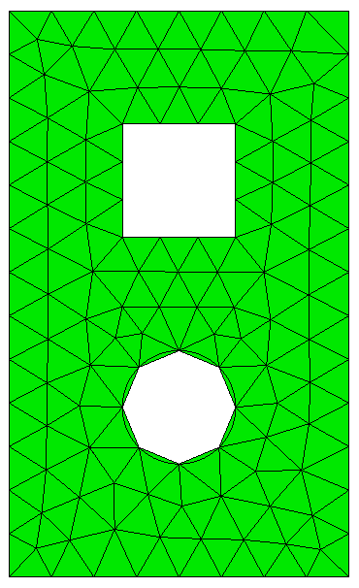
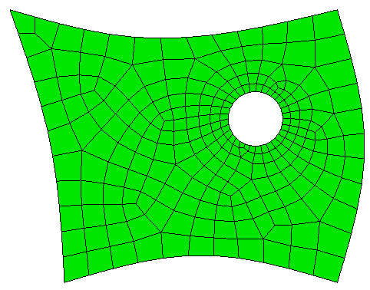
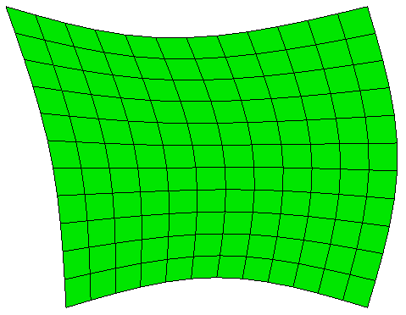
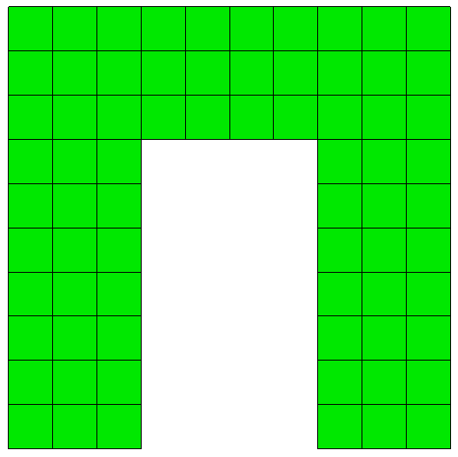
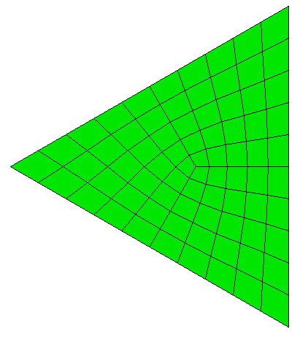
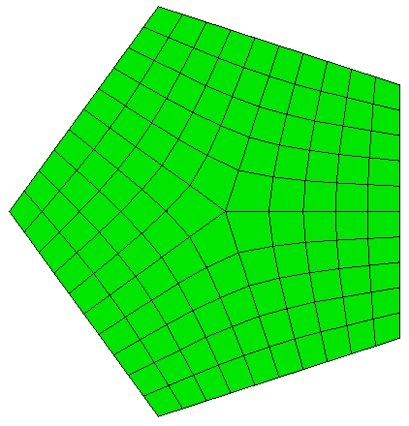
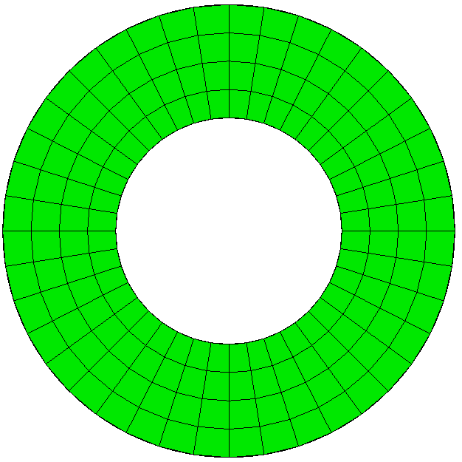
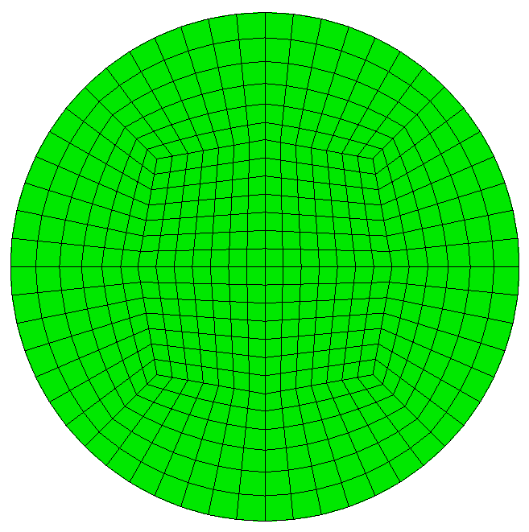
Surface Meshing Schemes
CUBIT™ Provides a number of different surface mesh schemes. Choosing the best scheme depends on the shape and number of curves in the surface. Your choice also depends on how you plan to mesh the volume.
TriMesh
Map
SubMap
Pave
TriPrimitive
Polyhedron
Hole
Circle

Slide 4
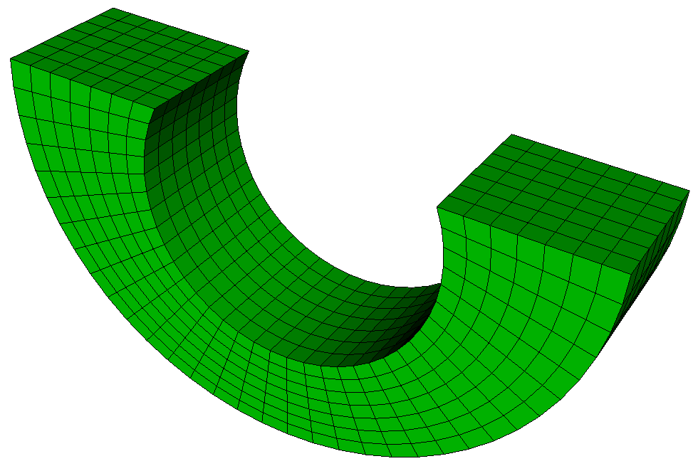
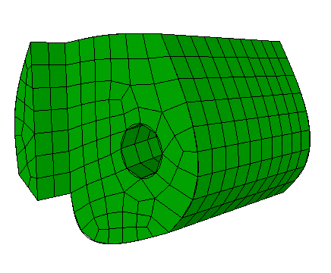
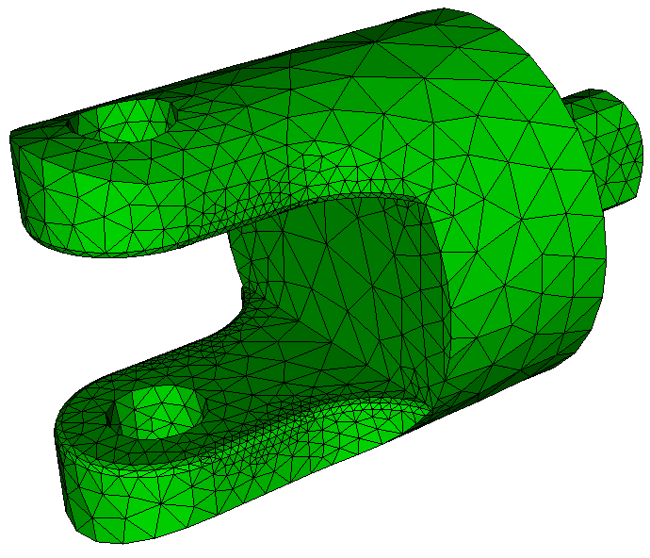
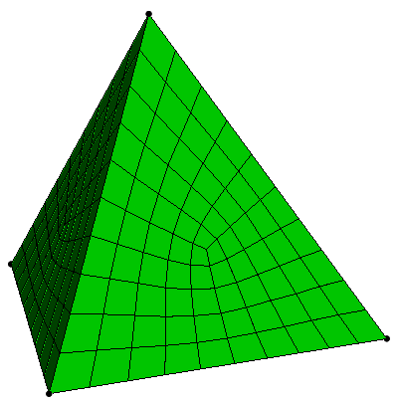
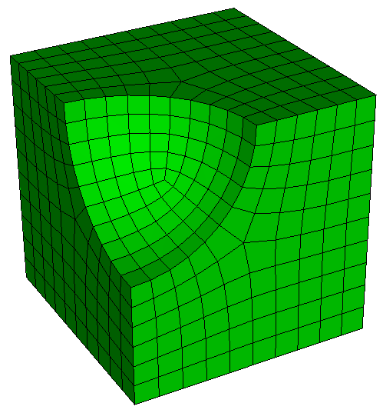
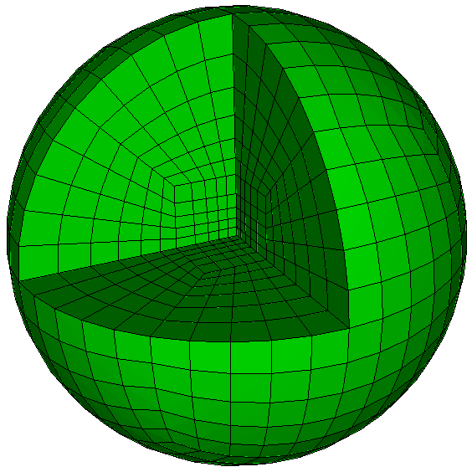
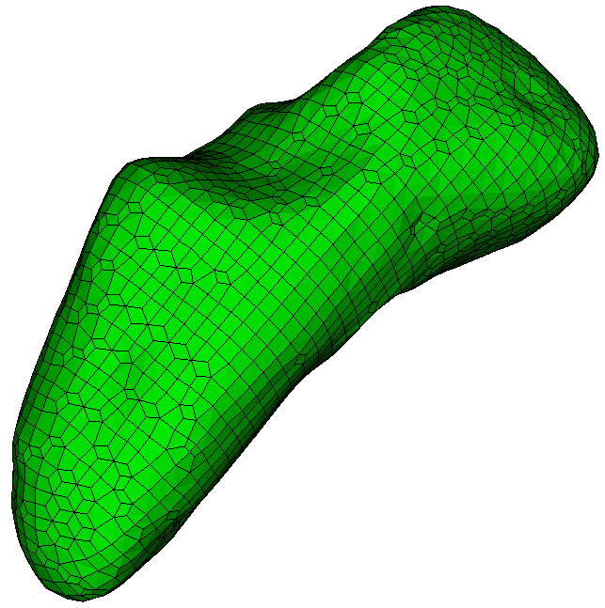
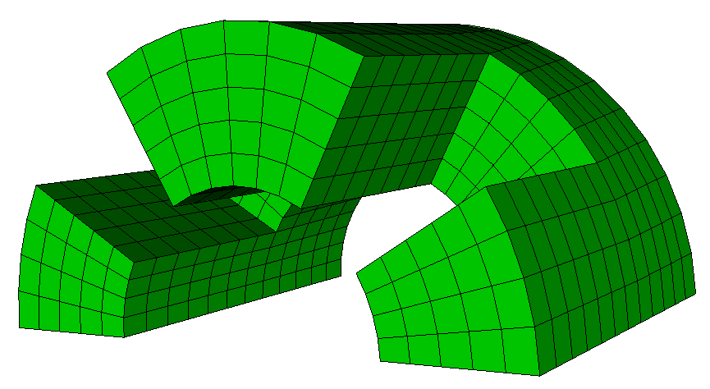
Volume Meshing Schemes
CUBIT™ Provides a number of different volume mesh schemes. Similar to Surface Scheme Selection, Volume Scheme Selection is based on the shape of the geometry and the requirements of the analysis code.
Map
Sweep
TetMesh
TetPrimitive
SubMap
Polyhedron
Sphere
Sculpt Parallel

Slide 5
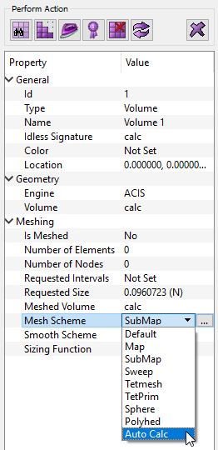
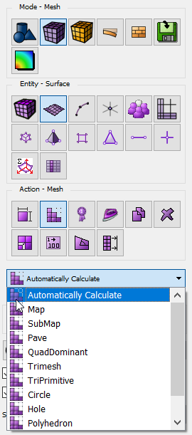
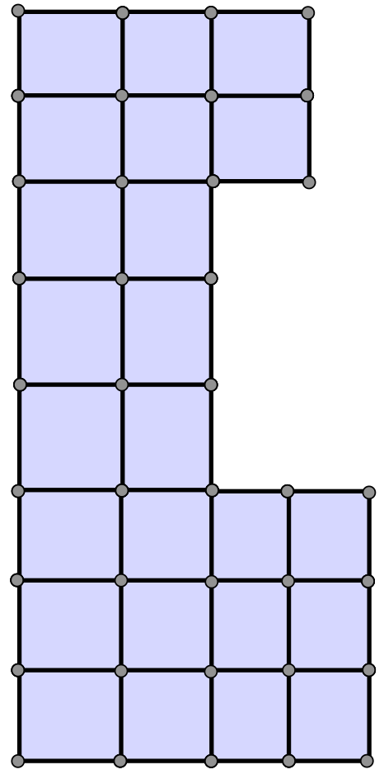
Auto Scheme Selection
Volume and Surface Schemes can be manually applied from the Property Page or from the CUBIT™ Volume/Surface Meshing Command Panels.
By choosing Automatically Calculate, CUBIT™ will attempt to select the best mesh scheme for the surface
Scheme priority will be set based on characteristics of geometry.
Volumes
1. Map
2. SubMap
3. Sweep
Surfaces
CUBIT™ Property Page
CUBIT™ Surface Meshing
Command Panel
1. Map
2. SubMap
3. TriPrim
4. Pave

Slide 6
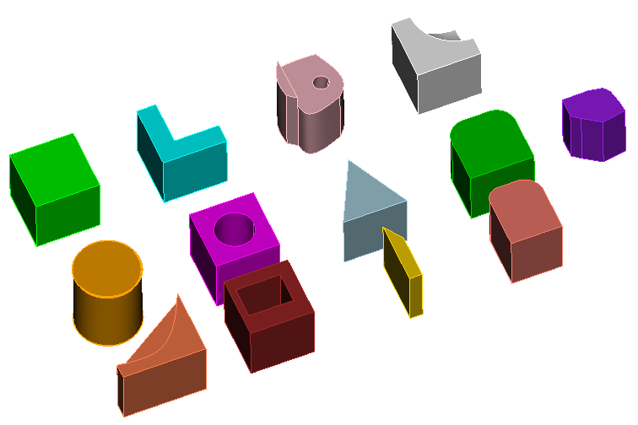
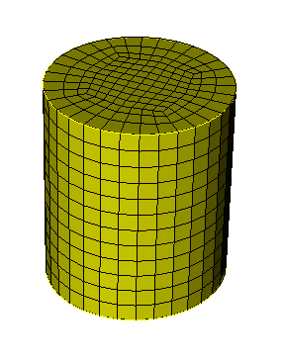
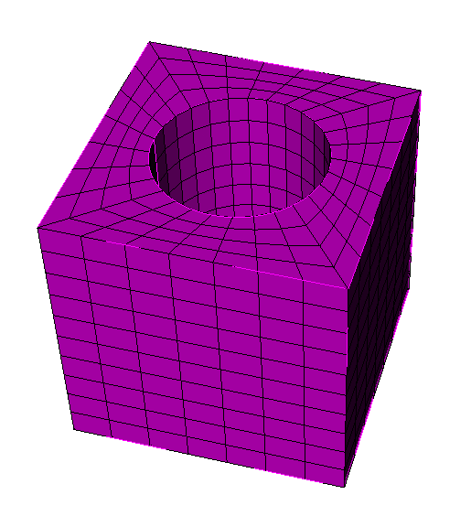
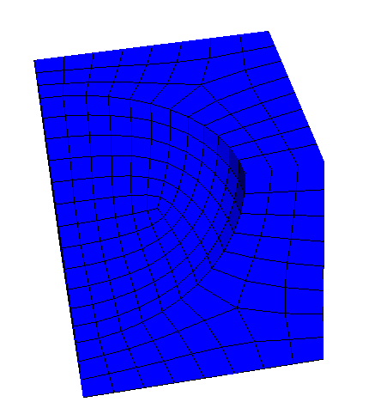
Exercise 7.1 Meshing Schemes
1
Reset and import schemes.sat
Set mesh size to 1.00
Use the Auto Calc and mesh all surfaces and volumes and check the auto-selected schemes
Reset volumes and experiment with different surface and volume meshing schemes. For example:
2
3
mesh volume all
4
surface 9 scheme circle
mesh surface 9
mesh vol 2
surface 17 scheme hole rad_intervals 4
mesh surface 17
mesh vol 3
Volume 3
volume 5 scheme polyhedron
mesh vol 5
Volume 5
Volume 2

Slide 7
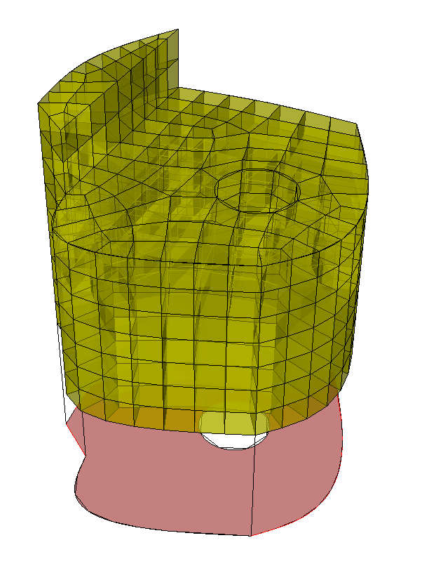
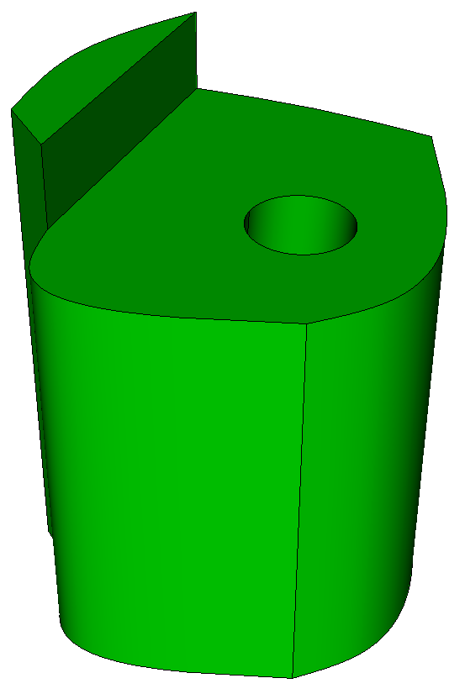
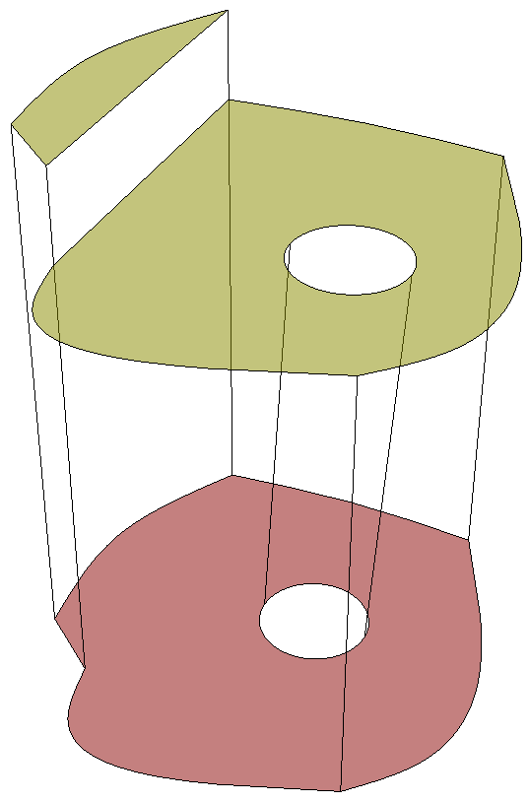
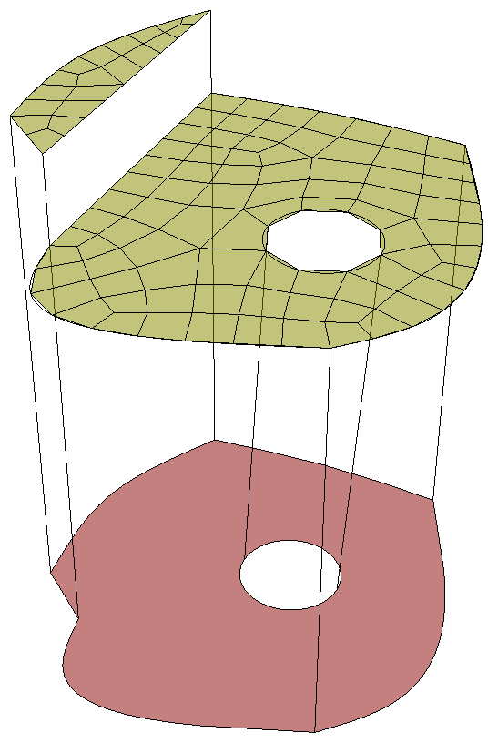
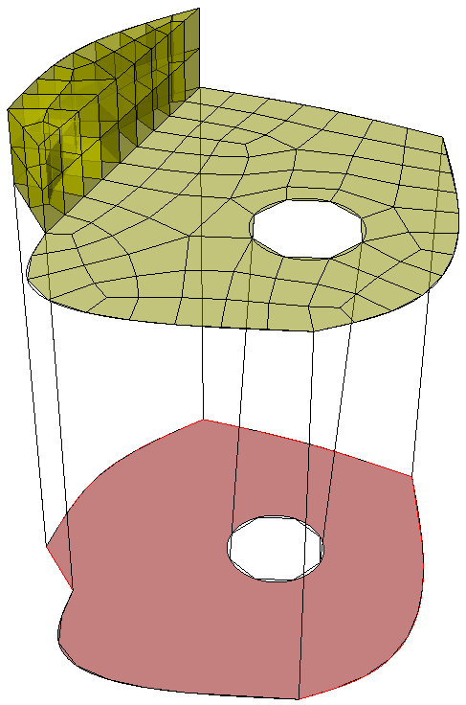
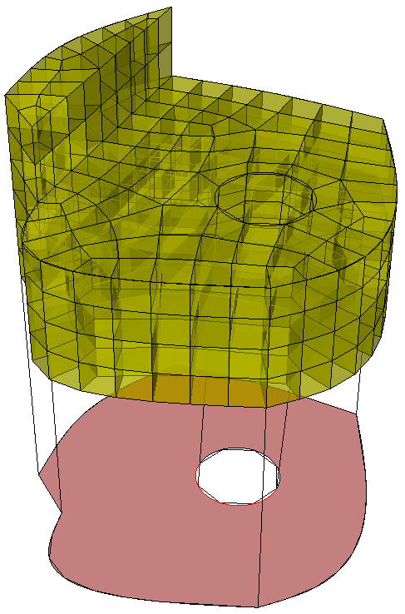
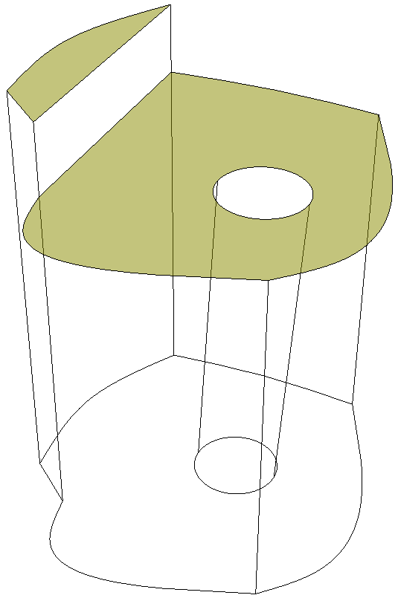
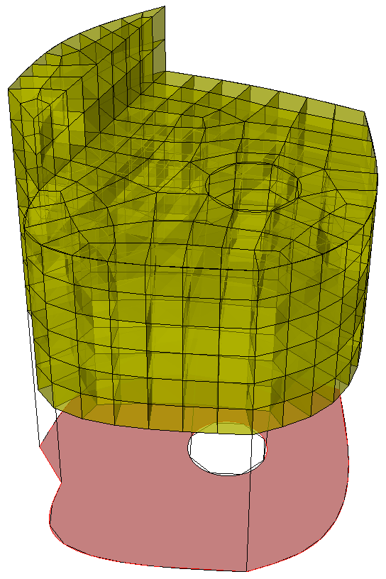
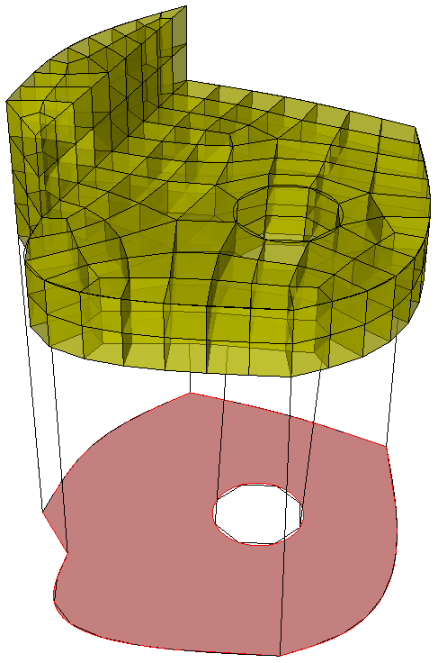
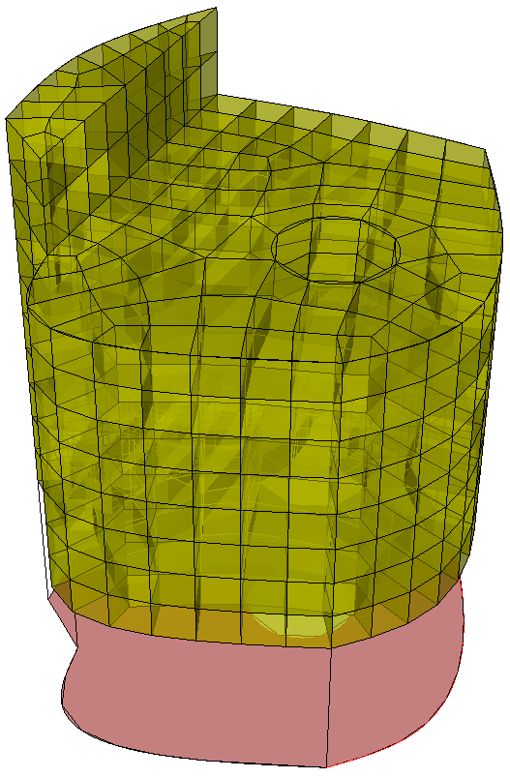
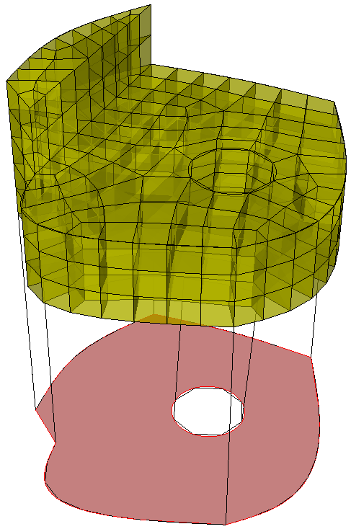
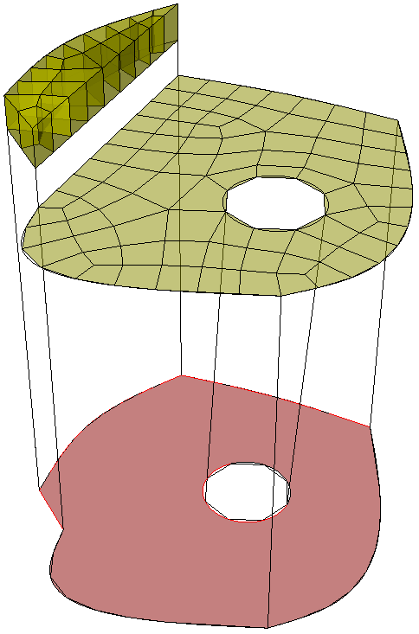
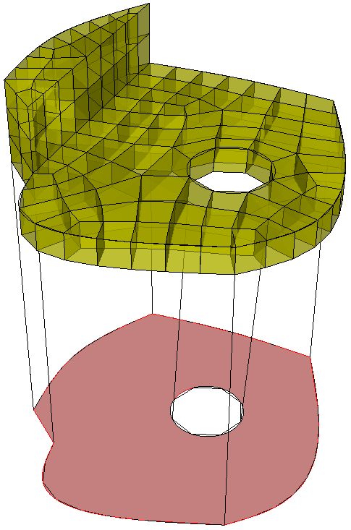
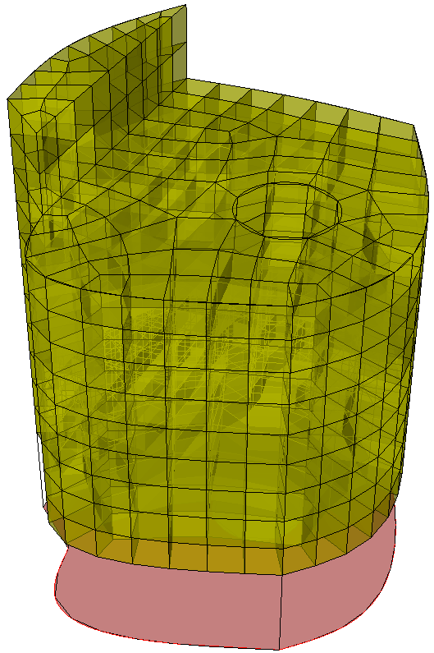
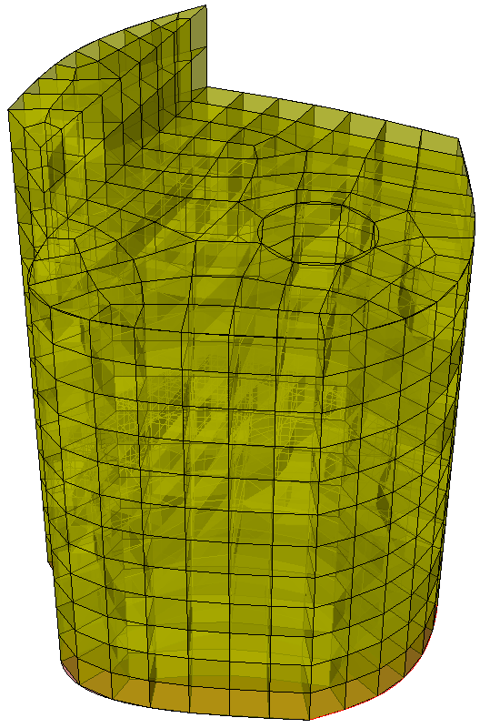
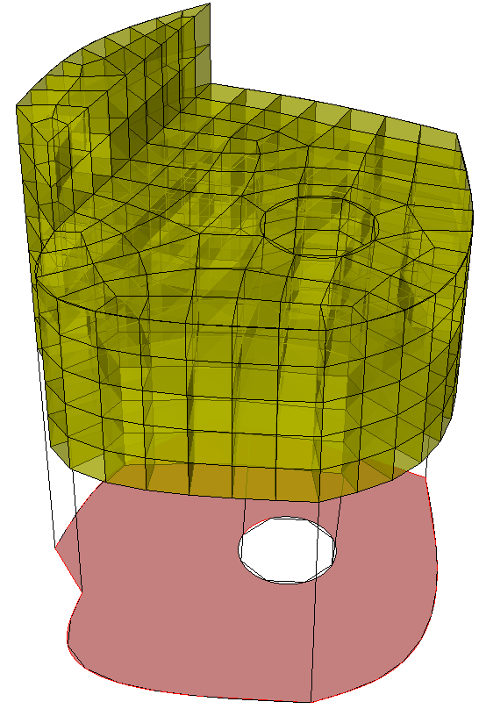
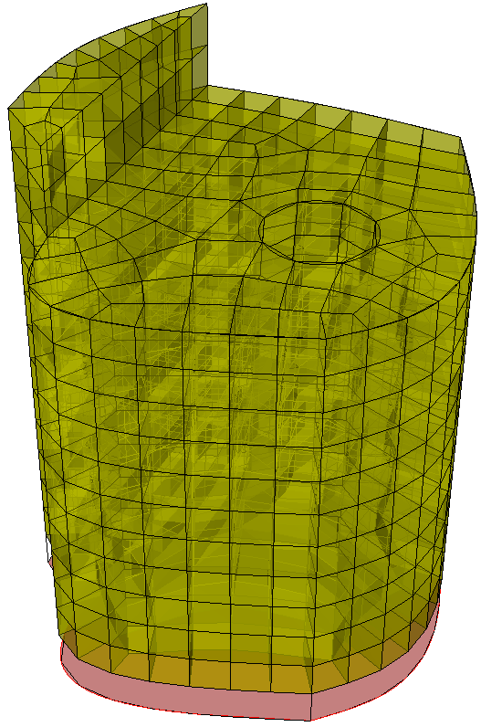
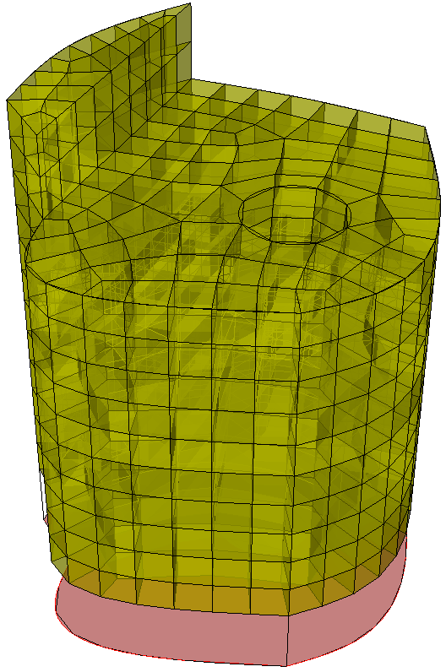
Sweep Scheme
Source Surfaces
One or more surfaces
Can be meshed with any Quad Scheme (Pave, Map)
Source surfaces
Source surfaces
Source surfaces
Source surfaces
Source surfaces
Source surfaces
Source surfaces
Source surfaces
Source surfaces
Source surfaces
Source surfaces
Source surfaces
Source surfaces
Source surfaces
Source surfaces
Source surfaces
Source surfaces
Target surface
Target surface
Target surface
Target surface
Target surface
Target surface
Target surface
Target surface
Target surface
Target surface
Target surface
Target surface
Target surface
Target surface
Target surface
Target Surface
Must be a single surface
Must be unmeshed
Matches topology of source surfaces
Target surface

Slide 8
Sweep Scheme
Linking surfaces
Linking surfaces
Linking surfaces
Linking surfaces
Linking Surfaces
Must be “Mappable”
Connect Sources with Target

Slide 9
Sweep Scheme
Most frequently used meshing scheme
Normally requires geometry to be decomposed to apply sweeping (webcutting)

Slide 10
Sweep Scheme
Setting Source and target Surfaces
Shortcut from property panel to scheme selection
1
1
Navigate to Scheme Selection Command Panel
2
Choose Sweep Scheme
2
3
Pick Sources and Targets
1
4
Apply Scheme
3
4

Slide 11
Exercise 7.2 Sweeping
Volume 14
1
Import “schemes.sat”
2
Isolate volume 14
3
Sweep Option 1:
Use the sweep scheme command panel to set source and target surfaces so that resulting mesh looks like Sweep Option 1
4
Sweep Option 2:
Do the same for Sweep option 2.
(Important: Use 3 source surfaces and one target surface)
Sweep Option 1
Sweep Option 2

Slide 12
Sculpt
Ideal for non-mechanical/
organic shapes
But can be used for any geometry
Overlay Grid Method
Uses Cartesian Grid as Base Mesh
Adjusts nodes to geometry
Inserts Layer of Hexes

Slide 13
Sculpt
Sculpt is a separate companion application to CUBIT™ .
Does not use Scheme, instead uses Sculpt Parallel command.
1
Can be run from CUBIT™ GUI or in batch from OS command line
2
Parallel application uses MPI to run on multiple cores/processors
3
If you get an error
Check your working directory with “pwd”
Ensure your working directory has write permissions
Change directories or create a new directory
See Cubit 200 for more details/exercises

Slide 14
Exercise 7.3 Sculpt
1
1
Import the stl file “eros_asteroid.stl” (change the file filter to “stl”)
Preview the overlay grid resolution
Mesh
Use the slice tool to view the interior hexes
Delete mesh and experiment with alternate sizes
2
Navigate to sculpt panel
3
4
5
3
6
3
5
4

Slide 15
Tetmesh Scheme
Arbitrary geometry
Mostly push-button/automatic
May still require geometry clean-up

Slide 16
Exercise 7.4 Tet Meshing
1
Import ACIS file driver.sat OR cad6.sat
Import model
1
cad6.sat
driver.sat

Slide 17
Exercise 7.4 (continued) Tet Meshing
1
Mode - Mesh
1
2
3
4
2
Entity - Volume
5
Action - Mesh
3
4
Choose Tetmesh Scheme
5
Select Volume to Mesh (1)
6
Apply the Tetmesh Scheme
7
Click the Mesh Button
OR
6
From Cubit Command Window
Volume 1 scheme tetmesh
7
Mesh Volume 1

