Slide 1
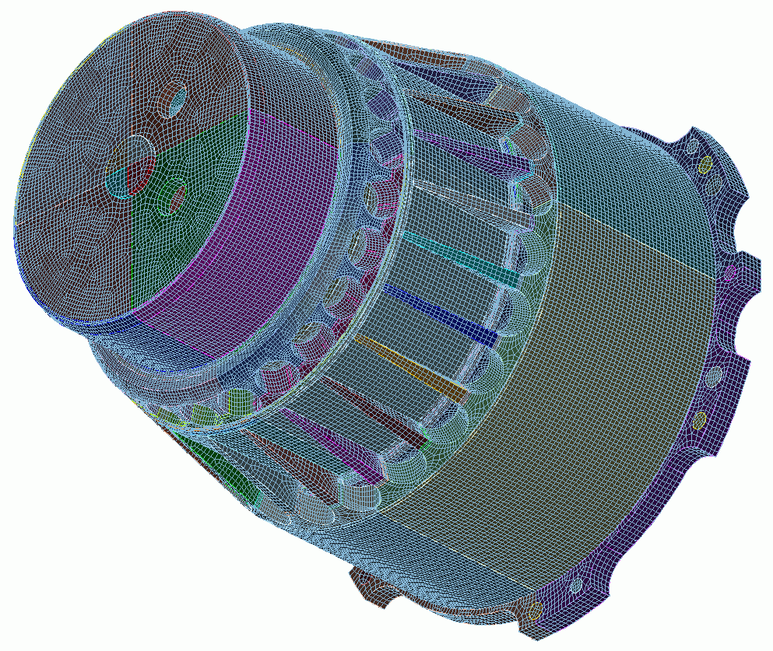
Usability Tools
5
CUBIT
Geometry and
Mesh Generation Toolkit
CUBIT™ 100 Tutorials
Steven Owen
SAND2022-15021 PE

Slide 2
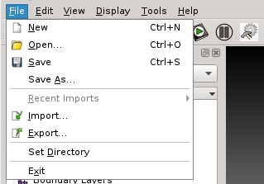
The CUBIT™ .cub File
CUBIT™ Database File contains:
Geometry
Meshing Schemes
Intervals
Virtual Geometry
Mesh
Boundary Conditions
Snapshot of the current state of the model
Save
Choose Save or Save As… to save or create a .cub file
Open
Choose Open to read a .cub file
Deletes existing data and Resets your CUBIT™ session with the new data from the .cub file

Slide 3
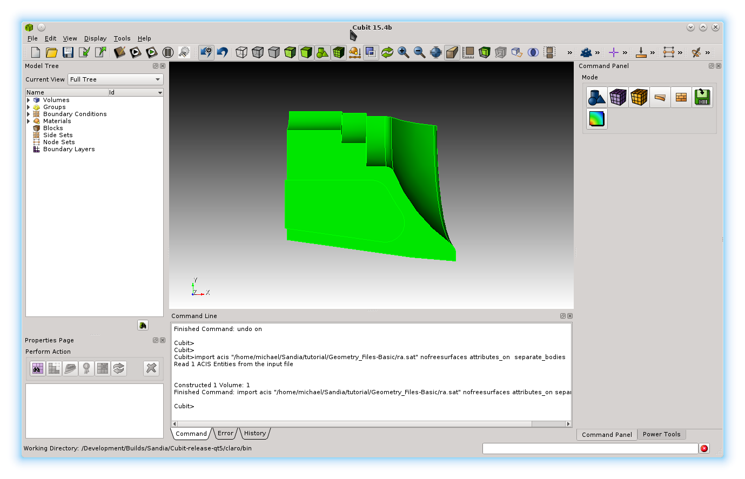
The CUBIT™ Journal File
Create/Edit Journal
Playback Journal File
CUBIT Journal File contains:
Sequential list of CUBIT™ commands
Comments
APREPRO Scripts
Complete list of sequential commands used to regenerate a desired state of a model
Automatic Journal File Creation
On start-up, CUBIT™ automatically creates a new .jou file and logs every command in the session to the file
Default location is the installation directory
Tip: Set a custom location for automatic journals files in Tools->Options… (Cubit->Preferences… on Mac) under History
Named cubitXX.jou and historyXX.jou

Slide 4
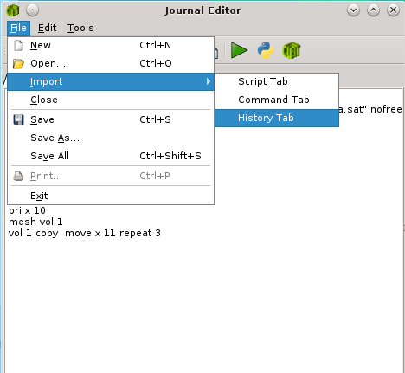
Creating and Editing Journal Files
Journal File Editor
Interactive Editor for CUBIT™ journal files
Can also use any text editor
1
Open the Journal File Editor
Edit the current session
Import the History Tab: record of all commands to date in the session
Add, delete or edit the CUBIT™ commands
2
Play commands
Highlight and right click on one or more commands
Use the Play Selected menu item
Python Scripting
Toggle between CUBIT™ command language and python scripting
2
Import the current CUBIT™ session for editing in the Journal Editor

Slide 5
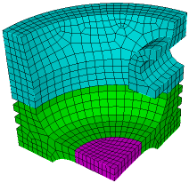
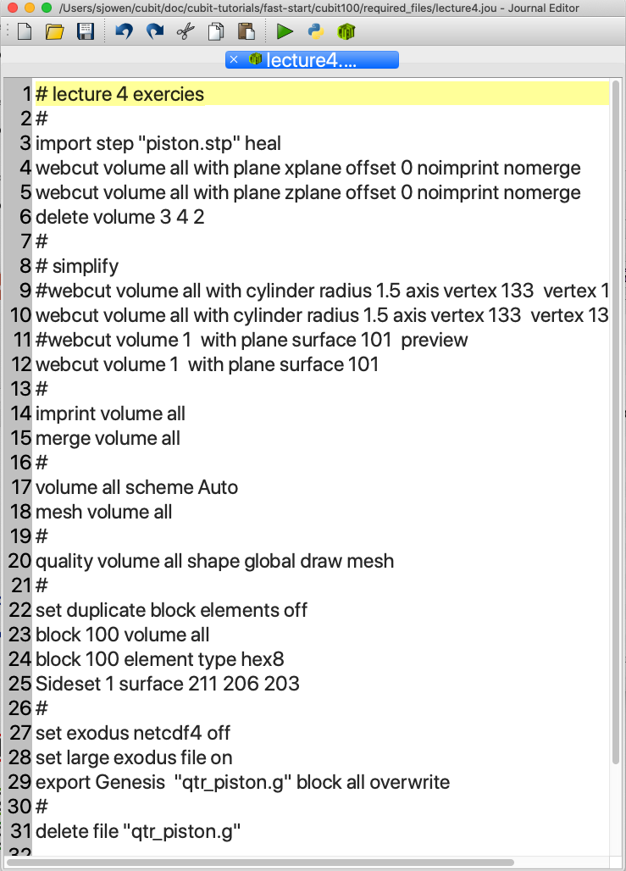
Exercise 5.1
Generate and Run a Journal File
1
Open the Journal File editor
2
Open the file ”lecture4.jou” in the journal editor
3
Try editing and running commands from the journal editor
4
Reset and run “lecture4.jou” from the command window
CUBIT> play "lecture4.jou"
Save a .cub File
5
Save a .cub file. Name it “lecture4.cub”
6
Reset and open file “lecture4.cub”

Slide 6
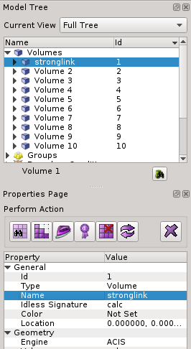
Entity Names
All geometry entities can be given 1 or more names
Reasons to use names
More intuitive in commands
More persistent than IDs - saved to SAT
Can group entities by name
Names propagate during webcuts, can track original parts (Gear becomes Gear and Gear@A when split)
To change names
Geometry Tree View: Right-Click menu, “Rename”
Property Panel: Edit “Name” value
Command line: <entity> name “<name>”
a
Tip: Using names can avoid conflicts with new versions of CUBIT if IDs change
CUBIT> mesh stronglink
CUBIT> draw stronglink
a
b
c
b
CUBIT> volume 1 name “stronglink”

Slide 7
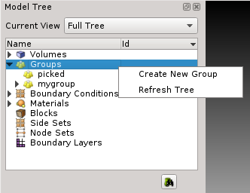
Groups
To create/edit groups from the command line
group "assembly1" add vol 1 2 4
group "bad-hexes" equals quality vol 1 high 0.3
assembly1 remove vol 4
Adds volume 1,2 and 4 to group named assembly1
Adds hexes with quality < 0.3 to group bad-hexes
Removes volume 4 from group assembly1
To create groups from the Geometry Tree
1
Right-Click on Groups in the Geometry Tree
2
Select Create New Group
1
2
3
Enter a unique new group name
3

Slide 8
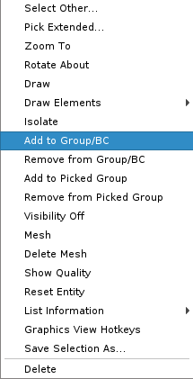
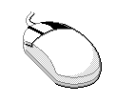
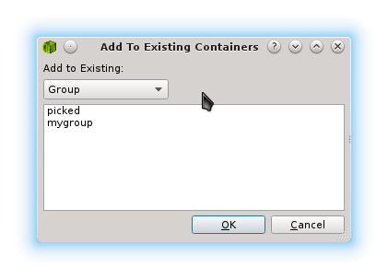
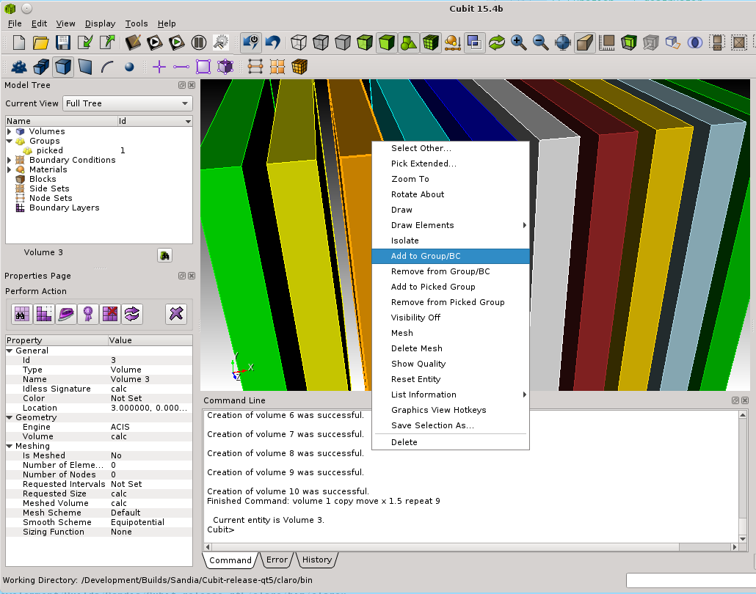
Groups
a
Add to Group/BC/Part
Remove from Group/BC/Part
Right-click after selecting entity in the Graphics Window
Choose an existing group to add/remove to and Click OK
a
b
b
Add to Picked Group
Remove from Picked Group
Picked group is reserved
Always exists
Immediately adds/removes from picked group

Slide 9
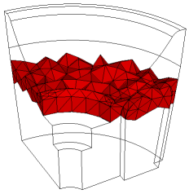
Keyboard Shortcuts (Hotkeys)
Speeds up frequently used tasks
Focus should be in Graphics Window (click any open space)
Examples:
Control-s
Speed save the model to filename.cub.X
Increments X each time cntrl-s is executed
l (lower case L)
When a geometry entity is selected, lists its attributes to the command window
e
When a geometry entity is selected, echoes the ID of the entity to the command line
x, y or z
Displays a slice of the interior mesh elements in the x, y or z planes. Use j and k to move the slice plane
Display hotkeys from the Help menu
i
Toggle the visibility of the current selection
TAB
Toggle the selection to other entities obscured by surfaces/volumes in front
h
Display list of available keyboard shortcuts*
*Some keyboard shortcuts are only available in the command line version of CUBIT™

Slide 10
Display Tools
True Hidden Line
Display Geometry
Refresh Graphics
Turn on Undo
Solid/Smooth
Display Mesh
Display Virtual
Transparent
Wireframe
Hidden Line
Display BCs
Undo
Display Modes
Select enclosed/extended
Show model edges
Toggle Perspective
Toggle Slice Mode
Locate Overlapping
Surfaces
Toggle Slice Tool
X-Ray Selection
Zoom Out
Auto Center
Toggle Scale
Box/Poly
Zoom In

Slide 11
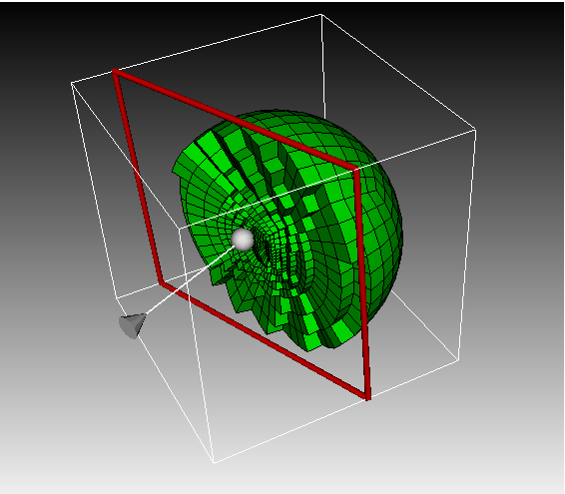
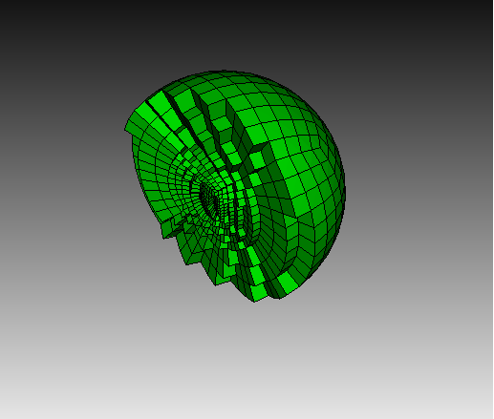
Slice Tool
Toggle Slice Mode
Toggle Slice Tool

Slide 12
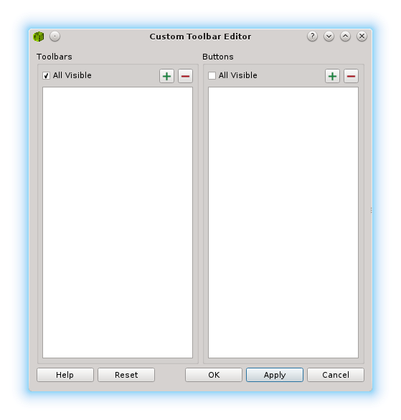
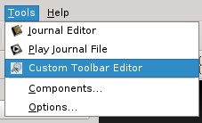
Custom Toolbars
Create a series of frequently used commands and assign them to a button in the toolbar
2
1
Select Custom Toolbar Editor from the Tools menu, or use the toolbar shortcut.
1
2
Click the ‘+’ button under the Toolbars column.

Slide 13
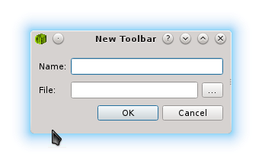
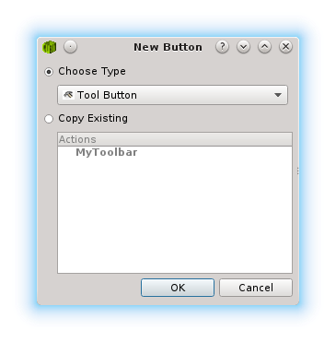
Custom Toolbars
3
4
3
Give the new toolbar a name and file location and click OK.
4
With the new toolbar selected, click the ‘+’ button under the Buttons column.
5
5
Choose ‘Tool Button’ as the new button type and click OK.

Slide 14
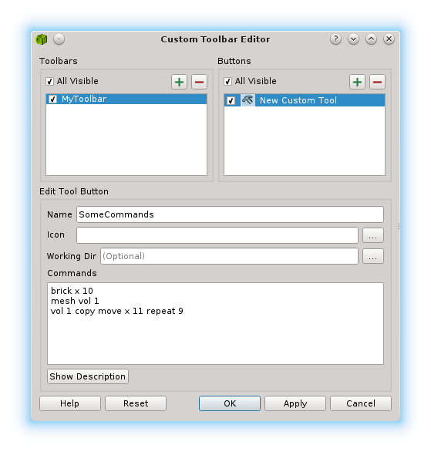
Custom Toolbars
6
Give the new button a name.
Enter any series of CUBIT™ commands that will be executed any time you hit the button
7
Click OK to save the toolbar
and button.
8
6
You should see a new toolbar and icon appear with the other toolbars
7
Select this button to execute your custom commands
8

Slide 15
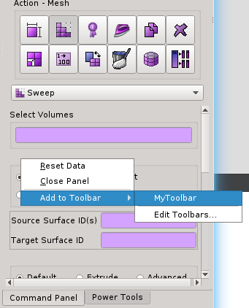
Custom Toolbars
Create shortcuts to frequently-used Command Panels.
1
Open any command panel.
2
Right-click on any blank space in the panel and select Add to Toolbar from the context menu.
1
3
Select the custom toolbar you want to add the shortcut to. Click OK in the editor to confirm.
2
3
You should see a new toolbar icon for the panel.
Select this button to open the corresponding Command Panel.

