Slide 1
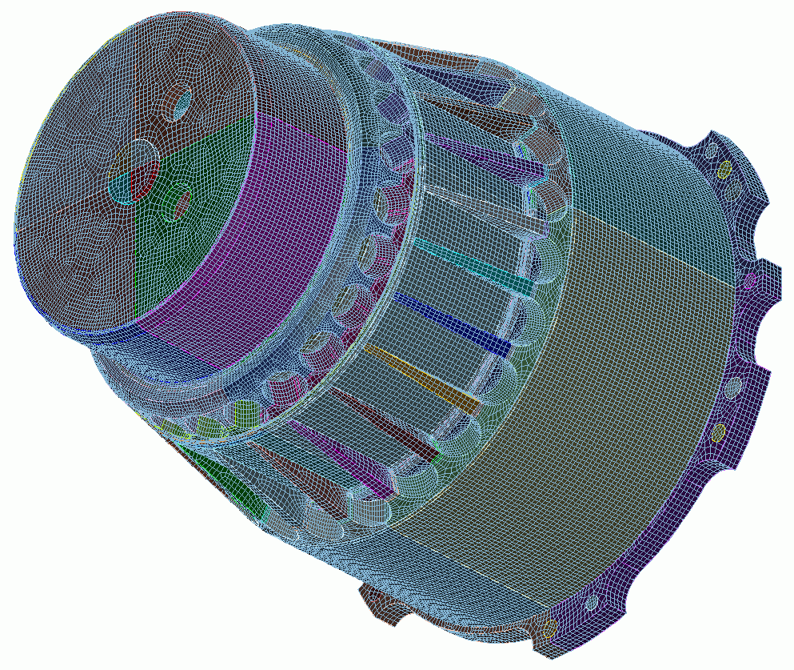

Graphical User
Interface Basics
3
CUBIT
Geometry and
Mesh Generation Toolkit
CUBIT™ 100 Tutorials
Steven Owen
SAND2022-15021 PE

Slide 2
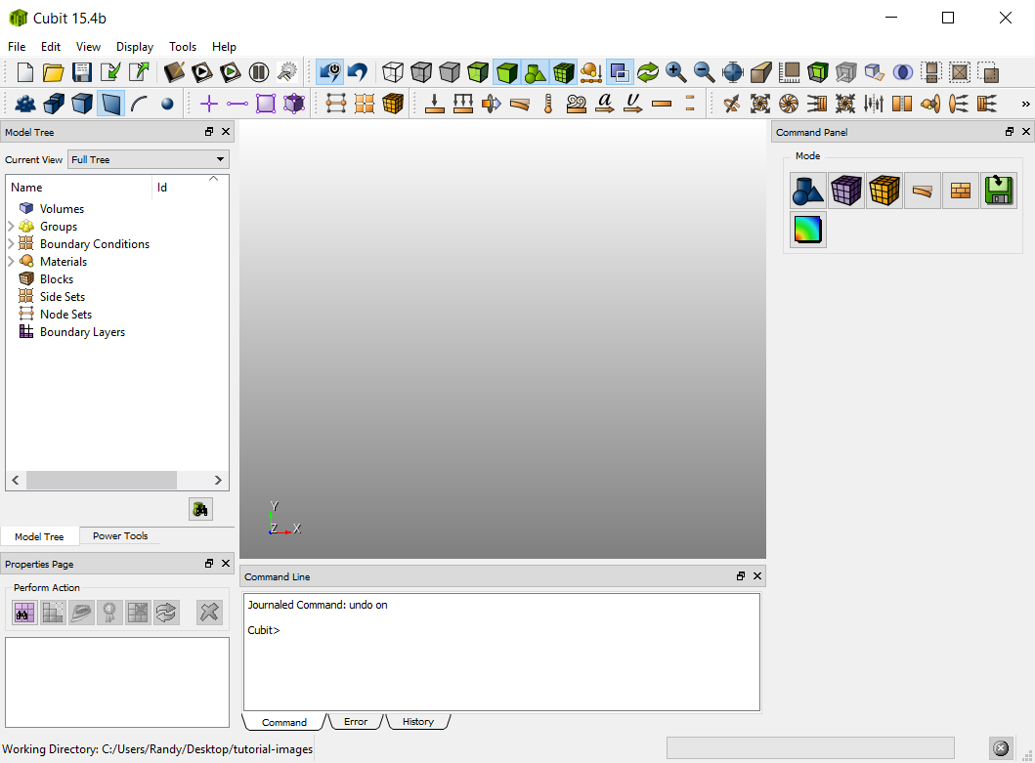
CUBIT™ Graphical User Interface
Pulldown Menu Commands
Toolbars
Tip: Drag and drop windows
to customize workspace.
With 2 monitors try moving the
command window or panel to its
own monitor to maximize space.
Graphics Window
Model Tree
Command Panel
Power Tools
Tip: Use the Tools->Options (Windows)
or Cubit->Preferences (Mac) to
customize the look and feel of the GUI
and graphics
Properties Page
Command Window

Slide 3
CUBIT™ Main Toolbar
Play/Record an ID-less journal file
Open a Cubit™ file
Save to a Cubit™ file
Play a journal file
Reset
Custom toolbar editor
Import from a geometry file
Open the journal editor
Pause current journal file
Export to a geometry file

Slide 4

CUBIT™ Display Toolbar
Display Composite Surface Curves
Toggle Scale
Tip: Make sure
icon is selected to ensure undo will work
Curve valence (Display merges)
Zoom in, out, and fit
Display modes
Show Overlaps
redisplay
Check point save/undo
perspective
on/off
Custom selection tools
Display BCs
Slice Tool

Slide 5


Entity Selection Filters
Toggles what kind of entity is available for graphical selection
Geometry Entities
Mesh Entities
Volumes
Curves
Nodes
Quads and Tris
Groups
Surfaces
Vertices
Edges
Hexes and Tets
Bodies
(More than one volume grouped together)
Tip: Pickwidgets (edit fields in command dialogs) “hijack” selection filters so that only the expected entity type is selectable

Slide 6
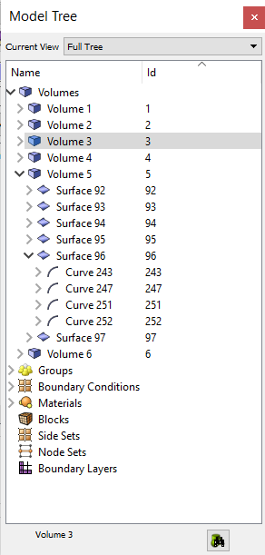
The Model Tree
List Type
Tip: Rename any geometry
entity by clicking on its
current name in the
Model Tree
Current Selection
(Same as Graphics Window Selection)
Hierarchical view of current parts in your model
Lists of Boundary Conditions
Expand tree to show graphics window selection(s)

Slide 7

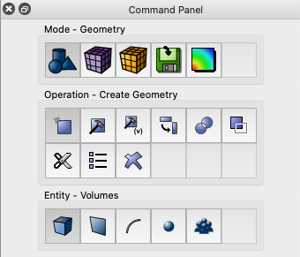
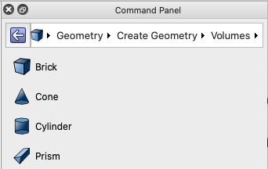
Command Panels
Tip: Change the navigation mode from the Options (Windows) Preferences (Mac) panels. Select Command Panels and check the Use Full Navigation toggle
Access to all CUBIT commands available via hierarchical menu structure
Navigation Modes:
Full Navigation
Breadcrumb Navigation
Displays full
path to
command
(more compact
than full
navigation)
Select text in path to navigate to commands
Select any button to reveal next level of buttons

Slide 8
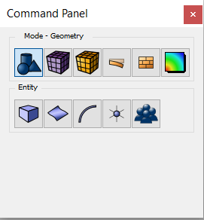





Command Panels
Press an Icon to enter a new mode
- Geometry: Create, modify, cleanup…
- Mesh: Intervals, schemes, smoothing…
- Boundary Conditions
- Analysis Setup: Export mesh
- Post Processing: Customizable shortcut
Full Navigation Mode

Slide 9
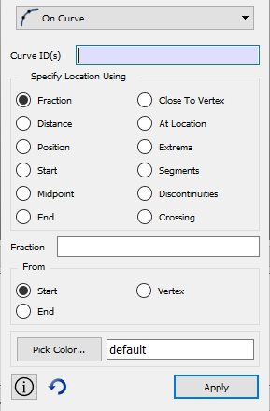
Command Panels
Almost all Cubit™ commands can be executed from command panel dialogs
Drop Down Menu
  Select the type of operation
  (sub-action).
ID Input Field (Pickwidget)
  You can type IDs here, or fill the box by picking
Command Options Input
Apply Button
  Cubit™ command syntax generated
  Executes command and applies the current options.
Command Help
(opens browser)
Tip: Some commands have a preview button.
Automatically Reset the dialog after Apply
A quick way to display results of command without making permanent changes to model

Slide 10
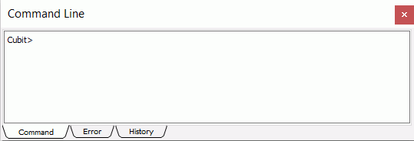
CUBIT™ Command Line Window
CUBIT™ commands entered and information displayed
CUBIT™ command syntax:
Commands are case insensitive and can be abbreviated
Cubit> create cylinder radius 3 height 10
Cubit> create brick x 10 y 10 z 10
Cubit> cylinder rad 3 hei 10
Cubit> brick x 10
Tip: Enter partial command
and type “?” to display
full syntax for command
List of all CUBIT commands executed in session

Slide 11
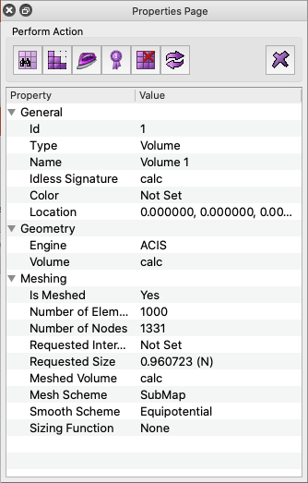

Properties Page
Action Buttons: Immediate actions performed on current selection(s)
  Preview Mesh : Displays preview of nodes on curves
  Mesh: generate a mesh with current settings
  Smooth: smooth the mesh with current settings
  Mesh Quality: Display mesh quality with default metric
  Delete Mesh: delete the mesh from selection (keep settings)
  Reset Entity: reset all settings for selection (including deleting mesh)
  Delete: Delete the selected geometry
Information about the current selection(s)
Information is updated when a new entity is selected
Tip: Some attributes can
be directly edited in the
properties page.
Examples:
Name of entity
Color of entity
Meshing Scheme
Requested mesh size

Slide 12
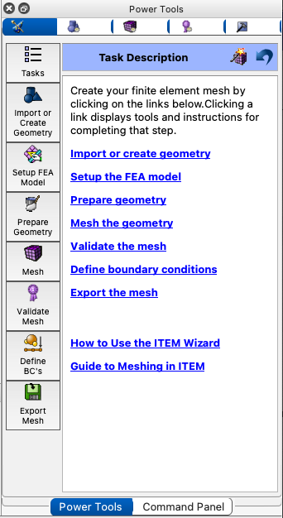
Power Tools
Click to change to a different Power Tool
Specialized tools for performing diagnostics and managing your model
CUBIT™ Power Tools
ITEM Wizard: Step-by-step workflow from CAD to mesh
Diagnose Geometry: Find and fix potential problems in geometry
Diagnose Meshability: Check whether geometry can be meshed
Diagnose Mesh Quality: Check mesh quality
Defeature Geometry: Tool for defeaturing (experimental)
Tip: The Diagnose Geometry
Power Tool contains new
machine learning capabilities
for defeaturing and part
classification
Compare Mesh: Check for overlap between geometry and mesh
Assemblies: Manage assembly metdata

Slide 13
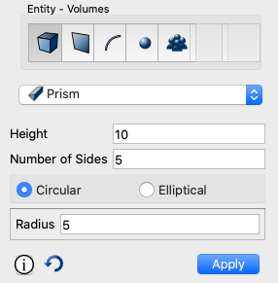
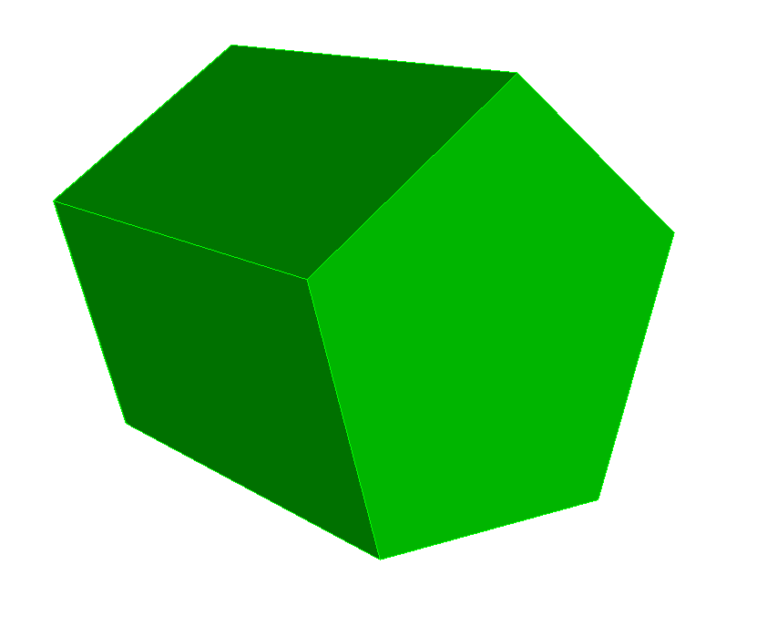

Exercise 3.1
Become Familiar with the Interface
0
Reset from the command window:
1
Create a prism:
height = 10
number of sides = 5 radius = 5
CUBIT> reset
2
Use tool bar buttons to visualize the prism:
transparent
smooth
wire frame
3
Use selection tools to select a:
vertex
curve
surface
volume
4
Mesh the prism with hexes and select a:
node
edge
quad (face)
hex
CUBIT> mesh vol 1

