Slide 1
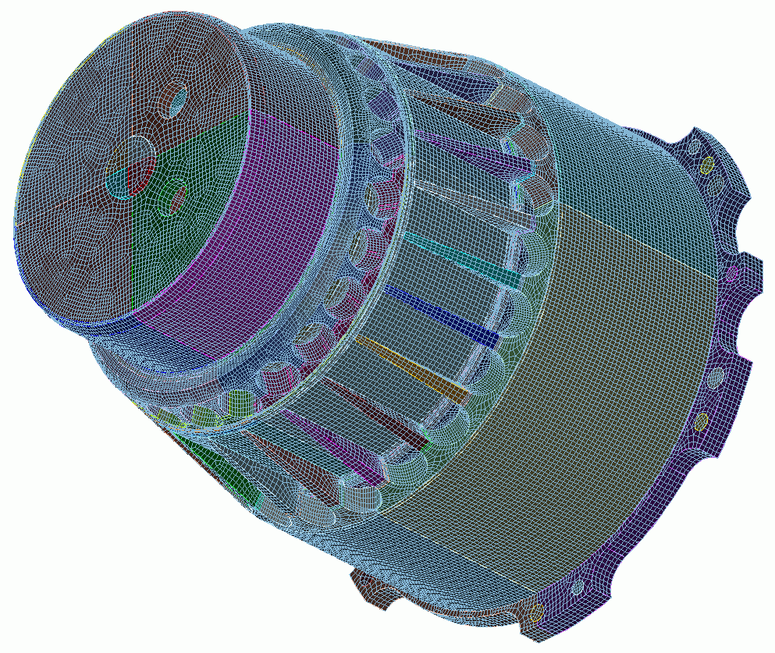
Getting Started
2
CUBIT
Geometry and
Mesh Generation Toolkit
CUBIT™ 100 Tutorials
Steven Owen
SAND2022-15021 PE

Slide 2
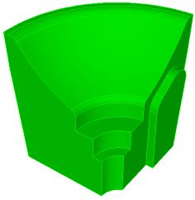
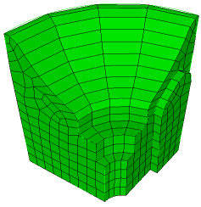
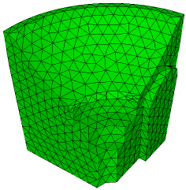
Exercise 2.1 Getting Started
Solid Model
Hex Mesh
Tet Mesh
Import the geometry from a file
Set the mesh size to 0.5
Set the mesh scheme to sweep
Create a hexahedral mesh
Delete mesh
Set the mesh scheme to tetmesh
Create a tetrahedral mesh

Slide 3
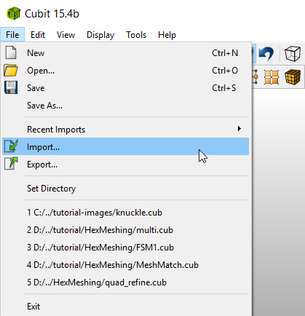
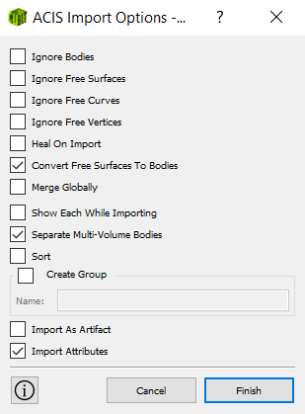
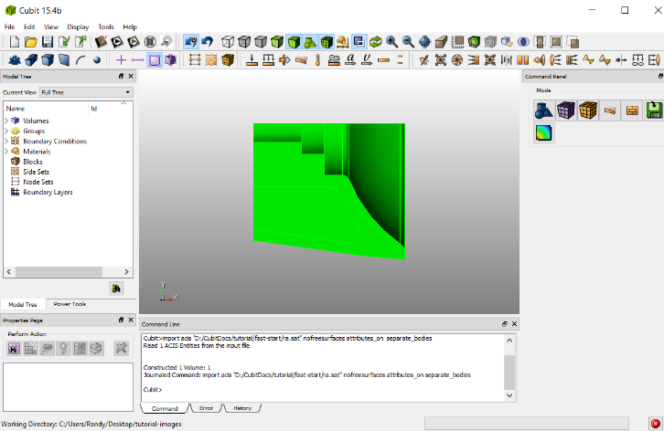
Exercise 2.1 Import the Solid Model
1
2
1
Use the File – Import menu to import the file “ra.sat”
2
Click Finish

Slide 4
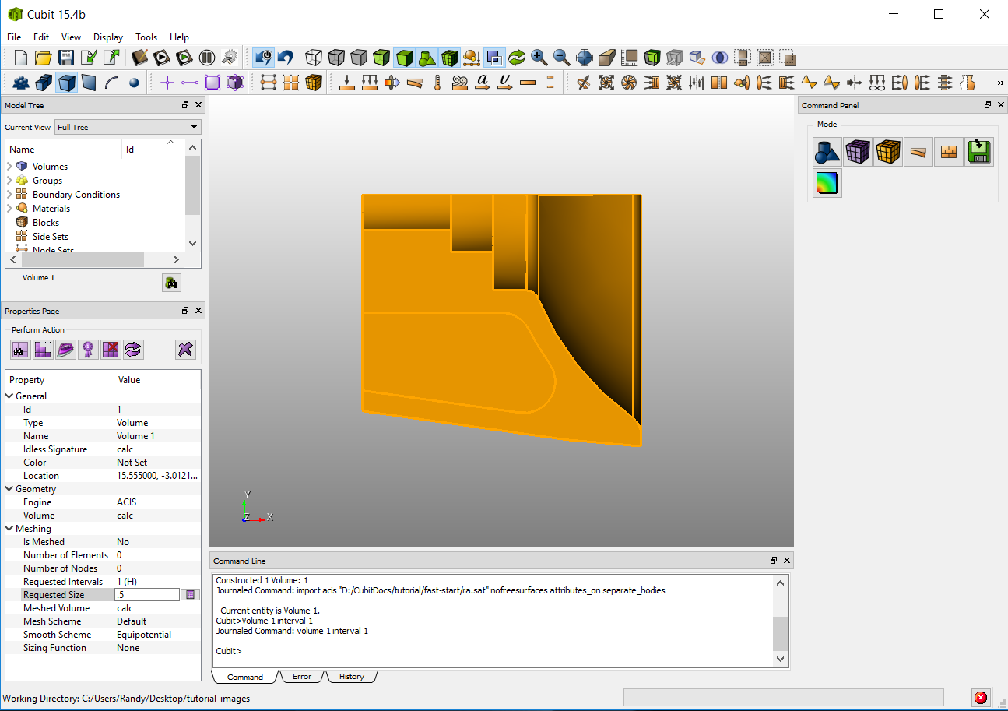
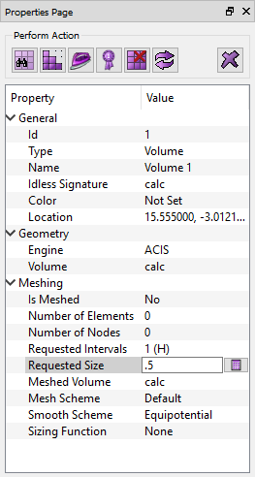
Exercise 2.1 Set the Mesh Size
1
Click Volume Selection Filter Icon
1
2
click on the part
2
3
Set the Requested Size on the property panel to 0.5 and hit Return
3

Slide 5
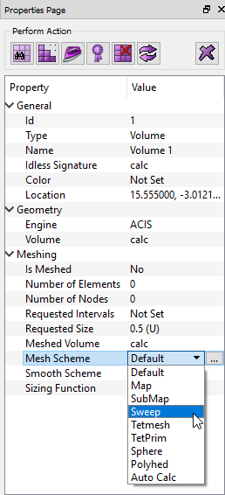
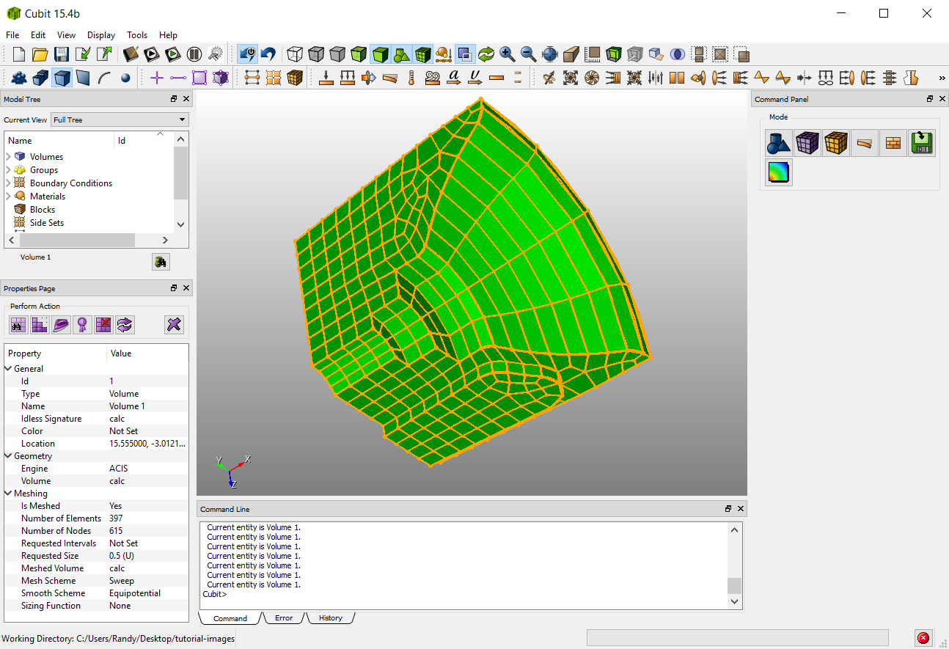
Exercise 2.1 Create a Hexahedral Mesh
2
1
Select the Sweep scheme from the dropdown menu next to Mesh Scheme
1
2
Click the Mesh Button

Slide 6
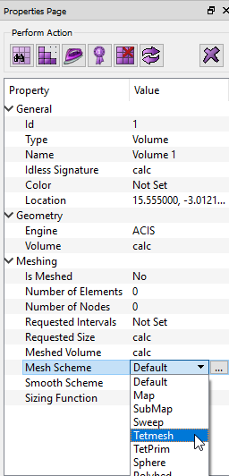
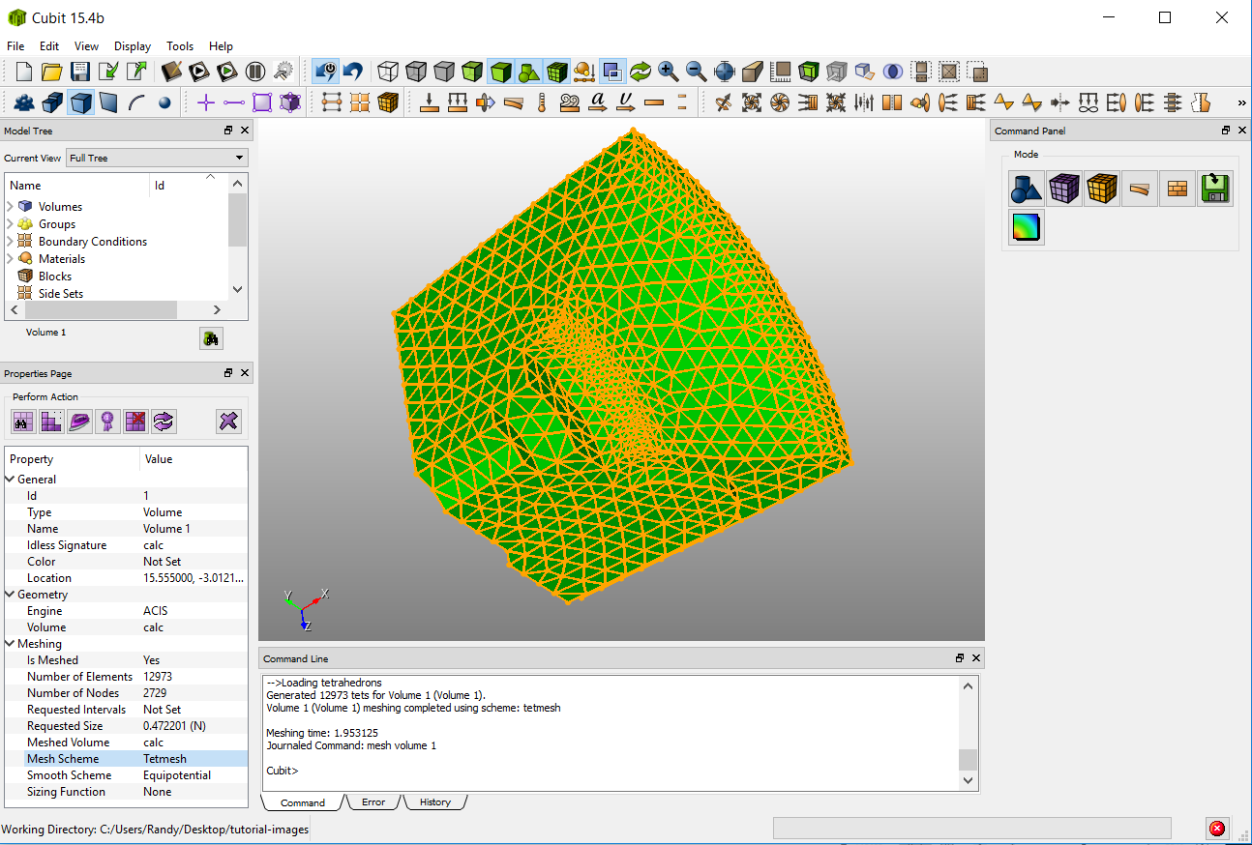
Exercise 2.1 Create a Tetrahedral Mesh
1
3
1
Delete the mesh and reset the volume by clicking on the Reset Button
2
Choose the Tetmesh scheme from the dropdown menu next to Mesh Scheme
2
3
Click the Mesh Button

