Slide 1
CUBIT™ Fast-Start Tutorial
27. Cubit SDK
Notes:
Title: lecture 27: Cubit SDK
SAND Number: SAND2020-1554 TR

Slide 2
Software Development Kit (SDK)
CUBIT™ has Application Programming Interfaces (APIs) available for integration with external applications
These APIs, libraries and supporting files are included in the CUBIT™ SDK
APIs are available in the C++ programming language and support integration with other C++ applications

Slide 3
SDK Features
CUBIT™ Interface
The same API available for Python
Supports issuing commands
Supports many model queries
Issue Command
Queries
get_mesh_size()
get_quality_stats()
get_bounding_box()
Application
Cubit

Slide 4
SDK Features
Mesh Export Interface
Write out mesh data into your own format or one not supported by CUBIT™
Mesh Import Interface
Import mesh data from your own format or one not supported by CUBIT™
Material Interface
Define your custom materials
Import/Export your custom materials in your own format
Application
Cubit
Mesh I/O
Custom File

Slide 5
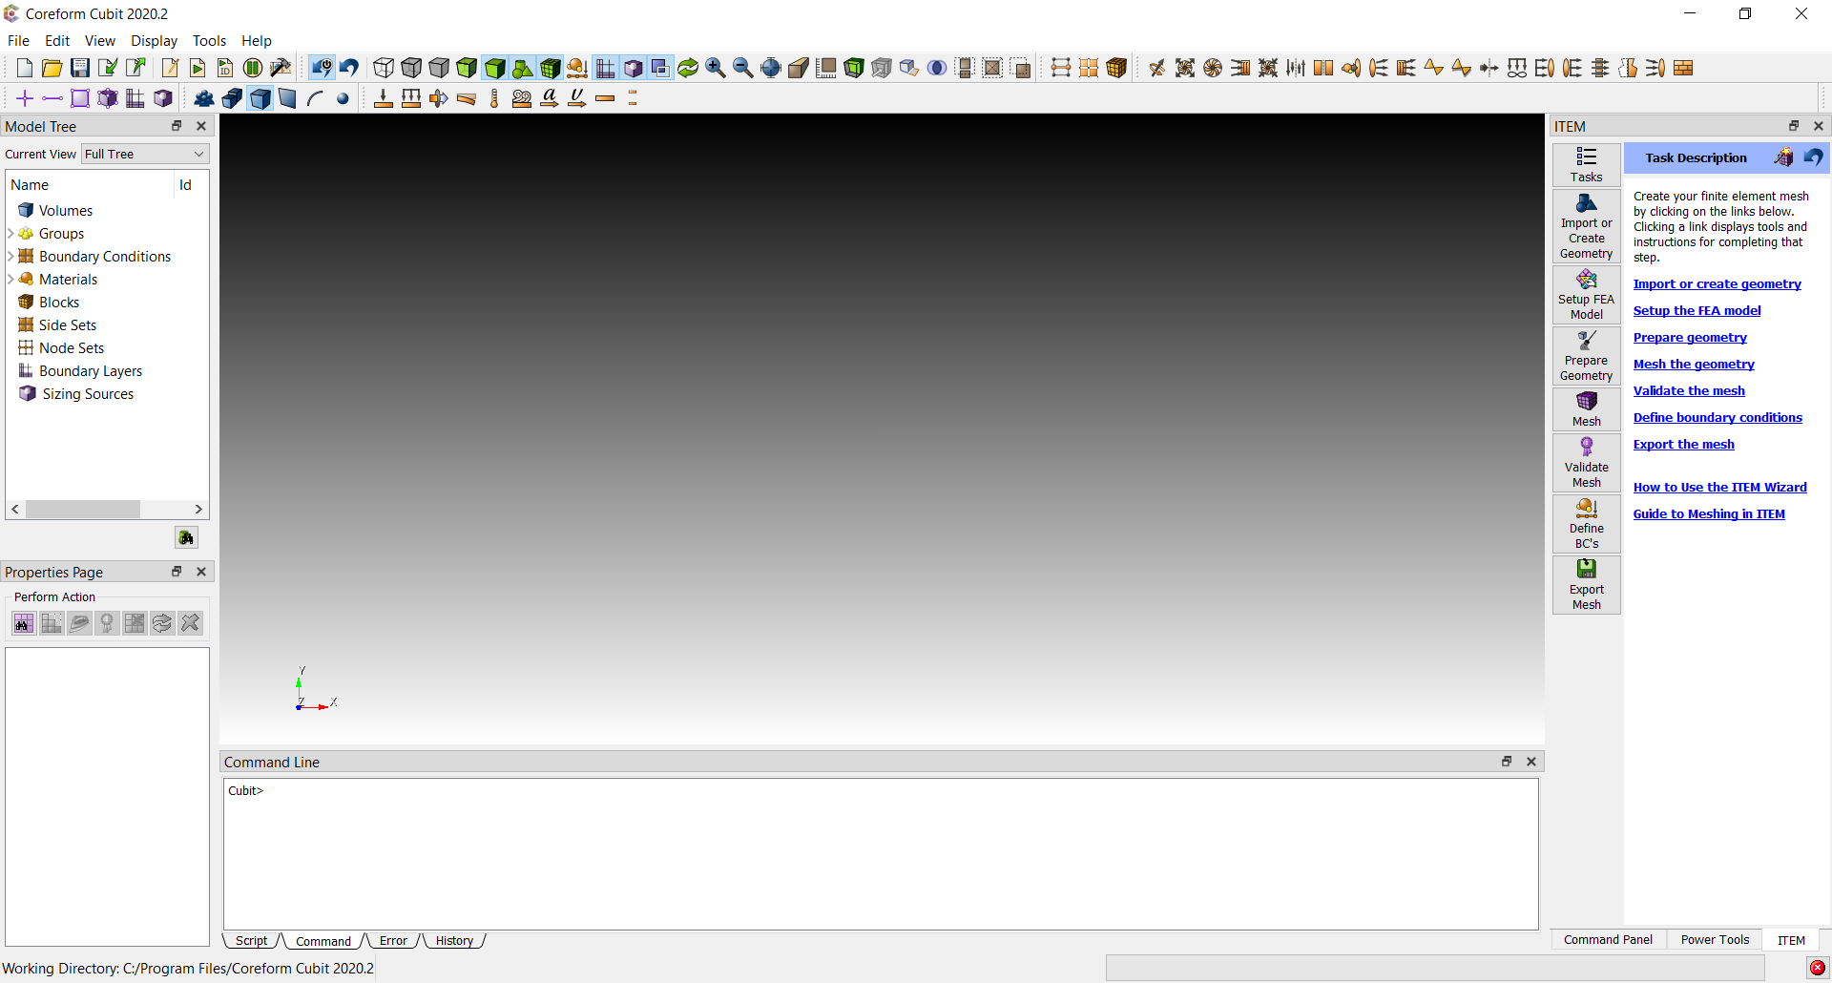
SDK Features
Claro Components
Extend and modify the Qt based user interface

Slide 6
SDK Features
Custom Commands
Create your own custom command
Invoke the custom command using cubit.cmd()
Integrated with journaling
Application
cmd()
Cubit
Custom Command

Slide 7
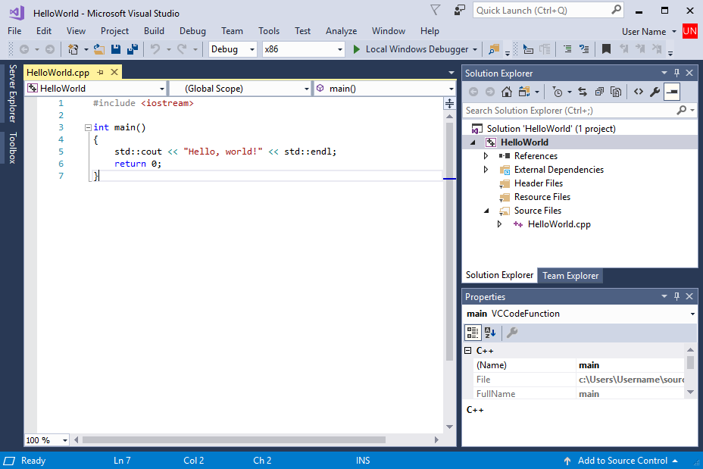
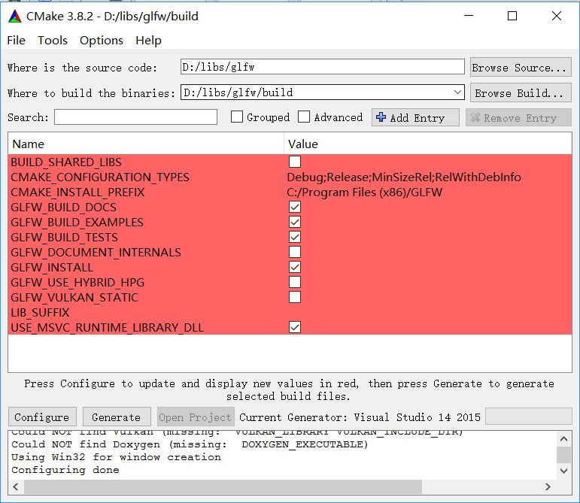
SDK Requirements
A C++ compiler
GCC on Linux
Visual Studio on Windows
Xcode on Mac
CMake (recommended)
SDK includes CMake files describing header directories and libraries to assist setup of projects

Slide 8
SDK Setup
Download 2 files
CUBIT™
CUBIT™ SDK

Slide 9
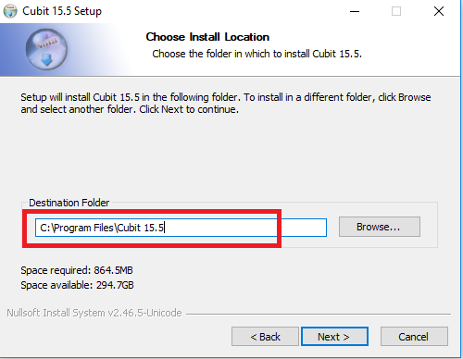
SDK Setup
Install CUBIT™
Remember location

Slide 10
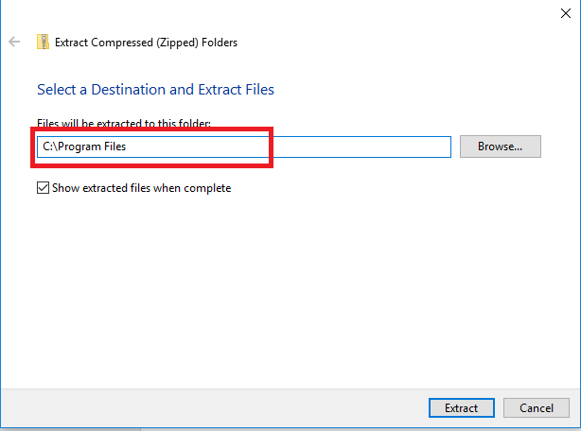
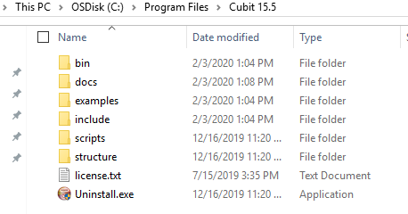
SDK Setup
Install CUBIT™ SDK
At same location
Be aware .zip file contains “Cubit 15.5” folder
Result is combined installations

Slide 11
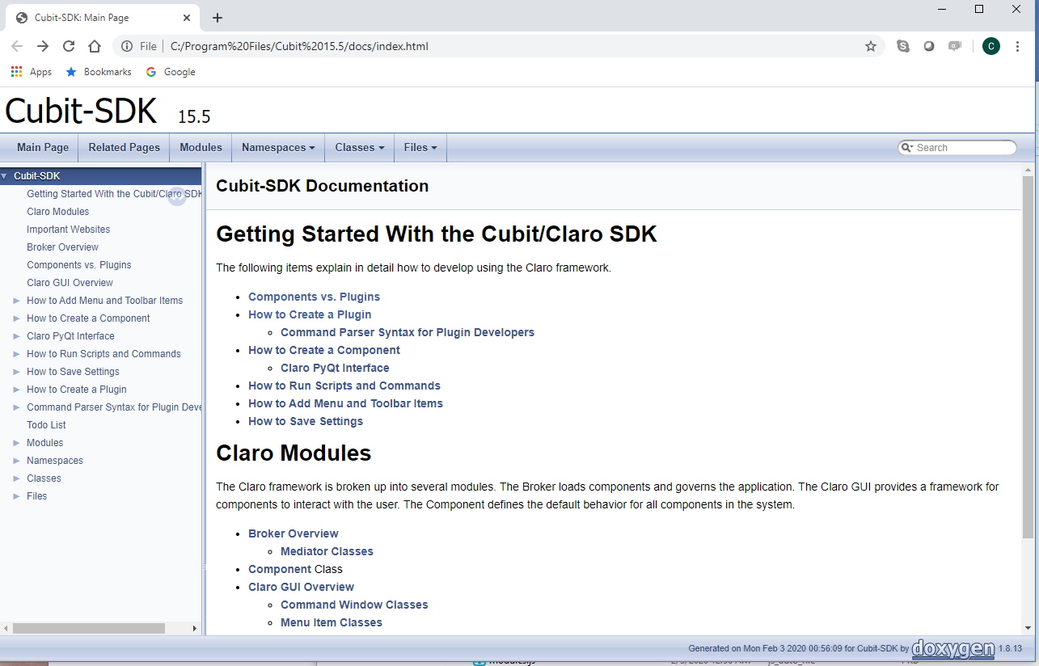
SDK Documentation
<installation>/docs/index.html

Slide 12
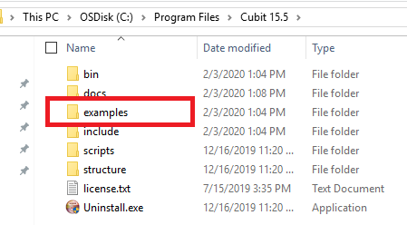
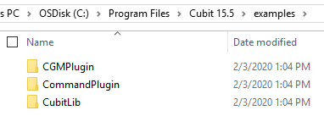
SDK Examples
<installation>/examples

Slide 13
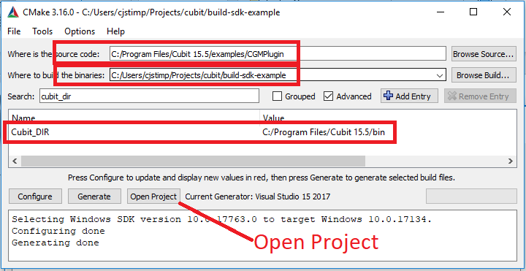
Example 1
Start CMake-GUI : specify source and build dirs.
Ensure building 64 bit
Specify Cubit_DIR

Slide 14
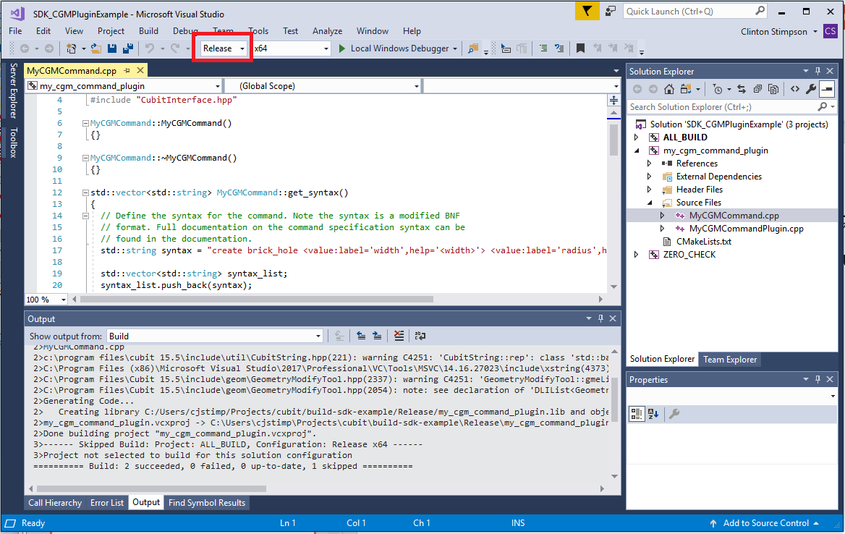
Example 1
Build ‘Release’ configuration if in Visual Studio

Slide 15
Example 1
Set CUBIT_PLUGIN_DIR=<path to plugin>
And run CUBIT™

Slide 16
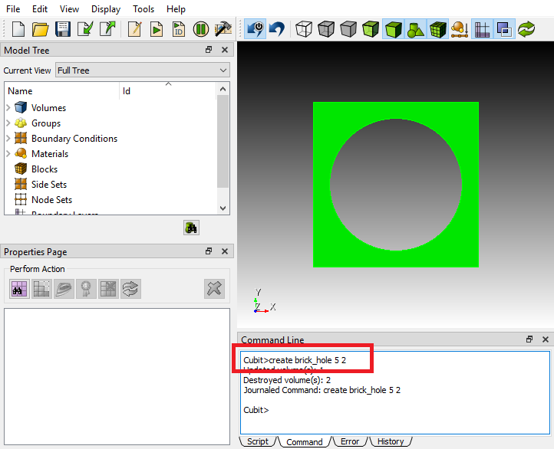
Example 1
Execute custom command in CUBIT™

