Slide 1
CUBIT™ Fast-Start Tutorial
21. Sculpt
Notes:
Type: FORMAL - Training
Title: Cubit 200 Training
SAND Number: SAND2020-0682 TR
Contact: Hensley,Trevor Michael

Slide 2
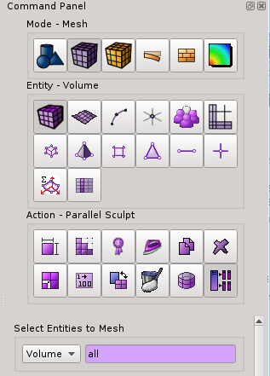
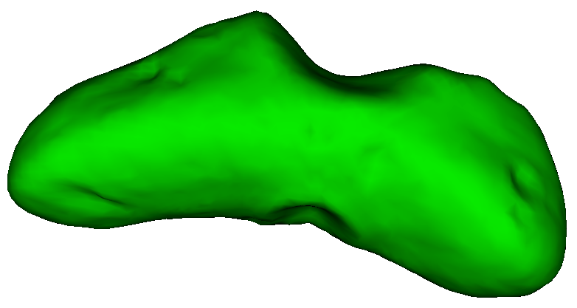
Example 1. Simple Sculpt Mesh
1
Import STL file “eros_asteroid.stl”
2
Navigate in Command Panel Window to Parallel Sculpt Panel
Mesh
3
Select the Parallel Sculpt button
Volume
Parallel
Sculpt
Asteroid Geometry
Notes:
In the pass we have used
CUBIT> sculpt parallel path mpiexec "C:\Program Files\Microsoft MPI\Bin\mpiexec.exe"

Slide 3
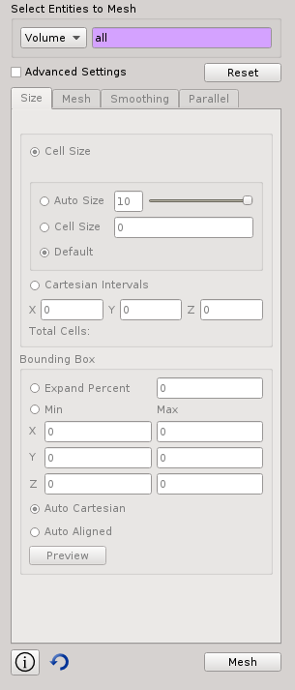
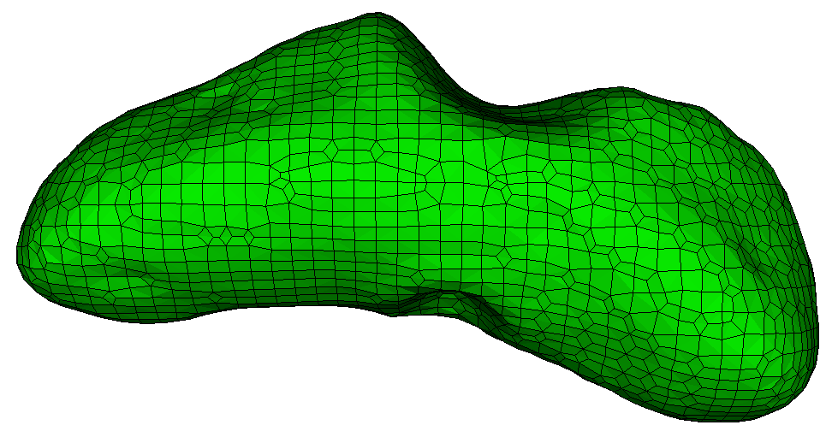
Example 1 Simple Sculpt Mesh
4
Make sure “All” or “1” is entered next to Volume
4
5
Click the Mesh Button
6
In Command Window issue the command
Draw Block All
Asteroid Geometry meshed using Sculpt
4

Slide 4
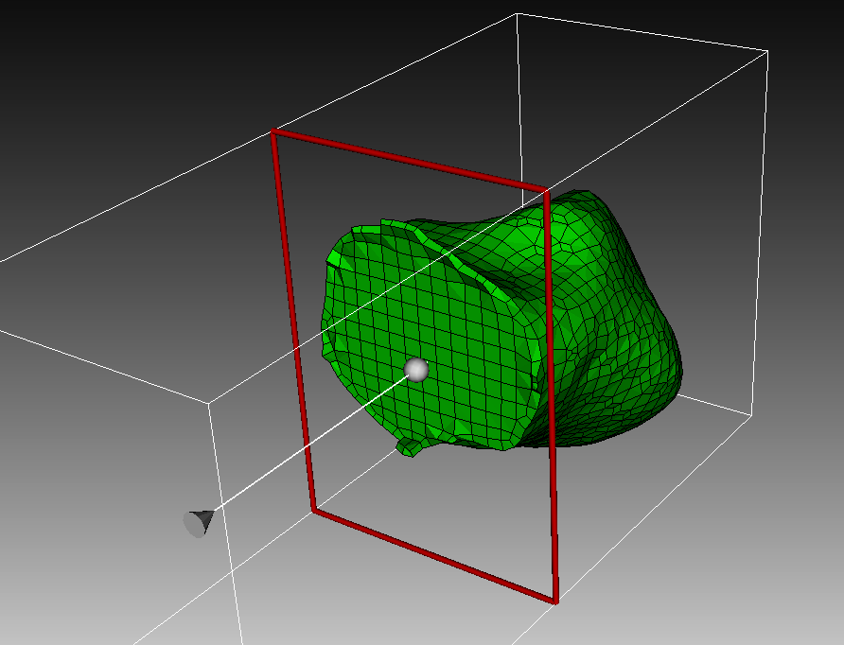
Example 1 Simple Sculpt Mesh
6
6
Select the slice tool to view the interior of the mesh
Sculpt generates a uniform grid of hexes on the interior, but fits a layer of hexes at the boundary
Sculpt creates a “Free Mesh” with no association to the geometry
Slice through Asteroid Mesh

Slide 5
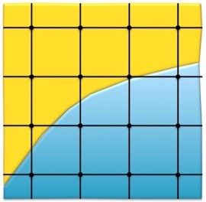
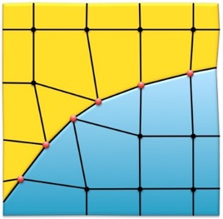
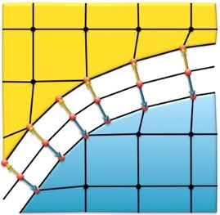
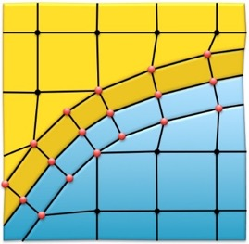
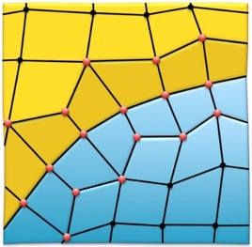
Sculpt Procedure
Overlay Grid Procedure used by Sculpt
Cartesian Grid overlaid on geometry
Nearby nodes projected to boundaries
Mesh pulled away from the boundaries
And Layer of hexes inserted
Smoothing performed to improve element quality

Slide 6
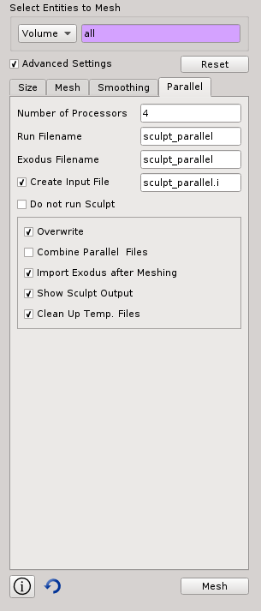
Example 2. Sculpt Application
Sculpt is a separate application from Cubit that runs in parallel on multiple processors
First, delete the current mesh by typing Delete Mesh in the Command Line Window
1
2
3
2
Click on Advanced Settings
3
Select the Parallel Tab
4
Unselect the option to Combine Parallel Files
Click the Mesh Button
4
5
6
In Command Window issue the command
Draw Block All
In this case we have generated 4 separate meshes. One mesh from each processor
5

Slide 7
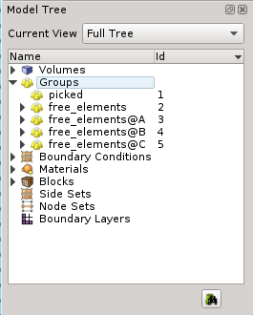
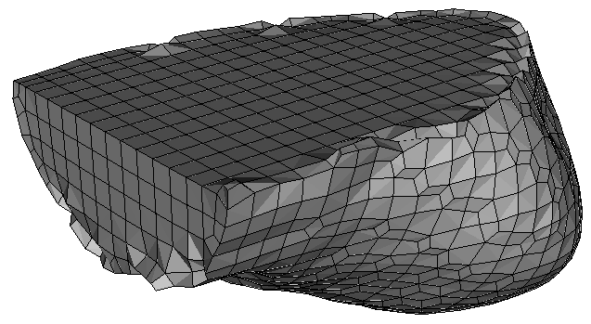
Example 2. Sculpt Application
Observe the Tree View in the Power Tools Window
7
Select the Groups to reveal the current groups in Cubit
7
Note that several groups with the base name “free_elements” are created.
Each group represents the set of elements generated on one processor. Nodes and faces are not shared between groups (because combine option was not used)
8
Draw each group independently to see the mesh each processor generated. From the command line use:
Draw group 3
Draw group 4
Draw group 5
Draw group 6
Tip: Groups and Blocks are not deleted when the mesh is deleted. Use delete block all and delete group all to get rid of them.
Mesh from one processor

Slide 8
Sculpt Application
CUBIT
stl
exo
psculpt
sculpt
exo
psculpt
exo
mpiexec
epu
exo
psculpt
exo
psculpt

Slide 9
Sculpt Application
sculpt: Application that controls start-up of mpiexec and psculpt. Main entry point from Cubit, that checks for the existence and compatibility of either the system mpiexec application or will use a local cubit installation of mpiexec.
mpiexec: Standard application available on most linux-based operating systems for starting up mpi-based applications on multiple processors. This should be available with your Cubit installation, but is also available from open-mpi.org
psculpt: The main mpi-based Sculpt application. Requires mpiexec to run.
epu: Used for combining multiple exodus files, generated with Sculpt, into a single exodus file. This executable is optional, but is useful for importing the resulting mesh into Cubit for viewing. It is part of the SEACAS tool suite developed by Sandia National Laboratories and is also included with your Cubit installation. It can also be obtained in open source form from sourceforge.net.
sculpt
mpiexec
psculpt
epu

Slide 10
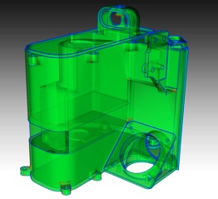
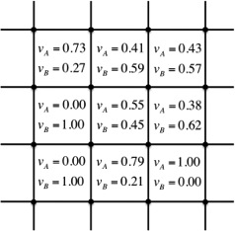
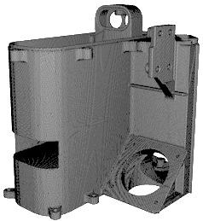
Sculpt Application
Geometry is first converted to “Volume Fraction” Data before meshing.
Advantages
Geometry Tolerant
No decomposition needed
No imprint/merge needed
Scalable to massive parallel
Disadvantages
No Geometry Associativity
Does not capture corners
“Small” features not resolved
May require large mesh

Slide 11
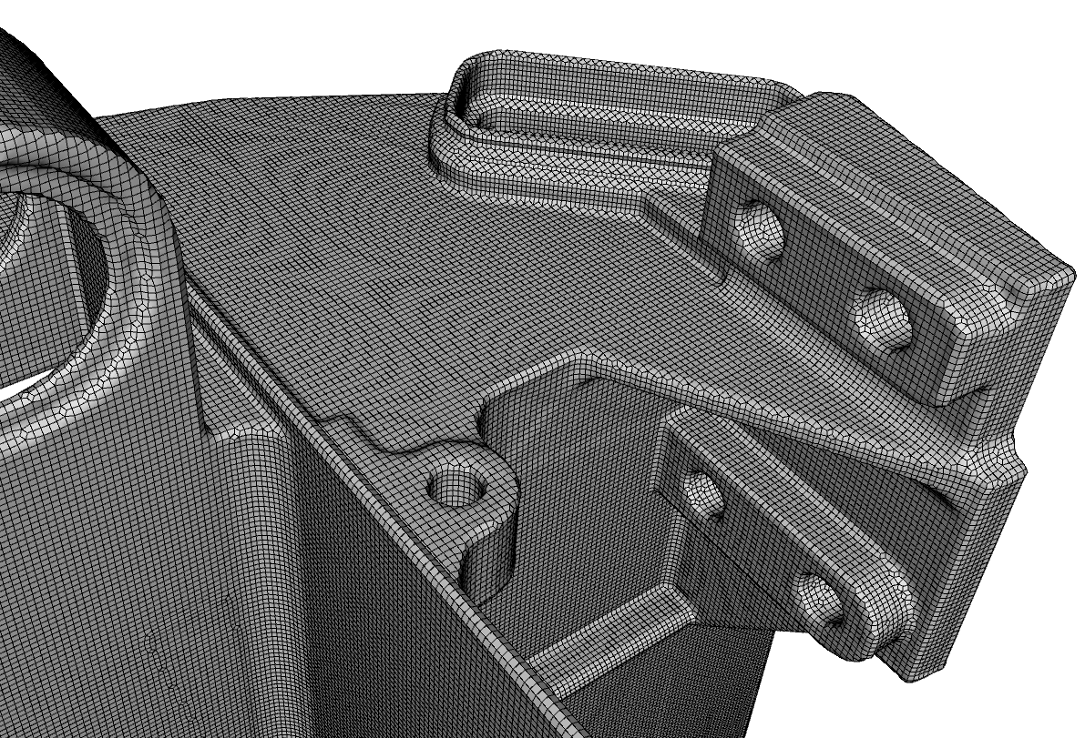

Slide 12
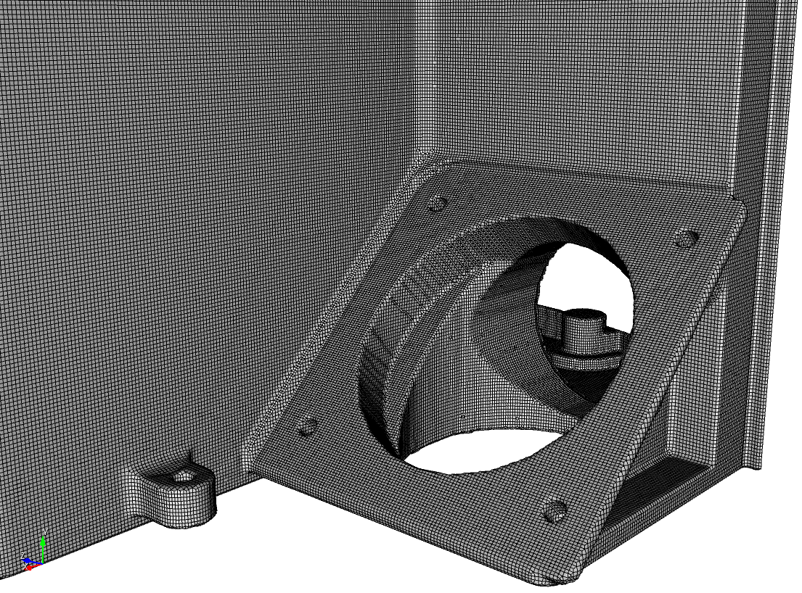

Slide 13
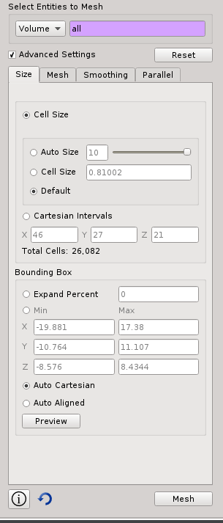
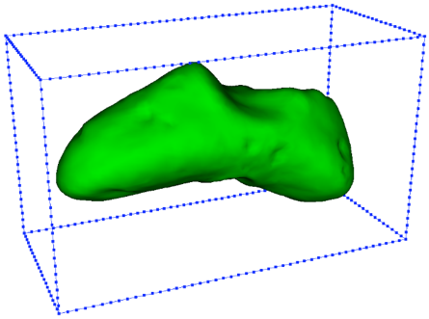
Sculpt Sizing
Select Blocks or Volumes
Volumes: Each volume treated as a separate mesh. One Block created per volume
Blocks: treat all volumes in block as continuous mesh
Resets all values in panel back to default. Use this if volumes/blocks change
4 ways to define size
Autosize – value 0-10. 0=fine, 10=coarse
Cell size – exact size
Default – use the size defined on the volume. If none then autosize=10
Cartesian Intervals – set the number of intervals in x-y-z directions. Tries to maintain constant aspect ratio
Base Grid Requires
Cell Size
Bounding Box
Number of cells in Cartesian Grid
3 ways to define box
Set exact x-y-z bounds
Auto Cartesian – Complete model enclosed in axis-aligned box
Auto Aligned – Sculpt attempts to find a natural orientation of the model with the a fitted box
Select to display preview of bounding box and size
Note: Fields automatically synchronize to reflect updated user selections

Slide 14
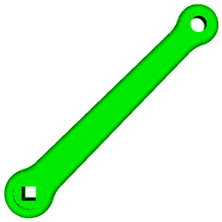
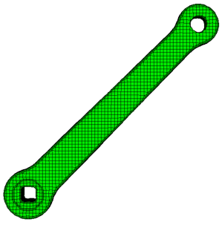
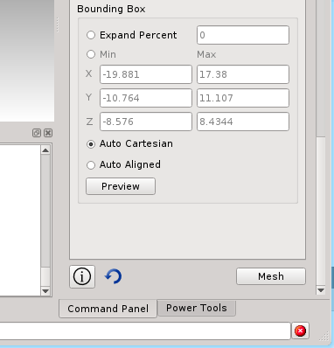
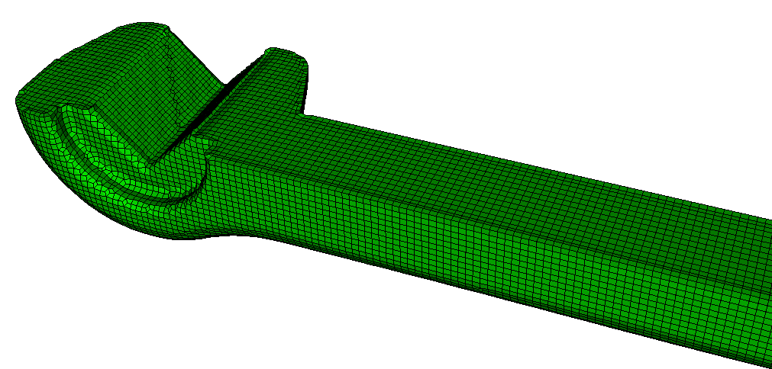
Example 3 Sculpt Sizing
Import the ACIS file “crank.sat”
Experiment with different mesh sizes to see its effect. Observe how well it captures the features.
Use the Auto Align feature. Observe the difference in the resulting mesh
How large of a mesh can you generate in under a minute or so.
Create an approximate ½ symmetry model using the bounding box feature.
Note the Total Cells estimate. This is total number of cells in the base grid (not mesh size) based on current input. Larger numbers indicate longer meshing times.
Hint: First rotate the model
Vol 1 rotate -45 about z
Use the Stop button to kill sculpt if meshing time gets too long.

Slide 15
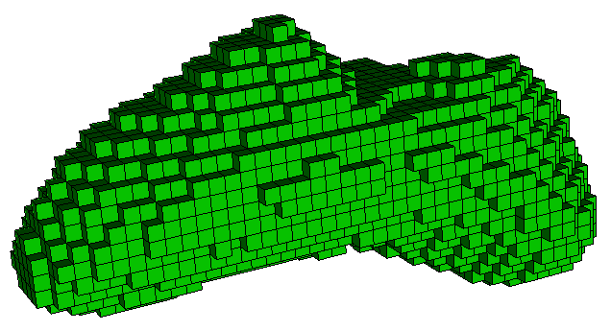
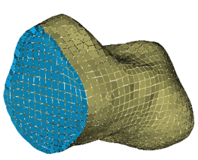
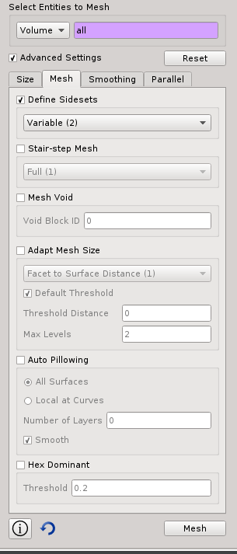
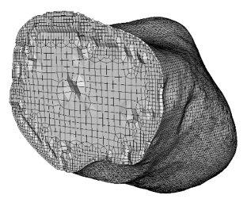
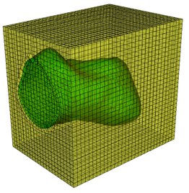
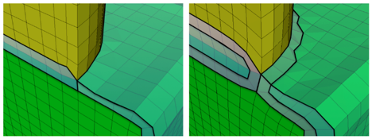
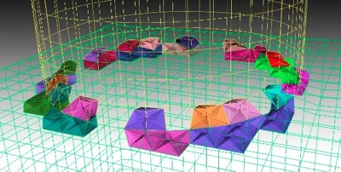
Sculpt Mesh
Sidesets: Options for generating sidesets
Stair-step mesh: Don’t insert buffer layers or smooth to boundaries. Mesh will be 100% cubes
Mesh Void: Generate mesh in surrounding void space. Void will be treated like another material
Adapt Mesh Size: Automatically refine at features and boundaries
Auto Pillowing: Insert additional layer(s) of hexes to improve mesh quality at multi-material interfaces (curves)
Hex Dominant: Replace any hex whose Scaled Jacobian falls below the threshold with 24 tets
Note: Turn this ON when using multiple materials

Slide 16
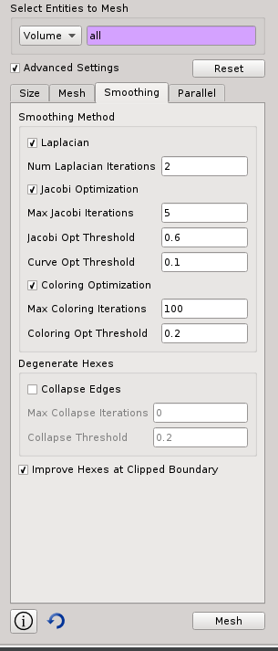
Sculpt Smoothing
Note: In most cases smoothing defaults should be sufficient
Laplacian: Fast/Cheap method for mesh quality improvement. Used alone can sometimes make quality worse.
Num Laplacian Iterations: Number of Laplacian Iterations to perform. (Each iteration effects all nodes in the mesh)
Max Jacobi Iterations: Number of Jacobi optimization Iterations to perform. Stops after this number of iterations or when all elements exceed threshold.
Jacobi Optimization: Targeted, more effective in improving quality. Less efficient.
Coloring Optimization: Spot smoothing that treats each node and surrounding hexes independently. Applied only at worst quality elements. Most expensive.
Jacobi Opt. Threshold: The lowest scaled Jacobian value in which Jacobi optimization smoothing will be applied.
Max Coloring Iterations: Number of Coloring optimization iterations to perform. Stops after this number of iterations or when all elements exceed threshold.
Collapse Edges: Allow Sculpt to collapse edges to create degenerate hexes in order to improve mesh quality.
Coloring Opt. Threshold: The lowest scaled Jacobian value in which coloring optimization smoothing will be applied.
Improve Hexes at Clipped Boundary: If checked, Smoothing will attempt to improve hexes that are at the clipped domain boundary without regard to constraining to the bounding planes. If not checked, boundaries will be planar.
Max Collapse Iterations: Number of edge collapse iterations to perform. Stops after this number of iterations or when all elements exceed threshold.
Collapse Threshold: The lowest scaled Jacobian value in which edge collapses will be applied.

Slide 17
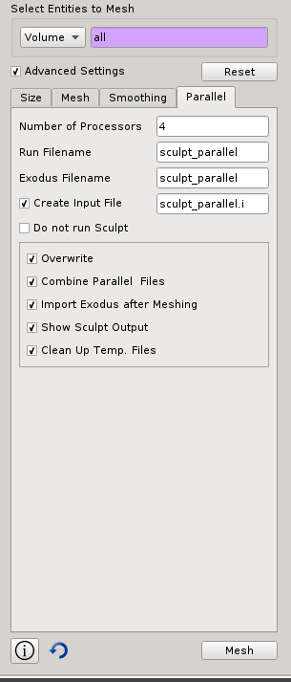
Sculpt Parallel
Number of Processors: Sculpt will decompose the domain into the specified number of subdomains for meshing. It is normally the total number of available compute cores (ie. 4, 8, etc.), however it can be any integer value.
Run Filename: Create an executable file (eg. sculpt_parallel.run) containing the OS command line for running sculpt in batch.
Create Input File: Create a sculpt input file containing all defined parameters in a readable form. This is for running sculpt in batch from the OS command line. For example:
sculpt -i sculpt_parallel.i -j 4
Exodus Filename: Optionally define the base name of the exodus files to be written, otherwise will use the run filename.
Do not run Sculpt: Cubit will only generate the necessary files to run sculpt in batch. It will not generate a mesh.
Overwrite: If not checked will prevent execution if run, input or exodus files of the same name are already present in the working directory.
Combine Parallel Files: Automatically run EPU on the resulting exodus mesh files to combine them into a single mesh file.
Import Exodus After Meshing: After running Sculpt, Mesh will be imported into Cubit as “Free Mesh”.
Show Sculpt Output: While running Sculpt from Cubit, the text output from Sculpt will be displayed to the Cubit Command Window
Clean Up Temp. Files: After successfully generating the mesh with Sculpt, all temporary files will be deleted. ie. run file, input file, log file, mesh files and STL files.

Slide 18
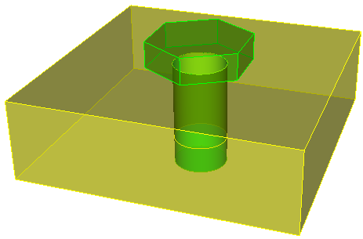
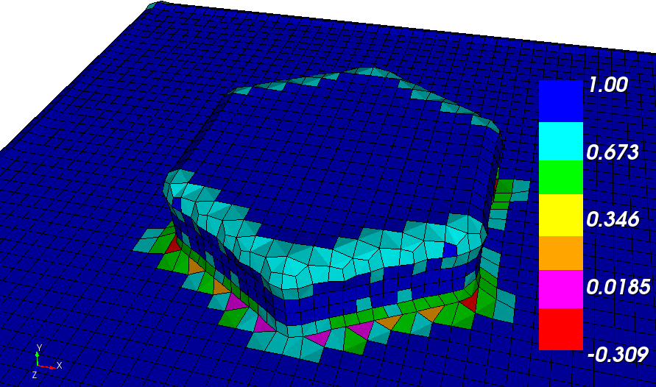
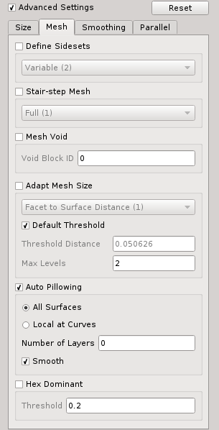
Exercise 4 Multiple Materials
Import the model “bolt-plate.sat”
Generate a mesh with a cell size of about 0.2
Display the mesh quality using the Scaled Jacobian Metric. Note where the worst quality elements are concentrated.
Delete the mesh
Select the Auto Pillowing option and mesh again.
Check Mesh Quality. What is the difference?
Use the slice tool to examine the interior of the mesh
Try using the All Surfaces and the Local At Curves option. What is the difference in the resulting mesh?

Slide 19
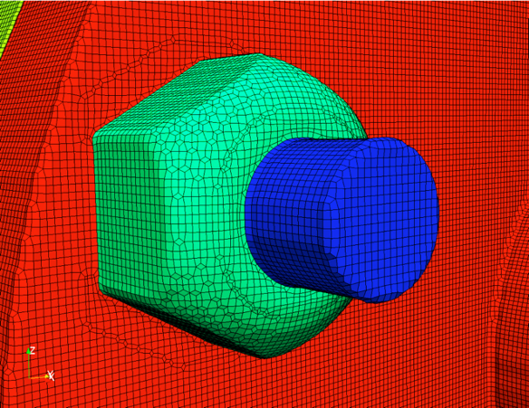
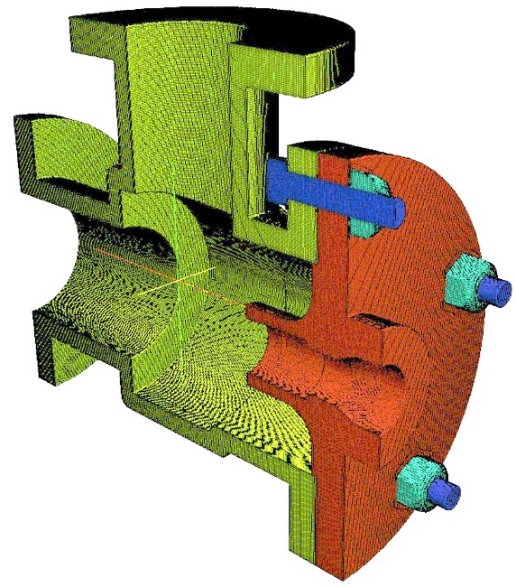
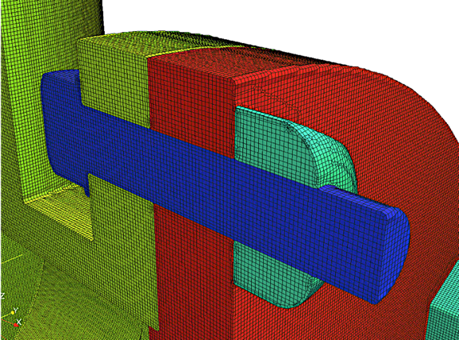
Example: Auto Pillow Insertion
Example of mesh generated with Sculpt using the Auto-pillow option to capture multiple materials

Slide 20
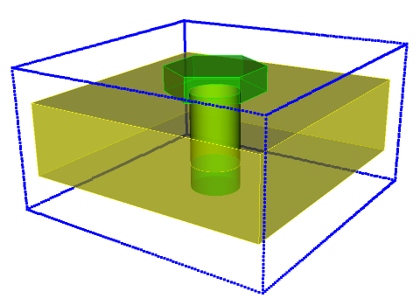
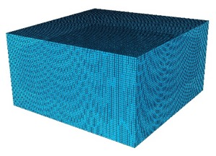
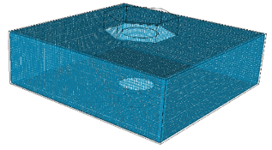
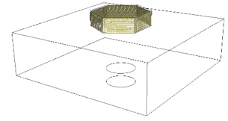
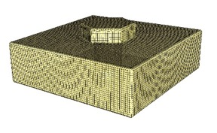
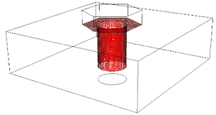
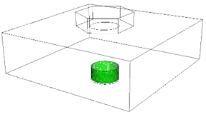
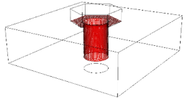
Sculpt Sidesets
Sculpt provides four different methods for generating and maintaining Sidesets
Fixed: Exactly three sidesets are generated
2. Variable: Sidesets generated at every unique surface, either at a free surface or between blocks
Sideset 1: all sides at the six sides of the original Cartesian grid. These are present only if the Void option is selected, or the geometry intersects the boundary
In this example there a 4 sidesets generated
Sideset 2
Sideset 1
Sideset 2: all sides that are at a free surface of any block of elements
Sideset 3: all sides that define the interface between different blocks
Sideset 3
(between block 1 and 2)
Sideset 4
6 sidesets are also generated for each face of the Cartesian grid if using the Void option. Sidesets are also generated where the geometry is cut by the boundary.

Slide 21
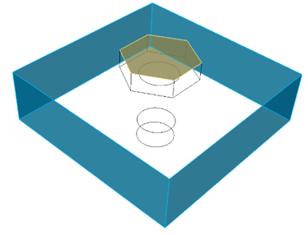
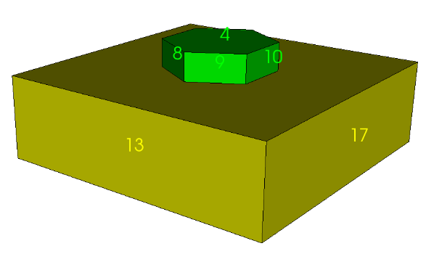
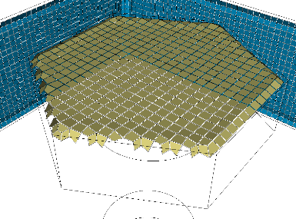
Sculpt Sidesets
Note that Nodesets are not yet supported in Sculpt
Sculpt provides four different methods for generating and maintaining Sidesets
3. Geometric Surfaces: One sideset generated for each geometric surface defined in the CAD model
4. Geometric Sidesets: Sidesets generated based on sidesets defined on the CAD model
User defines 2 sidesets on the solid model
Sideset 2
In this example there a 17 sidesets generated. One for each surface in the CAD model
CAD model with surface IDs labeled
Sideset 1
(composed of 4 surfaces)
Sideset 2
Sideset 13
Corresponds to surface 13
Sideset 1
Note that sides are only an approximation of the surface. They may not exactly align with bounding curves
Sideset 13
Sideset 17

Slide 22
Exercise 5. Capturing Features
Import the model “B3.sat”
Generate a mesh using the default settings. Note the mesh quality and how well the mesh represents the geometry.
Try meshing with a smaller size. At what size do you need to accurately capture the features in this model.
Are there Simplifications you can make to the model that may make feature capture more reasonable?
Reset and Import the model “B3-2.sat”. Note the difference in the features
Try meshing again. What cell size do you need to capture the geometry?
Mesh the “B3.sat” model using the adapt option and try to capture the small features in the hubs. Compare the number of elements without adapt.
Adapt option used with 2 levels of refinement and default threshold

Slide 23
Running Sculpt in Batch
Sculpt can be run in batch on your local desktop or on an HPC machine
2
To generate batch input files
1
Set your working directory
3
4
2
Click the Parallel Tab
1
3
Fill in names for files or use default (sculpt_parallel)
4
Select Do Not Run Sculpt
5
Click Mesh
With the Do Not Run Sculpt option, no mesh will be generated. Instead the batch input files will be written to your working directory
5

Slide 24
Running Sculpt in Batch
In your working directory you should see the following files
Diatom File: Contains a list of all geometry used as input to Sculpt
Input File: Contains a human readable form of all input parameters to sculpt
Run File: Contains a unix command line script to run sculpt with all parameters
STL File: Triangle-based geometry description. One per volume

Slide 25
Running Sculpt in Batch
Edit the .i file to view the sculpt input parameters
For a description of parameters, use the –h option on the unix command line
Type:
sculpt
To see a summary of all sculpt options
Type:
sculpt –h <option>
To see help on the any sculpt option

Slide 26
Running Sculpt in Batch
To run sculpt in batch:
sculpt –i <inuput file> -j <num_procs>
For example:
sculpt –i asteroid.i -j 4
Observe the mesh summary when the mesh is completed
Number Hexes < 0.0 Scaled Jacobian
Number Hexes < 0.2 Scaled Jacobian
Minimum mesh quality

Slide 27
Running Sculpt in Batch
Exodus mesh files created (1 per processor)
To combine mesh files:
epu –p <num_procs> <base_file_name>
For example:
epu –p 4 asteroid_mesh
To import mesh in to CUBIT™ to view mesh from command line
import mesh “asteroid_mesh.e” no_geom

Slide 28
Example 6. Microstructures
input_micro option
Input is ASCII text file Cartesian Grid of Volume fraction material data
Required header info
Volume fraction for each material in variable list
x, y, z cell centroid

Slide 29
Example 6. Microstructures
1
Create an input file (micro.i) with the following parameters
Begin sculpt
input_micro = micro.tec
exodus_file = micro
micro_expand = 2
pillow = 1
End Sculpt
2
Run sculpt with the following command
sculpt –i micro.i –j 8
3
Combine the parallel mesh files
epu –p 8 micro
4
Import the mesh into CUBIT™. From CUBIT™ command line:
cubit >import mesh “micro.e” no_geom
5
Draw the material blocks
cubit >draw block all

Slide 30
Example 6. Microstructures
micro_expand option
Sculpt option to expand the block by N layers
Affects the orthogonally of the surface interfaces at the boundary
1 expansion layer
No expansion
2 expansion layers

Slide 31
Example 7. Microstructures
input_cart_exo
From an exodus file
Cartesian Grid
Each element assigned to a unique material block
Create a conformal mesh with smooth interfaces
Cartesian Exodus File
Smooth material interfaces
1
Generate a conformal mesh with the following input file
Begin sculpt
input_cart_exo = micro_2D.e
exodus_file = micro_3D
End Sculpt
Note that this problem is actually a 1-layer thick 3D mesh

Slide 32
Example 8. Microstructures
input_spn
From an ascii file
One integer per cell
Integer represents dominant material in cell
Simple spn input file comprised of one integer per cell
Cartesian Exodus File
Smooth material interfaces

Slide 33
Example 8. Microstructures
input_spn
Begin sculpt
input_spn = TwoPhase.spn
exodus_file = TwoPhase
# number of cells (required)
nelx = 64
nely = 64
nelz = 64
# smoothing options
smooth = 8
csmooth = 5
laplacian_iters = 10
max_opt_iters = 20
End Sculpt
1
Generate a conformal mesh with the following input file
2
View the results in CUBIT™
3
Modify the smoothing options and view the results. Try the following options:
smooth = 9
csmooth = 2

Slide 34
Example 9. Microstructures
Sculpt can be used to generate mesh-based geometry that can be used in CUBIT™ for tet meshing
1
Run the input file “sculpt_micro9.i” on the command line.
sculpt –i sculpt_micro9.i
2
Import the resulting exodus mesh into cubit as mesh based geometry
Import mesh geom “micro_clipped.e.1.0”
Tetmesh
size 2.0
3
Delete the triangle mesh and generate a tet mesh
Delete mesh
Vol all size 0.5
Vol all scheme tetmesh
Mesh vol all
Mesh-Based
Geometry
Tetmesh
size 1.0
Tetmesh
size 0.5

